Slide 1

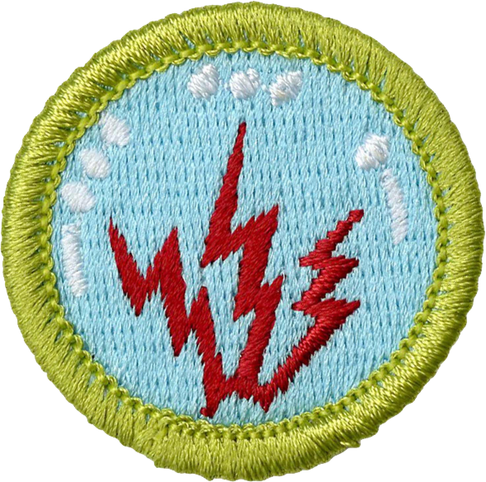
Radio
Merit
Badge
Module B
1
Notes:
Cover Slide w/1 minute instructor intro 00:00
[1] Instructors:
> Welcome back from the station!

Slide 2
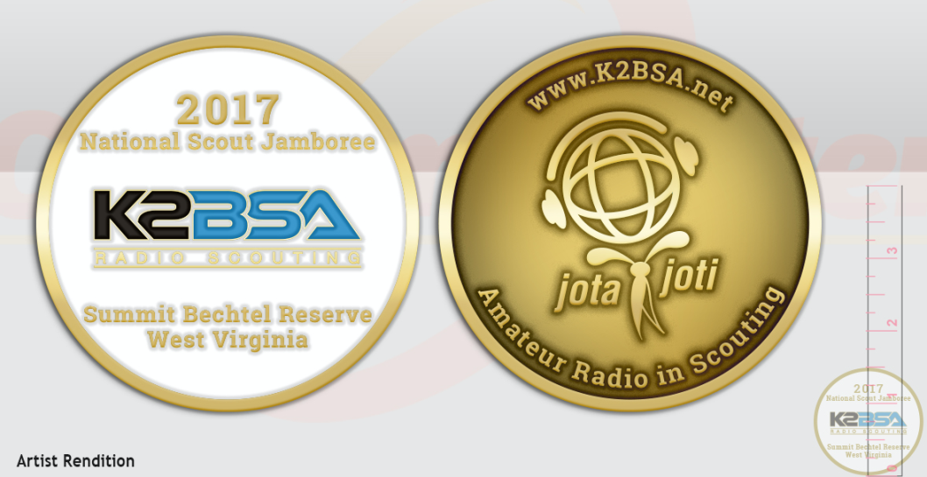
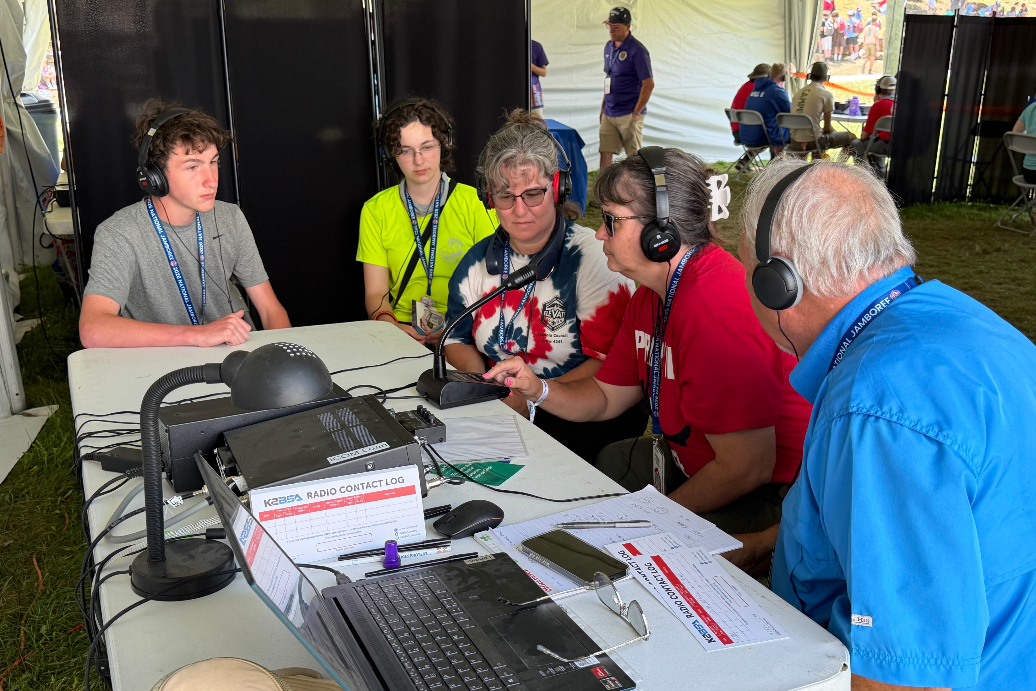
Req. 8a(6).: Visit a radio installation
Radio Station Visit:
What did you see?
2026
1
Notes:
0 minutes for this slide 0:00
[1] Instructor: How was your visit???
SLIDE END

Slide 3
Req. 8a(6).: Visit a radio installation
Radio Station Visit:
What did you see?
2026
Who did you talk to?
What is the purpose of the Radio Station?
How many different radios were there?
What equipment did you see?
How was the equipment used?
1
Notes:
2 minutes for this slide 0:00
[1] Instructor: Get scouts to talk about who they made contact with, what equipment they saw, etc.
SLIDE END

Slide 4
Req. 9(b).: Interview a radio expert
Radio Station Visit:
Interviewing Your Host…
What type of education & training did your host have?
What career do / did they have?
How long have they been doing radio?
What types of licenses are required to use the and maintain the equipment?
1
Notes:
1 minutes for this slide 2:00
[1] Instructor: Did you have a chance to talk to your host? What did you learn about them?
SLIDE END

Slide 5
Req. 2a: Introduction to the Electromagnetic Spectrum
Frequency
Electromagnetic
Spectrum
1
Notes:
0 minutes for this slide. 3:00
[1] Now we are going to learn about the Electromagnetic Spectrum!
To truly learn how radio works there are a few science concepts you will need to learn. The idea of “frequency” is one we’ll talk about first.
SLIDE END

Slide 6
Req. 2a: Introduction to the Electromagnetic Spectrum
Frequency
1 cycle per second
or
1 Hertz
=
=
9 Hertz
1 second
1
2
3
4
5
Notes:
2 minutes for this slide 3:00
[5] As we’ve shown earlier, even though we can’t “see” radio waves, we often draw them as ripples like these on the screen.
[4] We also have seen that radio waves travel; they’re always in motion.
[3] If we timed the waves you see on the screen, they would end up taking one second to move from the left vertical yellow line to the right vertical yellow line.
[2] We say that the single sweep of the top wave shown is traveling one cycle per second. In radio talk, we give a name to “cycle per second.” We call it a Hertz (named after an old guy who was a radio pioneer); in this instance, “one Hertz.”
[1] If nine cycles go by in one second, we would call that frequency “nine Hertz.”
Ask: What would we call it if a thousand cycles passed by in one second? One million? Seven million? A billion?
SLIDE END

Slide 7
Req. 2a: Introduction to the Electromagnetic Spectrum
Quick intro into SI Units
Prefix | Symbol | Multiplication Factor
Giga | G | 10⁹ = 1,000,000,000
Mega | M | 10⁶ = 1,000,000
Kilo | k | 10³ = 1000
Show Units Chart
One Cycle per Second is one hertz or 1 Hz.
As frequency increases Units make it easier.
Kilohertz (1 kHz = 1000 Hz) 10³
Megahertz (1 MHz = 1,000,000 Hz) 10⁶
Gigahertz (1 GHz = 1,000,000,000 Hz) 10⁹
1
Notes:
1 minutes for this slide 5:00
[1] Most of you are familiar with the SI unit prefixes when it comes to hard drive space, with kilobytes, Megabytes, and Gigabytes. The same set of prefixes also works with frequency! Most of the frequencies used by radio operators are in kilo-hertz, Mega-hertz, or Giga-hertz. This is thousands, millions, or even billions of oscillations in one second.
SLIDE END

Slide 8
Req. 2a: Introduction to the Electromagnetic Spectrum
Wavelength
1
Longer wavelengths
Lower frequencies
Lower energy
1
2
3
Shorter wavelengths
Higher frequencies
Higher energy
4
2
3
1
5
6
Notes:
2 minutes for this slide 6:00
[6] Now let’s talk about “wavelength.” Radio waves have certain lengths, and it’s very important to understand this. For starters, you can see that the peaks and valleys of these two radio waves are spaced differently.
[5] <stops movement>
[4] We call the distance between two successive peaks the “wavelength” of the radio wave.
[3] Notice that the wavelength of the top wave is longer than that of the lower wave. The wavelength of the bottom is 1/3 that of the top; you can see that three successive peaks fit in the same space as one above.
[2] The longer the wavelength, the lower the frequency.
One interesting thing is that with longer wavelengths and lower frequencies, the amount of energy in the radio wave is lower, too.
[1] Shorter wavelengths result in higher frequencies.
And just the opposite of longer waves, shorter wavelengths present much higher energy; that’s why the “micro” waves in a microwave oven can heat food!
SLIDE END

Slide 9
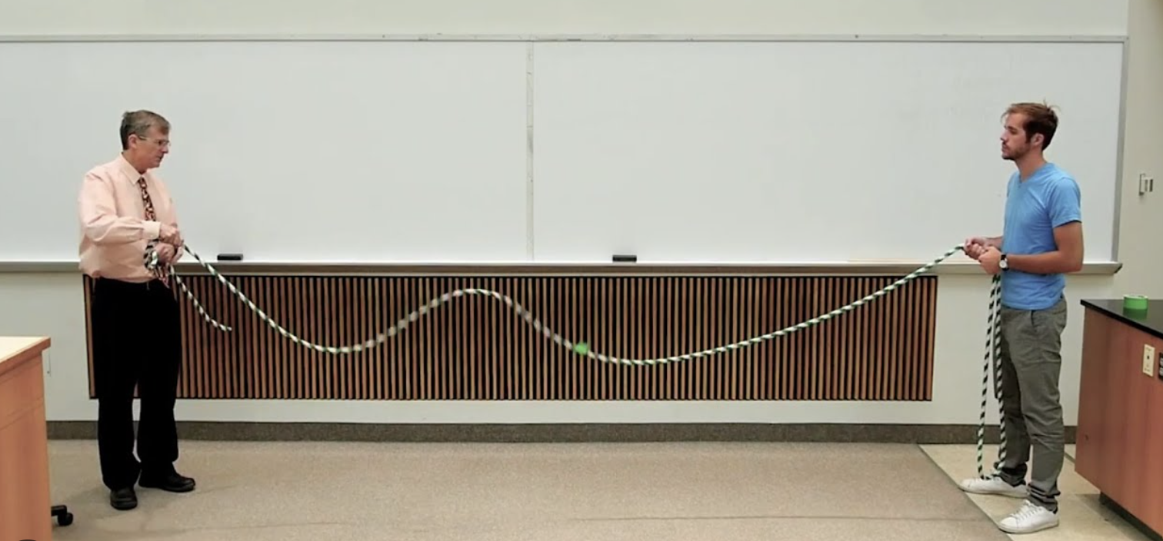
Req. 2a: Introduction to the Electromagnetic Spectrum
Wave Demo Time!
1
Notes:
3 minutes for this slide 8:00
[1] Take rope, have two scouts hold each end and shake with different levels of force.
Observe different wavelengths and frequencies. Note that more input energy results in higher frequencies.

Slide 10

Req. 2a(2).: Electromagnetic Spectrum
ELF Extremely Low Frequency
3 Hz
30 Hz
SLF Super Low Frequency
30 Hz
300 Hz
ULF Ultra Low Frequency
300 Hz
3 kHz
VLF Very Low Frequency
3 kHz
30 kHz
LF Low Frequency
30 kHz
300 kHz
MF Medium Frequency
300 kHz
3 MHz
HF High Frequency
3 MHz
30 MHz
VHF Very High Frequency
30 MHz
300 MHz
UHF Ultra High Frequency
300 MHz
3 GHz
SHF Super High Frequency
3 GHz
30 GHz
EHF Extremely High Frequency
30 GHz
300 GHz
THF Tremendously High Frequency
300 GHz
3 THz
Visible Light
300 THz
3000 THz
1
Notes:
1 minute for this slide 11:00
[1] The EM spectrum is made up of lots of frequency bands that have similar characteristics. On the low frequency end, the waves are very long and penetrate a long way. This is used for submarine communication for example. The most fascinating point here is that some of these waves travel very well through solid material, like the earth!
On the other end of the spectrum, these waves carry more energy and include satellite, radar, x-rays and beyond. It even includes light!
SLIDE END

Slide 11
Req. 2a(2).: Electromagnetic Spectrum
ELF Extremely Low Frequency
3 Hz
30 Hz
SLF Super Low Frequency
30 Hz
300 Hz
ULF Ultra Low Frequency
300 Hz
3 kHz
VLF Very Low Frequency
3 kHz
30 kHz
LF Low Frequency
30 kHz
300 kHz
MF Medium Frequency
300 kHz
3 MHz
HF High Frequency
3 MHz
30 MHz
VHF Very High Frequency
30 MHz
300 MHz
UHF Ultra High Frequency
300 MHz
3 GHz
SHF Super High Frequency
3 GHz
30 GHz
EHF Extremely High Frequency
30 GHz
300 GHz
THF Tremendously High Frequency
300 GHz
3 THz
Visible Light
300 THz
3000 THz
1
Notes:
0 minutes for this slide 12:00
[1] There are five frequency bands that contain the frequencies most often used by the vast majority of radio operators.
SLIDE END

Slide 12
Req. 2a.: Electromagnetic Spectrum
MEDIUM FREQUENCY
MF
HF
HIGH FREQUENCY
VHF
VERY HIGH FREQUENCY
UHF
ULTRA HIGH FREQUENCY
SUPER HIGH FREQUENCY
SHF
1
Notes:
1 minutes for this slide 12:00
[1] MF stands for Medium Frequency: This is the group where you’ll find AM radio, marine radio and some ham radio bands.
HF is High Frequency: This group of frequencies is used for short wave broadcasting. Ham radio operators use HF for most international communication.
VHF is Very High Frequency: These frequencies are used for local communication such as broadcast TV, FM entertainment radio, business and ham radio. These frequencies (and higher) are the ones that operate line-of-sight.
UHF = Ultra High Frequency: Used by police, cell phones and ham radio. FRS radio (so-called “Talk-Abouts) lies in this group, too. SHF = Super High Frequency: This is the home of short-range wi-fi and next generation digital radio.
SLIDE END

Slide 13
Req. 2a(1).: Electromagnetic Spectrum
MF
300 kHz
1 MHz
2 MHz
3 MHz
HF
3 MHz
10 MHz
20 MHz
30 MHz
VHF
30 MHz
100 MHz
200 MHz
300 MHz
UHF
300 MHz
1 GHz
2 GHz
3 GHz
SHF
3 GHz
10 GHz
20 GHz
30 GHz
1
Notes:
2 minutes for this slide 13:00
[1] Look closely at this chart. It shows that MF includes frequencies from 300 kHz up to 3 MHz. That’s how many of those individual peaks and valleys (cycles) go by in one second. As we move through each level we can see that frequencies increase ten-fold.
SLIDE END

Slide 14
Req. 2a(3).: Radio Services
AM Broadcast
Marine
MF
300 kHz
1 MHz
2 MHz
3 MHz
HF
3 MHz
10 MHz
20 MHz
30 MHz
VHF
30 MHz
100 MHz
200 MHz
300 MHz
UHF
300 MHz
1 GHz
2 GHz
3 GHz
SHF
3 GHz
10 GHz
20 GHz
30 GHz
1
VHF
Notes:
1 minute for this slide 15:00
[1] Now let’s look closer at our four groups, starting with “medium frequencies.”
Remember the FCC? The FCC assigns a large portion of the bottom end of the medium frequency range for use by AM radio stations. These days, most people listen to AM radio for sports, news and political talk radio. Most of the time, they listen in their cars!
At the top end of the range, we have frequencies set aside for “marine frequencies.” The Coast Guard monitors these frequencies for boaters who might be in trouble. Big ships even use these frequencies!
SLIDE END

Slide 15
Req. 2a(3).: Radio Services
AM Broadcast
160M
Marine
MF
300 kHz
1 MHz
2 MHz
3 MHz
HF
3 MHz
10 MHz
20 MHz
30 MHz
VHF
30 MHz
100 MHz
200 MHz
300 MHz
UHF
300 MHz
1 GHz
2 GHz
3 GHz
SHF
3 GHz
10 GHz
20 GHz
30 GHz
1
Notes:
1 minute for this slide 16:00
[1] Right in the middle of the MF range is a space set aside for ham radio. From now on, we’ll show ham radio frequencies in red (with white lettering). Note that hams call this the 160 Meter band at 1.8 MHz.
Ask: Why do you supposed it’s called the 160 Meter Band?
We often refer to bands by their approximate wavelength for these frequencies. Their wavelength is about 160 meters, just over 500 feet between peaks!
SLIDE END

Slide 16
Req. 2a(3).: Radio Services
AM Broadcast
160M
Marine
MF
300 kHz
1 MHz
2 MHz
3 MHz
CB
HF
3 MHz
10 MHz
20 MHz
30 MHz
VHF
30 MHz
100 MHz
200 MHz
300 MHz
UHF
300 MHz
1 GHz
2 GHz
3 GHz
SHF
3 GHz
10 GHz
20 GHz
30 GHz
1
Notes:
1 minute for this slide 17:00
[1] Next comes the High Frequencies, or “HF” as radio operators call them.
How many of you have heard of “CB Radio.” What do you know about it? It used to be very popular, but now is pretty much used by truckers when they’re out on the highway.
SLIDE END

Slide 17
Req. 2a(3).: Radio Services
AM Broadcast
160M
Marine
MF
300 kHz
1 MHz
2 MHz
3 MHz
80M
60M
40M
30M
20M
17M
15M
12M
CB
10M
HF
3 MHz
10 MHz
20 MHz
30 MHz
VHF
30 MHz
100 MHz
200 MHz
300 MHz
UHF
300 MHz
1 GHz
2 GHz
3 GHz
SHF
3 GHz
10 GHz
20 GHz
30 GHz
1
Notes:
1 minute for this slide 18:00
[1] There’s a lot we’re not showing here, but we are showing that ham radio has lots of bands throughout this range!
Point out: You can also see that I have identified each of the ham radio segments by their approximate wavelengths.
For now, that’s as far as we’ll go with the High Frequency group.
SLIDE END

Slide 18
Req. 2a(3).: Radio Services
AM Broadcast
160M
Marine
MF
300 kHz
1 MHz
2 MHz
3 MHz
80M
60M
40M
30M
20M
17M
15M
12M
CB
10M
HF
3 MHz
10 MHz
20 MHz
30 MHz
TV
TV
FM
WEATHER
TV
VHF
VHF-
LOW
AVIATION
VHF-
HIGH
30 MHz
100 MHz
200 MHz
300 MHz
UHF
300 MHz
1 GHz
2 GHz
3 GHz
SHF
3 GHz
10 GHz
20 GHz
30 GHz
1
Notes:
1 minute for this slide 19:00
[1] Next comes Very High Frequencies, or “VHF.” This is the first frequency group that requires line of sight transmission. That’s why the type of communication is usually “close-in” or the transmitting towers for it are always located as high as possible in the immediate area.
Before cable TV, one of the most important VHF transmission was for television. This broadcasting still takes place, but cable TV is becoming more popular.
The radio in cars usually has this FM band included. While satellite radio has grown in recent years, many still listen to FM on their car radios, and sometimes even at home!
Aircraft pilots communicate with air traffic control in this band of VHF frequencies
“VHF-HI and VHF-LOW” are bands assigned to business and other private (licensed) communications
There is a little sliver of band for weather announcements, usually by the National Oceanic and Atmospheric Administration
SLIDE END

Slide 19
Req. 2a(3).: Radio Services
AM Broadcast
160M
Marine
MF
300 kHz
1 MHz
2 MHz
3 MHz
80M
60M
40M
30M
20M
17M
15M
12M
CB
10M
HF
3 MHz
10 MHz
20 MHz
30 MHz
TV
TV
FM
WEATHER
TV
VHF
VHF-
LOW
6M
AVIATION
2M
VHF-
HIGH
1.25M
30 MHz
100 MHz
200 MHz
300 MHz
UHF
300 MHz
1 GHz
2 GHz
3 GHz
SHF
3 GHz
10 GHz
20 GHz
30 GHz
1
Notes:
1 minutes for this slide 20:00
[1] And of course, there are ham radio bands in here as well (describe)
SLIDE END

Slide 20
Req. 2a(3).: Radio Services
AM Broadcast
160M
Marine
MF
300 kHz
1 MHz
2 MHz
3 MHz
80M
60M
40M
30M
20M
17M
15M
12M
CB
10M
HF
3 MHz
10 MHz
20 MHz
30 MHz
TV
TV
FM
WEATHER
TV
VHF
VHF-
LOW
6M
AVIATION
2M
VHF-
HIGH
1.25M
30 MHz
100 MHz
200 MHz
300 MHz
UHF
FRS/GMRS
TV
2G CELL PHONES
3G CELL PHONES
300 MHz
1 GHz
2 GHz
3 GHz
SHF
3 GHz
10 GHz
20 GHz
30 GHz
1
Notes:
1 minutes for this slide 21:00
[1] Now for the Ultra High Frequencies, or “UHF”.
Starting off, there are some TV frequencies in this UHF group to add to the prior VHF group. We also have the frequencies used for mobile/cell phones.
Ask: “How many of you have used an FRS radio? The frequencies these radios use is in this UHF group
SLIDE END

Slide 21
Req. 2a(3).: Radio Services
AM Broadcast
160M
Marine
MF
300 kHz
1 MHz
2 MHz
3 MHz
80M
60M
40M
30M
20M
17M
15M
12M
CB
10M
HF
3 MHz
10 MHz
20 MHz
30 MHz
TV
TV
FM
WEATHER
TV
VHF
VHF-
LOW
6M
AVIATION
2M
VHF-
HIGH
1.25M
30 MHz
100 MHz
200 MHz
300 MHz
UHF
70cm
FRS/GMRS
TV
2G CELL PHONES
33cm
23cm
13cm
12cm
3G CELL PHONES
300 MHz
1 GHz
2 GHz
3 GHz
SHF
3 GHz
10 GHz
20 GHz
30 GHz
1
Notes:
0 minutes for this slide 22:00
[1] Just like the other frequency groups, there are ham radio bands, (we call them “allocations”) throughout the UHF group.
SLIDE END

Slide 22
Req. 2a(3).: Radio Services
AM Broadcast
160M
Marine
MF
300 kHz
1 MHz
2 MHz
3 MHz
80M
60M
40M
30M
20M
17M
15M
12M
CB
10M
HF
3 MHz
10 MHz
20 MHz
30 MHz
TV
TV
FM
WEATHER
TV
VHF
VHF-
LOW
6M
AVIATION
2M
VHF-
HIGH
1.25M
30 MHz
100 MHz
200 MHz
300 MHz
UHF
70cm
FRS/GMRS
TV
2G CELL PHONES
33cm
23cm
13cm
12cm
3G CELL PHONES
300 MHz
1 GHz
2 GHz
3 GHz
5G / wifi
Weather
Military Radar
Broadcast
Satellite
Internet
SHF
3 GHz
10 GHz
20 GHz
30 GHz
1
Notes:
1 minutes for this slide 22:00
[1] The SHF is even higher frequencies that are short range, but can transit a lot of data. This is home to 5G, Starlink, Military Radar, and digital broadcast radio.
SLIDE END

Slide 23
Req. 2a(3).: Radio Services
AM Broadcast
160M
Marine
MF
300 kHz
1 MHz
2 MHz
3 MHz
80M
60M
40M
30M
20M
17M
15M
12M
CB
10M
HF
3 MHz
10 MHz
20 MHz
30 MHz
TV
TV
FM
WEATHER
TV
VHF
VHF-
LOW
6M
AVIATION
2M
VHF-
HIGH
1.25M
30 MHz
100 MHz
200 MHz
300 MHz
UHF
70cm
FRS/GMRS
TV
2G CELL PHONES
33cm
23cm
13cm
12cm
3G CELL PHONES
300 MHz
1 GHz
2 GHz
3 GHz
3.3 GHz
5G / wifi
5.6 GHz
10 GHz
Weather
Military Radar
Broadcast
Satellite
Internet
24 GHz
SHF
3 GHz
10 GHz
20 GHz
30 GHz
1
Notes:
0 minutes for this slide 23:00
[1] Just like the other frequency groups, there are ham radio bands, (we call them “allocations”) throughout the SHF group.
SLIDE END

Slide 24
Req. 2a(3).: Radio Services
AM Broadcast
160M
Marine
MF
WWV
300 kHz
1 MHz
2 MHz
3 MHz
80M
60M
40M
30M
20M
17M
15M
12M
CB
10M
HF
WWV
WWV
WWV
WWV
WWV
3 MHz
10 MHz
20 MHz
30 MHz
TV
TV
FM
WEATHER
TV
VHF
VHF-
LOW
6M
AVIATION
2M
VHF-
HIGH
1.25M
30 MHz
100 MHz
200 MHz
300 MHz
UHF
70cm
FRS/GMRS
TV
2G CELL PHONES
33cm
23cm
13cm
12cm
3G CELL PHONES
300 MHz
1 GHz
2 GHz
3 GHz
3.3 GHz
5G / wifi
5.6 GHz
10 GHz
Weather
Military Radar
Broadcast
Satellite
Internet
24 GHz
SHF
3 GHz
10 GHz
20 GHz
30 GHz
1
Notes:
1 minutes for this slide 23:00
[1] Remember our discussion about WWV? It was that signal that I played for you earlier.
You can see that WWV is located at many locations in the MF and HF frequencies, because these are the worldwide shortwave frequencies. Not only does WWV give you accurate time, but it also can let you know how well various radio frequencies are traveling on any given day, since they do vary!
SLIDE END

Slide 25
Req. 2a(3).: Radio Services
AM Broadcast
160M
Marine
MF
WWV
300 kHz
1 MHz
2 MHz
3 MHz
80M
60M
40M
30M
20M
17M
15M
12M
CB
10M
HF
WWV
WWV
WWV
WWV
WWV
3 MHz
10 MHz
20 MHz
30 MHz
TV
TV
FM
WEATHER
TV
VHF
VHF-
LOW
6M
AVIATION
2M
VHF-
HIGH
1.25M
30 MHz
100 MHz
200 MHz
300 MHz
UHF
70cm
FRS/GMRS
TV
2G CELL PHONES
33cm
23cm
13cm
12cm
3G CELL PHONES
300 MHz
1 GHz
2 GHz
3 GHz
3.3 GHz
5G / wifi
5.6 GHz
10 GHz
Weather
Military Radar
Broadcast
Satellite
Internet
24 GHz
SHF
3 GHz
10 GHz
20 GHz
30 GHz
1
Notes:
1 minute for this slide 24:00
[1] As we’ve said earlier, just because there are “blank spaces” between the frequencies I’ve shown you doesn’t mean they aren’t used. We just wanted to show some of the uses for these frequencies. A full spectrum chart has hundreds of different radio spectrum allocations and there are no “empty” bands.
SLIDE END

Slide 26
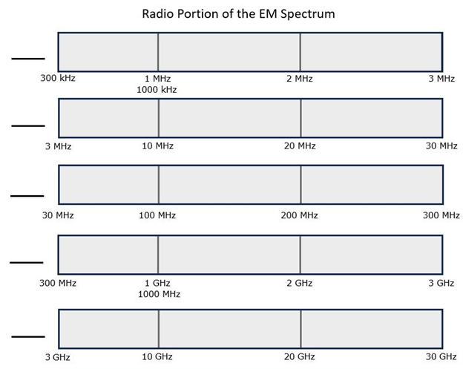
Req. 2a(3).: Radio Services
Now Fill Out Your Chart!
1
Notes:
3 minutes for this slide 25:00
[1] Now fill out your radio spectrum chart with the names of the four radio sections and at least 8 radio services! Raise your hand if you have questions or need more time.
SLIDE END

Slide 27
Req. 4.: How Radio Waves Carry Information
How Radio Waves
Carry Information
1
Notes:
1 minutes for this slide 28:00
[1] Radio is about a lot of things, “radio waves” being an extremely important part. There are all sorts of radio waves in the electromagnetic spectrum. But did you ever wonder how these radio waves are sent or received or convey information?
SLIDE END

Slide 28

Req. 4.: How Radio Waves Carry Information
1
Notes:
0 minutes for this slide 29:00
[1] We often compare radio waves with the ripples in water caused by a thrown rock.
SLIDE END

Slide 29
Req. 4.: How Radio Waves Carry Information
ANTENNA
1
2
Notes:
1 minute for this slide 29:00
[2] Instead of throwing a rock, radio waves are somehow thrown by some sort of antenna.
[1] Waves of many different types will start at the antenna and travel in many directions for long distances, sometimes around the world.
We’re pretty sure they don’t look like the waves shown here, but at least you get the idea.
And these waves are all around us, right here where we’re sitting. Your mobile phones are receiving (and sending) radio waves all the time. The radio waves from Amateur Radio antennas are much stronger up high at the point where the radio waves “shoot” off the antenna.
SLIDE END

Slide 30


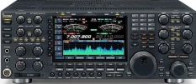
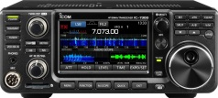
Req. 4.: How Radio Waves Carry Information
United States
Europe
Receiving
Antenna
Transmitting
Antenna
Voice
Into
Microphone
Radio
Transmitter
Radio
Receiver
Loud
Speaker
1
2
3
4
5
6
7
8
9
Notes:
3 minutes for this slide 30:00
[9] Radio uses transmitters to generate energy waves and a radio receivers to detect them and make them useful
[8] There can be tens, hundreds or thousands of miles between a transmitter and receiver, across the city, county, country or WORLD (or SPACE!)
[7] Transmitters must be connected to an antenna to send out the waves
[6] Receivers must also have some sort of antenna to collect the waves
[5] These energy waves are generated when some sort of signal (like a voice into a microphone) is presented to a radio transmitter
[4] The transmitter converts the voice (in this example) to radio wave energy and sends this energy up to the antenna
[3] The antenna throws-off the waves in directions and distances based on how the system is designed
[2] The transmitted energy waves are collected by any receiving antenna designed to detect them, and sends the radio wave energy down to the receiver.
[1] The radio receiver processes the energy waves and converts them into audio that you can hear either through a speaker or headphones
Many radio receivers can be directly connected to a computer where the signal is digitized.
SLIDE END

Slide 31
Req. 4a.: How
Information is Transmitted
-AM & FM
How
Information
is
Transmitted
1
Notes:
0 minutes for this slide 33:00
[1] Now that we know how radio waves are sent and received, let’s talk about how radio waves carry information.
SLIDE END

Slide 32
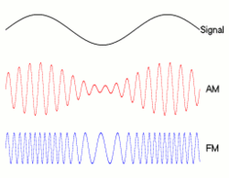
Req. 4a.: How
Information is Transmitted
-AM & FM
Verbal
(audio) message being sent
AM (Amplitude Modulation)
FM (Frequency Modulation)
1
Notes:
1 minute for this slide 33:00
[1] When we talk, the variation of our vocal cords creates audio sound waves. That’s how you can hear my voice right now. The wave on the screen represents an audio sound wave; it is what we want to transmit from our radio antenna.
SLIDE END

Slide 33
Req. 4a.: How
Information is Transmitted
-AM & FM
Verbal
(audio) message being sent
AM (Amplitude Modulation)
FM (Frequency Modulation)
1
Notes:
1 minute for this slide 34:00
[1] One way we can transmit our audio wave is to use Amplitude Modulation, or “AM”. If you look closely at this AM radio wave, you actually can see three waves. The higher frequency radio carrier wave that the transmitter sends out the antenna, and our original audio wave, duplicated along the top and bottom of the carrier. We say the amplitude (“vertical height”) of the carrier changes according to the audio signal it is carrying. When you listen to “AM radio,” your radio receiver is detecting this kind of wave.
SLIDE END

Slide 34
Req. 4a.: How
Information is Transmitted
-AM & FM
Verbal
(audio) message being sent
AM (Amplitude Modulation)
FM (Frequency Modulation)
1
Notes:
1 minute for this slide 35:00
[1] Now we see a totally different way to carry our voice: Frequency Modulation, or “FM.” Note how the three moving illustrations here compare. Different than AM, the FM signal keeps the same amplitude, but changes its frequency with each change in your voice signal. There are advantages and disadvantages to AM and FM that we don’t have time to talk about here. But at least you can easily see how they are very different!
SLIDE END

Slide 35
Req. 4a.: How
Information is Transmitted
-AM & FM
Verbal
(audio) message being sent
AM (Amplitude Modulation)
FM (Frequency Modulation)
1
Notes:
0 minutes for this slide 36:00
[1] These are only a couple ways information can be sent over the airwaves. Let’s study some more!
SLIDE END

Slide 36
Req. 4a.: How
Information is Transmitted
- SSB
AM (Amplitude Modulation)
SSB (Single
Sideband)
1
Notes:
1 minute for this slide 36:00
[1] To look at our next mode of transmitting information, we’ll bring back up our Amplitude Modulation diagram.
Our next mode is Single Sideband, or SSB. Notice you’re not seeing anything right now. That’s because no one is talking into the microphone. In the AM signal above, there is always a transmitted carrier, even if no one is talking. Once you start talking into an AM transmitter, the carrier is then modulated as shown.
SLIDE END

Slide 37
Req. 4a.: How
Information is Transmitted
- SSB
AM (Amplitude Modulation)
SSB (Single
Sideband)
1
Notes:
1 minute for this slide 37:00
[1] But in a Single Sideband transmission, nothing happens on the airwaves unless you talk. Here we’re showing an SSB signal that matches the words that are being spoken into the mic.
Instructor: You can cycle back to #2 and then click your remote’s advance button to replay.
Single Sideband is much more efficient with energy than is an AM signal because no energy is going out when there is no talking, even during the pauses between words or sentences!
SLIDE END

Slide 38
Req. 4a.: CW
CW
1
Notes:
0 minutes for this slide 38:00
[1] Let’s look at another way to send information in our transmitted signal.
SLIDE END

Slide 39
Req. 4a.: CW
“CW”
CONTINUOUS WAVE
1
Notes:
1 minute for this slide 38:00
[1] This image shows an actual scan of a different kind of radio carrier wave. It’s called “continuous wave” and it oscillates up and down continuously.
SLIDE END

Slide 40
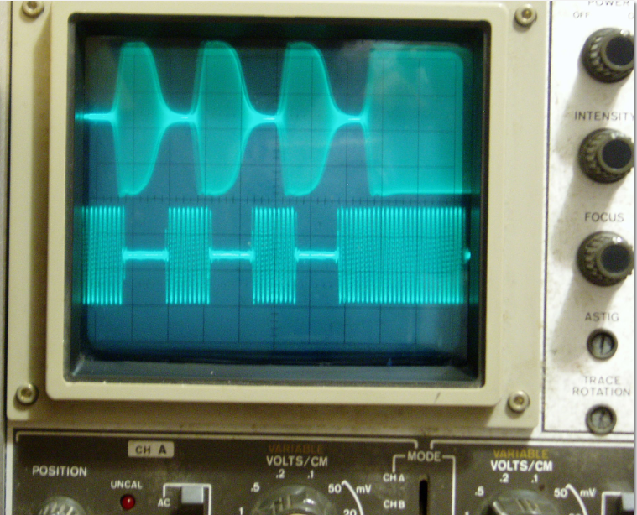
Req. 4a.: CW
Turning the CW on and off
1
Notes:
1 minute for this slide 39:00
[1] If the ham operator wanted to, he or she could transmit a solid continuous wave. However, it can also be broken up by turning the wave on and off. Can you guess what why we would do this?
SLIDE END

Slide 41
Req. 4a.: CW
DIT
DIT
DIT
DAH
1
Notes:
1 minute for this slide 40:00
[1] When one of these little pieces of continuous wave is detected by a radio receiver, it makes a short “dit” sound in the speaker or headset.
If the operator strings three of these short bursts of continuous wave, it will create three “dit sounds”.
A slightly longer burst results in what the operator calls a “dash” or “dah.” What we see here is that the operator sent continuous wave bursts of “dit-dit-dit-dah.” What information do you think the operator is sending?
SLIDE END

Slide 42
Req. 4a.: CW
DIT
DIT
DIT
DAH
V
1
Notes:
0 minutes for this slide 41:00
[1] The operator is sending the Morse Code for the letter “V.”
We ham operators refer to the sending of Morse Code as “CW.” This comes from the fact that this means of communication turns on and off an otherwise continuous wave.
CW was the first form of messaging on the airwaves. In a sense, it was also the first form of digital communications!
SLIDE END

Slide 43
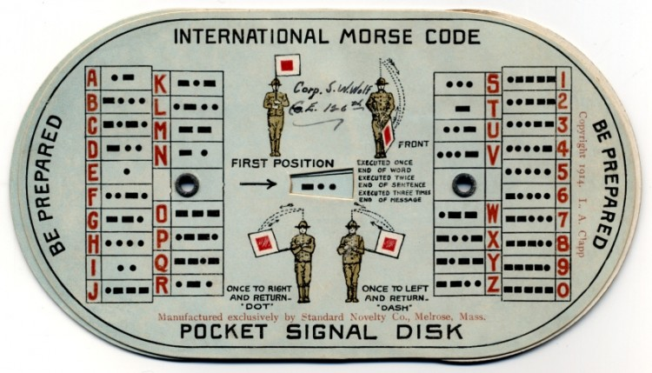
Req. 4a.: CW
1
Notes:
1 minute for this slide 41:00
[1] This was a typical Morse Code and Semaphore aid for Scouts in the 1940s and 1950s.
Either Morse Code or Semaphore was a requirement for Scouting rank until 1974. Morse Code goes way back to the 1800s!
Find the letter “V” and you’ll see those three “dits” and one “dah” that we just talked about….
SLIDE END

Slide 44
Req. 4a.: CW
B
S
A
1
2
3
Notes:
1 minute for this slide 42:00
[3] Let’s look at one more…
[2] Take a look at this string of CW dits and dahs. What might the operator be sending here?
[1] Here you go!
SLIDE END

Slide 45
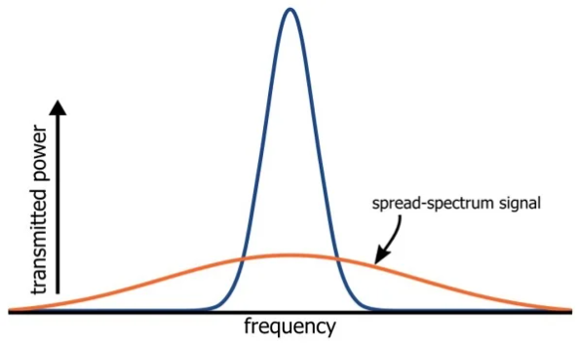
Req. 4a – Information by Radio
What is Spread Spectrum Communication?
Traditional radio signal
1
Notes:
1 minute for this slide 43:00
[1] One way that radio operators can exchange data even if there is interference present is by using “spread spectrum communication”. This splits up the signal across lots of different frequencies so if something is interfering with some of the frequencies, others can get through.
SLIDE END

Slide 46
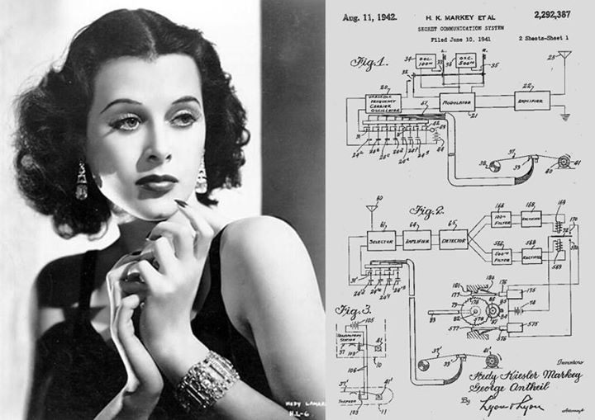
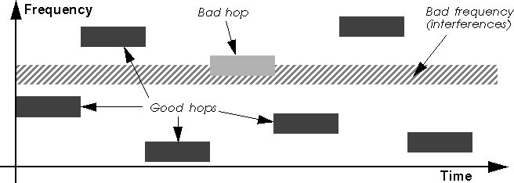
Req. 4a – Information by Radio
Frequency Hopping:
What Bluetooth and 1940’s Actress Heddy Lamarr have in common!
1
Notes:
1 minute for this slide 44:00
[1] Another way to spread data across many channels is to use “frequency hopping”, where the signal moves around in a wide band of frequencies. That way if there are sources of interference at certain frequencies your signal can “hop” away from those bad ones.
This concept was actually developed by a 1940’s era scientist & actress names Heddy Lamarr!
SLIDE END

Slide 47
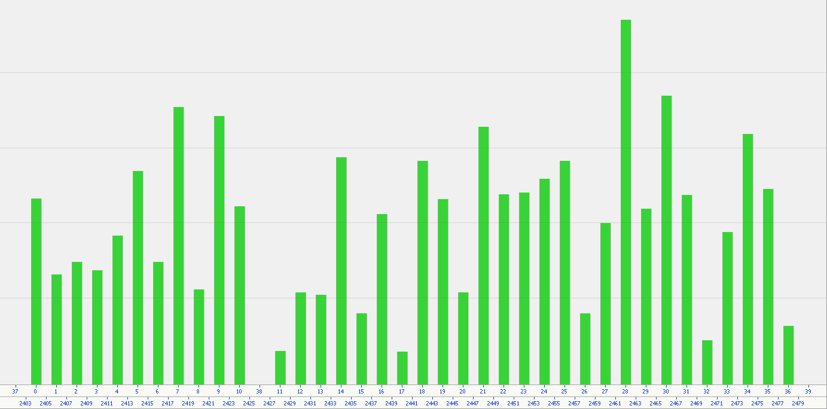
Req. 4a – Information by Radio
Bluetooth: Frequency Hopping
Signal spread over >40 separate frequencies
2400 MHz
2479 MHz
Radio Frequency
1
Notes:
1 minute for this slide 45:00
[1] Frequency hopping is how modern digital radio works. Here is a plot of a Bluetooth signal, like from your wireless headphones to your phone. The data stream is constantly hopping around within the Bluetooth band looking for channels with the lowest interference and fastest data rate.
SLIDE END

Slide 48

Req. 4b.: Digital Signals
Computers talk in Binary
(not Voice or Morse Code)
01010111 01101000 01100101 01101110 00100000 01100011 01101111 01101101 01110000 01110101 01110100 01100101 01110010 01110011 00100000 01100011 01100001 01101101 01100101 00100000 01101111 01101110 00100000 01110100 01101000 01100101 00100000 01110011 01100011 01100101 01101110 01100101 00101100 00100000 01110111 01100101 00100000 01110111 01100001 01101110
1
Notes:
1 minute for this slide 46:00
[1] Of course, your computer doesn’t really talk in Morse Code. It talks in binary, or 1s and 0s.
SLIDE END

Slide 49
American Standard Code for Information Interchange (ASCII)
Req. 4b.: Digital Signals
A | 1000001 | a | 1100001 |  | N | 1001110 | n | 1101110
B | 1000010 | b | 1100010 |  | O | 1001111 | o | 1101111
C | 1000011 | c | 1100011 |  | P | 1010000 | p | 1110000
D | 1000100 | d | 1100100 |  | Q | 1010001 | q | 1110001
E | 1000101 | e | 1100101 |  | R | 1010010 | r | 1110010
F | 1000110 | f | 1100110 |  | S | 1010011 | s | 1110011
G | 1000111 | g | 1100111 |  | T | 1010100 | t | 1110100
H | 1001000 | h | 1101000 |  | U | 1010101 | u | 1110101
I | 1001001 | i | 1101001 |  | V | 1010110 | v | 1110110
J | 1001010 | j | 1101010 |  | W | 1010111 | w | 1110111
K | 1001011 | k | 1101011 |  | X | 1011000 | x | 1111000
L | 1001100 | l | 1101100 |  | Y | 1011001 | y | 1111001
M | 1001101 | m | 1101101 |  | Z | 1011010 | z | 1111010
SLIDE 49
1
Notes:
1 minute for this slide 47:00
[1] In order for computers to understand our alphabet, we assign each letter and number a unique combination of 8 1s and 0s.
This is known as ASCII, or the American Standard Code for Information Interchange.
Therefore, when we talk to our computers, they can translate our language into theirs.
SLIDE END

Slide 50
Req. 4b.: Digital Signals
“Scouting America”
01010011 01100011 01101111 01110101 01110100 01101001 01101110 01100111 00100000 01000001 01101101 01100101 01110010 01101001 01100011 01100001
So How Do We Send this over the Radio?
SLIDE 50
1
Notes:
0 minutes for this slide 48:00
[1] This is what Scouting America looks like to a computer.
So, if we want to have computers talk to each other over the radio, we have to find a way to send all these 1s and 0s efficiently.
SLIDE END

Slide 51
Req. 4b.: Digital Signals
CARRIER
1
Notes:
1 minute for this slide 48:00
[1] Now let’s look at radio wave signals, and get an idea on what might be going on…
First we have a typical continuous wave. There is no modulation; that is, there are no dits and dahs or 1s and 0s being sent with this continuous wave. If you could somehow hear it, it would sound like a continuous tone on your radio.
SLIDE END

Slide 52
Req. 4b.: Digital Signals
+
01000101 (“E”)?
1
Notes:
1 minute for this slide 49:00
[1] How can we add digital information to a continuous radio wave?
Suppose we want to send an “E” in digital…
That would be sending 01000101 in ASCII or “dit” in Morse.
SLIDE END

Slide 53
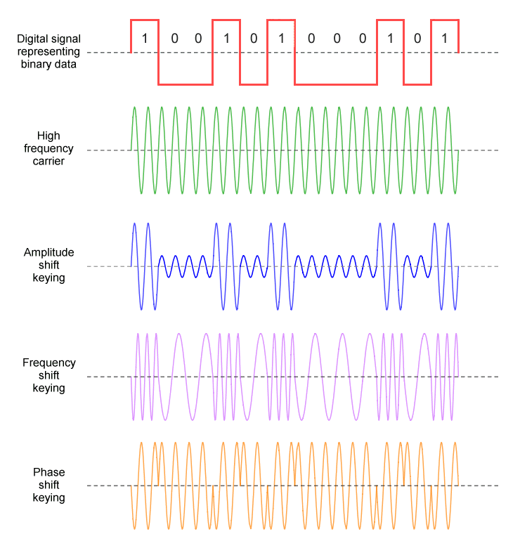
Req. 4b.: Digital Signals
+
1
Notes:
2 minutes for this slide 50:00
[1] Now here are three different ways that we could encode the digital information.
The first shows modulation by varying the amplitude of the carrier wave, having a large amplitude for 1s and a lower amplitude for 0s.
The second shows frequency modulation or frequency shift keying, where we make the frequency a little shorter for 1s and longer for 0s.
The third was is phase shift keying, where we flip the direction of the wave if we want to send a 1 and leave it alone if we want to send a 0.
SLIDE END

Slide 54
Req. 4b.: Digital Signals
0 1 0 0 0 1 0 1
“E”
1
Notes:
1 minute for this slide 52:00
[1] Now you can see that the last 8 bits of data that we encoded on our carrier wave are 01000101, which is the
ASCII code for an E. This is how digital radio encodes data.
Each group of 8 binary numbers is a byte.
Put 1 million bytes together and you have just sent a MB over a radio, like wifi or celluar!
SLIDE END

Slide 55
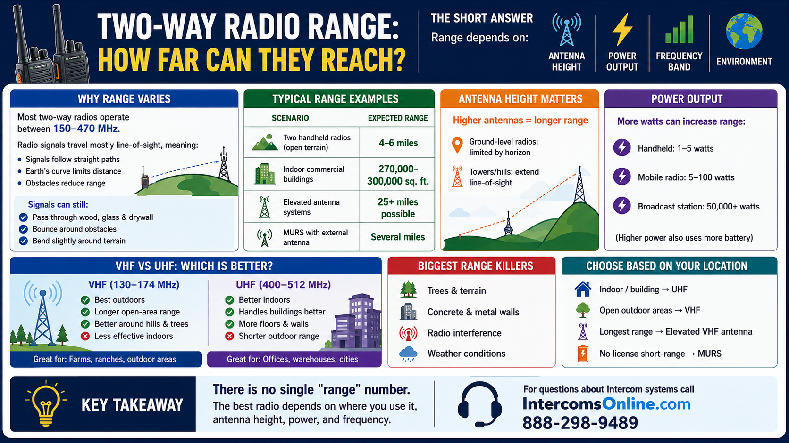
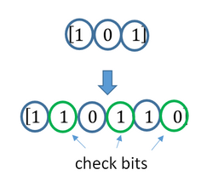
Req. 4c.: Range versus Encoding Method
Digital Data has some range advantages over analog voice encoding.
Built In Error Checking
Phase Shift Encoding tolerates higher noise than AM or FM
1
Notes:
1 minute for this slide 53:00
[1] With digital data, error correction is possible, which means information can be sent over noisier frequencies. Also, phase shift encoding is much less sensitive to noise than amplitude or frequency encoding.
SLIDE END

Slide 56
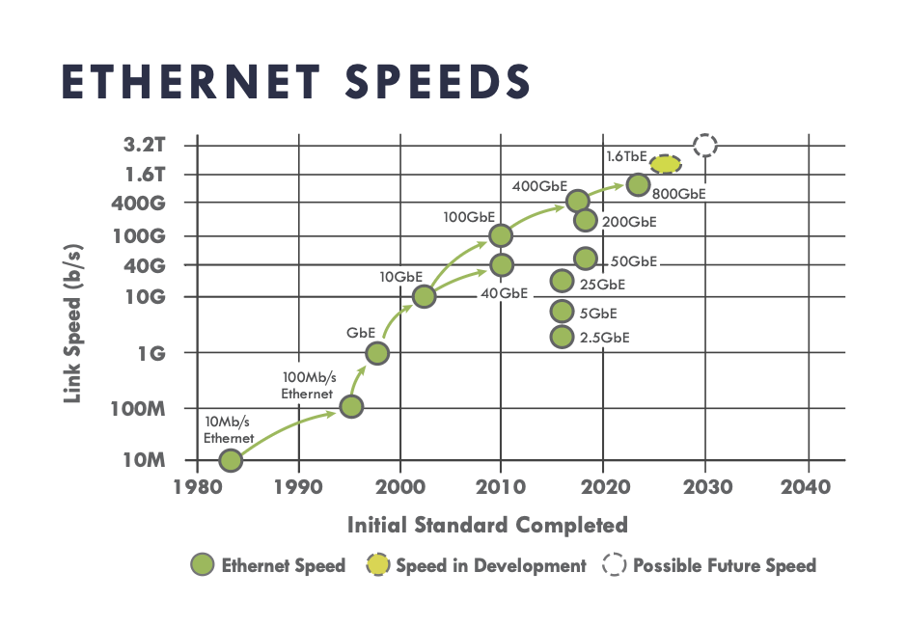
Req. 4d.: Max Data Rate
How Fast Can We Send Information via Radio?
Max data rate for fiber is about 1000GB/Sec
“5G”
WiFi
Standard
Max data rate for Wifi or 5G is about 1GB/Sec
1
Notes:
1 minute for this slide 54:00
[1] With channel sharing and phase modulation, sending information over radio waves is currently peaking at around 1 GB/sec.
That is a lot of 1s and 0s!
We can send information more than1000x faster over fiberoptics than via radio, but we need the fiber connection to do so!
SLIDE END

Slide 57
Req. 5.a&b.: Block Diagrams
Block Diagrams
&
Schematics
1
Notes:
1 minute for this slide 55:00
[1] When you really get into radio, you may become interested in how they are put together and what makes them work. You will learn how to use block diagrams and schematics. We’ll start here by “building” a ham radio station using a block diagram:
SLIDE END

Slide 58
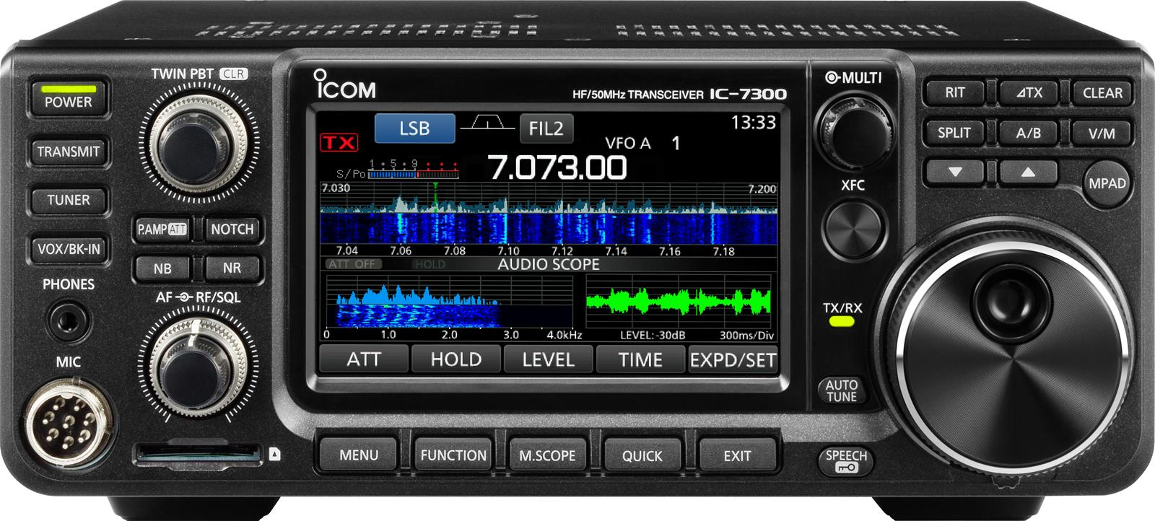
Req. 5.a&b.: Block Diagrams
Transceiver
1
Notes:
0 minutes for this slide 56:00
[1] Usually when a radio operator starts thinking about the station, the transceiver is one of the first things that come to mind. You’ll see lots of them here at K2BSA.
We’ll lay down this label (Transceiver) as part of our radio station block diagram.
SLIDE END

Slide 59
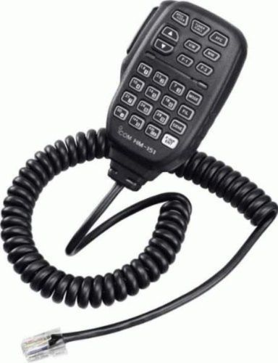
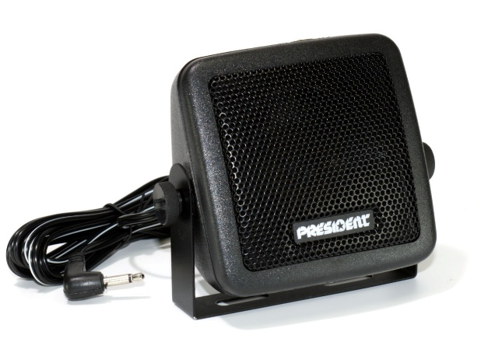
Req. 5.a&b.: Block Diagrams
Speaker
Microphone
Transceiver
1
Notes:
1 minute for this slide 56:00
[1] Most hams will use a microphone like this connected to the transceiver to convert their voice into radio waves.
We’ll connect the microphone label to the transceiver on our block diagram
SLIDE END

Slide 60
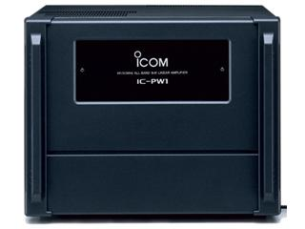
Req. 5.a&b.: Block Diagrams
Speaker
Amplifier
Microphone
Transceiver
Amplifier
1
Notes:
0 minutes for this slide 57:00
[1] Many hams want to add an amplifier to their radio station. Why might you think they would want an amplifier?
For our station here, we’ll connect our transceiver to an amplifier label to end up with a stronger radio signal.
SLIDE END

Slide 61
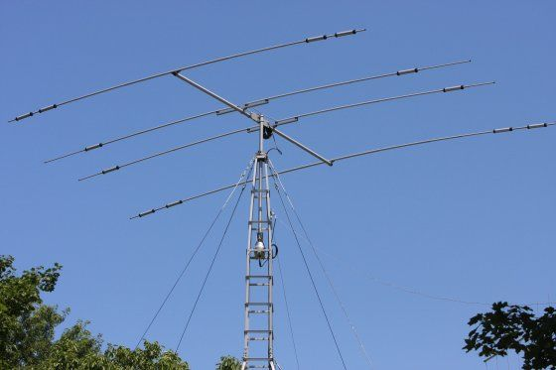
Req. 5.a&b.: Block Diagrams
Antenna
Antenna
Speaker
Microphone
Transceiver
Amplifier
1
Notes:
1 minute for this slide 57:00
[1] All ham radio stations use some sort of antenna to radiate our signal
Here is our block label for the antenna
SLIDE END

Slide 62
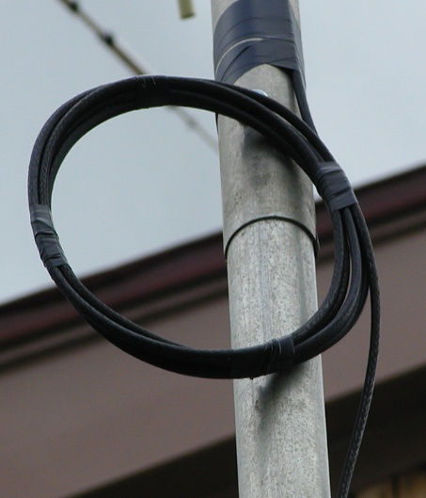
Req. 5.a&b.: Block Diagrams
Antenna
Feedline
Speaker
Feedline
Microphone
Transceiver
Amplifier
1
Notes:
0 minutes for this slide 58:00
[1] We connect the amplifier to the antenna with a special kind of wire called the feedline. The feedline carries the amplified radio signal to the antenna
SLIDE END

Slide 63
Req. 5.a&b.: Block Diagrams
Antenna
Speaker
Feedline
Microphone
Transceiver
Amplifier
1
Notes:
0 minutes for this slide 58:00
[1] There you have it: A basic ham radio station in a block diagram. The block diagram gives you a high level picture of your ham radio station system. But as you become more interested in how things work, you might want to become familiar with schematics. Schematics are “maps” of all the electronic components inside a device.
Now let’s look at schematics…
SLIDE END

Slide 64
Req. 5.a&b.: Schematic Diagrams
Antenna
Feedline
Speaker
Receiver
Amplifier
Microphone
Transmitter
1
Notes:
0 minutes for this slide 58:00
[1] Sometimes the receiver & transmitter are separate, and sometimes they are the same device – the transceiver.
SLIDE END

Slide 65
Req. 5.a&b.: Schematic Diagrams
Antenna
Speaker
Feedline
Microphone
Transceiver
Amplifier
1
Notes:
0 minutes for this slide 58:00
[1] Let’s look at one component of our ham radio station, the transceiver.
SLIDE END

Slide 66
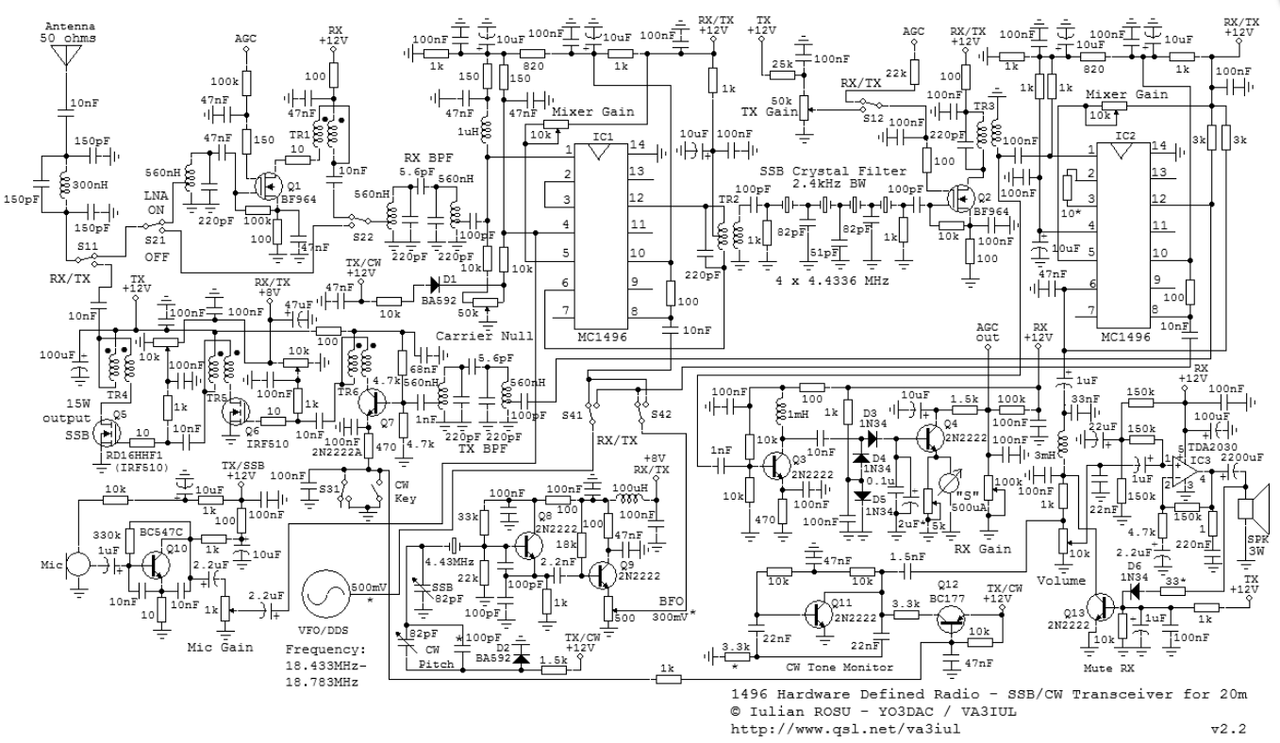
Req. 5.a&b.: Schematic Diagrams
Transceiver
1
Notes:
1 minute for this slide 58:00
[1] A schematic maps out all the components in our transceiver and how they are connected. This is very helpful when troubleshooting the equipment. You can’t really repair a complex device like a ham radio transceiver, or even a simple one for that matter, without knowing how to read and use a schematic.
If you want to learn more about schematics, the Electronics Merit Badge will help you get there!
SLIDE END

Slide 67

Req. 5.a&b.: Schematic Diagrams
Antenna
Speaker
Feedline
Microphone
Transceiver
Amplifier
1
Notes:
1 minute for this slide 60:00
[1] You can see if we just shrink the size of our schematic to make it part of our block diagram, it really doesn’t help us.
SLIDE END

Slide 68
Req. 5.a&b.: Schematic Diagrams
Finish Block
Diagram
Antenna
Speaker
Feedline
Microphone
Transceiver
Amplifier
1
Notes:
1 minute for this slide 61:00
[1] The block diagram helps us at a high level, seeing the whole system in an easy-to-read manner.
Before you become knowledgeable about electronics, components and schematics, a block diagram should help you understand how a radio system goes together.
***Note to Instructor: They should have been building their block diagram throughout the prior slides. This time period is provided for them to finish the drawing.
SLIDE END

Slide 69
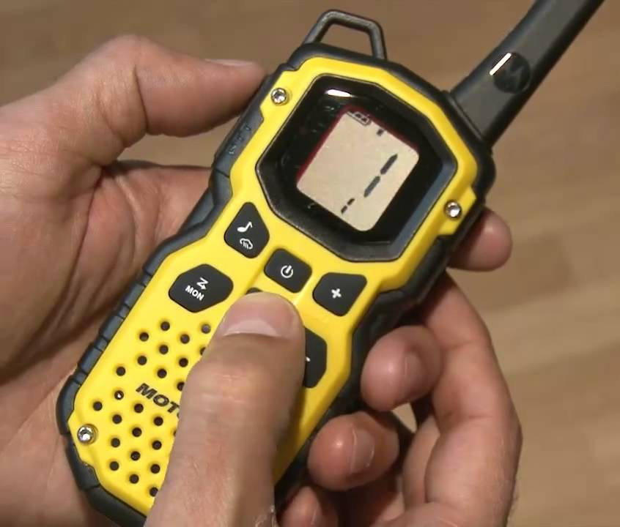
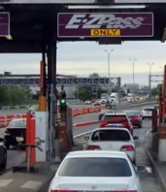
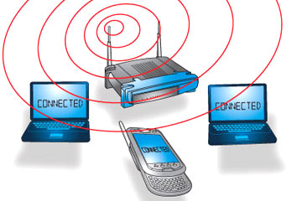
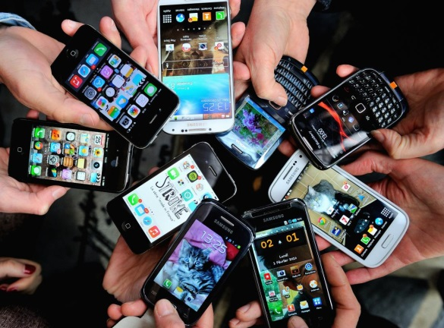
Req. 5.c.: Consumer Devices that Use Radio
Radio for Consumers
1
Notes:
1 minute for this slide 62:00
[1] Recall back in the beginning of class, we talked about which consumer devices we used every day that rely on radio communication. Can you name some of them?
SLIDE END

Slide 70
Req. 5d.: NOAA Weather Radio (NWR)
The NOAA Weather Service & Radio
1
Notes:
0 minutes for this slide 63:00
[1] Now we are going to talk about how radio is used to keep the public aware of the weather.
SLIDE END

Slide 71
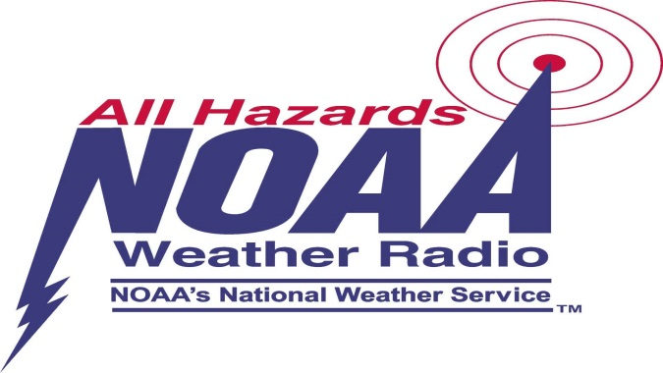
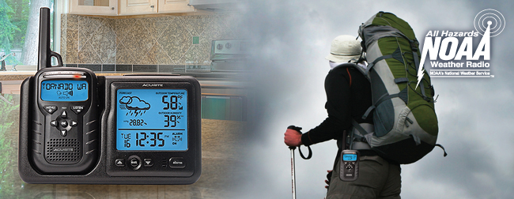
Req. 5d.: NOAA Weather Radio (NWR)
1
Notes:
1 minute for this slide 63:00
[1] NOAA Weather Radio (NWR; also known as NOAA Weather Radio All Hazards) is a network of radio stations in the United States that broadcast continuous weather information directly from a nearby (<40 miles) weather forecast office.
NOAA Weather Radio broadcasts National Weather Service warnings, watches, forecasts, weather observations and other hazard information 24 hours a day.
It also broadcasts alerts of non-weather emergencies such as national security, natural, environmental and public safety (such as an AMBER Alert) through the U.S. Federal Communications Commission's (FCC) Emergency Alert System.
SLIDE END

Slide 72
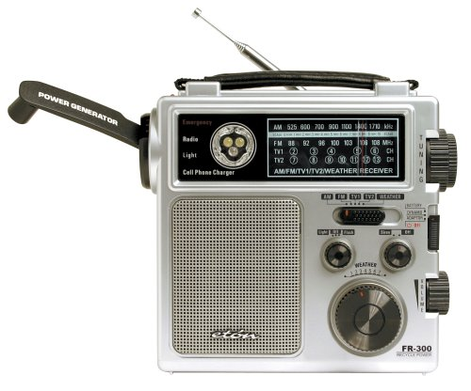
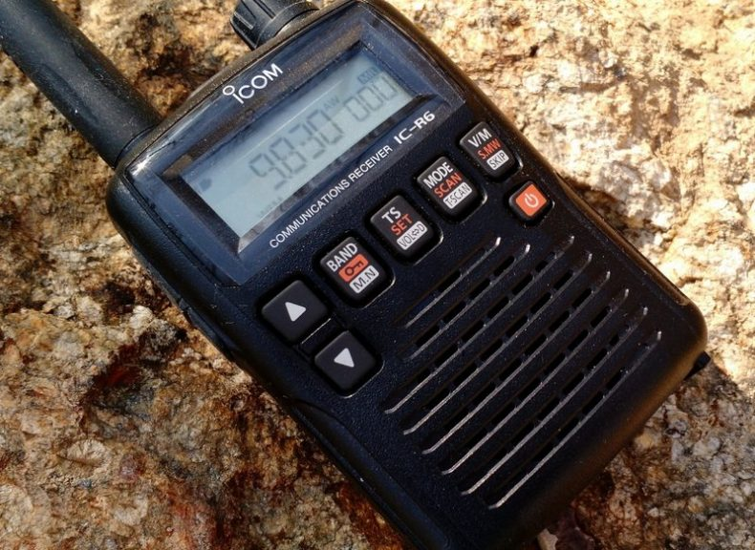
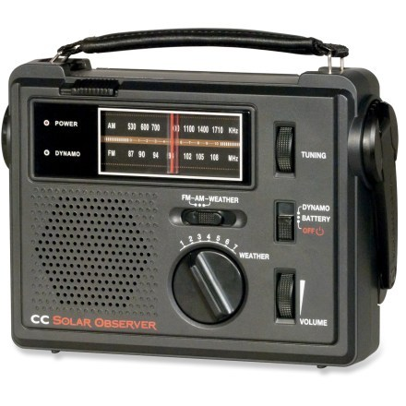
Req. 5d.: NOAA Weather Radio (NWR)
1
Notes:
1 minute for this slide 64:00
[1] There are many special radios designed for receiving NWR broadcasts. One of these radio receivers could be a great addition to your home emergency kit!
SLIDE END

Slide 73
Req. 5e.: RFID
Radio Frequency Identification (RFID)
1
Notes:
0 minutes for this slide 65:00
[1] Now we are going to talk about how radio is used to do inventory!
SLIDE END

Slide 74
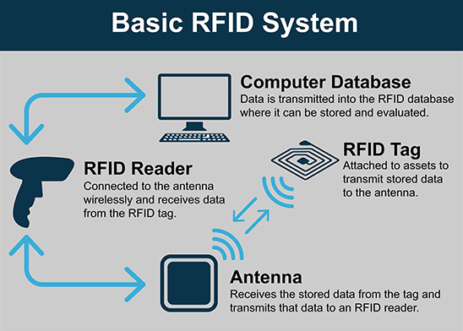
Req. 5e.: RFID
How does RFID work?
1
Notes:
1 minute for this slide 65:00
[1] RFID works through a reader and tag system, where a reader sends out radio frequency (RF) signals that power an RFID tag. The tag, which contains a microchip and antenna, then transmits its stored data back to the reader, which converts the radio waves into usable information. The reader's signal can power the tag (passive tags) or the tag can have its own power source (active tags), which determines its read range.
SLIDE END

Slide 75
Req. 7a.: Cell Phones
How
Cell Phone
Systems Work
1
Notes:
0 minutes for this slide 66:00
[1] As we mentioned at the beginning of this course, most all of us use radio every day, even if we’re not a ham radio operator! We use cell phones!
SLIDE END

Slide 76
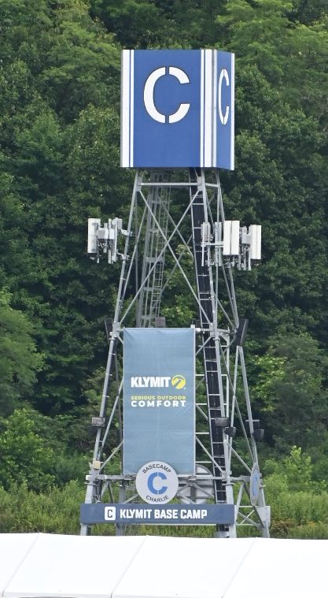
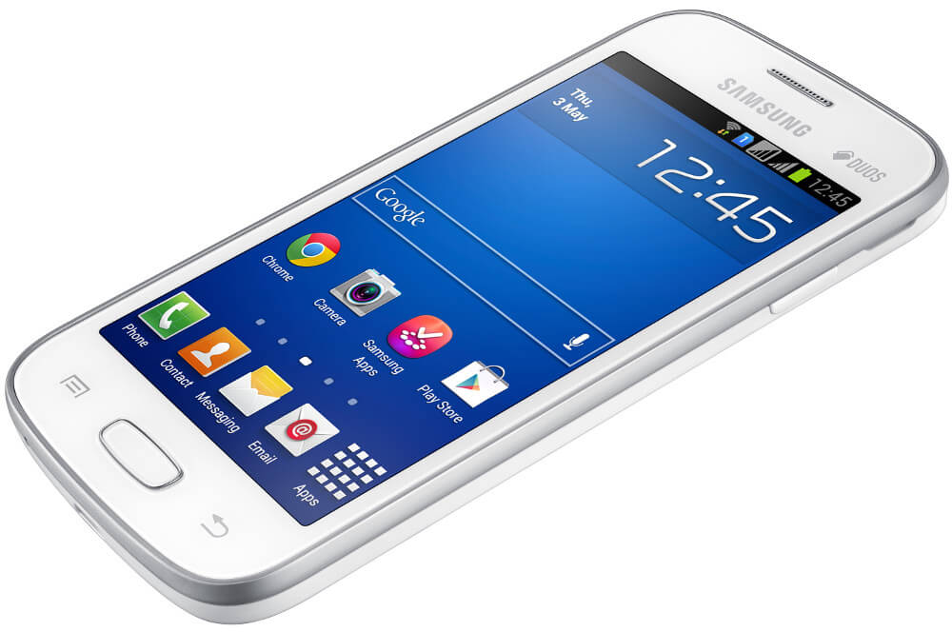
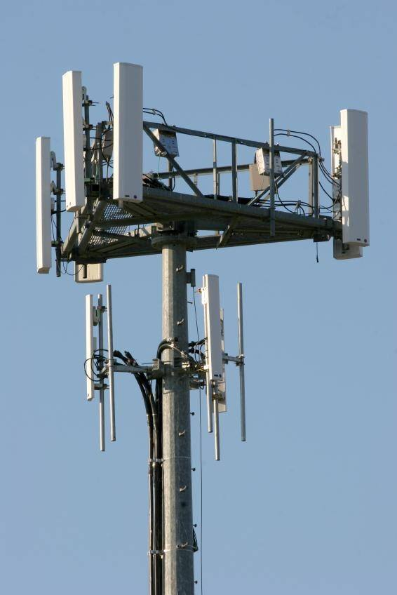
Req. 7a.: Cell Phones
1
Notes:
1 minute for this slide 66:00
[1] Ever see one of these towers someplace in your town? ASK: What is it?
Cellular telephone base station antennas like this one are located in more places than you would imagine! We take them for granted, but this is a very interesting technology! They send and receive communications signals 24 hours a day.
A mobile phone or wireless device is a low-power two way radio operating at a maximum of 2 watts (peak).
SLIDE END

Slide 77
Req. 7a.: Cell Phones
Transceiver
Computer
Battery
Transmitting/Receiving Antenna
Microphone
Speaker
1
Notes:
2 minutes for this slide 67:00
Much of the phone is a battery, strong enough to make several calls, send lots of test messages, search the Internet and take photos with the camera!
The phone has an audio circuit that includes a microphone and a small speaker. Some have earpiece connections; others use Bluetooth to send an audio signal to a wireless earpiece. Bluetooth is another form of digital radio!
Of course, the phone has a computer with lots of memory. A cell phone has more computing power than the computer used when we sent a man to the moon!
The phone has a transceiver section, one that transmits and receives signals.
Finally, no radio system will work without an antenna. Yes, even cell phones have built-in antennas!
Such mobile phones have become more important for all the things they do besides making a call!
SLIDE END

Slide 78
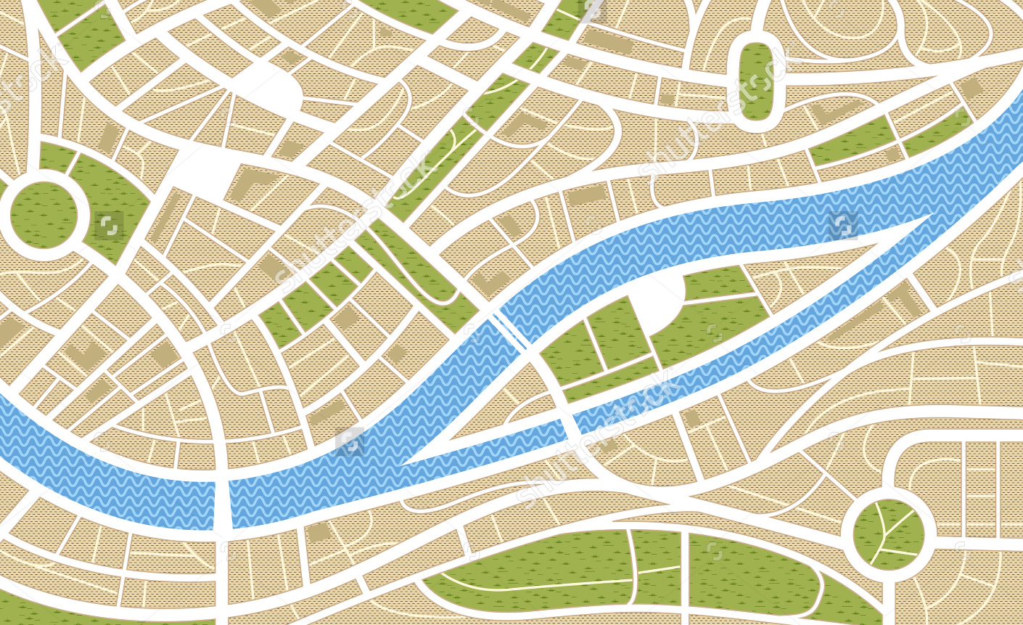

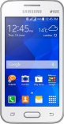
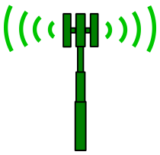

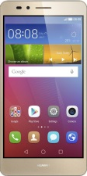
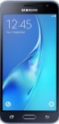
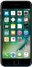
Req. 7a.: Cell Phones
1
2
3
4
6
7
8
9
5
Notes:
3 minutes for this slide 69:00
[9] Let’s look at the basics of a cellular telephone system in a make-believe town (somewhere.)
[8] First, we’ve got those base station antennas. Wireless companies locate them in the best possible places, considering population, obstructions to signals and available property. We’re just showing four base station antennas here, but there are usually enough in any size town to cover most all areas.
[7] Now we’re showing the “cells” that are covered by the base station antennas. The cell is as big as the range of the base station antenna. Here we’re showing they all reach out the same distance, but in reality, the distances can vary quite a bit. If we want a bigger cell, we can at least increase the power of a base station transmitter. For this discussion, we’ll show them to have the same range.
[6] The base station antennas are all wired directly to the cell carrier’s network, which ties all base stations together around the country.
[5] The cell carrier’s network is also tied to other carrier’s networks and to standard telephone systems.
[4] When your phone is turned-on, even when you are not using it, it tries to link up with the nearest base station antennas. How well it’s doing this is usually shown with some indication on your phone.
In this case, the phone is linked very well to two base station antennas because of your location.
[3] When you call a friend up here, he is also close enough to a base station tower to have a very connection. He probably won’t experience a “drop” because he has a strong signal.
[2] But when you call a different friend down here, his location is on the edge of the cell, with no other base station near by. His call may “drop” because of this.
[1] And when you try calling another friend down here, his cell phone will not pick up a signal because he is out of range of the cell. His phone will probably indicate “no signal” or “out of range” or something like that.
SLIDE END

Slide 79
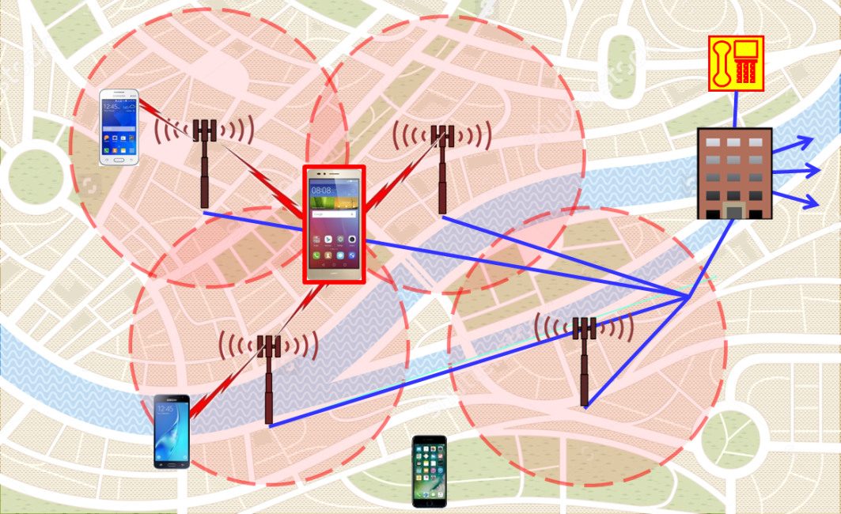
Req. 7d.: Cell Phone System Limitations in Disasters
90+% load during normal times…
What will happen with a bigger-than-normal load?
Limitations in Disasters
1
Notes:
1 minute for this slide 72:00
[1] We could talk a lot about the differences between using mobile phones and ham radio during disasters, but let’s look at some big differences.
Cell systems during normal use are handling large numbers of regular calls, usually at about a 90% load. We’ve learned that cell systems quickly are overloaded when a disaster occurs: If twice as many people tried to use a mobile phone, the system would be loaded at 180% -- It won’t work! The only real load with ham radio is the ability of trained hams to operate under emergency protocol.
SLIDE END

Slide 80
Req. 7d.: Cell Phone System Limitations in Disasters
90+% load during normal times…
What will happen with a bigger-than-normal load?
Still requires
land- line telephone system
Requires functioning electrical power system
Limitations in Disasters
1
Notes:
1 minute for this slide 73:00
[1] Cell systems also require electrical power. Ham radio does as well, but can easily be functional with batteries or portable generators. Cell systems do not have the same capabilities!
SLIDE END

Slide 81
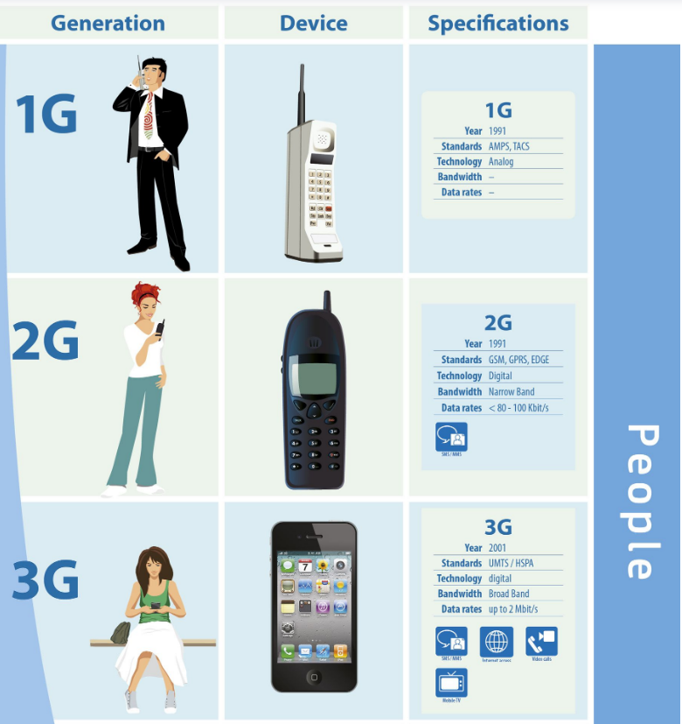
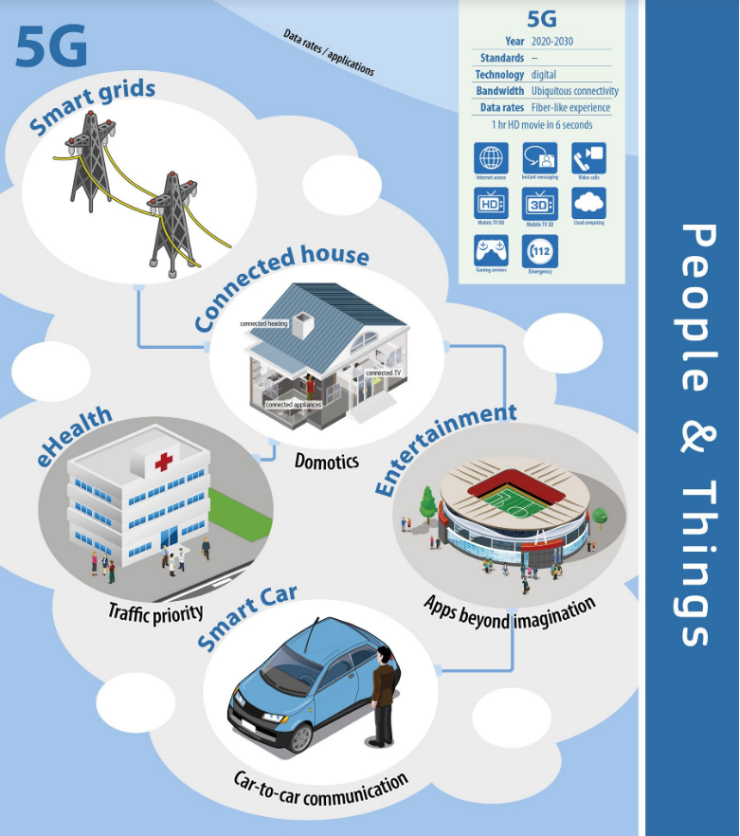
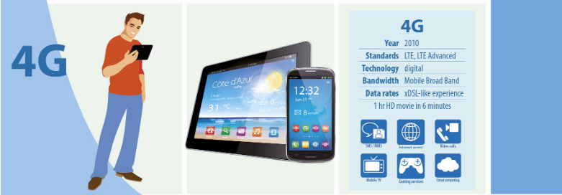
Req 7a.: Cell Phone Generations
1
Notes:
2 minutes for this slide 74:00
[1] Many of you have heard of the different generations of cellular networks. The first generator of cellular standard arrived in 1991 and was all analog. With each generation, new features and higher data rates arrive. Higher data rates allows users to stream more and more information (Megabytes) per second.

Slide 82
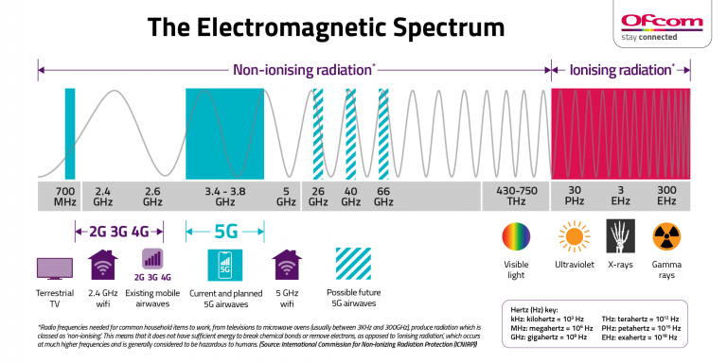
Req 4c.: Digital Data Range
Greater Bandwidth (more data)
Better Transmission (more distance)
1
Notes:
2 minutes for this slide 76:00
[1] With “5G”, cell phones (which are actually radios) now transmit in the 3-4 GHz band, meaning that in each channel they can transmit 3-4 Billion bits of information per second, and they use many channels in there as well! There is a tradeoff however. With higher frequency comes shorter transmission distance. This means there must be more 5G antennas in more places. Most 5G antennas are really tiny however so you are likely surrounded by them in a city and would never know it!

Slide 83
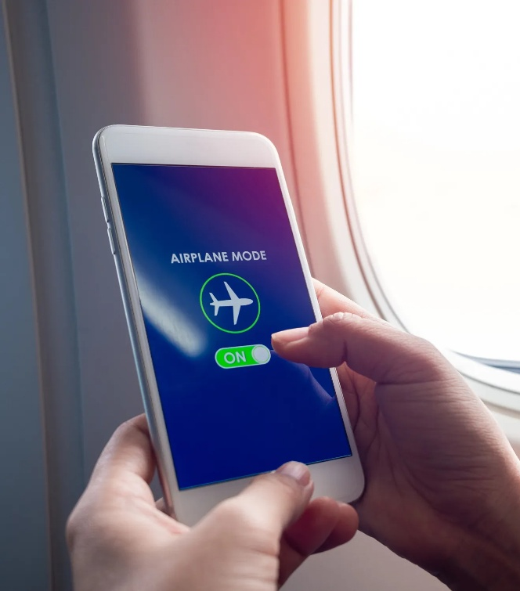

Req. 7b & 7c.: Cell Phone System Information
What is “Airplane Mode” in a cell phone?
How do cell phones know where they are (and what time it is)?
1
Notes:
1 minute for this slide 78:00
[1] Cell systems have an ”airplane mode” where the cellular frequencies that would potentially interfere with aircraft operation are disabled. Both Bluetooth and wifi can still be used in this mode. Cell phones also are radio receivers. They know where they are and what time it is by receiving radio signals from orbiting satellites.
SLIDE END

Slide 84

Req. 7c.: Cell Phone System Information
Time & Position in a cell phone & GPS receiver
1
Notes:
1 minute for this slide 79:00
[1] Cell phones (and other GPS receivers) use the speed of light to determine where they are and what time it is! By measuring the difference in arrival time of signals from several satellites, your cell phone knows where it is and can tell the time accurately to 1 millionth of a second!
SLIDE END

Slide 85

Req. 7e.: Wireless Charging
Can power be delivered via radio waves?
RF Power Demo
1
Notes:
2 minutes for this slide 80:00
[1] You may have already guessed that radio waves carry energy and can transmit power.
Did you know that you can light up a fluorescent bulb with just radio waves, or even charge your phone?
(Instructor uses Tesla Coil to show RF power lighting up fluorescent light bulb)

Slide 86

Req. 7e.: Wireless Charging
What is “wireless charging”?
Standard inductive charging (like Qi) uses lower frequencies
(80–300 kHz) for close-range, high-power charging
1
Notes:
1 minute for this slide 82:00
[1] Wireless charging is actually a radio as well! Induction chargers send out very short-range radio signals that contain a lot of energy through the magnetic field it generates. This alternating magnetic field then generates a current in the battery of your phone and charges it!
SLIDE END

Slide 87

Req. 8a(1).: Amateur Radio Service
AMATEUR
RADIO SERVICE
1
Notes:
1 minute for this slide 83:00
[1] The Federal Communications Commission or “FCC” is the government agency that established the “Amateur Radio Service.”
There are many reasons to have such a service.
Here’s a few:
SLIDE END

Slide 88




Req. 8a.(1): Amateur Radio Service
1
Notes:
1 minutes for this slide 84:00
[1] Amateur Radio does public Service – Community service and disaster help (A Scout does a Good Turn daily – this is another way to do that)
SLIDE END

Slide 89





Req. 8a.(1): Amateur Radio Service
1
Notes:
0 minutes for this slide 85:00
[1] Amateur Radio does International goodwill – A great way to talk to people in other countries.
SLIDE END

Slide 90



Req. 8a.(1): Amateur Radio Service
1
Notes:
1 minute for this slide 85:00
[1] Amateur Radio does Experimentation – Hams have invented many technologies used in places outside of ham radio, including new kinds of software and hardware
SLIDE END

Slide 91

Req. 8a.(1): Amateur Radio Service
Talking with Friends over Radio is Fun!
(And you learn some valuable skills!)
1
Notes:
1 minute for this slide 86:00
[1] Amateur Radio teaches Communication skills – Hams become excellent communicators.
There are many ways to have fun in ham radio. Of course, there’s the basic operating, contacting people all over the United States and the world!
SLIDE END

Slide 92

Req. 8a.(1): Amateur Radio Fun!
Amateur
Radio
Direction
Finding
(ARDF)
“Foxhunting”
Fox Hunt Demo
1
Notes:
2 minutes for this slide 87:00
[1] Foxhunting, another Amateur Radio activity, is known as a “radiosport,” because it requires radio skills, physical fitness, and other Scout skills such as map and compass.
SLIDE END

Slide 93

Req. 8a.(1): Amateur Radio Fun!
AM Sat Demo
1
Notes:
1 minute for this slide 89:00
[1] You could become interested in satellite communication and create your own Earth Station.
SLIDE END

Slide 94

Req. 8a.(1): Amateur Radio Fun!
1
Notes:
0 minutes for this slide 90:00
[1] Sometimes hams can contact astronauts on the International Space Station who are also ham operators!
SLIDE END

Slide 95

Req. 8a.(1): Amateur Radio Fun!
Moonbounce
Earth-Moon-Earth
(EME)
Moon
1
Notes:
0 minutes for this slide 90:00
[1] With something we call “Moonbounce” a signal with the right equipment and antennas can reflect off the moon, travel back to earth and be received by another ham a continent away!
SLIDE END

Slide 96


Req. 8a.(1): Amateur Radio Fun!
Digital
1
Notes:
1 minute for this slide 90:00
[1] Many hams are into digital communication, where software is combined with radio equipment to transmit all types of digital signals around the world. What you see here are various types of modulated signals that are created by the software that drives the transmitter.
SLIDE END

Slide 97


Req. 8a.(1): Amateur Radio Fun!
SOTA
POTA
1
Notes:
1 minute for this slide 91:00
[1] Some hams are big into the outdoors, combining their radio hobby with high adventure. Those involved in “National Parks On The Air” try to visit and operate from as many national parks as possible.
In addition, in “Summits On The Air”, hams will climb to the top of various mountain peaks and operate from the top!
SLIDE END

Slide 98
Req. 8a(2).: Amateur Radio License Differences
Extra
3
General
2
Technician
1
Amateur Radio Licenses
1
Notes:
1 minute for this slide 92:00
[1] There are three amateur radio licenses in the United States:
SLIDE END

Slide 99

Req. 8a(2).: Amateur Radio License Differences
Extra
3
General
2
Technician
Amateur Radio Licenses
1
Notes:
0 minutes for this slide 93:00
[1] The Technician Class license requires you to learn basic operating procedures, understand important radio regulations and learn some basic electronics.
Technician Class license holders are allowed to operate on several bands, with an emphasis on VHF and UHF.
SLIDE END

Slide 100

Req. 8a(2).: Amateur Radio License Differences
Extra
3
General
Technician
Amateur Radio Licenses
1
Notes:
0 minutes for this slide 93:00
[1] General Class license holders need to have an intermediate understanding of practices, regulations and electronics theory. While they can are allowed to use the same bands as Technicians, Generals also get on more of the shortwave bands and communicate all around the world.
SLIDE END

Slide 101

Req. 8a(2).: Amateur Radio License Differences
Extra
General
Technician
Amateur Radio Licenses
1
Notes:
1 minute for this slide 93:00
[1] Extra Class license holders have passed an exam on advanced electronics theory and practices. The have privileges on all bands, and can administer license examinations.
SLIDE END

Slide 102

Req. 8a(2).: Amateur Radio License Differences
Extra
General
Testing
Technician
Amateur Radio Licenses
1
Notes:
1 minute for this slide 94:00
[1] The FCC allows certified volunteers to administer amateur radio license exams. These volunteers are call “Volunteer Examiners” Around here, exams are given at __________________________ (fill in your local exam town).
SLIDE END

Slide 103
Req. 8a.(5): Types of Equipment
TYPES OF
HAM RADIO
EQUIPMENT
1
Notes:
0 minutes for this slide 95:00
[1] Let’s cover some of the names for equipment that is used by ham radio operators.
SLIDE END

Slide 104

Req. 8a.(5): Types of Equipment
Ham Shack (Base Station)
1
Notes:
1 minutes for this slide 95:00
[1] The base station is where a licensed operator typically operates. It is often called the “ham shack”. This is where all the heavy gear is located. Some ham shacks can be very complicated. Others are relatively simple. It only needs one radio to be a base station.
SLIDE END

Slide 105

Req. 8a.(5): Types of Equipment
Base Station Transceiver
1
Notes:
0 minute for this slide 96:00
[1] Many hams use a Base Station Transceiver. This is the main radio we typically are talking and listening on.
SLIDE END

Slide 106


Req. 8a.(5): Types of Equipment
Mobile Transceivers
1
Notes:
1 minutes for this slide 96:00
[1] Many hams use their mobile radios more than anything else! Mobile radios in automobiles can communicate locally, especially through repeaters, but they also can be the kind of radio that will communicate internationally! Of course, some hams might get a little carried away with their mobile stations!
SLIDE END

Slide 107


Req. 8a.(5): Types of Equipment
Handy-Talkie (H-T)
1
Notes:
0 minutes for this slide 97:00
[1] And, most all hams have at least one handheld radio. You might call them a “walkie-talkie” but we call them “H-Ts” for short. This is an abbreviation for “Handy-Talkie”, a term that usually isn’t used much anymore by hams (but we still use the abbreviation!) Ham radio operators often carry their H-Ts with them (just in case)!
SLIDE END

Slide 108

Req. 8a(4).: Emergency Calls
Emergency
Calls
1
Notes:
1 minute for this slide 97:00
[1] We all live in areas where there are different types of risk for major disaster events.
The East coast has its hurricanes.
The West coast has its earthquakes and tsunamis
The middle of the country has its tornadoes
As a ham radio operator, you need to be ready to send an emergency message.
In fact, during catastrophic emergencies like the one we just showed, anyone can use any kind of radio when it’s a life or death situation.
If you are a ham, or even if you aren’t and have access to communications equipment, you would turn on the gear and first listen for what we call “traffic” (people already talking).
SLIDE END

Slide 109
Req. 8a(4).: Emergency Calls
“BREAK-BREAK”
“MAYDAY!”
“EMERGENCY!”
1
Notes:
1 minutes for this slide 98:00
[1] Then you would speak clearly into the microphone and say “Break-Break.” This tells people you likely have an immediate need to make a contact.
The common word used on the radio for “I HAVE AN EMERGENCY” is “MAYDAY”
If you forget the word Mayday, you could just say “Emergency!”
SLIDE END

Slide 110
Req. 8a(4).: Emergency Calls
1
Notes:
0 minutes for this slide 99:00
[1] Ask: What do you think this is?
That’s right. It is the symbols we use when writing Morse Code.
Ask: What do you think it’s saying?
SLIDE END

Slide 111
Req. 8a(4).: Emergency Calls
S
O
S
1
Notes:
1 minutes for this slide 99:00
[1] Good guess! That’s right, it means S-O-S, which is the Morse Code version of the word Mayday.
SLIDE END

Slide 112







Req 9a.: Technical Radio Careers
Careers In Radio
1
Notes:
2 minutes for this slide 100:00
[1] There are some great technical career opportunities in radio. Let’s pick one and talk about the education, training, and experience needed to make it a career!
SLIDE END

Slide 113
Radio
Merit
Badge
1
Notes:
102:00

