Slide 1
Radio
Merit
Badge
Module A
1
Notes:
Cover Slide w/3 minutes instructor intro 00:00
[1] Instructors:
> Introduce self
Name, call, years licensed
Ham radio interests
> Describe how this course will work
90 minute class
Station visit/operations
Less than a 120 minute class
> Hand out and describe how notes forms are to be used

Slide 2
Req. 1.: What is Radio?
S
A
B
1
2
3
4
5
6
7
Notes:
2 minutes for this slide 03:00
[7] Ask: Have you ever looked closely at the Radio Merit Badge itself?
There are strange little markings around the top of the merit badge, above the “lightning bolts”
[6] The first little group is a dash followed by three dots.
[5] In Morse Code, that’s the letter “B”
[4] The second group is three dots
[3] The letter “S”
[2] Can you guess what the third is?
[1] A dot and a dash for the letter “A”
“BSA”
Morse Code was the first kind of message sent by man using radio waves.
REQUIREMENT 1 END

Slide 3
Req. 1.: What is Radio?
What is
Radio?
1
Notes:
1 minute for this slide 05:00
What exactly is “radio?”
SLIDE END

Slide 4
Req. 1.: What is Radio?
Radio?
Communication system, using electromagnetic waves
Wireless
“Off The Grid”
2
1
Notes:
1 minute for this slide 06:00
[2] A technical way of describing radio is that it’s a system to communicate, using electromagnetic waves. But that’s kind of a GEEK response!
[1] Many refer to radio as “Wireless”, which it is… Some will say ham radio is “off the grid”, meaning that with only a generator, a radio and an antenna, we don’t need cell towers, power or telephone lines to communicate.
SLIDE END

Slide 5
Req. 1.: What is Radio?
Radio?
1
Notes:
1 minute for this slide 07:00
[1] How many have used one of these? Is it a “radio?” It is wireless, that’s for sure. But in order for it to communicate, it needs the rest of the system, including computers and telephone wires to interconnect the cell phone towers. But there is definitely a part of it that is “radio.” And most of you use it every day!
SLIDE END

Slide 6
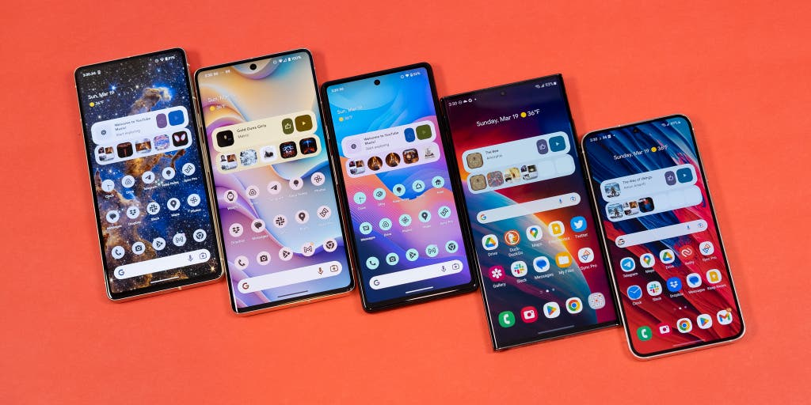
Req. 1.: What is Radio?
?
1
Notes:
1 minute for this slide 08:00
[1] How many radios are in your cell phone?
SLIDE END

Slide 7
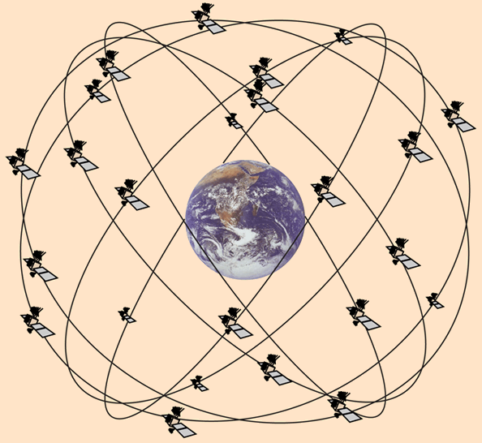
Req. 1.: What is Radio?
6
2
3
4
1
5
1
Notes:
1 minute for this slide 09:00
[1] There are 5 or 6 radios in a modern cell phone, depending on who made it. Cellular service, wifi, Bluetooth, GPS, Near field Communications for things like Apple Pay and Android Pay, and some cell phones still have a Broadcast FM radio receiver.
SLIDE END

Slide 8
Req. 1.: What is Radio?
Lot’s of things
we use every day
could be considered
forms of radio…
1
2
3
4
5
6
1
Notes:
1 minute for this slide 10:00
[1] Many everyday items are actually radios in disguise! Can you think of some?
SLIDE END

Slide 9
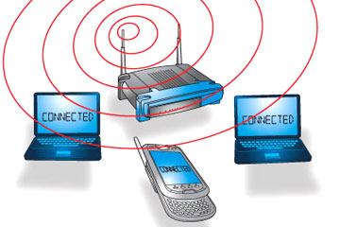
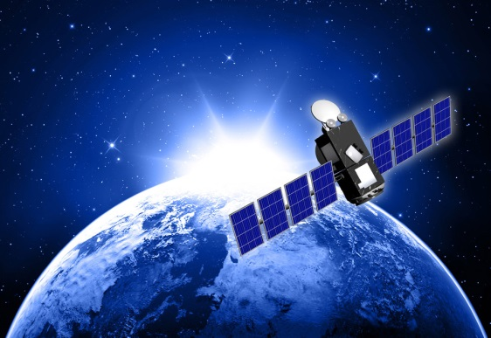
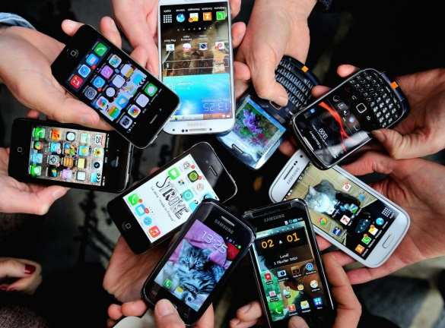
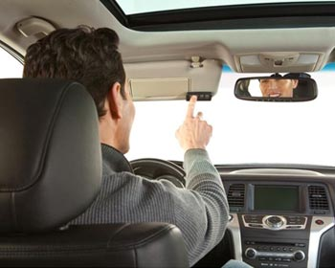
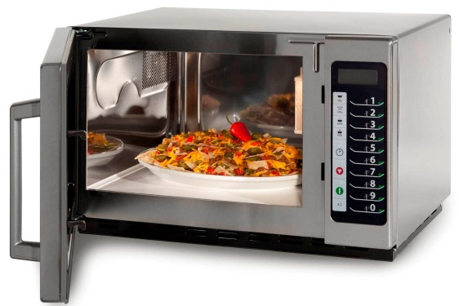
Req. 1.: What is Radio?
1
2
3
4
5
6
Notes:
2 minutes for this slide 11:00
[6] Today we get our entertainment, news and other information over the Internet. The Internet usually makes it to our devices through radio using WiFi
[5] In addition to WiFi, we get information via satellite, another radio method that is very strong.
But radio isn’t just entertainment and information.
[4] We use radio when we operate our mobile phones.
[3] We use radio when we open the garage door remotely.
[2] We use radio when we heat something in the microwave oven.
[1] We even use radio when the EZPass in our car communicates with the gate to charge us the toll and let us through.
SLIDE END

Slide 10
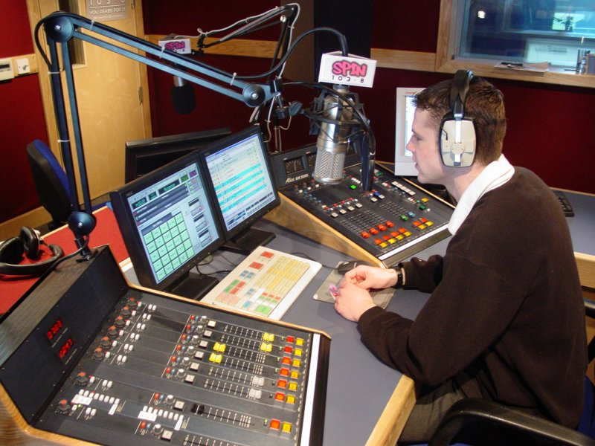
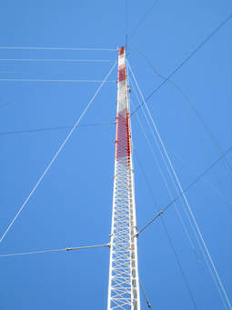
Req. 1.a.: Broadcast Radio
1
2
Notes:
One minute for this slide 13:00
[2] Broadcast radio used to be a major entertainment source before the Internet. Today there are still many good music radio stations, but there are a huge number of talk radio stations such as ESPN.
Usually, a broadcast radio station has one or more studios like this one, with large “boards” (the equipment with all the buttons and knobs) and of course, computers.
[1] Broadcast stations also use large antenna towers like this one, to make sure their signal can reach as many of their intended audience as possible. When there is a hill or small mountain nearby a populated area, you’ll see one or more of these!
SLIDE END

Slide 11
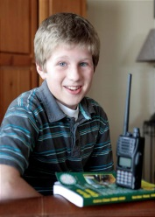
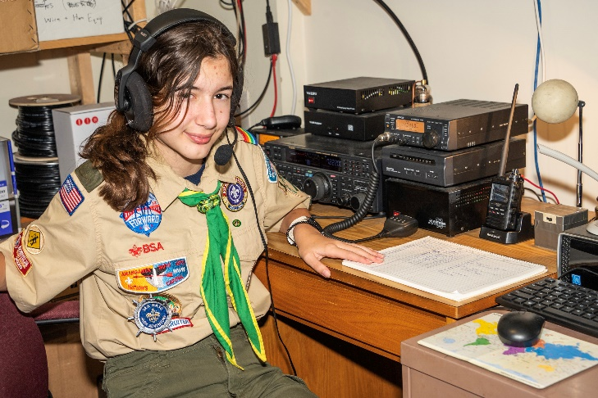
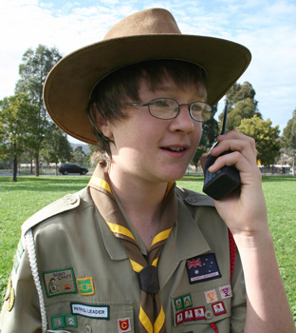
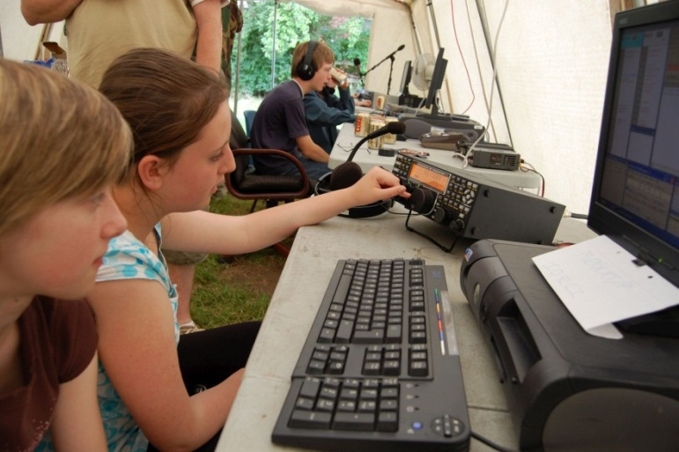
Req. 1.a.: Hobby Radio
1
Notes:
1 minute for this slide 14:00
[1] Radio as a hobby is very popular.
Probably the single biggest group of hobby radio people is with ham radio operators
There is no minimum age; every one of you in this class could get an amateur radio license.
SLIDE END

Slide 12
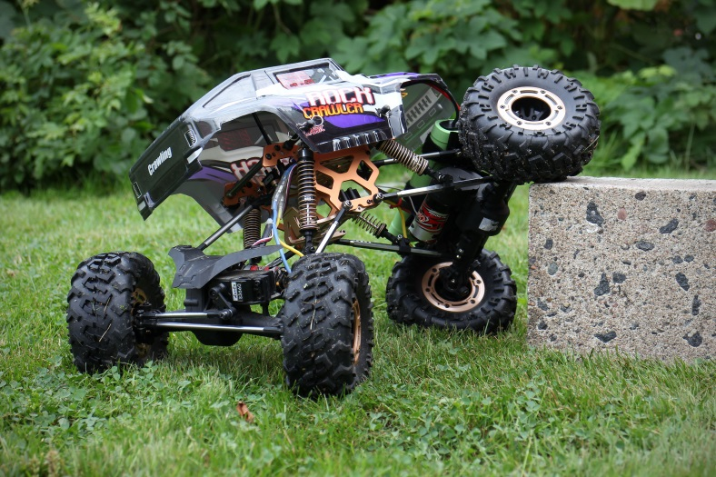
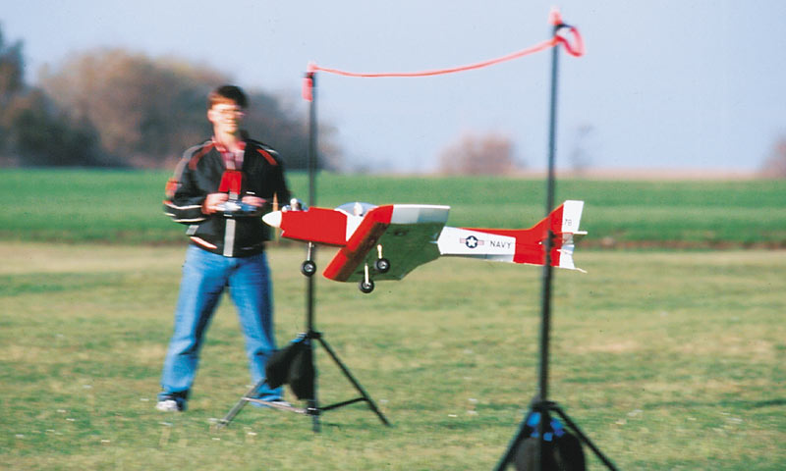
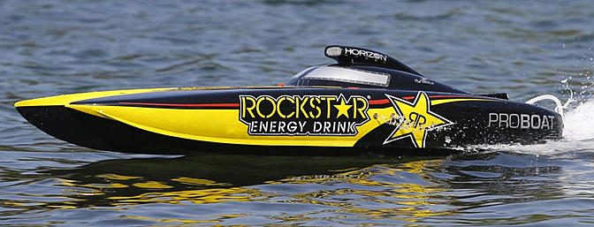
Req. 1.a.: Hobby Radio
1
Notes:
1 minute for this slide and next two 15:00
[1] Another type of hobby radio is Radio Control of cars, boats and airplanes.
SLIDE END

Slide 13
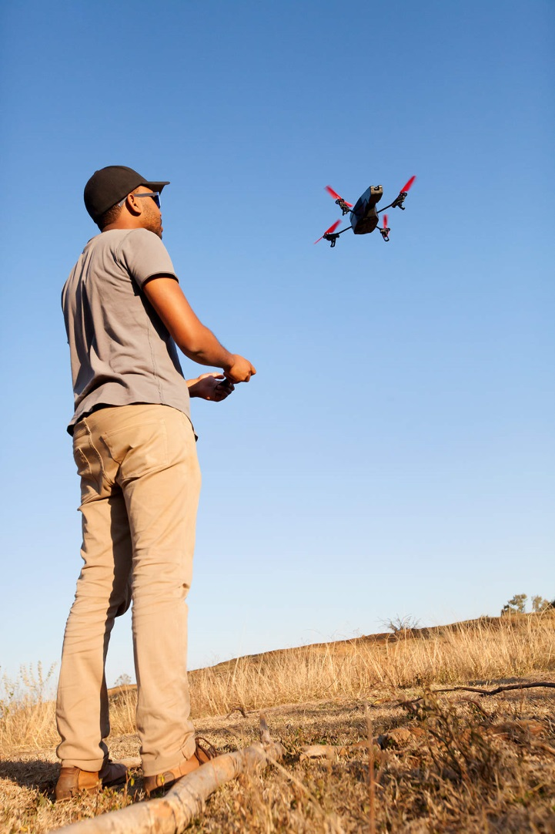
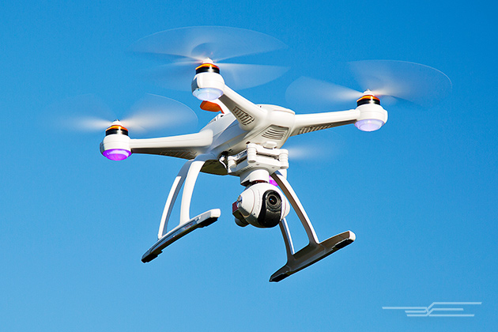
Req. 1.a.: Hobby Radio
1
Notes:
1 minute for this slide and next one 15:00
[1] These days, drones are becoming a very popular radio controlled device
SLIDE END

Slide 14
Req. 1.a.: Hobby Radio
1
Notes:
1 minute for this slide and last two 15:00
[1] Citizens Band radio is used by many truckers.
SLIDE END

Slide 15
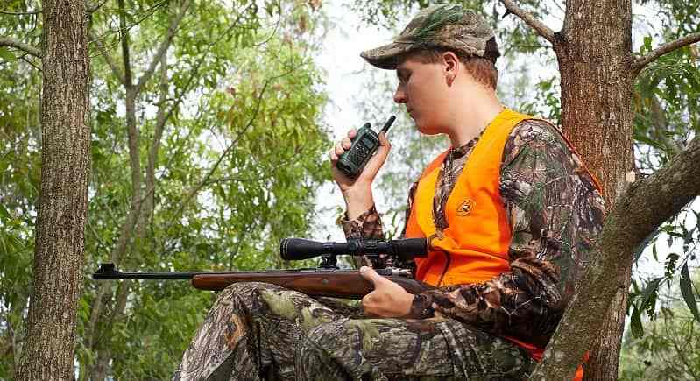
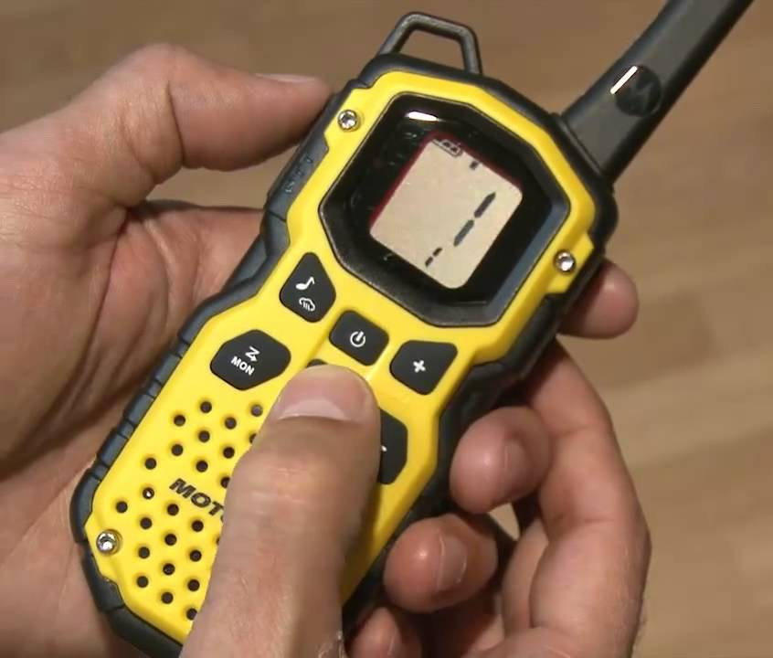
Req. 1.a.: Hobby Radio
1
Notes:
1 minute for this slide 16:00
[1] Many like to use Family Radio Service (FRS) radios when they need to communicate wirelessly such as during hunting.
SLIDE END

Slide 16
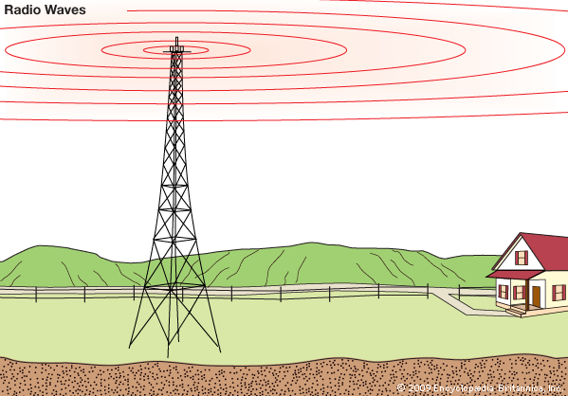
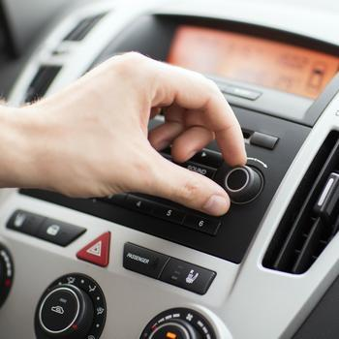
Req. 1.b.: Broadcasting vs. Two-Way Radio
1
Notes:
1 minute for this slide 17:00
[1] Broadcasting is one-way communication.
Usually you can spot a broadcasting antenna; it’s very tall and such antennas are usually located near large population areas.
Everyone can listen-in on their radio to the programming.
Broadcasting is usually operated as a business, where advertisers pay to have their products/services advertised over the air waves.
Two-Way Communication is just that; it’s NOT one-way broadcasting; there are always two (or more) involved
SLIDE END

Slide 17
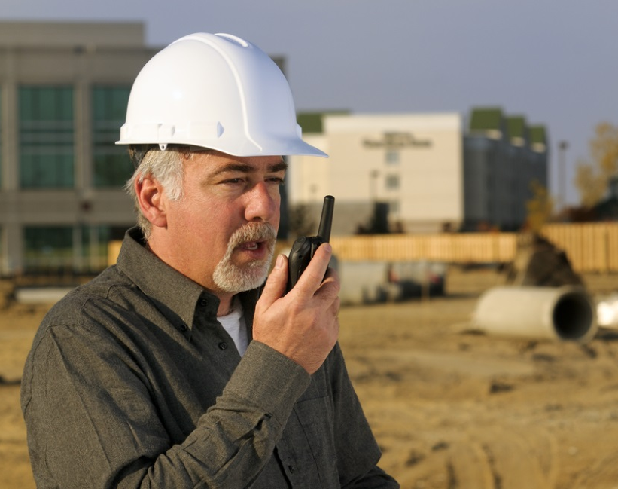
Req. 1.b.: Broadcasting vs. Two-Way Radio
1
Notes:
1 minute for this slide 18:00
[1] Businesses use two-way communication to be more efficient.
SLIDE END

Slide 18
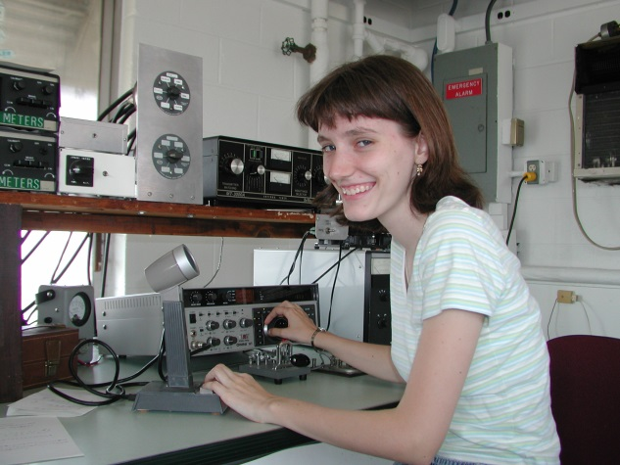
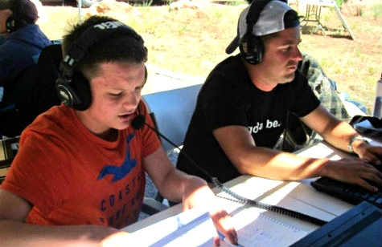
Req. 1.b.: Broadcasting vs. Two-Way Radio
1
Notes:
1 minute for this slide 19:00
[1] Ham radio operators use two-way communication in emergencies, when experimenting with equipment and antennas, and mostly for fun!
SLIDE END

Slide 19
Req. 1.c.: Call Signs
Call Signs
1
Notes:
0 minutes for this slide 20:00
[1] Call signs are a unique identification for a licensed radio station.
SLIDE END

Slide 20
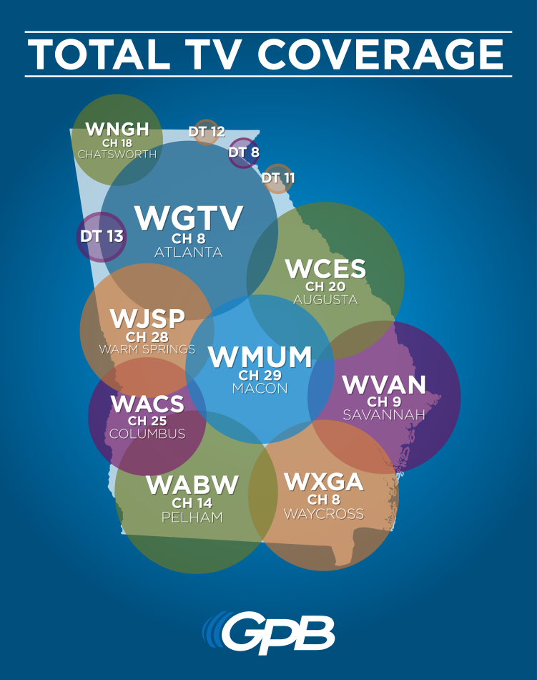
Req. 1.c.: Call Signs
1
2
Notes:
1 minute for this slide 20:00
[2] Broadcast radio station call signs are three or four letters such as the FM station above and the television broadcasting stations on the right.
Cable television does not use call signs because their signal does not travel over the airwaves
[1] U.S. Amateur radio station call signs are letters and a number such as the one shown above
SLIDE END

Slide 21
Req. 1.c.: Call Signs
K2GW
K2GW
AA - AL
K
KA - KZ
N
NA - NZ
W
WA - WZ
AD4UM
AD4UM
N7QR
N7QR
WB8AXP
WB8AXP
2
1
Notes:
2 minutes for this slide 21:00
[2] Every licensed ham radio operator is assigned a unique call sign.
[1] All U.S. ham radio operators have call signs beginning with AA-AL, K, N or W
SLIDE END

Slide 22
Req. 1.c.: Call Signs
K2GW
AD4UM
0 - 9
N7QR
WB8AXP
1
Notes:
1 minute for this slide 23:00
[1] Each U.S. ham radio operator also has a single number in their call letters, 0-9
SLIDE END

Slide 23
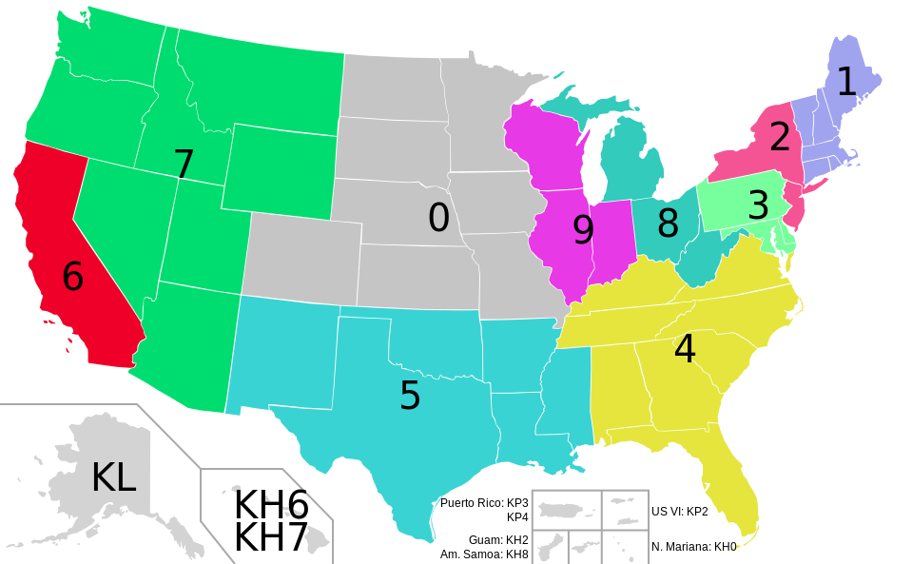
Req. 1.c.: Call Signs
1
Notes:
1 minute for this slide 24:00
[1] The number in our call shows the call sign district where our first license was granted.
(If you move to another district, you keep the same number. You can’t be sure anymore that a person with a certain district number actually lives in that district…) If each one of you passed the requirements for your ham radio license where you lived right now, what would the number be in your call?
SLIDE END

Slide 24
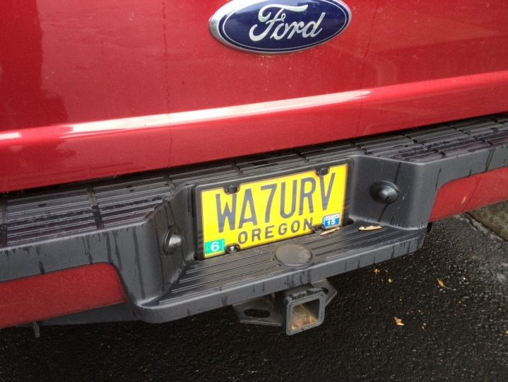
Req. 1.c.: Call Signs
Create Your Own Imaginary Call Sign!
1
Notes:
0 minutes for this slide 25:00
[1] It is very common for ham radio operators to have a custom license plate made for their vehicle, like this one.
SLIDE END

Slide 25
Req. 1.c.: Call Signs
Create Your Own Imaginary Call Sign!
1
Notes:
1 minute for this slide 25:00
[1] <Create Your Imaginary Call Sign>
Pick K, N, or W, a number, and add your initials
SLIDE END

Slide 26
Req. 1.c.: Call Signs
Global Call Signs
1
Notes:
1 minute for this slide 26:00
[1] There are 308 entities in the world with unique first letters or combinations of letters and numbers in radio call signs called “prefixes”. (Many countries have multiple entities, such as the U.S. with Guam, Puerto Rico, etc.)
SLIDE END

Slide 27
Req. 1.c.: Call Signs
Global Call Signs
5R8UI
1
Notes:
0 minute for this slide 27:00
[1] If I’m operating in my radio station and come across the call letters “5R8UI”, I know that other ham is licensed in Madagascar.
SLIDE END

Slide 28
Req. 1.c.: Call Signs
Global Call Signs
5R8UI
PW8S
1
Notes:
0 minutes for this slide 27:00
[1] If I contact someone with call letters “PW8S,” I know they are licensed in Brazil.
As a ham radio operator, my heart starts beating hard when I make a contact with a another ham from one of these faraway places!
SLIDE END

Slide 29
Req. 1.d.: Phonetic Alphabet
Phonetic
Alphabet
1
Notes:
1 minute for this slide 27:00
[1] Many letters sound similar over the radio.
Weak radio signals and noise might make it difficult to hear voices.

Slide 30
Req. 1.d.: Phonetic Alphabet
C
E
B
D
G
T
V
P
Z
Phil
Bill
1
1
2
Notes:
1 minute for this slide 28:00
[2] The letters B, C, D, E, G, P, T, V or Z might sound the same.
[1] A guy who gives his name “Phil” during a radio transmission is often mistaken for the name “Bill”
An operator for whom English is not a native language may pronounce letters differently, too.

Slide 31
Req. 1.d.: Phonetic Alphabet
A
lfa
H
otel
O
scar
V
ictor
B
ravo
I
P
W
ndia
apa
hiskey
C
harlie
J
Q
uebec
X
-ray
uliett
D
elta
K
ilo
R
omeo
Y
ankee
E
cho
L
ima
S
ierra
Z
ulu
F
oxtrot
M
T
ike
ango
G
olf
N
ovember
U
niform
1
Notes:
1 minute for this slide 29:00
[1] Radio operators use a standardized phonetic alphabet to improve understanding and avoid communication errors.
<Instructor give his own example> Now each of you speak the call you made a couple minutes ago, using the phonetic alphabet words instead of just saying the letters.
SLIDE END

Slide 32
Req. 4.: How Radio Waves Carry Information
How Radio Waves
Carry Information
1
Notes:
1 minutes for this slide 30:00
[1] Radio is about a lot of things, “radio waves” being an extremely important part. There are all sorts of radio waves.
SLIDE END

Slide 33
Req. 4.: How Radio Waves Carry Information
1
Notes:
0 minutes for this slide 31:00
[1] We often compare radio waves with the ripples in water caused by a thrown rock.
SLIDE END

Slide 34
Req. 4.: How Radio Waves Carry Information
ANTENNA
1
2
Notes:
1 minute for this slide 31:00
[2] Instead of throwing a rock, radio waves are somehow thrown by some sort of antenna.
[1] Waves of many different types will start at the antenna and travel in many directions for long distances, sometimes around the world.
We’re pretty sure they don’t look like the waves shown here, but at least you get the idea.
And these waves are all around us, right here where we’re sitting. Your mobile phones are receiving (and sending) radio waves all the time. The radio waves from Amateur Radio antennas are much stronger up high at the point where the radio waves “shoot” off the antenna.
SLIDE END

Slide 35
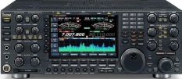
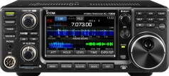
Req. 4.: How Radio Waves Carry Information
United States
Europe
Receiving
Antenna
Transmitting
Antenna
Voice
Into
Microphone
Radio
Transmitter
Radio
Receiver
Loud
Speaker
1
2
3
4
5
6
7
8
9
Notes:
4 minutes for this slide 32:00
[9] Radio uses transmitters to generate energy waves and a radio receivers to detect them and make them useful
[8] There can be tens, hundreds or thousands of miles between a transmitter and receiver, across the city, county, country or WORLD (or SPACE!)
[7] Transmitters must be connected to an antenna to send out the waves
[6] Receivers must also have some sort of antenna to collect the waves
[5] These energy waves are generated when some sort of signal (like a voice into a microphone) is presented to a radio transmitter
[4] The transmitter converts the voice (in this example) to radio wave energy and sends this energy up to the antenna
[3] The antenna throws-off the waves in directions and distances based on how the system is designed
[2] The transmitted energy waves are collected by any receiving antenna designed to detect them, and sends the radio wave energy down to the receiver.
[1] The radio receiver processes the energy waves and converts them into audio that you can hear either through a speaker or headphones
Many radio receivers can be directly connected to a computer where the signal is digitized.
SLIDE END

Slide 36
Req. 2.a.: Introduction to How Radio Waves Travel
How
Radio Waves
Travel
1
Notes:
1 minute for this slide 36:00
[1] Some people think the whole idea of “radio waves” is magic! What do you think?
SLIDE END

Slide 37
Req. 2.a.: Introduction to How Radio Waves Travel
186,000 miles per second!
1
2
3
4
Notes:
1 minute for this slide 37:00
[4] Even though we can’t really “see” radio waves, we often show them as a series of ripple lines like this.
[3] Radio waves actually move.
[2] They move at the speed of light!
Ask: How fast is “the speed of light”?
[1] <186,000 mi/second> or <approx. 300,000,000 meters/second>
SLIDE END

Slide 38
Req. 2.a.: Introduction to How Radio Waves Travel
EARTH
1
Notes:
1 minute for this slide 38:00
[1] The simplest for of radio wave travel is called “line of sight.” You’ll learn later that radio waves called “Very High Frequency” (and higher) depend pretty much on line of sight.
As shown here, someone transmitting radio waves from their location to yours is simply a matter of sending the signal straight across.
Have them draw this image on their work sheet!
SLIDE END

Slide 39
Req. 2.a.: Introduction to How Radio Waves Travel
EARTH
1
Notes:
1 minute for this slide 39:00
[1] This works well unless there is something in the way of the line-of-sight signal, such as a small mountain.
SLIDE END

Slide 40
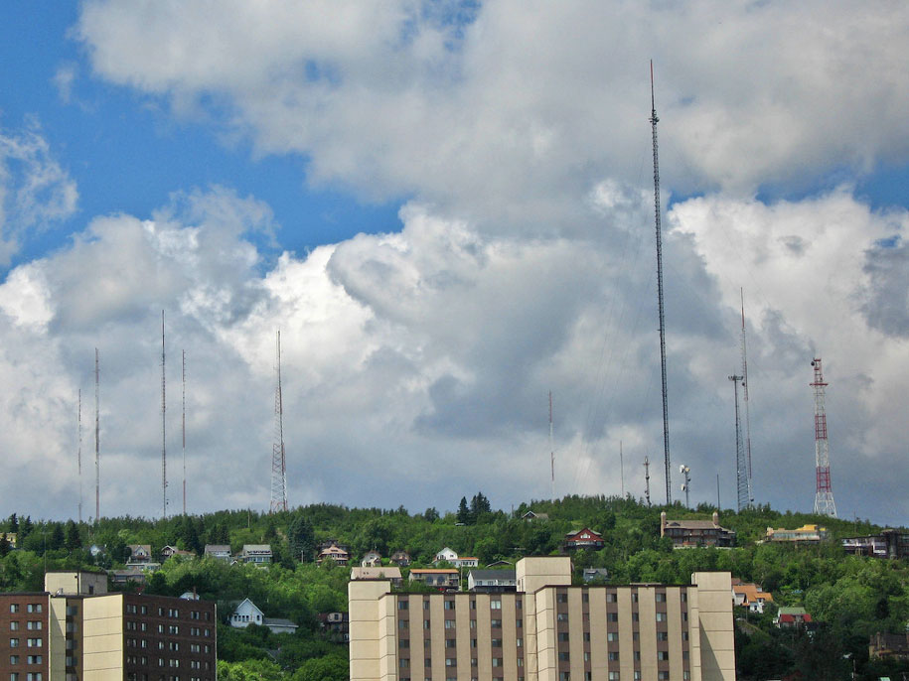
Req. 2.a.: Introduction to How Radio Waves Travel
EARTH
1
Notes:
0 minutes for this slide 40:00
[1] That’s why you’ll often see antennas on hilltops so that their line-of-sight signal will travel farther!
SLIDE END

Slide 41
Req. 2.a.: How Radio Waves Travel
EARTH
1
Notes:
1 minute for this slide 40:00
[1] Even if there are no mountains in the way of you line-of-sight signal the curve of the earth will eventually make it impossible for the signal to reach someone far enough around the curve! Line-of-sight signals can “bend” a little, but not for long distances.
That’s where other forms of wireless radio come into play.
SLIDE END

Slide 42
Req. 2.a.: How Radio Waves Travel
IONOSPHERE
2ND HOP
CHICAGO
DENVER
SKIP ZONE
SAN
FRANCISCO
GROUND
WAVES
2ND SKIP ZONE
SKIP
DISTANCE
2ND HOP
SKIP DISTANCE
NEW YORK CITY
EARTH
1
13
15
16
14
2
3
5
12
10
6
9
7
4
11
8
Notes:
5 minutes for this slide 41:00
[16] Consider four cities lying along the curvature of the earth, San Francisco, Denver, Chicago and New York City. We’ve already talked about line-of-sight radio waves, and we know they pretty much can’t follow the curve of the earth.
[15] Even some transmitters designed to send radio waves around the earth will throw off ground waves that won’t go very far.
[14] This is where the Ionosphere comes in. The Ionosphere is an interesting invisible cloud of charged particles that surrounds the earth. This is one of the most interesting parts of radio because it has many effects on radio waves.
[13] If I’m in San Francisco, my transmitter and antenna will throw off radio waves at an angle up into the sky.
[12] When my signal enters the Ionosphere, the radio waves bend back down toward the earth as if they were being reflected off a mirror. While the Ionosphere isn’t exactly a mirror, it has a similar effect. My radio waves come back down to earth at approximately the same angle they entered the Ionosphere, and can be detected by someone listening on my frequency near where the waves get close to the ground.
[11] We call this reflection off the Ionosphere “skip” and the total up and down distance is called “skip distance”
[10] What about the people in Denver? People listening on my frequency cannot hear my signal because it has “skipped” over them! We call this area where a signal skips over the “skip zone.”
[9] After the first skip of my signal, it will reflect off the earth and head back out towards the Ionosphere. It will then reflect again off the Ionosphere, heading back down to earth. Here we show that it hits somewhere near New York City, where someone may be listening in.
[8] We call this the “2nd hop” (or 2nd skip) of my signal. My signal has gone all the way from San Francisco to New York City; not possible with line-of-site or ground waves.
[7] And with a second hop, there is a second skip zone. In the case no one in Chicago will hear my signal because it’s travelling too high for their antennas to detect!
[6] The total of both hops is called the “2nd hop skip distance”
There are two other interesting things that can happen with skip:
[5] Let’s say I position my antenna in such a way as to lower the angle my radio waves travel to the ionosphere.
[4] They will reflect back down at that lower angle, making them go much farther like I’m showing here. Now my first skip hop got my signal all the way to Chicago, while on the first try, it didn’t quite go as far.
[3] And on the 2nd hop, this signal travels over New York City to someplace in the Atlantic Ocean (maybe a tropical island?).
[2] Finally, I might position my antenna so that radio waves angle up too sharply.
[1] They will deflect a bit, but they’ll end up going right through the ionosphere into space; no one will hear them (except an alien or possibly an astronaut or satellite!)
SLIDE END

Slide 43
Req. 2.a.: How Radio Waves Travel
EARTH
1
2
3
Notes:
1 minute for this slide 46:00
[3] Now let’s look at what really is amazing…
[2] This skip effect can take a radio wave signal all the way around the other side of earth!
[1] What’s really crazy, signals can sometimes skip their way completely around the earth, and I’m able to hear my own signal!
If the instructor has time: At 186,000 miles per second, how long does it take my signal to make one run around the earth? (25,000/186,000 = .134 seconds; a little more than a tenth of a second.
In our illustration here, it would take about .065 seconds to travel half way around the world!.
SLIDE END

Slide 44
Req. 2.a.: How Radio Waves Travel
EARTH
Finish
Drawing!
1
Notes:
0 min for this slide 47:00
[1] Now finish your drawings for Requirement 2a.
SLIDE END

Slide 45
Req. 2.b.: WWV and WWVH
Precise Time & Radio
1
Notes:
0 min for this slide 47:00
[1] What do we think radio has to do with precision timekeeping?
SLIDE END

Slide 46
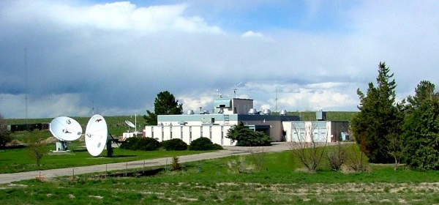
Req. 2.b.: WWV and WWVH
WWV
1
Notes:
1 minute for this slide 47:00
[1] What exactly is “WWV?” WWV is the call sign of the United States National Institute of Standards and Technology's (NIST) radio station near Fort Collins, Colorado.
SLIDE END

Slide 47
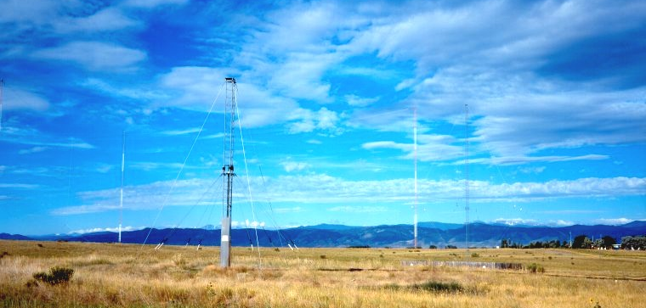
Req. 2.b.: WWV and WWVH
WWV
1
Notes:
1 minutes for this slide 48:00
[1] WWV uses high performance antennas to continuously transmit its signal, and can be heard all over the world!
They transmit simultaneously on several frequencies. Their frequencies and time signals are controlled by atomic clocks located in Boulder, Colorado.
SLIDE END

Slide 48
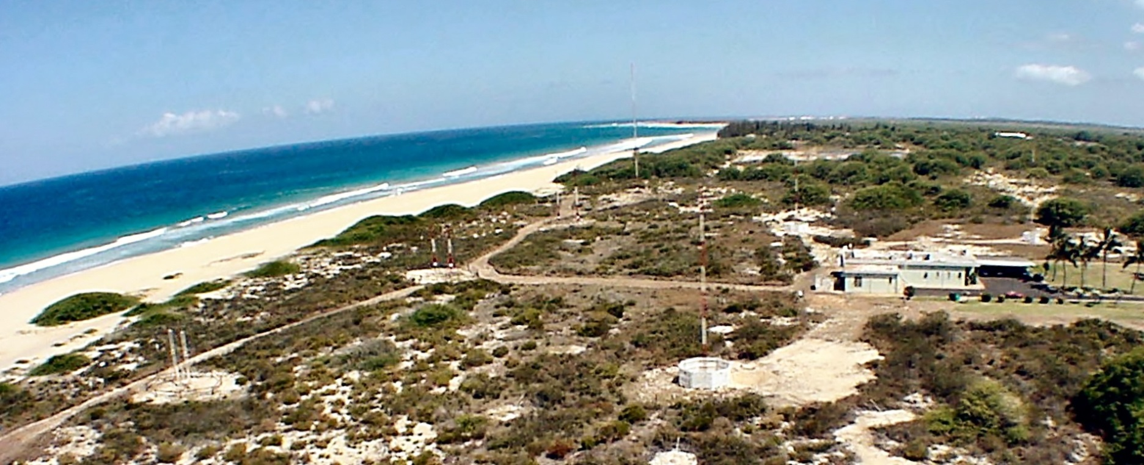
Req. 2.b.: WWV and WWVH
WWVH
1
Notes:
1 minute for this slide 49:00
[1] NIST also operates the very similar radio station WWVH in Kauai, Hawaii, using the same frequencies.
WWV and WWVH make recorded announcements; since they share frequencies, WWV uses a male voice to distinguish itself from WWVH, which uses a female voice.
They also make other recorded announcements of general interest, e.g., the GPS satellite constellation status and severe oceanic weather warnings. By listening to WWV and WWVH we can determine what the ionosphere is doing and how radio waves will propagate off of it.
SLIDE END

Slide 49
Req. 2.b.: WWV and WWVH
<Click for WWV audio>
1
Notes:
1 minute for this slide 50:00
[1] Instructor: In presentation mode, simply click on speaker icon.
It is helpful to have external speakers for this audio
SLIDE END

Slide 50
Req. 2.c.: DX
1
2
1
Notes:
1 minute for this slide 51:00
[1] Ask: Can you guess what the abbreviation “DX” means?
SLIDE END

Slide 51
Req. 2.c.: DX
= “DISTANCE”
1
Notes:
0 minutes for this slide 52:00
[1] DX is shorthand for "distance."
There’s no exact amount of distance defined for DX, but we say DX communication is over great distances using the ionosphere to refract the transmitted radio signal.
DXing is the pursuit of distant stations with the goal of earning various awards.
SLIDE END

Slide 52
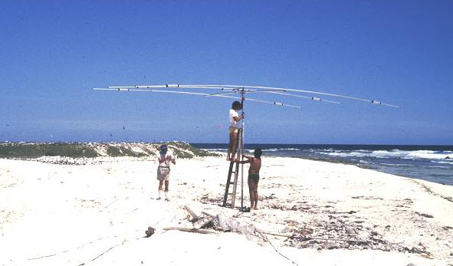
Req. 2.c.: DX
DXpedition
= “DISTANCE”
1
Notes:
1 minutes for this slide 52:00
[1] A DXpedition is a trip to operate in a rare DXCC entity, such as one to Scarborough Reef in the South China Sea.
SLIDE END

Slide 53
Req. 2.d. ITU/FCC
ITU?
FCC?
1
Notes:
1 minute for this slide 53:00
[1] Because radio has no boundaries (radio waves don’t stop at borders), the countries of the free world get together and make formal agreements on how radio should be used.
It is up to each country to create their own laws which ensure they abide by the international agreements.
An formal international group has been created to coordinate the agreements between countries.
SLIDE END

Slide 54
Req. 2.d. ITU/FCC
International
Telecommunication Union
Federal
Communications Commission
International
Treaty
United States
Radio Law
2
Notes:
2 minutes for this slide 54:00
[2] This international group is called the International Telecommunications Union (or “ITU”). The ITU coordinates the agreements in the form of treaties between countries and has headquarters in Geneva, Switzerland.
[1] The agency in the U.S. government which creates and enforces law to help us fulfill the international treaties is called the Federal Communications Commission (FCC).
Nearly all who transmit radio signals for any purpose are required to be registered and licensed by the FCC.
The FCC is the agency that assigns those call signs we talked about earlier in Requirement 1c.
REQUIREMENT 2 END

Slide 55
Req. 6: Electrical Safety
Safety!
1
Notes:
1 minute for this slide 56:00
[1] We need to discuss a topic very important to all ham radio operators: Safety! In radio, safety requires a lot of understanding. We won’t have enough time to really get into this here, but let’s cover the most important things to think about:
SLIDE END

Slide 56
Req. 6: Electrical Safety
1
Notes:
0 minutes for this slide 57:00
[1] The part of our body that is most affected by electricity is our heart.
SLIDE END

Slide 57
Req. 6: Electrical Safety
120 volts AC
1
Notes:
1 minutes for this slide 57:00
[1] If we come in contact with the same 120 volts AC you find in your house the electricity will look for a direct path to ground.
SLIDE END

Slide 58
Req. 6: Electrical Safety
120 volts AC
1
Notes:
0 minutes for this slide 57:00
[1] If it’s a really good ground like a puddle of water, there will be a really strong path for electricity, and that path might travel right through your heart!
SLIDE END

Slide 59
Req. 6: Electrical Safety
120 volts AC
0-5 mA
Safe values
0-1 mA
No sensation
1
Notes:
1 minute for this slide 57:00
[1] If only 1/1000 of an amp (1 milliamp) flows through your body when you contact 120 volts, you probably won’t feel it.
Up to 5 milliamps of current flow at 120 volts is considered safe.
SLIDE END

Slide 60
Req. 6: Electrical Safety
1000mA
Can electrocute 20 adults
120 volts AC
50mA
Heart convulsions usually fatal
15-20 mA
Painful shock – inability to let go
0-5 mA
Safe values
0-1 mA
No sensation
1
Notes:
1 minute for this slide 58:00
[1] If you touch 120 volts and 15-20 milliamps flow through your body, it will be a very painful shock; you may not be able to let go because your muscles will be contracted.
At 50 milliamps, your heart will convulse and you will usually die from electrocution.
At 1000 milliamps (1 amp) can electrocute 20 adults at the same time!
SLIDE END

Slide 61
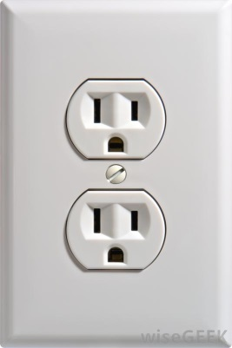
Req. 6: Electrical Safety
1000mA
Can electrocute 20 adults
120 volts AC
15,000 mA
Heart convulsions usually fatal
50mA
15-20 mA
Painful shock – inability to let go
0-5 mA
Safe values
0-1 mA
No sensation
1
Notes:
1 minute for this slide 59:00
[1] Hopefully, you’ll have respect for a simple home electrical outlet that can deliver 15,000 milliamps or more!
SLIDE END

Slide 62
Req. 6: Electrical Safety Rules
Safety
Rules!
1
Notes:
1 minute for this slide 60:00
[1] There are some basic common sense rules when working around electricity, whether it has to do with radio or not. (The title of this section is “Safety Rules!” You could consider it as saying “safety does rule!”)
SLIDE END

Slide 63
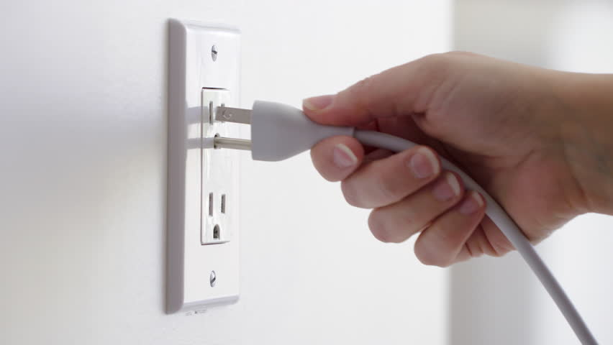
Req. 6: Electrical Safety Rules
1
Notes:
1 minute for this slide 61:00
[1] Whenever you’re working on radio equipment, unplug the equipment first. Leave the “hot” service work to someone who knows good safety practices for doing that work! Unless you know the special precautions necessary when working on energized equipment, don’t do it! Equipment should be turned-off and unplugged when you work on it.
SLIDE END

Slide 64
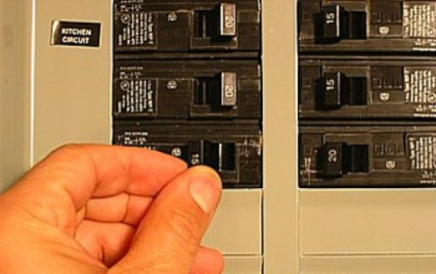
Req. 6: Electrical Safety Rules
1
Notes:
1 minutes for this slide 62:00
[1] Sometimes it may be necessary to turn the power off at the circuit breaker box. Don’t hesitate to do that, making sure it’s OK with other family members. And never let anyone else turn the power off or on for you. You need to always confirm with your eyes the status of an electric circuit!
SLIDE END

Slide 65
Req. 6: Electrical Safety Rules
1
Notes:
0 minutes for this slide 63:00
[1] Just like you aren’t very effective doing homework when you’re tired, you are not safe working with electricity when you’re tired. Don’t do it!
SLIDE END

Slide 66
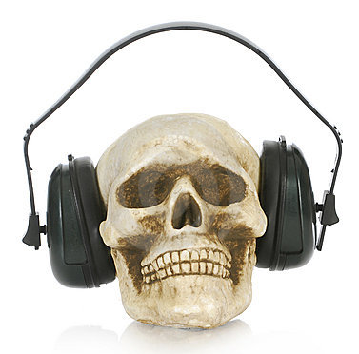
Req. 6: Electrical Safety Rules
1
Notes:
0 minutes for this slide 63:00
[1] Never wear headphones when repairing equipment. They could create a ground path for electricity to travel right through your head!
SLIDE END

Slide 67
Req. 6: Electrical Safety Rules
3
2
1
1
Notes:
2 minutes for this slide 63:00
[3] Here we show a guy using both hands while working on something involving electricity.
[2] If the surfaces provide a path to ground, the shortest path will be through his chest and heart – not a good thing.
[1] If instead, he puts one hand in his pocket, the shortest path to ground will be down the side of his body, through his leg and then to ground. This can be a very bad shock; it might even knock him out, but it may not kill him. Having electricity go through your chest creates a likely scenario for death.
SLIDE END

Slide 68
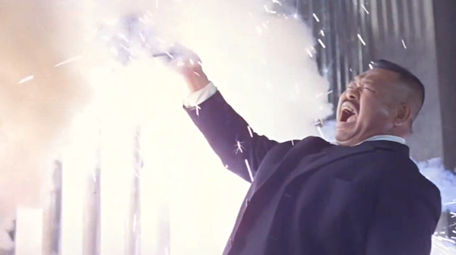
Req. 6: Electrical Safety Rules
1
Notes:
0 minutes for this slide 65:00
[1] Be careful with electricity; death is permanent.
SLIDE END

Slide 69
Req. 6: Electrical Grounding Safety
Grounding
1
Notes:
1 minute for this slide 65:00
[1] One of the most important safety features of your home ham shack is how the station is properly grounded. Being “grounded” may have meant only one thing to you up to this point. Now it means something a lot better and safer!
SLIDE END

Slide 70
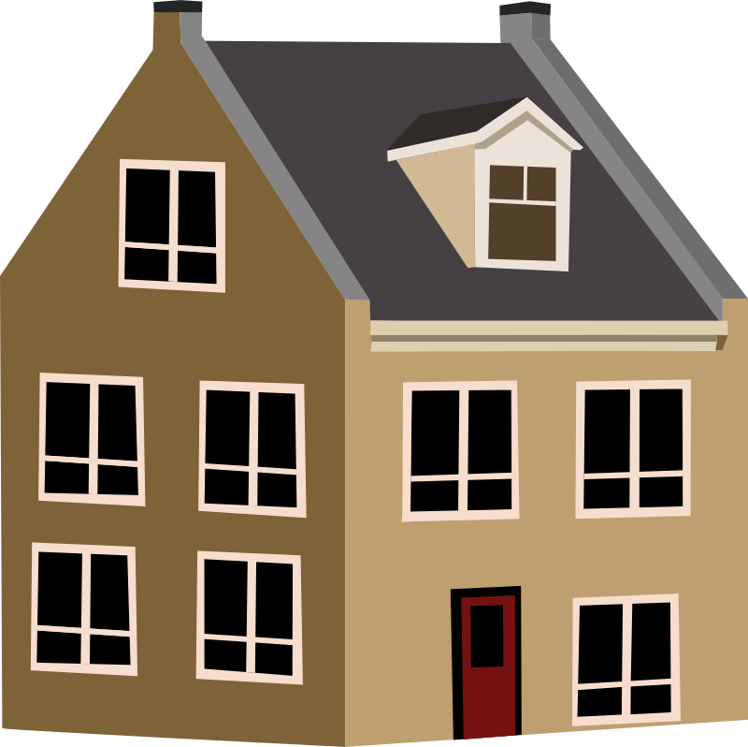
Req. 6: Electrical Grounding Safety
120/
240v
Earth
Ground
1
Notes:
2 minutes for this slide 66:00
[1] One of the most important safety features of your home ham shack is how the station is properly grounded. Being “grounded” may have meant only one thing to you up to this point. Now it means something a lot better and safer!
Let’s look at how grounding occurs in your home.
There is a heavy duty wire connected between a transformer and your home. This wire carries 120/240 volts.
It also carries a ground wire that is connected to Earth ground near the pole or the underground transformer.
SLIDE END

Slide 71
Req. 6: Electrical Grounding Safety
120/
240v
Earth
Ground
Earth
Ground
5
Notes:
1 minute for this slide 68:00
[1] After it attaches to your home, a main power line is routed through the walls to a circuit breaker box.
The box distributes both 240 and 120 volts throughout the home.
Regardless of the circuit voltage, each includes a ground wire that attaches to the circuit breaker box, then routes outside the box to a ground rod. It is the same Earth ground that the power pole or underground transformer is attached to.
SLIDE END

Slide 72
Req. 6: Electrical Grounding Safety
120/
240v
Earth
Ground
Earth
Ground
1
2
Notes:
1 minute for this slide 69:00
[2] When you look closely at an electrical outlet, each socket has an individual ground receptacle that is attached to the overall electrical system ground. If you have your own radio shack in the house, your radios will likely have power supplies that use three-prong plugs, so they will be attached to the electrical system’s Earth ground. But that’s not enough!
[1] When you plug in electrical equipment that have three-prong plugs, they become connected to Earth ground if everything is wired correctly and the connections are properly made.
SLIDE END

Slide 73
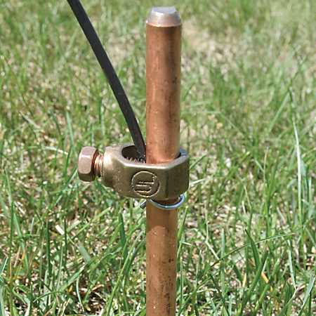
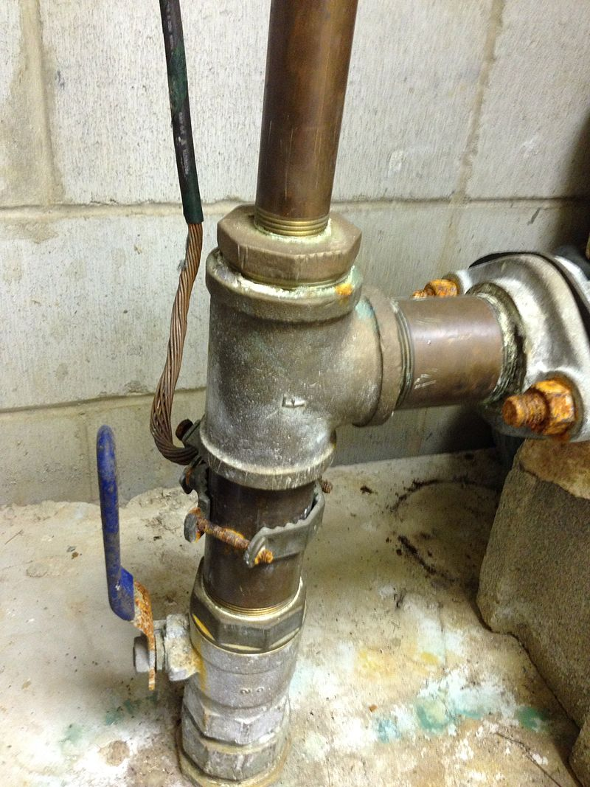
Req. 6: Electrical Grounding Safety
120/
240v
Earth
Ground
Earth
Ground
1
Notes:
1 minute for this slide 70:00
[1] The attachment at the ground rod looks like this. Grounding will be different depending on the kind of soil, so you really have to know (loam & clay: GOOD; sand and rock: NOT GOOD) Some ham shacks have separate ground wires attached to home cold-water pipes like this one. The idea is that cold water pipes eventually run through the Earth ground. Hot water piping may be isolated at the water heater from Earth ground, so they should never be used for this purpose. Natural gas lines should also not be used for grounding.
SLIDE END

Slide 74
Req. 6: Electrical Grounding Safety
120/
Ham
Shack
240v
Earth
Grounds
Earth
Ground
Earth
Ground
1
Notes:
1 minute for this slide 71:00
[1] Every ham shack should have an additional Earth ground system. A separate wire is run from your operating table down to ground rods you have pounded into the ground from 6 to 8 feet. Most radio shacks need more than one of these ground rods.
As homes are using more and more plastic plumbing, we recommend the hams use separate ground rods unless they know for sure that materials use for piping will in fact be Earth grounded.
SLIDE END

Slide 75
Req. 6: Safety in the Radio Shack
Personal Safety Around Antennas
1
Notes:
0 minutes for this slide 72:00
[1] In addition to just electrical safety, we want to make sure we understand all the hazards when dealing with antennas.
SLIDE END

Slide 76
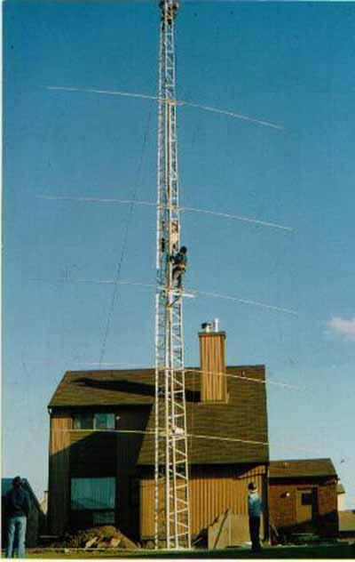
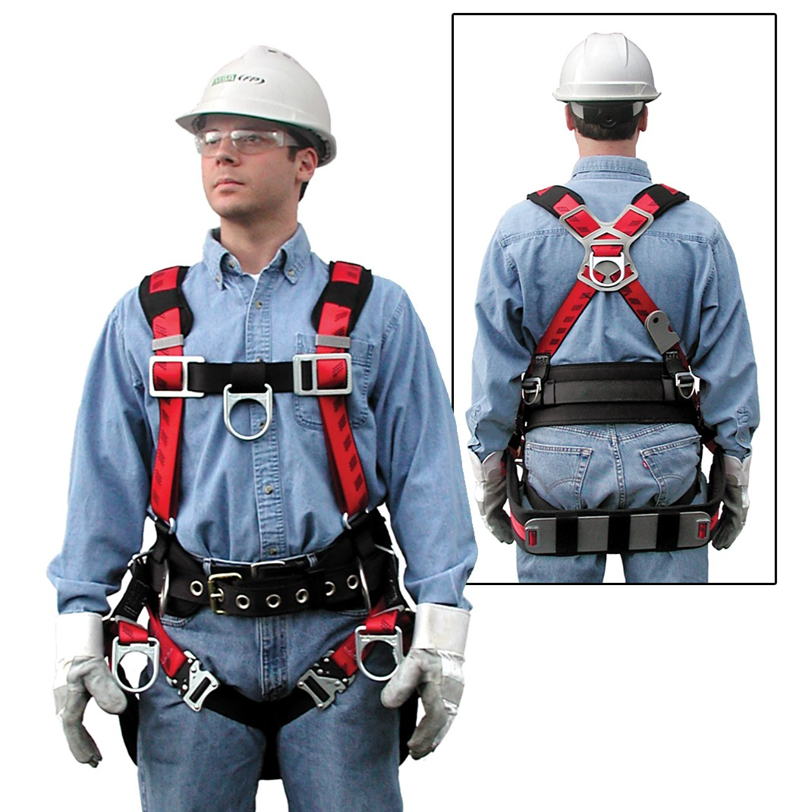
Req. 6: Electrical Safety Rules
1
Notes:
1 minute for this slide___ 72:00
[1] Too many deaths have occurred over the years from people not wearing proper protective equipment when climbing towers! Here is an example of someone properly dressed to do antenna maintenance.
SLIDE END

Slide 77
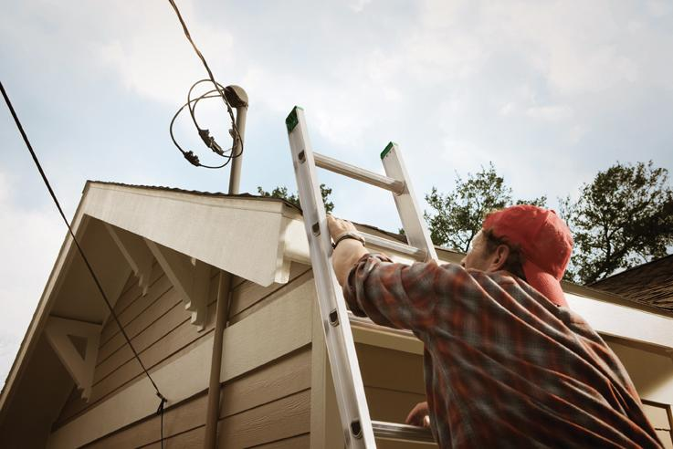
Req. 6: Electrical Safety Rules
1
Notes:
1 minute for this slide___ 73:00
[1] What all can you find wrong in this picture? Another situation that occurs is when accessing the roof of your home to set up the antenna. You must steer clear of power lines and never have your antenna near such a line!
SLIDE END

Slide 78
Req. 6: Safety in the Radio Shack
Electrical Safety in the
Radio Shack
1
Notes:
0 minutes for this slide 74:00
[1] Here’s some other important safety factors:
SLIDE END

Slide 79
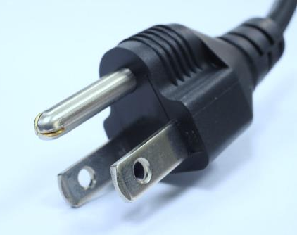
Req. 6: Safety in the Radio Shack
1
Notes:
0 minutes for this slide 74:00
[1] A three-prong plug like this is included on most ham radio equipment that plugs into an outlet. The prongs need to be in good shape. The single round prong will connect the radio equipment to the house ground that we’ve already talked about.
SLIDE END

Slide 80
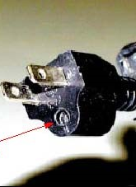
Req. 6: Safety in the Radio Shack
1
Notes:
1 minute for this slide 74:00
[1] Never use a plug that has the ground prong cut off or somehow removed. If equipment came with a three-prong power cord, it was designed to have all three prongs in place. If they are not, you could be exposing yourself to the risk of a serious shock or electrocution!
SLIDE END

Slide 81
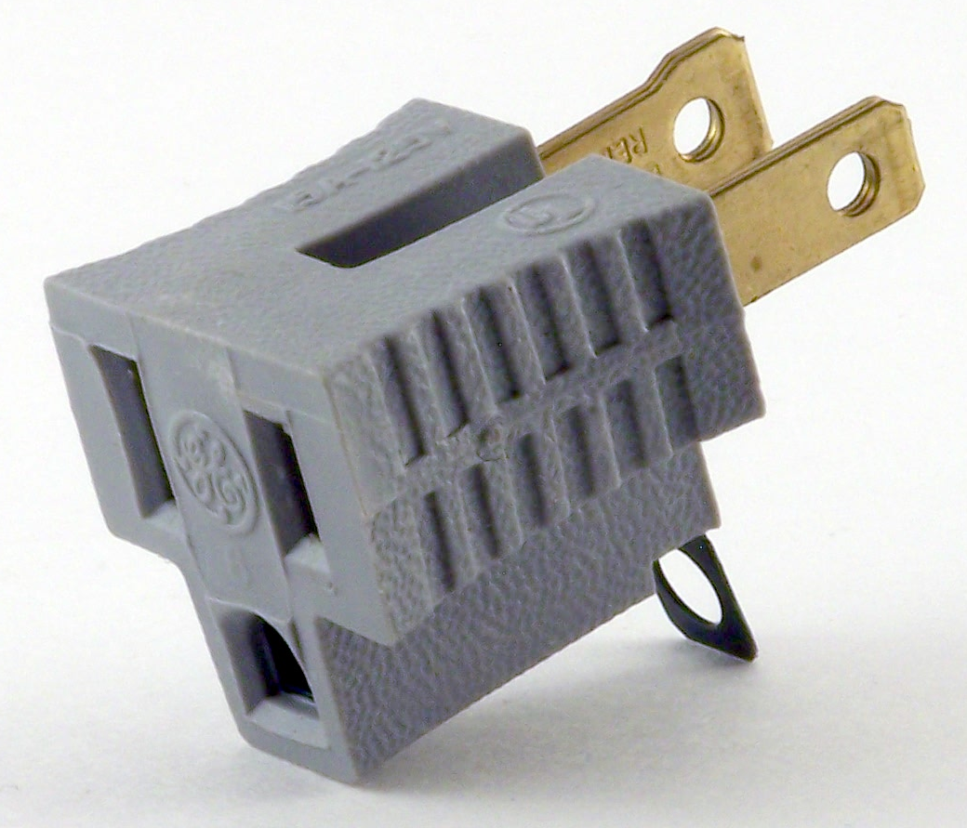
Req. 6: Safety in the Radio Shack
1
Notes:
0 minutes for this slide 75:00
[1] Sometimes people will use these adaptors to keep from cutting the ground pin, but this can be very hazardous, too! (no ground, etc.)
SLIDE END

Slide 82
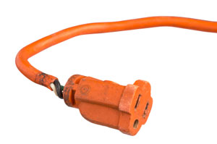
Req. 6: Safety in the Radio Shack
1
Notes:
1 minute for this slide 75:00
[1] Another one we see too often is a power cord with insulation that has broken away. This cord should be either repaired or discarded. Repair does not include just using electrical tape. This area is a weakened area, and if the internal insulation hasn’t yet broken away, it will soon. Repair would include replacement of the molded socket in such a manner that the wire has a strain relief and no exposed internal wires (and no tape!)
SLIDE END

Slide 83
Req. 6: Safety in the Radio Shack
2
1
3
Notes:
1 minute for this slide 76:00
[3] One comment about Ground Fault Interrupter (GFI) outlets. These are being used more and more in newer home wiring, and they can be installed in older homes, too. They are also a good idea for ham radio shacks.
GFIs will break the circuit much quicker than the circuit breaker in your panel. You could easily die from a shock before the panel breaker would trip, but a GFI trips very rapidly with very little current flow to ground. To do this they have an electronic monitoring circuit that should be tested, and that’s why there is a test button and a reset button.
Some areas now require AFCIs (Arc-Fault-Circuit-Interrupting) breakers. These are located at the breaker panel, and are designed to protect against electrical fires (as opposed to GFIs).
[2] Just press the black button to test. It will trip the GFI if everything is working as it should.
[1] Once you’ve finished testing it, press the red button to activate the outlet. If you don’t press the red button, the outlet will remain “dead” until you do.
SLIDE END

Slide 84
Req. 6: Safety in the Radio Shack
1
Notes:
0 minutes for this slide 77:00
[1] Here’s a handy device you can use to test all the three-prong outlets in your ham shack and your house. This will tell you if your outlets are wired properly and in what shape the mechanical connectors are inside the outlet. The red button on the tester also serves the same purpose as the “test button” on a GFI.
SLIDE END

Slide 85
Req. 6: Electrical Cord Safety
1
Notes:
1 minute for this slide ______ 77:00
Here’s a few more things to think about.
You never want something like this on the left or in the lower right. Not only might you be overloading the capability of one outlet, you might also be exposing yourself to electrical shock with some of these loose connections. A fire could occur here as well.
The picture on the top right shows a two-prong plug being inserted into a two prong outlet. The outlet is ungrounded; the device to which the plug is attached is probably safe without the ground, but the outlet here is the problem. You would not have a proper ground on any device with a three-prong plug!
All radio ham shacks must be using grounded outlets, preferably with Ground Fault Circuit Interrupters!
SLIDE END

Slide 86
Req. 6: Safety Lightning Protection
Lightning
Protection
2
Notes:
0 minutes for this slide 78:00
[2] Now we’ll change the topic to lightning, the scourge of many ham radio operators.
SLIDE END

Slide 87
Req. 6: Safety Lightning Protection
Lightning
Stroke
Density
30+
20
16
14
12
8
6
4
2
1
0.5
0.1
1
Notes:
1 minute for this slide 78:00
[1] Here is a map of the continental United States that shows the density of lightning strokes from 2005 to 2014.
How many of you live within areas that show on the upper end of the scale (orange, red, dark red, purple)?
(Instructor shows his QTH and comments on his own situation.)
SLIDE END

Slide 88
Req. 6: Safety Lightning Protection
1
Notes:
0 minutes for this slide 79:00
[1] Let’s take a look at a typical ham radio system.
The heart of our system is the radio.
VISUALS CONTINUE ON NEXT SLIDE

Slide 89
Req. 6: Safety Lightning Protection
1
Notes:
1 minute for this slide 79:00
[1] A critical part of our system is the antenna. Our antenna could be a wire, or an expensive tower setup like this one. Some hams will set up their metal rain gutters to serve as an antenna, or maybe even their aluminum flag pole! For this discussion, we’ll use the tower.
Even the power line coming to the house is part of our station system.
ASK: Anybody know what this might be?
Ham radio operators usually have lightning arrestors in their antenna feed lines to theoretically keep a lightning strike from their radios. I say “theoretically” because if we think we can totally control the nature of a lightning strike, that’s giving ourselves too much credit. Lightning arrestors are a good precautionary step with no guarantees. That said, we should have them in our system.
VISUALS CONTINUE ON NEXT SLIDE

Slide 90
Req. 6: Safety Lightning Protection
1
Notes:
1 minute for this slide 80:00
[1] The most important element for safety is our grounding system. This includes not only how we ground our equipment/antennas, but also the geology of the ground itself (damp/dry/hard/soft, etc). We don’t have time to get into this in depth, but the design of our ground system is critical not only for safety, but in many cases for how effective our system is in sending and receiving signals!
VISUALS CONTINUE ON NEXT SLIDE

Slide 91
Req. 6: Safety Lightning Protection
1
Notes:
0 minutes for this slide 81:00
[1] You can see here that this ham operator put a lot of work into making a good ground at the base of his antenna.
VISUALS CONTINUE ON NEXT SLIDE

Slide 92
Req. 6: Safety Lightning Protection
1
Notes:
1 minutes for this slide 81:00
[1] He also did a lot of engineering to properly feed the antenna lines into the house, another very important part of the ground system!
VISUALS CONTINUE ON NEXT SLIDE

Slide 93
Req. 6: Safety Lightning Protection
1
Notes:
0 minutes for this slide 82:00
[1] Even more, he set up his radio shack bench with grounding measures.
VISUALS CONTINUE ON NEXT SLIDE

Slide 94
Req. 6: Safety Lightning Protection
1
Notes:
0 minutes for this slide 82:00
[1] Let’s watch what happens (at least theoretically) when lightning strikes our ham radio system.
SLIDE END

Slide 95
Req. 6: Safety Lightning Protection
1
Notes:
1 minute for this slide 82:00
[1] One of the common ways this can happen is when lightning strikes the electrical power lines. Energy from the strike can travel down the line, looking for a ground. It can instantly travel to the nearest ground which in this case could be the grounded entry point into our house.
Another high risk entry point is through our antenna.
The best case scenario is for the energy to travel down the metal tower and into the ground system around the antenna base. Some energy may try to go down the antenna feed line, but if our lightning arrester does the job, it will bypass to ground. (As we said before, there is no guarantee of this!)
SLIDE END

Slide 96
Req. 6: Safety Lightning Protection
1
Notes:
1 minute for this slide 83:00
[1] Now let’s look at what happens if there isn’t a good system ground. If we didn’t have adequate grounding around the antenna base and either didn’t have a good lightning arrester (or the one we had didn’t work), the energy would travel to the nearest ground which likely would be down to (and through) the radio and into the radio station’s ground rod or the building’s ground system. Your radio FRIES in this case, and if you’re near it and touching it, YOU might fry too!
SLIDE END

Slide 97
Req. 6: Safety Lightning Protection
1
Notes:
0 minutes for this slide 84:00
[1] Since there is no good ground at the base of the antenna, the lightning finds the closes path to ground through the radio.
SLIDE END

Slide 98
Req. 6: Direct Current Safety
Direct Current Safety
1
Notes:
0 minutes for this slide 84:00
[1] If anyone thinks that power from a direct current (DC) power supply is safe, just look at what happens when you short out a car battery!
SLIDE END

Slide 99
Req. 6: Direct Current Safety
Direct Current Safety
1
Notes:
1 minute for this slide 84:00
[1] If anyone thinks that power from a direct current (DC) power supply is safe, just look at what happens when you short out a car battery!
Remember our chart earlier that showed how little alternating current (AC) was required to kill you. 12 volts direct current is much less voltage, and that is one factor, but look at this chart that shows the cranking amps in an automobile battery! In come cases, over a thousand amps!
SLIDE END

Slide 100
Req. 6: Direct Current Safety
Direct Current Safety
1
2
Notes:
1 minutes for this slide 85:00
[2] If you short the positive (red) terminals on this high current ham radio power supply with the negative (black) ground terminals, you’ll get the same result as that from a battery and can severely injure yourself and damage the supply beyond repair, let alone the expense associated with buying a new power supply!
[1] Carefully observe the polarity of these terminals. It’s pretty universal that “red” means “positive” and “black” means “negative.” If you ever encounter a supply that isn’t set up with these colors, have second thoughts on whether you should use it!
SLIDE END

Slide 101
Req. 9.a.(6): 10-Minute Real or Simulated Contact PREPARATION _
Use the K2BSA Operating Card
Listen and call another ham radio station
Talk with the other radio station operator
Relax and have fun
Give FIRST name ONLY
Tell where you live
Describe your school
Talk about Scouting
Use Q-signals
Log your contact on card
Be prepared to talk about it when you return!
Contact!
1
Notes:
2 minutes for this slide 86:00
[1] After this, you’re about to head on over to our radio station to get your time in making a contact. But first, let’s give you some pointers on how to have fun while you’re doing it!
<Instructor: use slide graphics as your talking points>
SLIDE END

Slide 102
Req. 9.a.(6): 10-Minute Real or Simulated Contact PREPARATION
2023 K2BSA
Contact Card
Notes:
1 minute for this slide 86:00
[1] Here is an example of a QSL card! Note that it has a bunch of useful “Q” Signals on it, as well as places to log critical information about a contact with another radio user. Be sure to ask your radio helper about it!
SLIDE END

Slide 103
Radio
Merit
Badge
1
Notes:
87:00

