Slide 1
Radio
Merit
Badge
Module 2
1
Notes:
Cover Slide w/3 minutes instructor intro 00:00
[1] Instructors:
> Introduce self
Name, call, years licensed
Ham radio interests

Slide 2
Req. 3: Introduction to the Electromagnetic Spectrum
Frequency
1 cycle per second
or
1 Hertz
Electromagnetic
Spectrum
=
=
9 Hertz
1 second
1
2
3
4
5
6
Notes:
3 minutes for this slide 3:00
[6] If you want to learn about radio, there are a few things you need to learn before anything else. The idea of “frequency” is one we’ll talk about first.
[5] As we’ve shown earlier, even though we can’t “see” radio waves, we often draw them as ripples like these on the screen.
[4] We also have seen that radio waves travel; they’re always in motion.
[3] If we timed the waves you see on the screen, they would end up taking one second to move from the left vertical yellow line to the right vertical yellow line.
[2] We say that the single sweep of the top wave shown is traveling one cycle per second. In radio talk, we give a name to “cycle per second.” We call it a Hertz (named after an old guy who was a radio pioneer); in this instance, “one Hertz.”
[1] If nine cycles go by in one second, we would call that frequency “nine Hertz.”
Ask: What would we call it if a thousand cycles passed by in one second? One million? Seven million? A billion?
SLIDE END

Slide 3
Req. 3: Introduction to the Electromagnetic Spectrum
Wavelength
1
Longer wavelengths
Lower frequencies
Lower energy
1
2
3
Shorter wavelengths
Higher frequencies
Higher energy
1
2
3
4
5
6
7
8
Notes:
3 minutes for this slide 6:00
[8] Now let’s talk about “wavelength.” Radio waves have certain lengths, and it’s very important to understand this. For starters, you can see that the peaks and valleys of these two radio waves are spaced differently.
[7] <stops movement>
[6] We call the distance between two successive peaks the “wavelength” of the radio wave.
[5] Notice that the wavelength of the top wave is longer than that of the lower wave. The wavelength of the bottom is 1/3 that of the top; you can see that three successive peaks fit in the same space as one above.
[4] The longer the wavelength, the lower the frequency.
[3] One interesting thing is that with longer wavelengths and lower frequencies, the amount of energy in the radio wave is lower, too.
[2] Shorter wavelengths result in higher frequencies.
[1] And just the opposite of longer waves, shorter wavelengths present much higher energy; that’s why the “micro” waves in a microwave oven can heat food!
Ask: What would the wavelength be for one Hertz? 186,000 mi. 10 Hertz? 18,600 mi. 100 Hertz? 1,860 miles 1000 Hertz? (1 kHz) 186 mi. 10,000 Hertz (10 kHz) = 18.6 miles
SLIDE END

Slide 4
Req. 3.a.: Electromagnetic Spectrum
Get out
your notes!
Let’s start drawing
the spectrum
MF
MEDIUM FREQUENCY
300 kHz
1 MHz
2 MHz
3 MHz
HF
HIGH FREQUENCY
3 MHz
10 MHz
20 MHz
30 MHz
VHF
VERY HIGH FREQUENCY
30 MHz
100 MHz
200 MHz
300 MHz
UHF
ULTRA HIGH FREQUENCY
300 MHz
1 GHz
2 GHz
3 GHz
1
6
2
3
4
5
7
Notes:
4 minutes for this slide 9:00
[7] Radio frequencies are divided into ranges based on how these frequencies behave in nature. We don’t have time to talk about all of the frequency ranges, but let’s look at a few that relate to some common radio signals.
[6] MF stands for Medium Frequency: This is the group where you’ll find AM radio, marine radio and some ham radio bands.
[5] HF is High Frequency: This group of frequencies is used for short wave broadcasting. Ham radio operators use HF for most international communication.
[4] VHF is Very High Frequency: These frequencies are used for local communication such as broadcast TV, FM entertainment radio, business and ham radio. These frequencies (and higher) are the ones that operate line-of-sight.
[3] UHF = Ultra High Frequency: Used by police, cell phones and ham radio. FRS radio (so-called “Talk-Abouts) lies in this group, too.
[2] Look closely at this chart. It shows that MF includes frequencies from 300 kHz up to 3 MHz. That’s how many of those individual peaks and valleys (cycles) go by in one second.
[1] As we move through each level we can see that frequencies increase ten-fold.
SLIDE END

Slide 5
Req. 3.b.: Electromagnetic Spectrum
ELF Extremely Low Frequency
3 Hz
30 Hz
SLF Super Low Frequency
30 Hz
300 Hz
ULF Ultra Low Frequency
300 Hz
3 kHz
VLF Very Low Frequency
3 kHz
30 kHz
LF Low Frequency
30 kHz
300 kHz
MF Medium Frequency
300 kHz
3 MHz
HF High Frequency
3 MHz
30 MHz
VHF Very High Frequency
30 MHz
300 MHz
UHF Ultra High Frequency
300 MHz
3 GHz
SHF Super High Frequency
3 GHz
30 GHz
EHF Extremely High Frequency
30 GHz
300 GHz
THF Tremendously High Frequency
300 GHz
3 THz
1
2
3
4
Notes:
2 minutes for this slide 13:00
[4] Here again we show the four frequency groups from the last slide.
There are many more frequency groups we’re not going to talk about, but they create an interesting scientific picture of frequencies!
Point out: These frequencies are listed from top to bottom, low to high. That may be confusing, but it’s how radio experts map out these ranges.
[3] There are five groups of frequencies lower than the four we’ve been studying. Some are used for very specialized communication. (Submarines) And there has been some ham radio work in the LF group. The most fascinating point here is that some of these waves travel very well through solid material, like the earth!
[2] There are three frequency groups higher than our four. These are very fascinating for many ham radio experimenters and scientists, and includes satellite, radar, x-rays and beyond. It even includes light!
[1] But overall, our group of four is what’s important to the vast majority of ham radio operators.
SLIDE END

Slide 6
Req. 3.c.: Radio Services
MF
AM Broadcast
160M
Marine
300 kHz
1 MHz
2 MHz
3 MHz
HF
3 MHz
10 MHz
20 MHz
30 MHz
VHF
30 MHz
100 MHz
200 MHz
300 MHz
UHF
300 MHz
1 GHz
2 GHz
3 GHz
1
2
3
4
Notes:
2 minutes for this slide 15:00
[4] Now let’s look closer at our four groups, starting with “medium frequencies.”
[3] Remember the FCC? The FCC assigns a large portion of the bottom end of the medium frequency range for use by AM radio stations. These days, most people listen to AM radio for sports, news and political talk radio. Most of the time, they listen in their cars!
[2] At the top end of the range, we have frequencies set aside for “marine frequencies.” The Coast Guard monitors these frequencies for boaters who might be in trouble. Big ships even use these frequencies!
[1] Right in the middle of the MF range is a space set aside for ham radio. From now on, we’ll show ham radio frequencies in red (with white lettering). Note that hams call this the 160 Meter band.
Ask: Why do you supposed it’s called the 160 Meter Band?
We often refer to bands by their approximate wavelength for these frequencies. Their wavelength is about 160 meters, just over 500 feet between peaks!
SLIDE END

Slide 7
Req. 3.c.: Radio Services
MF
AM Broadcast
160M
Marine
300 kHz
1 MHz
2 MHz
3 MHz
HF
80M
60M
40M
30M
20M
17M
15M
12M
CB
10M
3 MHz
10 MHz
20 MHz
30 MHz
VHF
30 MHz
100 MHz
200 MHz
300 MHz
UHF
300 MHz
1 GHz
2 GHz
3 GHz
1
2
3
Notes:
2 minutes for this slide 17:00
[3] Next comes the High Frequencies, or “HF” as radio operators call them.
[2] There’s a lot we’re not showing here, but we are showing that ham radio has lots of bands throughout this range!
Point out: You can also see that I have identified each of the ham radio segments by their approximate wavelengths.
[1] Ask: How many of you have heard of “CB Radio.” What do you know about it? It used to be very popular, but now is pretty much used by truckers when they’re out on the highway.
For now, that’s as far as we’ll go with the High Frequency group.
SLIDE END

Slide 8
Req. 3.c.: Radio Services
MF
AM Broadcast
160M
Marine
300 kHz
1 MHz
2 MHz
3 MHz
HF
80M
60M
40M
30M
20M
17M
15M
12M
CB
10M
3 MHz
10 MHz
20 MHz
30 MHz
6M
TV
TV
FM
2M
WEATHER
TV
1.25M
VHF
VHF-
LOW
AVIATION
VHF-
HIGH
30 MHz
100 MHz
200 MHz
300 MHz
UHF
300 MHz
1 GHz
2 GHz
3 GHz
1
2
3
4
5
6
7
Notes:
2 minutes for this slide 19:00
[7] Next comes Very High Frequencies, or “VHF.” This is the first frequency group that requires line of sight transmission. That’s why the type of communication is usually “close-in” or the transmitting towers for it are always located as high as possible in the immediate area.
[6] Before cable TV, one of the most important VHF transmission was for television. This broadcasting still takes place, but cable TV is becoming more popular.
[5] The radio in cars usually has this FM band included. While satellite radio has grown in recent years, many still listen to FM on their car radios, and sometimes even at home!
[4] Aircraft pilots communicate with air traffic control in this band of VHF frequencies
[3] “VHF-HI and VHF-LOW” are bands assigned to business and other private (licensed) communications
[2] This little sliver of band is for weather announcements, usually by the National Oceanic and Atmospheric Administration
[1] And of course, there are ham radio bands in here as well (describe)
SLIDE END

Slide 9
Req. 3.c.: Radio Services
MF
AM Broadcast
160M
Marine
300 kHz
1 MHz
2 MHz
3 MHz
HF
80M
60M
40M
30M
20M
17M
15M
12M
CB
10M
3 MHz
10 MHz
20 MHz
30 MHz
6M
TV
TV
FM
2M
WEATHER
TV
1.25M
VHF
VHF-
LOW
AVIATION
VHF-
HIGH
30 MHz
100 MHz
200 MHz
300 MHz
UHF
70cm
FRS/GMRS
TV
CELL PHONES
33cm
23cm
13cm
12cm
300 MHz
1 GHz
2 GHz
3 GHz
1
2
3
4
5
6
Notes:
2 minutes for this slide 21:00
[6] Now for the Ultra High Frequencies, or “UHF”.
[5] Starting off, there are some TV frequencies in this UHF group to add to the prior VHF group.
[4] Now we have the frequencies used for mobile/cell phones. It used to be that a general purpose radio receiver could listen in on these frequencies, but for privacy, the FCC started requiring that manufacturer’s “block” the radio so that you can’t buy a radio anymore that can listen-in on these private phone calls.
[3] Just like the other frequency groups, there are ham radio bands, (we call them “allocations”) throughout the UHF group.
[2] Ask: “How many of you have used an FRS radio? (“Talkabout?”) The frequencies these radios use is in this UHF group
[1] As we’ve said earlier, just because there are “blank spaces” between the frequencies I’ve shown you doesn’t mean they aren’t used. We just wanted to show some of the uses for these frequencies.
SLIDE END

Slide 10
Req. 3.c.: Radio Services
MF
AM Broadcast
160M
Marine
WWV
300 kHz
1 MHz
2 MHz
3 MHz
HF
80M
60M
40M
30M
20M
17M
15M
12M
CB
10M
WWV
WWV
WWV
WWV
3 MHz
10 MHz
20 MHz
30 MHz
6M
TV
TV
FM
2M
WEATHER
TV
1.25M
VHF
VHF-
LOW
AVIATION
VHF-
HIGH
30 MHz
100 MHz
200 MHz
300 MHz
UHF
70cm
FRS/GMRS
TV
CELL PHONES
33cm
23cm
13cm
12cm
300 MHz
1 GHz
2 GHz
3 GHz
1
2
Notes:
5 minutes for this slide 23:00
[2] I want to share one more little detail with you:
Remember our discussion about WWV? It was that signal that I played for you earlier.
[1] You can see that WWV is located at many locations in the MF and HF frequencies, because these are the worldwide shortwave frequencies. Not only does WWV give you accurate time, but it also can let you know how well various radio frequencies are traveling on any given day, since they do vary!
That’s as much of the various assigned frequencies that I’ll show. I don’t want to totally blow you away with everything that is assigned to just these four frequency groups.
Now we’ll give you a few more minutes to finish up your electromagnetic spectrum charts.
SLIDE END

Slide 11
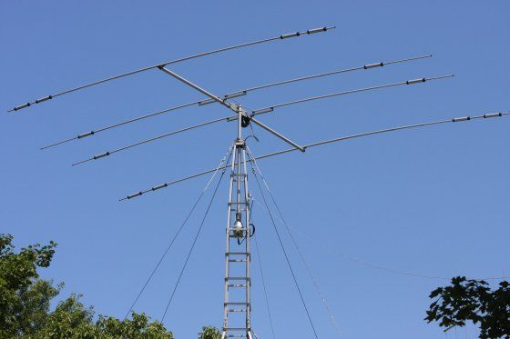
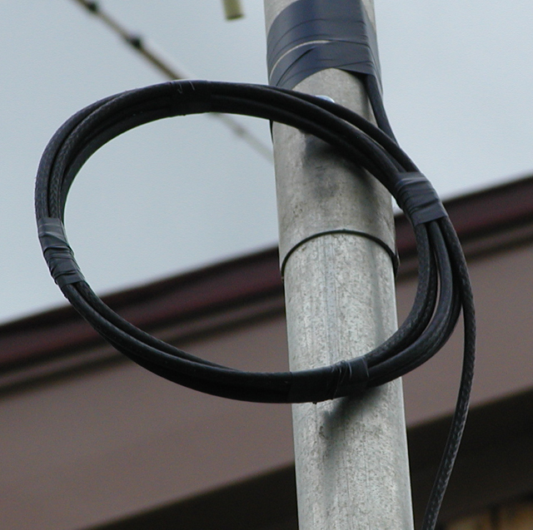
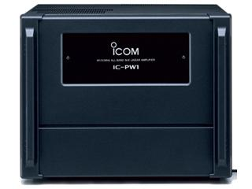
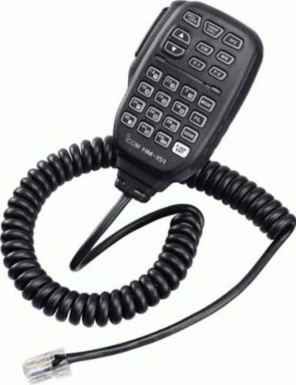
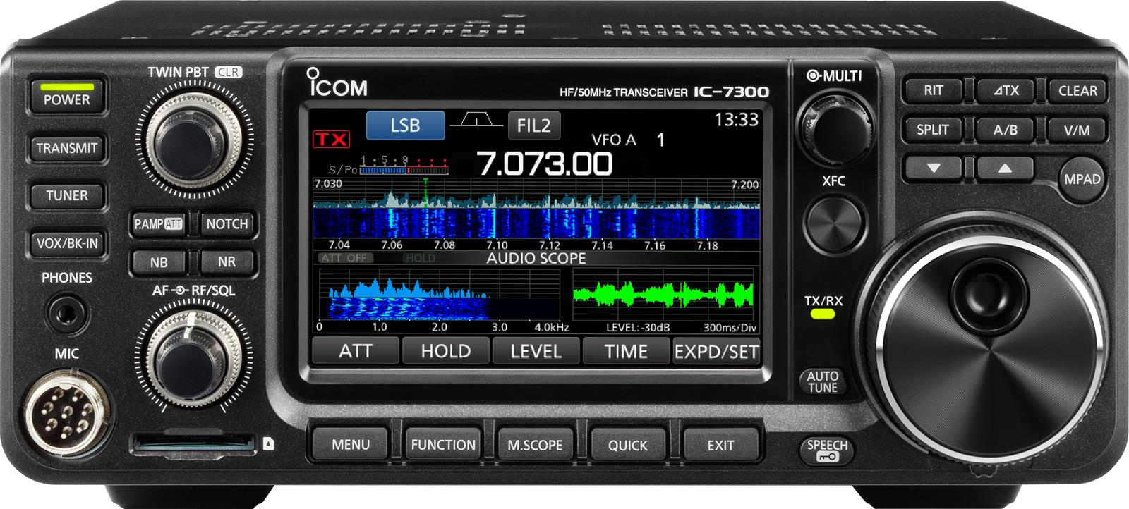
Req. 5.a.: Block Diagrams
Antenna
Block Diagrams
&
Schematics
Feedline
Antenna
Microphone
Transceiver
Amplifier
Feedline
Amplifier
Microphone
1
2
3
4
5
6
7
8
9
10
11
Notes:
3 minutes for this slide 28:00
[11] When you really get into radio, you may become interested in how they are put together and what makes them work. You will learn how to use block diagrams and schematics. We’ll start here by “building” a ham radio station using a block diagram:
[10] Usually when a radio operator starts thinking about the station, the transceiver is one of the first things that come to mind. You’ll see lots of them here at K2BSA.
[9] We’ll lay down this label (Transceiver) as part of our radio station block diagram.
[8] Most hams will use a microphone like this connected to the transceiver to convert their voice into radio waves.
[7] We’ll connect the microphone label to the transceiver on our block diagram
[6] Many hams want to add an amplifier to their radio station. Why might you think they would want an amplifier?
[5] For our station here, we’ll connect our transceiver to an amplifier label to end up with a stronger radio signal.
[4] All ham radio stations use some sort of antenna to radiate our signal
[3] Here is our block label for the antenna
[2] We connect the amplifier to the antenna with a special kind of wire called the feedline. The feedline carries the amplified radio signal to the antenna
[1] There you have it: A basic ham radio station in a block diagram. The block diagram gives you a high level picture of your ham radio station system. But as you become more interested in how things work, you might want to become familiar with schematics. Schematics are “maps” of all the electronic components inside a device.
Now let’s look at schematics…
SLIDE END

Slide 12
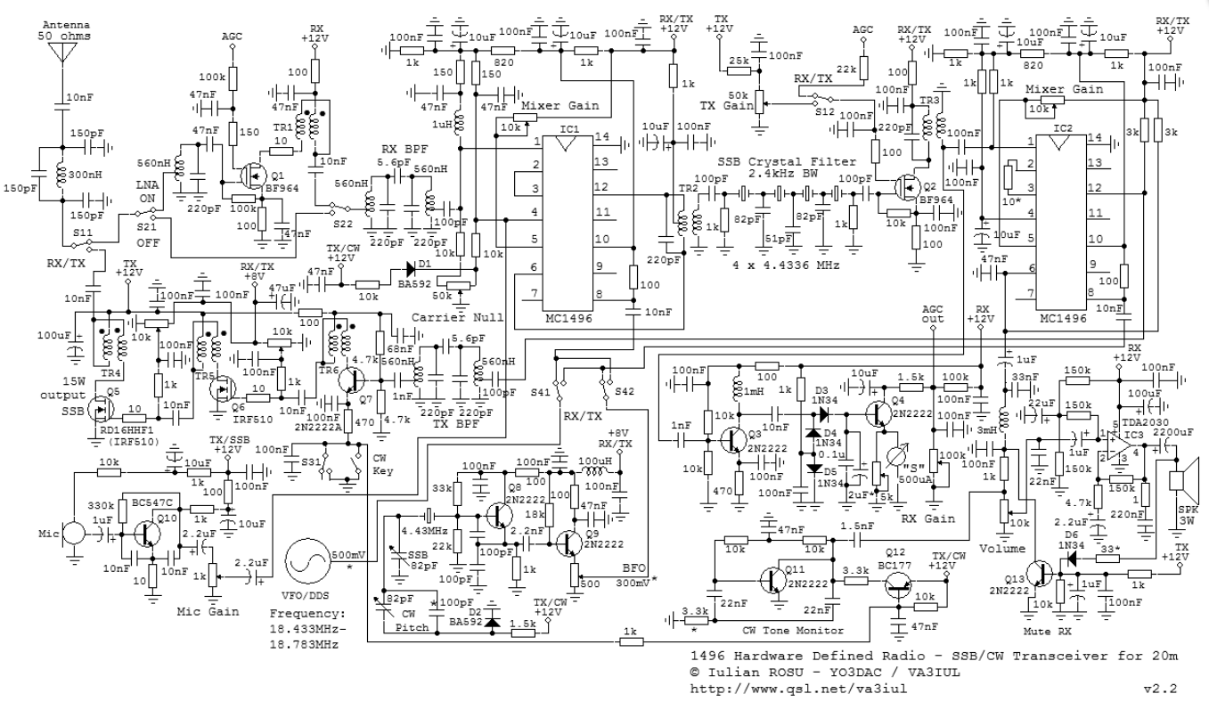
Req. 5.a.: Schematic Diagrams
Antenna
Feedline
Microphone
Transceiver
Amplifier
Transceiver
1
2
3
4
Notes:
2 minutes for this slide 31:00
[5] Let’s look at one component of our ham radio station, the transceiver.
[4] A schematic maps out all the components in our transceiver and how they are connected. This is very helpful when troubleshooting the equipment. You can’t really repair a complex device like a ham radio transceiver, or even a simple one for that matter, without knowing how to read and use a schematic.
If you want to learn more about schematics, the Electronics Merit Badge will help you get there!
[3] You can see if we just shrink the size of our schematic to make it part of our block diagram, it really doesn’t help us.
[2] The block diagram helps us at a high level, seeing the whole system in an easy-to-read manner.
[1] Before you become knowledgeable about electronics, components and schematics, a block diagram should help you understand how a radio system goes together.
SLIDE END

Slide 13
Req. 5.b.: Radio Station Diagram
Finish
Block
Diagram
1
Notes:
5 minutes for this slide 33:00
[1] Note to Instructor: They should have been building their block diagram throughout the prior slides. This time period is provided for them to finish the drawing.
SLIDE END

Slide 14
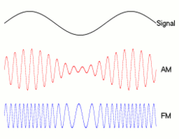
Req. 5.c.: How Information is Transmitted -AM & FM
Verbal
(audio) message being sent
AM (Amplitude Modulation)
FM (Frequency Modulation)
How
Information
is
Transmitted
1
2
3
4
5
Notes:
3 minutes for this slide 38:00
[5] Let’s look at how information is transmitted; how radio waves carry information.
[4] When we talk, the variation of our vocal cords creates audio sound waves. That’s how you can hear my voice right now. The wave on the screen represents an audio sound wave; it is what we want to transmit from our radio antenna.
[3] One way we can transmit our audio wave is to use Amplitude Modulation, or “AM”. If you look closely at this AM radio wave, you actually can see three waves. The higher frequency radio carrier wave that the transmitter sends out the antenna, and our original audio wave, duplicated along the top and bottom of the carrier. We say the amplitude (“vertical height”) of the carrier changes according to the audio signal it is carrying. When you listen to “AM radio,” your radio receiver is detecting this kind of wave.
[2] Now we see a totally different way to carry our voice: Frequency Modulation, or “FM.” Note how the three moving illustrations here compare. Different than AM, the FM signal keeps the same amplitude, but changes its frequency with each change in your voice signal. There are advantages and disadvantages to AM and FM that we don’t have time to talk about here. But at least you can easily see how they are very different!
[1] These are only a couple ways information can be sent over the airwaves. Let’s study some more!
SLIDE END

Slide 15
Req. 5.c.: How Information is Transmitted - SSB
AM (Amplitude Modulation)
SSB (Single
Sideband)
1
2
3
Notes:
2 minutes for this slide 41:00
[3] To look at our next mode of transmitting information, we’ll bring back up our Amplitude Modulation diagram.
[2] Our next mode is Single Sideband, or SSB. Notice you’re not seeing anything right now. That’s because no one is talking into the microphone. In the AM signal above, there is always a transmitted carrier, even if no one is talking. Once you start talking into an AM transmitter, the carrier is then modulated as shown.
[1] But in a Single Sideband transmission, nothing happens on the airwaves unless you talk. Here we’re showing an SSB signal that matches the words that are being spoken into the mic.
Instructor: You can cycle back to #2 and then click your remote’s advance button to replay.
Single Sideband is much more efficient with energy than is an AM signal because no energy is going out when there is no talking, even during the pauses between words or sentences!
SLIDE END

Slide 16
Req. 5.c.: CW
CW?
DIT
DIT
DIT
DAH
V
“CW”
CONTINUOUS WAVE
1
2
3
4
5
6
7
8
Notes:
3 minutes for this slide 43:00
[8] Let’s look at another way to send information in our transmitted signal.
[7] This image shows an actual scan of a different kind of radio carrier wave. It’s called “continuous wave” even though you see breaks in it like we show here. The name might be confusing to you:
[6] If the ham operator wanted to, he could transmit a solid continuous wave like this one. He breaks up the continuous wave for a reason, though. Can you guess what that reason might be?
[5] When one of these little pieces of continuous wave is detected by a radio receiver, it makes a short “dit” sound in the speaker or headset.
[4] If the operator strings three of these short bursts of continuous wave, it will create three “dit sounds”.
[3] A slightly longer burst results in what the operator calls a “dash” or “dah.” What we see here is that the operator sent continuous wave bursts of “dit-dit-dit-dah.” What information do you think the operator is sending?
[2] The operator is sending the Morse Code for the letter “V.”
[1] We ham operators refer to the sending of Morse Code as “CW.” What does CW mean?
CW was the first form of messaging on the airwaves. In a sense, it was also the first form of digital communications!
SLIDE END

Slide 17
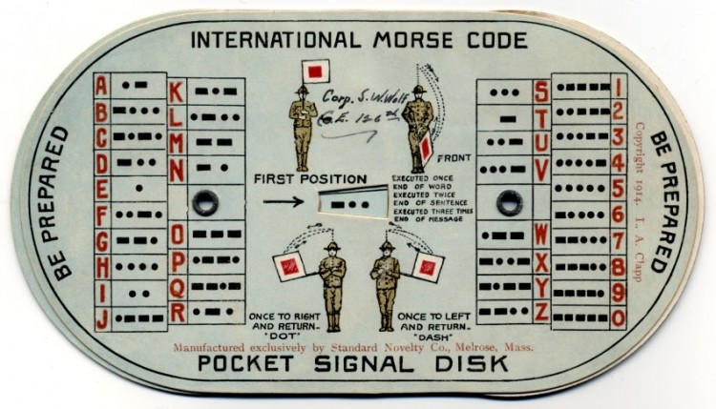
Req. 5.c.: CW
1
2
Notes:
1 minute for this slide 46:00
[2] This was a typical Morse Code and Semaphore aid for Scouts in the 1940s and 1950s.
[1] We won’t say much about Semaphore (communicating with flags), but either Morse Code or Semaphore was once a requirement for Scouting rank. Morse Code goes way back to the 1800s!
Find the letter “V” and you’ll see those three “dits” and one “dah” that we just talked about….
SLIDE END

Slide 18
Req. 5.c.: CW
B
S
A
1
2
3
Notes:
1 minute for this slide 47:00
[3] Let’s look at one more…
[2] Take a look at this string of CW dits and dahs. What might the operator be sending here?
[1] Here you go!
SLIDE END

Slide 19
Req. 5.c.: Digital Signals
Digital!
1
2
3
Notes:
2 minutes for this slide 48:00
[3] Now let’s compare a couple of radio wave signals, and get your idea on what might be going on…
[2] First we have a typical continuous wave. There is no modulation; that is, there are no dits and dahs being sent with this continuous wave. If you could somehow hear it, it would sound like a continuous tone on your radio.
[1] Compare your continuous wave with this one.
ASK: What might this type of wave be? For what purpose would this kind of wave be transmitted?
SLIDE END

Slide 20
Req. 5.c.: Digital Signals
58μs
100μs
= 116
1
1
1
0
1
0
0
1
2
3
4
5
6
7
8
Notes:
2 minutes for this slide 50:00
[8] Let’s take a closer look at this digital radio wave…
[7] The wave consists of two different elements, a short burst and a longer burst.
[6] In this particular type of digital signal (and there are many different types), the first “high part” of short burst takes only 58 millionths of second to happen.
[5] The first high part in this longer burst takes 100 millionths of a second to happen. Not quite twice as long at the short one, but long enough to be different! The computer (and its software) that is connected to a radio receiver that detects this signal can identify the two separate lengths of these bursts.
[4] The first short burst is associated with the number “1”.
[3] The second longer burst is associated with the number “0”.
[2] The whole string of bursts then reads “1 – 1 – 1 - 0 – 1 – 0 – 0.”
[1] This is the Base 2 number for “116”, which could be code for some command or information understood by the receiving radio and/or computer software.
SLIDE END

Slide 21
Req. 5.c.: Digital Signals
Let’s Transmit
Digital!
A
B
MESSAGE DIRECTION
1
2
3
4
5
Notes:
2 minutes for this slide 52:00
[5] To help understand how all this works, let’s take a look at one example of digital communications in action…
[4] Here is a very simple digital communications system connected with wire or possibly fiber optics. In this example, we are sending some sort of digital information from A to B. We use a computer to create our information message and an encoder to change the digital data to some form of signal to be sent over the wire or cable. The digital signal is picked by a decoder at B which sends the decoded message to the computer at B where the operator can somehow read or use the data.
[3] Now let’s replace the encoder and decoder with radios that are set up to do such a thing.
[2] Of course, radios don’t communicate by wire; instead they transmit and receive radio waves over the air. Antennas are used to transmit the signal, then receive it.
[1] Now the same signal that was shared through wires or cables is now sent from one antenna to the other. We no longer are relying on the infrastructure of wires or cables. This is a very big deal. Where most communications systems rely somehow on wires or cables, ham radio signals can be entirely “off the grid.” In a major disaster or emergency, this comes in very handy!
SLIDE END

Slide 22
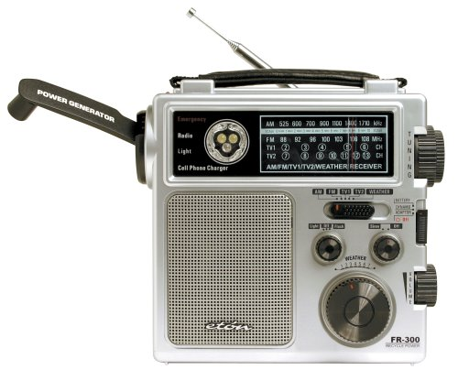
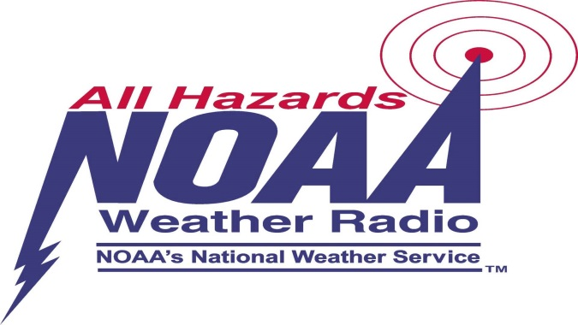
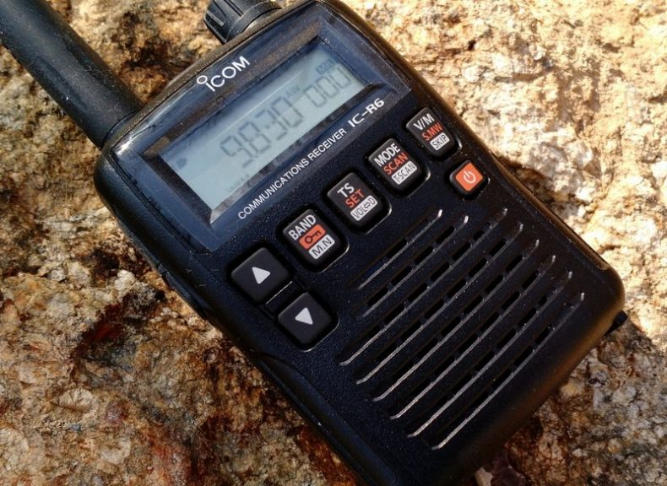
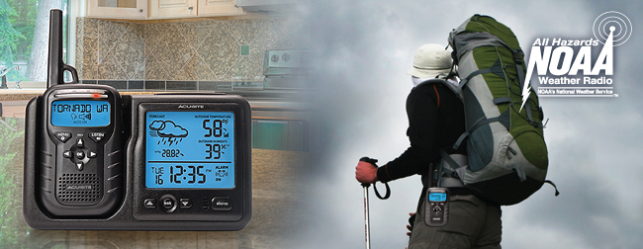
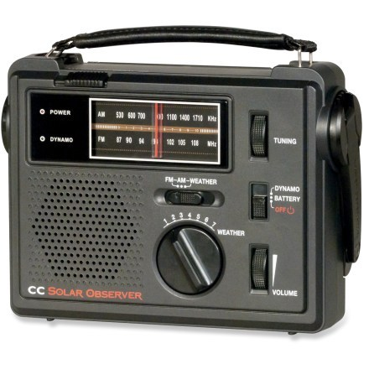
Req. 5.d.: NOAA Weather Radio (NWR)
1
2
Notes:
2 minutes for this slide 54:00
[2] NOAA Weather Radio (NWR; also known as NOAA Weather Radio All Hazards) is a network of radio stations in the United States that broadcast continuous weather information directly from a nearby (<40 miles) weather forecast office.
NOAA Weather Radio broadcasts National Weather Service warnings, watches, forecasts, weather observations and other hazard information 24 hours a day.
It also broadcasts alerts of non-weather emergencies such as national security, natural, environmental and public safety (such as an AMBER Alert) through the U.S. Federal Communications Commission's (FCC) Emergency Alert System.
[1] There are many special radios designed for receiving NWR broadcasts. One of these radio receivers could be a great addition to your home emergency kit!
SLIDE END

Slide 23
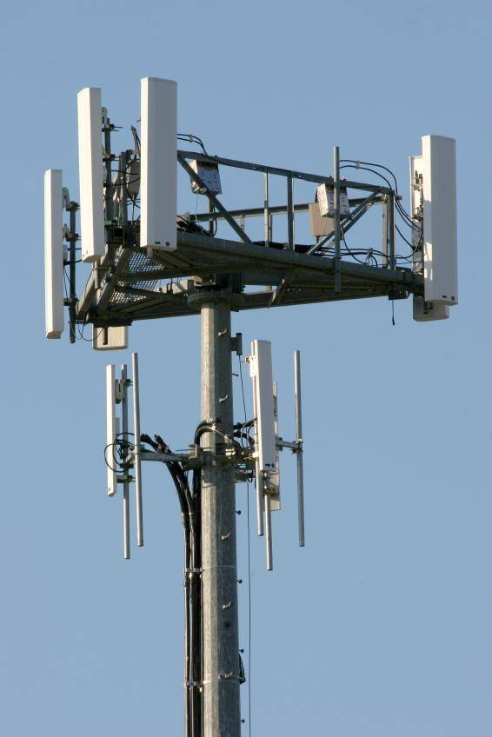
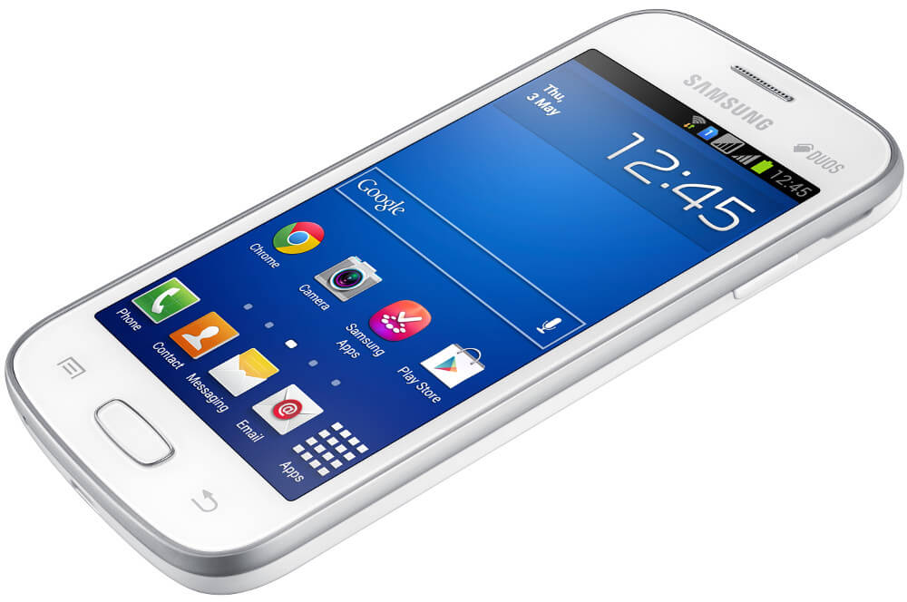
Req. 5.e.: Cell Phones
How
Cell Phone
Systems Work
Transceiver
Computer
Battery
Transmitting/Receiving Antenna
Microphone
Speaker
1
2
3
4
5
6
7
8
9
Notes:
3 minutes for this slide 56:00
[9] As we mentioned at the beginning of this course, most all of us use radio every day, even if we’re not a ham radio operator! We use cell phones!
[8] Ever see one of these someplace in your town? ASK: What is it?
Cellular telephone base station antennas like this one are located in more places than you would imagine! We take them for granted, but this is a very interesting technology! They send and receive communications signals 24 hours a day.
[7] A mobile phone or wireless device is a low-power two way radio operating at a maximum of 2 watts (peak).
[6] Much of the phone is a battery, strong enough to make several calls, send lots of test messages, search the Internet and take photos with the camera!
[5] The phone has an audio circuit that includes a microphone and a small speaker. Some have earpiece connections; others use Bluetooth to send an audio signal to a wireless earpiece. Bluetooth is another form of digital radio!
[4] Of course, the phone has a computer with lots of memory. A cell phone has more computing power than the computer used when we sent a man to the moon!
[3] The phone has a transceiver section, one that transmits and receives signals.
[2] Finally, no radio system will work without an antenna. Yes, even cell phones have built-in antennas!
[1] Such mobile phones have become more important for all the things they do besides making a call!
SLIDE END

Slide 24
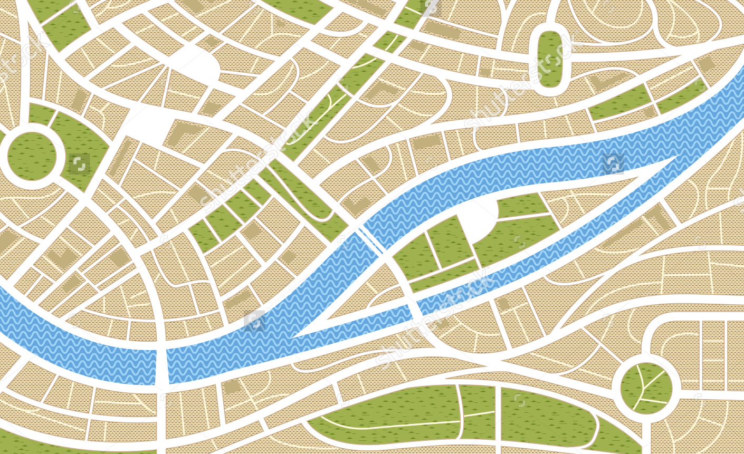
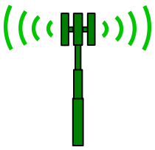
Req. 5.e.: Cell Phones
1
2
3
4
6
7
8
9
5
Notes:
3 minutes for this slide 59:00
[9] Let’s look at the basics of a cellular telephone system in a make-believe town (somewhere.)
[8] First, we’ve got those base station antennas. Wireless companies locate them in the best possible places, considering population, obstructions to signals and available property. We’re just showing four base station antennas here, but there are usually enough in any size town to cover most all areas.
[7] Now we’re showing the “cells” that are covered by the base station antennas. The cell is as big as the range of the base station antenna. Here we’re showing they all reach out the same distance, but in reality, the distances can vary quite a bit. If we want a bigger cell, we can at least increase the power of a base station transmitter. For this discussion, we’ll show them to have the same range.
[6] The base station antennas are all wired directly to the cell carrier’s network, which ties all base stations together around the country.
[5] The cell carrier’s network is also tied to other carrier’s networks and to standard telephone systems.
[4] When your phone is turned-on, even when you are not using it, it tries to link up with the nearest base station antennas. How well it’s doing this is usually shown with some indication on your phone.
In this case, the phone is linked very well to two base station antennas because of your location.
[3] When you call a friend up here, he is also close enough to a base station tower to have a very connection. He probably won’t experience a “drop” because he has a strong signal.
[2] But when you call a different friend down here, his location is on the edge of the cell, with no other base station near by. His call may “drop” because of this.
[1] And when you try calling another friend down here, his cell phone will not pick up a signal because he is out of range of the cell. His phone will probably indicate “no signal” or “out of range” or something like that.
SLIDE END

Slide 25
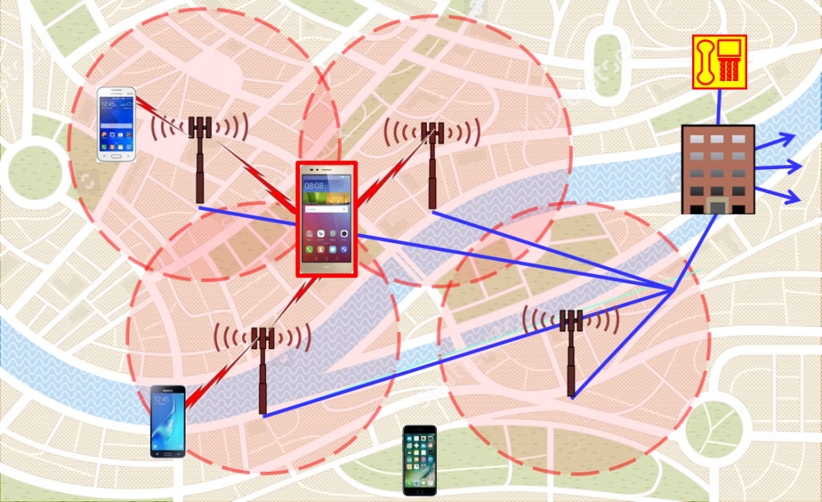
Req. 5.e.: Cell Phone System Limitations in Disasters
90+% load during normal times… What will happen with a bigger-than-normal load?
Still requires land- line telephone system
Requires functioning electrical power system
Limitations in Disasters
1
2
3
4
Notes:
2 minutes for this slide 62:00
[4] We could talk a lot about the differences between using mobile phones and ham radio during disasters, but let’s look at some big differences.
[3] Cell systems during normal use are handling large numbers of regular calls, usually at about a 90% load. We’ve learned that cell systems quickly are overloaded when a disaster occurs: If twice as many people tried to use a mobile phone, the system would be loaded at 180% -- It won’t work! The only real load with ham radio is the ability of trained hams to operate under emergency protocol.
[2] Cell systems do have a wireless component as we’ve already discussed, but we’ve also mentioned that the land line telephone system has to be functioning in order for cell phones to work. Ham radio does not have such a requirement.
[1] Cell systems also require electrical power. Ham radio does as well, but can easily be functional with batteries or portable generators. Cell systems do not have the same capabilities!
SLIDE END

Slide 26
Radio
Merit
Badge
1
Notes:
64:00

