Slide 1
Radio
Merit
Badge
Module 1
1
Notes:
Cover Slide w/3 minutes instructor intro 00:00
[1] Instructors:
> Introduce self
Name, call, years licensed
Ham radio interests
> Describe how this course will work
3 One hour classes
Station visit/operations
> Hand out and describe how notes forms are to be used

Slide 2
Req. 1.: What is Radio?
S
A
B
1
2
3
4
5
6
7
Notes:
2 minutes for this slide 03:00
[7] Ask: Have you ever looked closely at the Radio Merit Badge itself?
There are strange little markings around the top of the merit badge, above the “lightning bolts”
[6] The first little group is a dash followed by three dots.
[5] In Morse Code, that’s the letter “B”
[4] The second group is three dots
[3] The letter “S”
[2] Can you guess what the third is?
[1] A dot and a dash for the letter “A”
“BSA”
Morse Code was the first kind of message sent by man using radio waves.
REQUIREMENT 1 END

Slide 3
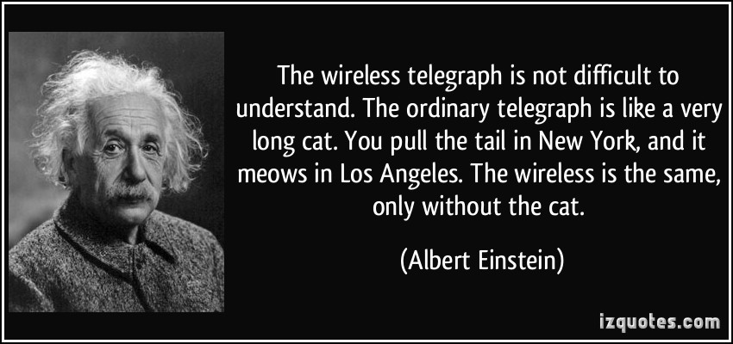
Req. 1.: What is Radio?
Radio?
What is
Radio?
Communication system, using electromagnetic waves
Wireless
“Off The Grid”
1
2
3
4
5
6
Notes:
2 minutes for this slide 05:00
[6] What exactly is “radio?”
[5] A technical way of describing radio is that it’s a system to communicate, using electromagnetic waves. But that’s kind of a GEEK response!
[4] Many refer to radio as “Wireless”, which it is…
[3] How many have used one of these? Is it a “radio?” It is wireless, that’s for sure. But in order for it to communicate, it needs the rest of the system, including computers and telephone wires to interconnect the cell phone towers. But there is definitely a part of it that is “radio.” And most of you use it every day!
[2] Some will say ham radio is “off the grid”, meaning that with only a generator, a radio and an antenna, we don’t need cell towers, power or telephone lines to communicate.
[1] Albert Einstein had a great quote. Will someone volunteer to read it for us?
SLIDE END

Slide 4
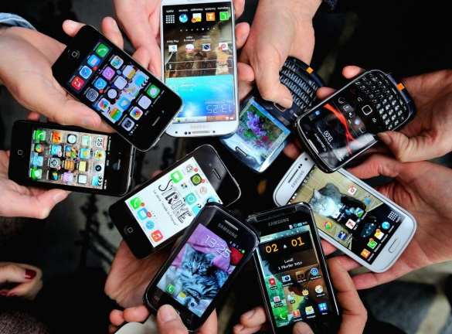
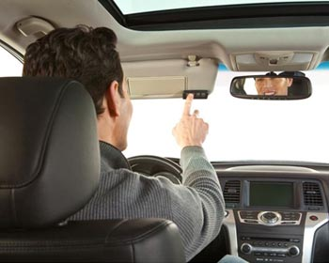
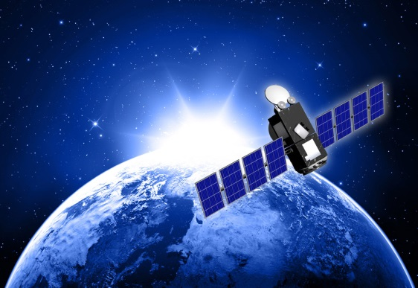
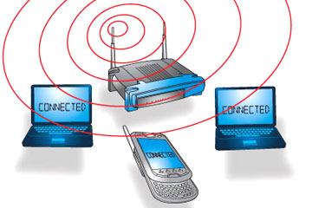
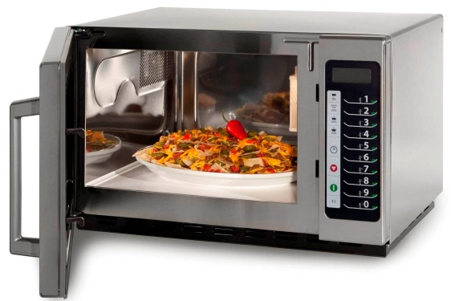
Req. 1.: What is Radio?
Lot’s of things
we use every day
could be considered
forms of radio…
1
2
3
4
5
6
7
Notes:
2 minutes for this slide 07:00
[7] Today we get our entertainment, news and other information over the Internet
[6] The Internet usually makes it to our devices through radio using WiFi
[5] In addition to WiFi, we get information via satellite, another radio method that is very strong.
But radio isn’t just entertainment and information.
[4] We use radio when we operate our mobile phones.
[3] We use radio when we open the garage door remotely.
[2] We use radio when we heat something in the microwave oven.
[1] We even use radio when the EZPass in our car communicates with the gate to charge us the toll and let us through.
SLIDE END

Slide 5
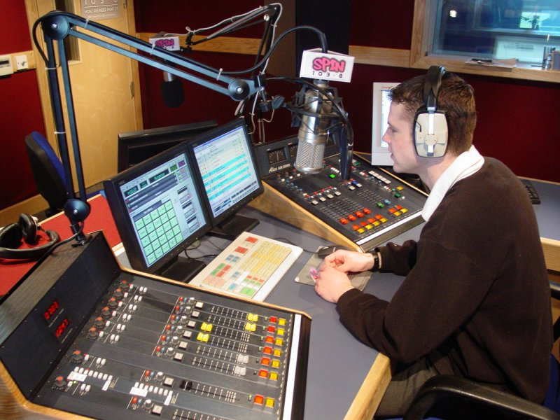
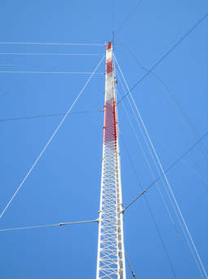
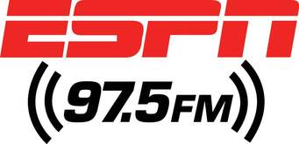
Req. 1.a.: Broadcast Radio
1
2
Notes:
One minute for this slide 09:00
[2] Broadcast radio used to be a major entertainment source before the Internet. Today there are still many good music radio stations, but there are a huge number of talk radio stations such as ESPN.
Usually, a broadcast radio station has one or more studios like this one, with large “boards” (the equipment with all the buttons and knobs) and of course, computers.
[1] Broadcast stations also use large antenna towers like this one, to make sure their signal can reach as many of their intended audience as possible. When there is a hill or small mountain nearby a populated area, you’ll see one or more of these!
SLIDE END

Slide 6
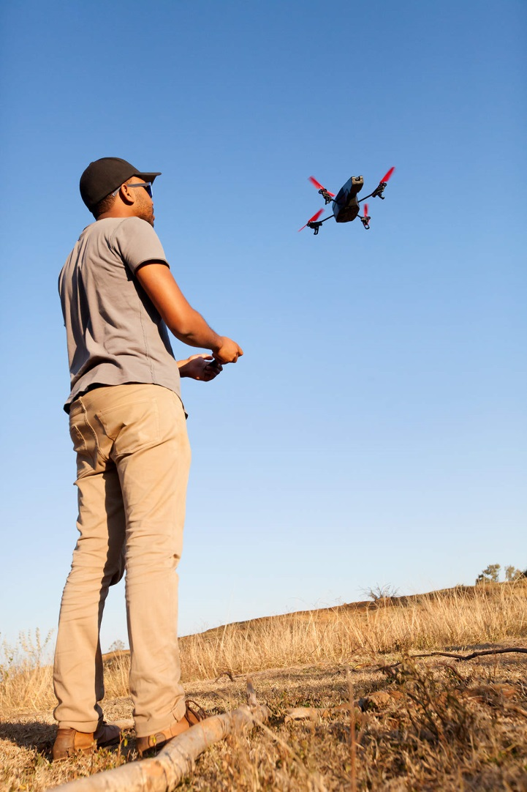
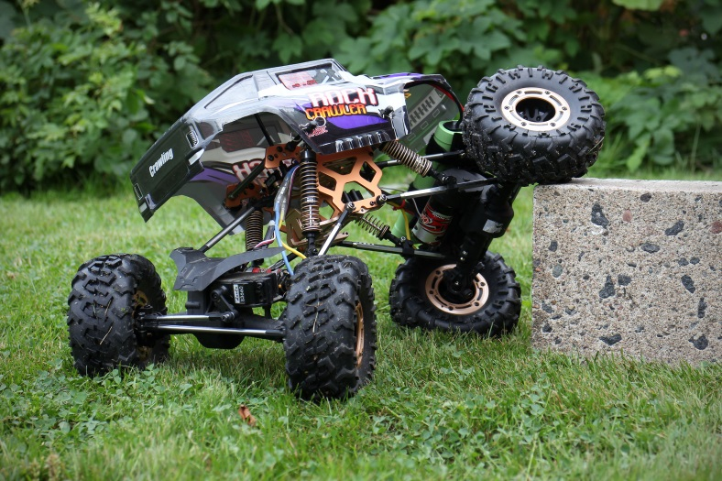
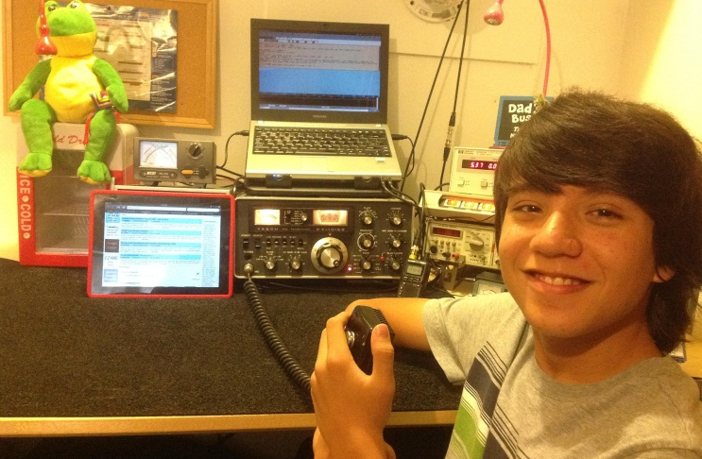
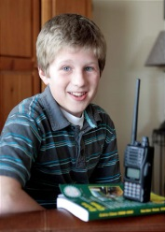
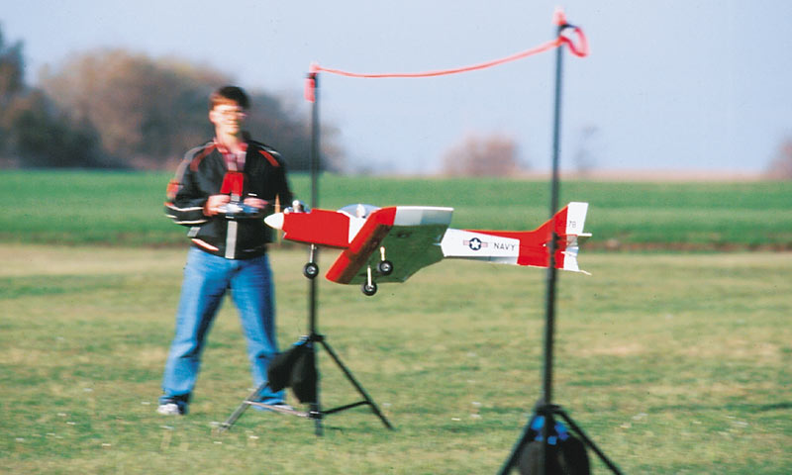
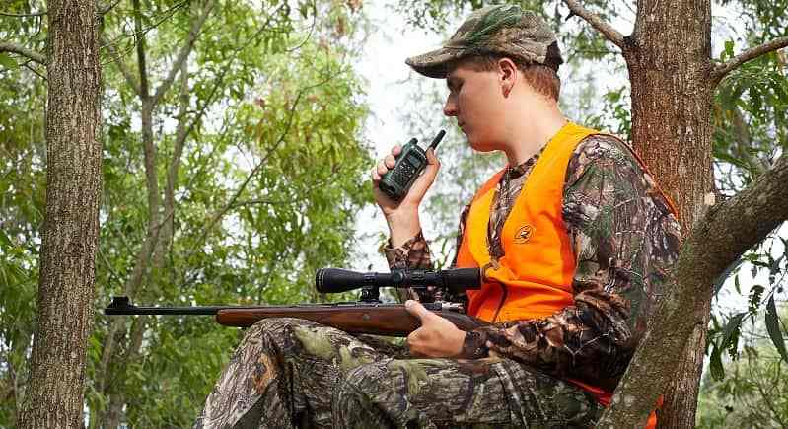
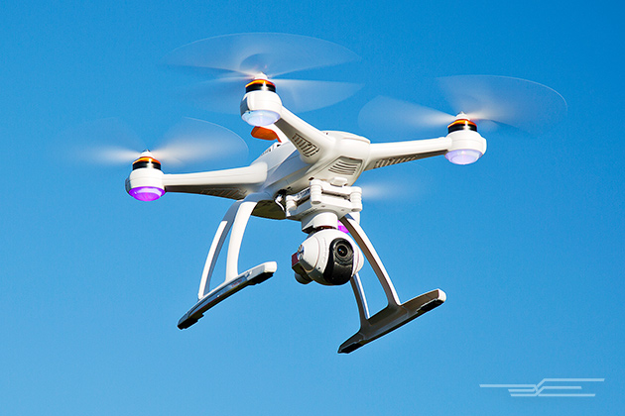
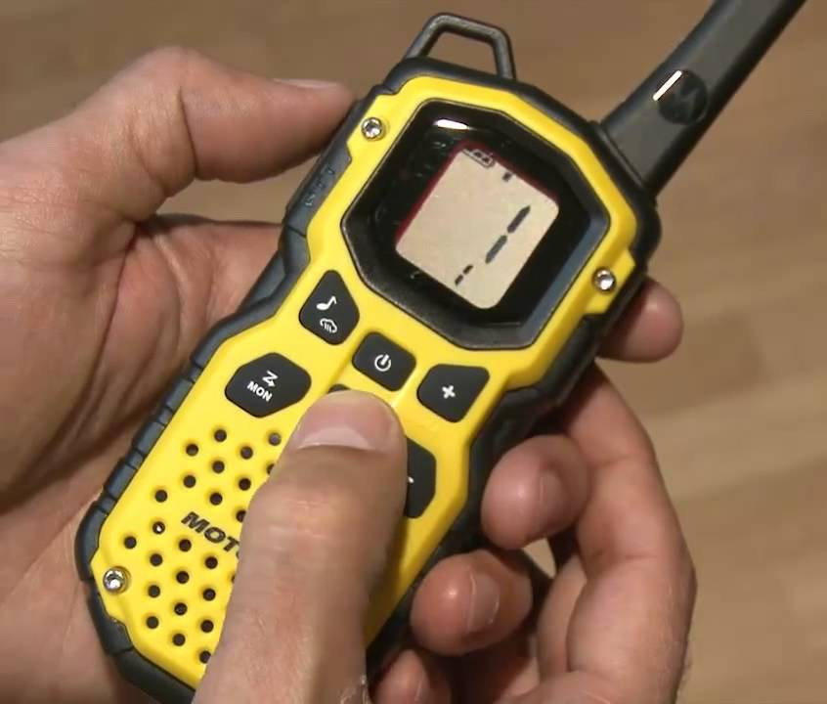
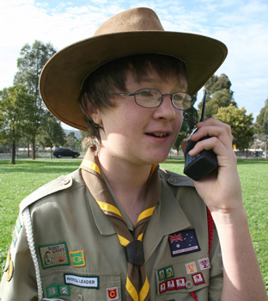
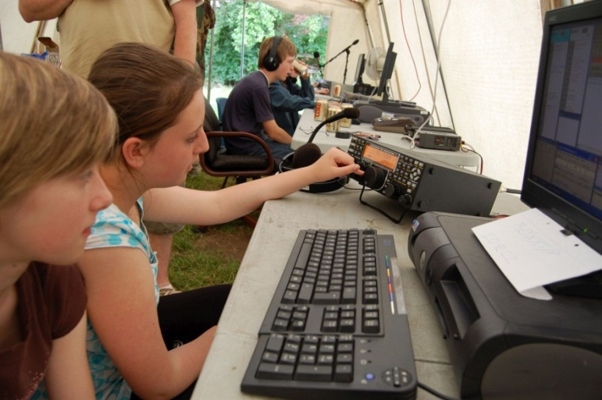
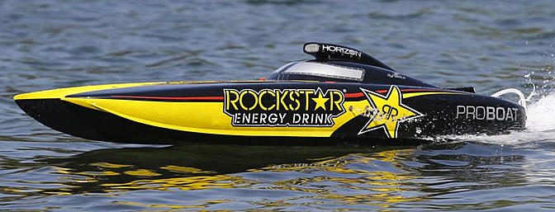
Req. 1.a.: Hobby Radio
2
1
3
4
5
Notes:
2 minutes for this slide 10:00
[5] Radio as a hobby is very popular.
Probably the single biggest group of hobby radio people is with ham radio operators
There is no minimum age; every one of you in this class could get an amateur radio license.
[4] Another type of hobby radio is Radio Control of cars, boats and airplanes.
[3] These days, drones are becoming a very popular radio controlled device
[2] Citizens Band radio is used by many truckers.
[1] Many like to use Family Radio Service (FRS) radios when they need to communicate wirelessly such as during hunting.
SLIDE END

Slide 7
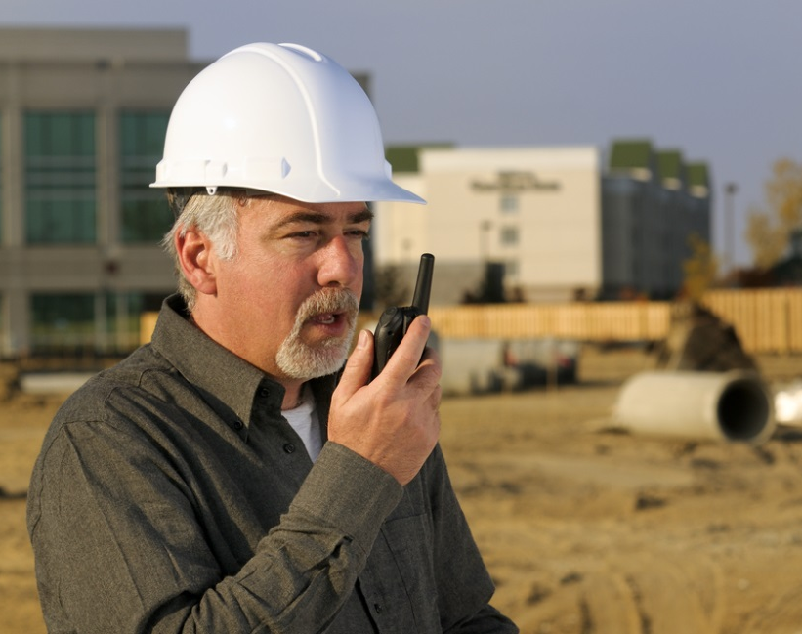
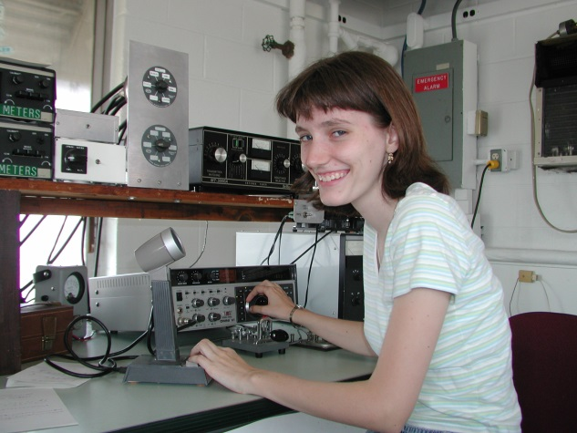
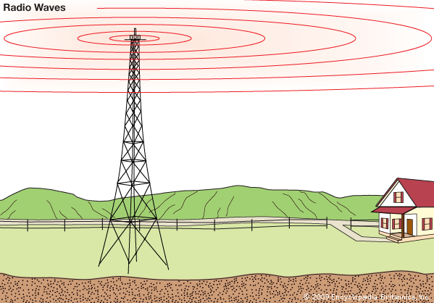
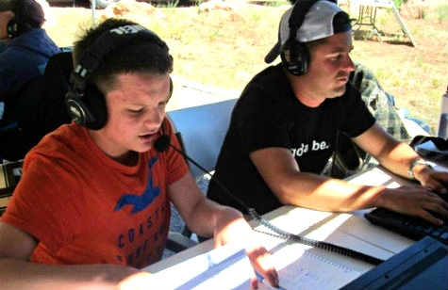
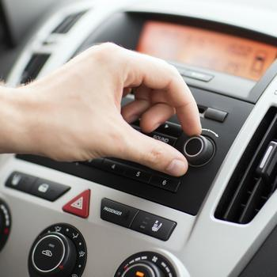
Req. 1.b.: Broadcasting vs. Two-Way Radio
1
2
3
Notes:
1 minute for this slide 12:00
[3] Broadcasting is one-way communication.
Usually you can spot a broadcasting antenna; it’s very tall and such antennas are usually located near large population areas.
Everyone can listen-in on their radio to the programming.
Broadcasting is usually operated as a business, where advertisers pay to have their products/services advertised over the air waves.
Two-Way Communication is just that; it’s NOT one-way broadcasting; there are always two (or more) involved
[2] Businesses use two-way communication to be more efficient.
[1] Ham radio operators use two-way communication in emergencies, when experimenting with equipment and antennas, and mostly for fun!
SLIDE END 14:00

Slide 8
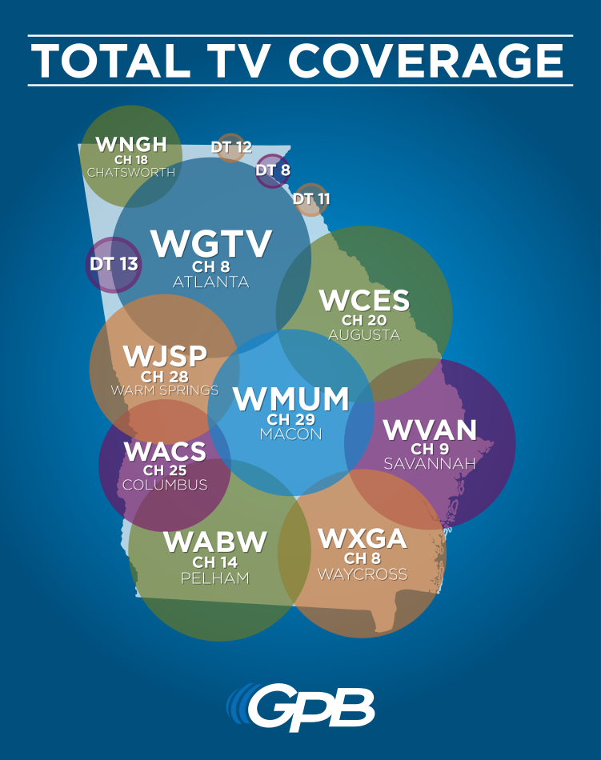
Req. 1.c.: Call Signs
Call Signs
1
2
3
Notes:
2 minutes for this slide 13:00
[3] Call signs are a unique identification for a licensed radio station.
[2] Broadcast radio station call signs are three or four letters such as the FM station above and the television broadcasting stations on the right.
Cable television does not use call signs because their signal does not travel over the airwaves
[1] U.S. Amateur radio station call signs are letters and a number such as the one shown above
SLIDE END

Slide 9
Req. 1.c.: Call Signs
K2GW
K2GW
K2GW
AA - AL
K
KA - KZ
N
NA - NZ
W
WA - WZ
AD4UM
0 - 9
AD4UM
AD4UM
N7QR
N7QR
N7QR
WB8AXP
WB8AXP
WB8AXP
1
2
3
Notes:
2 minutes for this slide 15:00
[3] Every licensed ham radio operator is assigned a unique call sign.
[2] All U.S. ham radio operators have call signs beginning with AA-AL, K, N or W
[1] Each U.S. ham radio operator also has a single number in their call letters, 0-9
SLIDE END

Slide 10
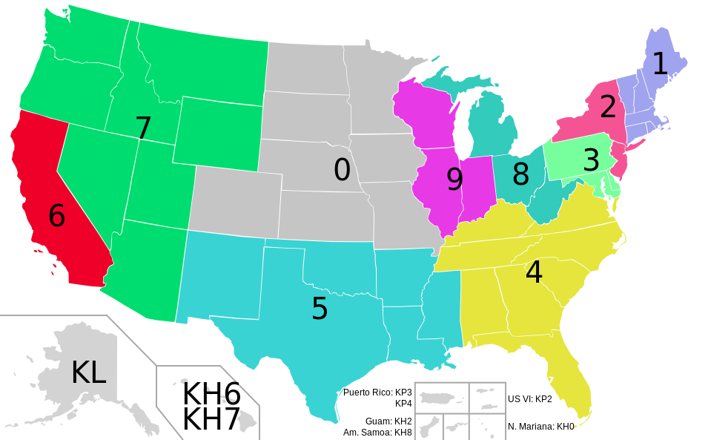
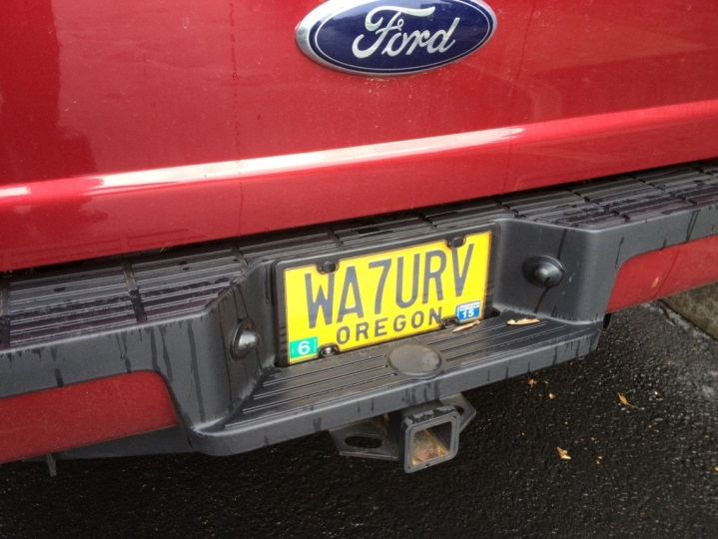
Req. 1.c.: Call Signs
Create Your Own Imaginary Call Sign!
1
2
3
Notes:
2 minutes for this slide 17:00
[3] The number in our call shows the call sign district where our first license was granted.
(If you move to another district, you keep the same number. You can’t be sure anymore that a person with a certain district number actually lives in that district…) If each one of you passed the requirements for your ham radio license where you lived right now, what would the number be in your call?
[2] It is very common for ham radio operators to have a custom license plate made for their vehicle, like this one.
[1] <Create Your Imaginary Call Sign>
Pick K, N, or W, a number, and add your initials
SLIDE END

Slide 11
Req. 1.c.: Call Signs
Global Call Signs
5R8UI
PW8S
1
2
3
4
Notes:
1 minute for this slide 19:00
[4] There are 308 entities in the world with unique first letters or combinations of letters and numbers in radio call signs called “prefixes”. (Many countries have multiple entities, such as the U.S. with Guam, Puerto Rico, etc.)
[3] If I’m operating in my radio station and come across the call letters “5R8UI”, I know that other ham is licensed in Madagascar.
[2] If I contact someone with call letters “PW8S,” I know they are licensed in Brazil.
[1] As a ham radio operator, my heart starts beating hard when I make a contact with a another ham from one of these faraway places!
SLIDE END

Slide 12
Req. 1.d.: Phonetic Alphabet
C
E
A
lfa
H
otel
O
scar
V
ictor
Phonetic
Alphabet
B
D
G
B
ravo
I
P
W
ndia
apa
hiskey
C
T
J
V
harlie
uliet
Q
uebec
X
-ray
P
Z
D
elta
K
ilo
R
omeo
Y
ankee
E
cho
L
ima
S
ierra
Z
ulu
Phil
Bill
F
oxtrot
M
T
ike
ango
G
olf
N
ovember
U
niform
1
2
3
4
Notes:
3 minutes for this slide 20:00
[4] Many letters sound similar over the radio.
Weak radio signals and noise might make it difficult to hear voices.
[3] The letters B, C, D, E, G, P, T, V or Z might sound the same.
[2] A guy who gives his name “Phil” during a radio transmission is often mistaken for the name “Bill”
An operator for whom English is not a native language may pronounce letters differently, too.
[1] Radio operators use a standardized phonetic alphabet to improve understanding and avoid communication errors.
<Instructor give his own example> Now each of you speak the call you made a couple minutes ago, using the phonetic alphabet words instead of just saying the letters.
SLIDE END

Slide 13
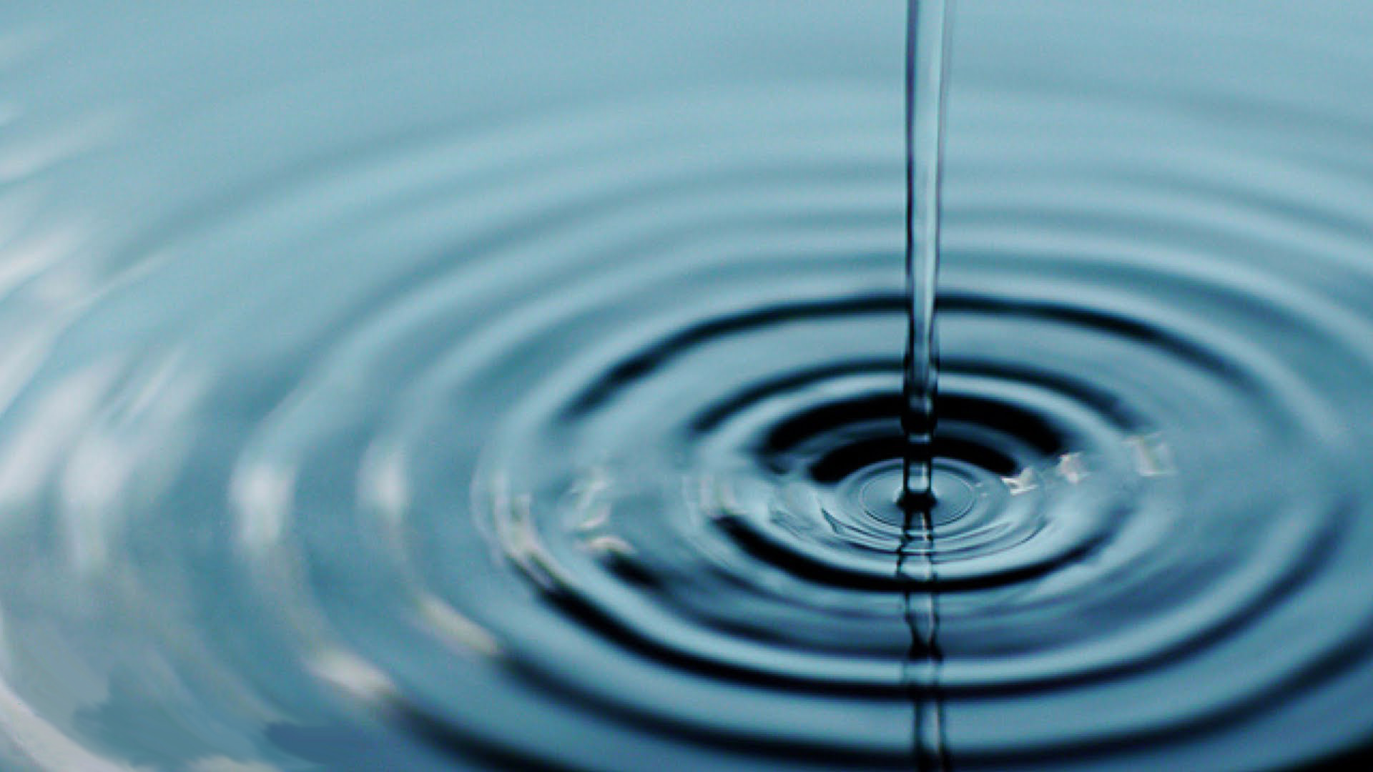
Req. 4.: How Radio Waves Carry Information
How Radio Waves
Carry Information
ANTENNA
1
2
3
4
Notes:
2 minutes for this slide 23:00
[4] Radio is about a lot of things, “radio waves” being an extremely important part. There are all sorts of radio waves.
[3] We often compare radio waves with the ripples in water caused by a thrown rock.
[2] Instead of throwing a rock, radio waves are somehow thrown by some sort of antenna.
[1] Waves of many different types will start at the antenna and travel in many directions for long distances, sometimes around the world.
We’re pretty sure they don’t look like the waves shown here, but at least you get the idea.
And these waves are all around us, right here where we’re sitting. Your mobile phones are receiving (and sending) radio waves all the time. The radio waves from Amateur Radio antennas are much stronger up high at the point where the radio waves “shoot” off the antenna.
SLIDE END

Slide 14
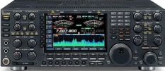
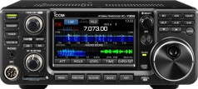
Req. 4.: How Radio Waves Carry Information
United States
Europe
Our Wireless
System
Receiving
Antenna
Transmitting
Antenna
Voice
Into
Microphone
Radio
Transmitter
Radio
Receiver
Loud
Speaker
1
2
3
4
5
6
7
8
9
10
Notes:
5 minutes for this slide 25:00
[10] Radio is wireless; the Internet is NOT wireless; cable TV is NOT wireless;
Radio is “OFF THE GRID.” That’s what makes radio cool! If electrical power, cell phone and telephone service goes out, you can still get through with radio! (using batteries, generators, solar, etc.)
[9] Radio uses transmitters to generate energy waves and a radio receivers to detect them and make them useful
[8] There can be tens, hundreds or thousands of miles between a transmitter and receiver, across the city, county, country or WORLD (or SPACE!)
[7] Transmitters must be connected to an antenna to send out the waves
[6] Receivers must also have some sort of antenna to collect the waves
[5] These energy waves are generated when some sort of signal (like a voice into a microphone) is presented to a radio transmitter
[4] The transmitter converts the voice (in this example) to radio wave energy and sends this energy up to the antenna
[3] The antenna throws-off the waves in directions and distances based on how the system is designed
[2] The transmitted energy waves are collected by any receiving antenna designed to detect them, and sends the radio wave energy down to the receiver.
[1] The radio receiver processes the energy waves and converts them into audio that you can hear either through a speaker or headphones
Many radio receivers can be directly connected to a computer where the signal is digitized.
SLIDE END

Slide 15
Req. 2.a.: Introduction to How Radio Waves Travel
186,000 miles per second!
How
Radio Waves
Travel
1
2
3
4
5
Notes:
2 minutes for this slide 30:00
[5] Some people think the whole idea of “radio waves” is magic!
[4] Even though we can’t really “see” radio waves, we often show them as a series of ripple lines like this.
[3] Radio waves actually move.
[2] They move at the speed of light!
Ask: How fast is “the speed of light”?
[1] <186,000 mi/second> or <approx. 300,000,000 meters/second>
SLIDE END

Slide 16
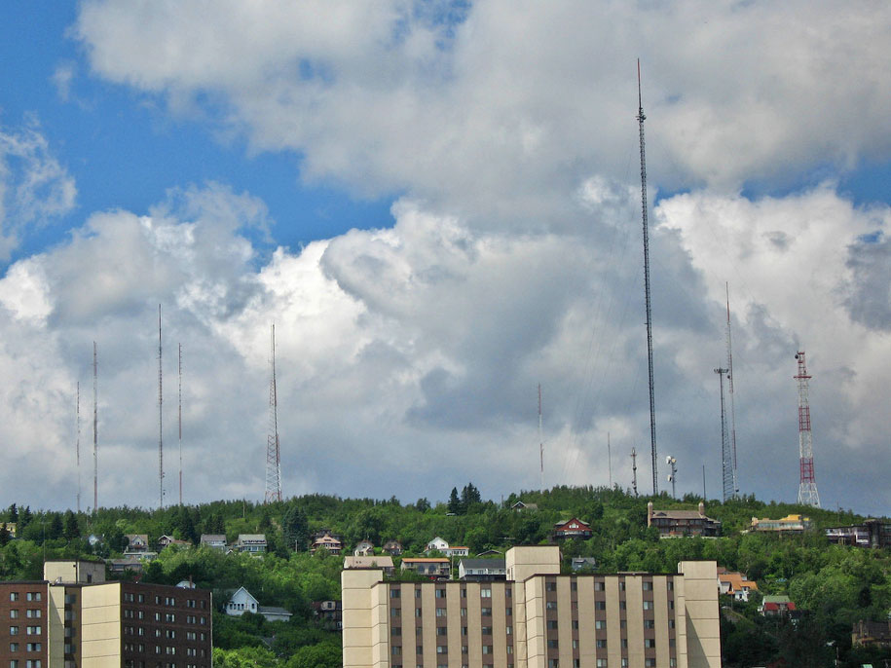
Req. 2.a.: Introduction to How Radio Waves Travel
EARTH
1
2
3
Notes:
2 minutes for this slide 32:00
[3] The simplest for of radio wave travel is called “line of sight.” You’ll learn later that radio waves called “Very High Frequency” (and higher) depend pretty much on line of sight.
As shown here, someone transmitting radio waves from their location to yours is simply a matter of sending the signal straight across.
Have them draw this image on their work sheet!
[2] This works well unless there is something in the way of the line-of-sight signal, such as a small mountain.
[1] That’s why you’ll often see antennas on hilltops so that their line-of-sight signal will travel farther!
SLIDE END 04:00

Slide 17
Req. 2.a.: How Radio Waves Travel
EARTH
1
Notes:
1 minute for this slide 34:00
[1] Even if there are no mountains in the way of you line-of-sight signal the curve of the earth will eventually make it impossible for the signal to reach someone far enough around the curve! Line-of-sight signals can “bend” a little, but not for long distances.
That’s where other forms of wireless radio come into play.
SLIDE END

Slide 18
Req. 2.a.: How Radio Waves Travel
IONOSPHERE
2ND HOP
CHICAGO
DENVER
SKIP ZONE
SAN
FRANCISCO
GROUND
WAVES
2ND SKIP ZONE
SKIP
DISTANCE
2ND HOP
SKIP DISTANCE
NEW YORK CITY
EARTH
1
13
15
16
14
2
3
5
12
10
6
9
7
4
11
8
Notes:
8 minutes for this slide 35:00
[16] Consider four cities lying along the curvature of the earth, San Francisco, Denver, Chicago and New York City. We’ve already talked about line-of-sight radio waves, and we know they pretty much can’t follow the curve of the earth.
[15] Even some transmitters designed to send radio waves around the earth will throw off ground waves that won’t go very far.
[14] This is where the Ionosphere comes in. The Ionosphere is an interesting invisible cloud of charged particles that surrounds the earth. This is one of the most interesting parts of radio because it has many effects on radio waves.
[13] If I’m in San Francisco, my transmitter and antenna will throw off radio waves at an angle up into the sky.
[12] When my signal enters the Ionosphere, the radio waves bend back down toward the earth as if they were being reflected off a mirror. While the Ionosphere isn’t exactly a mirror, it has a similar effect. My radio waves come back down to earth at approximately the same angle they entered the Ionosphere, and can be detected by someone listening on my frequency near where the waves get close to the ground.
[11] We call this reflection off the Ionosphere “skip” and the total up and down distance is called “skip distance”
[10] What about the people in Denver? People listening on my frequency cannot hear my signal because it has “skipped” over them! We call this area where a signal skips over the “skip zone.”
[9] After the first skip of my signal, it will reflect off the earth and head back out towards the Ionosphere. It will then reflect again off the Ionosphere, heading back down to earth. Here we show that it hits somewhere near New York City, where someone may be listening in.
[8] We call this the “2nd hop” (or 2nd skip) of my signal. My signal has gone all the way from San Francisco to New York City; not possible with line-of-site or ground waves.
[7] And with a second hop, there is a second skip zone. In the case no one in Chicago will hear my signal because it’s travelling too high for their antennas to detect!
[6] The total of both hops is called the “2nd hop skip distance”
There are two other interesting things that can happen with skip:
[5] Let’s say I position my antenna in such a way as to lower the angle my radio waves travel to the ionosphere.
[4] They will reflect back down at that lower angle, making them go much farther like I’m showing here. Now my first skip hop got my signal all the way to Chicago, while on the first try, it didn’t quite go as far.
[3] And on the 2nd hop, this signal travels over New York City to someplace in the Atlantic Ocean (maybe a tropical island?).
[2] Finally, I might position my antenna so that radio waves angle up too sharply.
[1] They will deflect a bit, but they’ll end up going right through the ionosphere into space; no one will hear them (except an alien or possibly an astronaut!
SLIDE END

Slide 19
Req. 2.a.: How Radio Waves Travel
EARTH
1
2
3
Notes:
1 minute for this slide 43:00
[3] Now let’s look at what really is amazing…
[2] This skip effect can take a radio wave signal all the way around the other side of earth!
[1] What’s really crazy, signals can sometimes skip their way completely around the earth, and I’m able to hear my own signal!
If the instructor has time: At 186,000 miles per second, how long does it take my signal to make one run around the earth? (25,000/186,000 = .134 seconds; a little more than a tenth of a second.
In our illustration here, it would take about .065 seconds to travel half way around the world!.
SLIDE END

Slide 20
Req. 2.a.: How Radio Waves Travel
EARTH
Finish
Drawing!
1
Notes:
6 min for this slide 44:00
[3] Now let’s look at what really is amazing…
[2] This skip effect can take a radio wave signal all the way around the other side of earth!
[1] What’s really crazy, signals can sometimes skip their way completely around the earth, and I’m able to hear my own signal!
If the instructor has time: At 186,000 miles per second, how long does it take my signal to make one run around the earth? (25,000/186,000 = .134 seconds; a little more than a tenth of a second.
In our illustration here, it would take about .065 seconds to travel half way around the world!.
SLIDE END

Slide 21
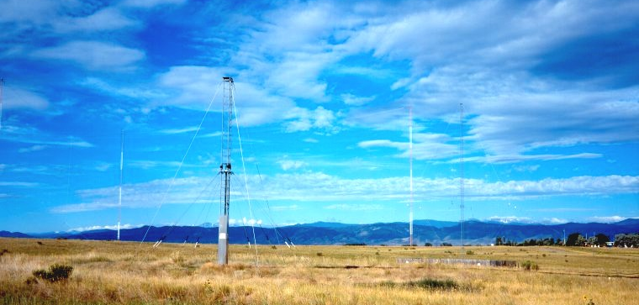
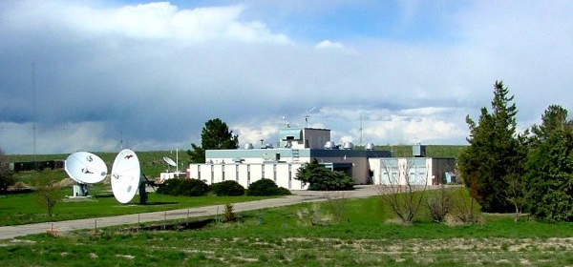
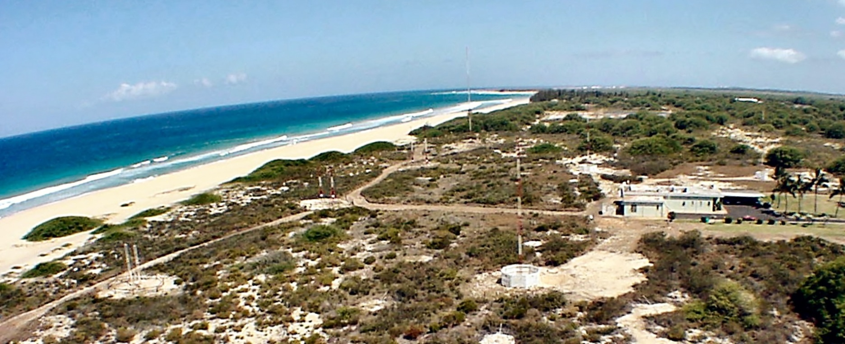
Req. 2.b.: WWV and WWVH
WWV
WWVH
1
2
3
4
Notes:
3 minutes for this slide 50:00
[4] What exactly is “WWV?”
[3] WWV is the call sign of the United States National Institute of Standards and Technology's (NIST) radio station near Fort Collins, Colorado.
[2] WWV uses high performance antennas to continuously transmit its signal, and can be heard all over the world!
They transmit simultaneously on several frequencies. Their frequencies and time signals are controlled by atomic clocks located in Boulder, Colorado.
[1] NIST also operates the very similar radio station WWVH in Kauai, Hawaii, using the same frequencies.
WWV and WWVH make recorded announcements; since they share frequencies, WWV uses a male voice to distinguish itself from WWVH, which uses a female voice.
They also make other recorded announcements of general interest, e.g., the GPS satellite constellation status and severe oceanic weather warnings.
SLIDE END

Slide 22
Req. 2.b.: WWV and WWVH
<Click for WWV audio>
1
Notes:
1 minute for this slide 53:00
[1] Instructor: In presentation mode, simply click on speaker icon.
It is helpful to have external speakers for this audio
SLIDE END

Slide 23
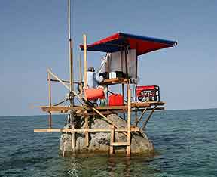
Req. 2.c.: DX
DXpedition
= “DISTANCE”
1
2
3
Notes:
2 minutes for this slide 54:00
[3] Ask: Can you guess what the abbreviation “DX” means?
[2] DX is shorthand for "distance."
There’s no exact amount of distance defined for DX, but we say DX communication is over great distances using the ionosphere to refract the transmitted radio signal.
DXing is the pursuit of distant stations with the goal of earning various awards.
[1] A DXpedition is a trip to operate in a rare DXCC entity, such as one to Scarborough Reef in the South China Sea.
SLIDE END

Slide 24
Req. 2.d. ITU/FCC
International
Telecommunication Union
Federal
Communications Commission
ITU?
FCC?
International
Treaty
United States
Radio Law
1
2
3
Notes:
3 minutes for this slide 56:00
[3] Because radio has no boundaries (radio waves don’t stop at borders), the countries of the free world get together and make formal agreements on how radio should be used.
It is up to each country to create their own laws which ensure they abide by the international agreements.
An formal international group has been created to coordinate the agreements between countries.
[2] This international group is called the International Telecommunications Union (or “ITU”). The ITU coordinates the agreements in the form of treaties between countries and has headquarters in Geneva, Switzerland.
[1] The agency in the U.S. government which creates and enforces law to help us fulfill the international treaties is called the Federal Communications Commission (FCC).
Nearly all who transmit radio signals for any purpose are required to be registered and licensed by the FCC.
The FCC is the agency that assigns those call signs we talked about earlier in Requirement 1c.
REQUIREMENT 2 END

Slide 25
Radio
Merit
Badge
1
Notes:
59:00

