Slide 1
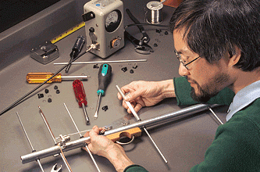
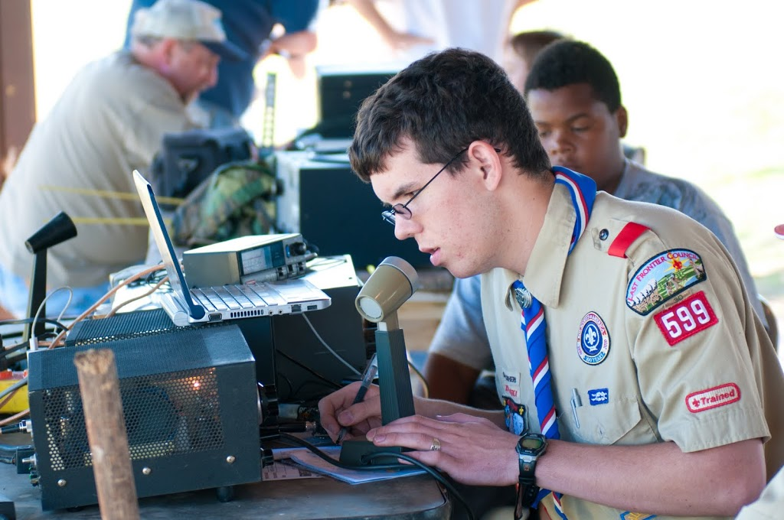
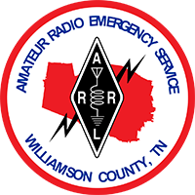
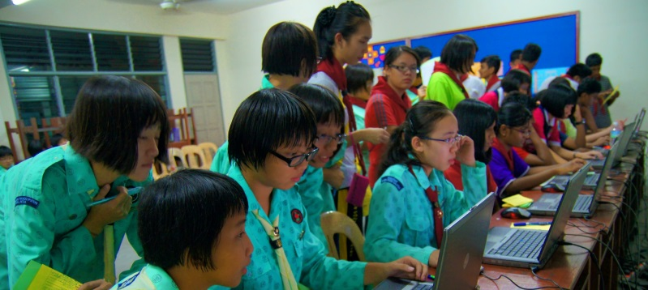
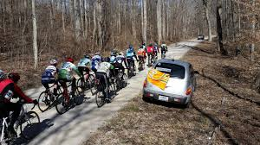
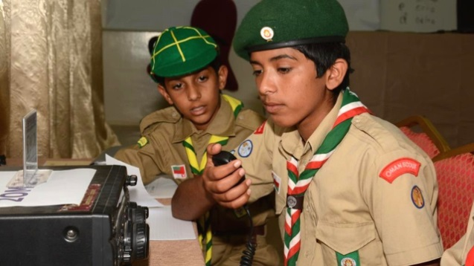
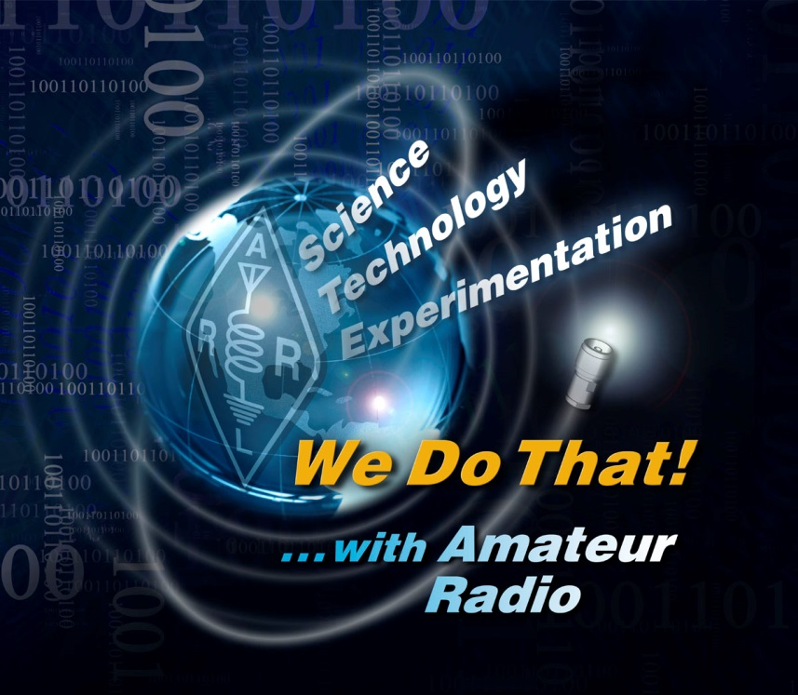
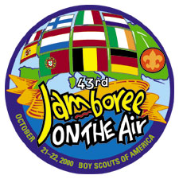
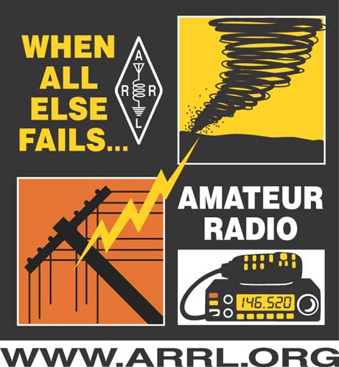
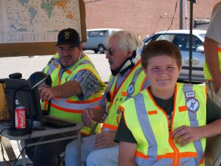
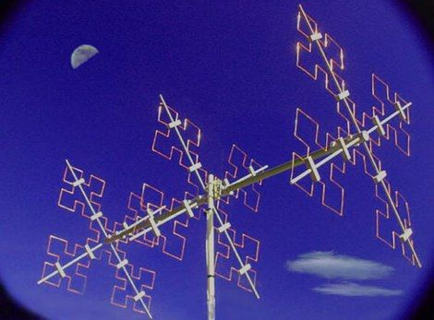
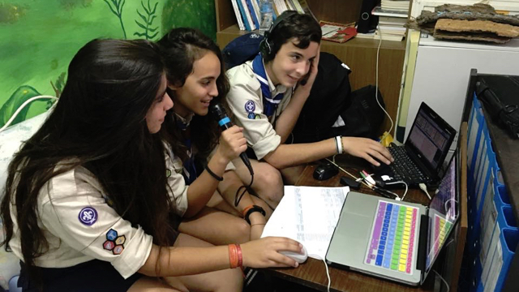
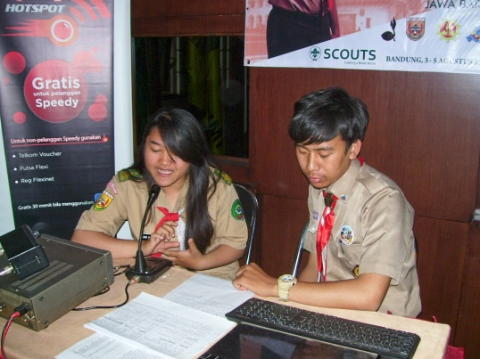
Req. 9.a.(1): Amateur Radio Service
AMATEUR
RADIO SERVICE
1
2
3
4
5
Notes:
2 minutes for this slide
[1] The Federal Communications Commission or “FCC” is the government agency that established the “Amateur Radio Service.”
There are many reasons to have such a service.
Here’s a few:
Public Service – Community service and disaster help (A Scout does a Good Turn daily – this is another way to do that)
International goodwill – A great way to talk to people in other countries.
Experimentation – Hams have invented many technologies used in places outside of ham radio, including new kinds of software and hardware
Communication skills – Hams become excellent communicators
SLIDE END

Slide 2
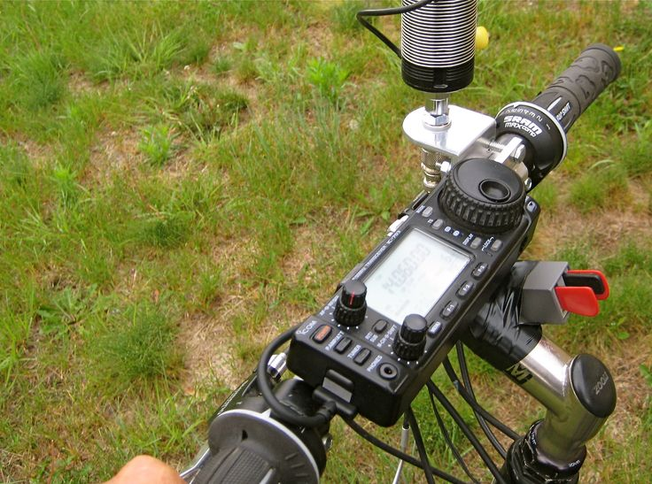
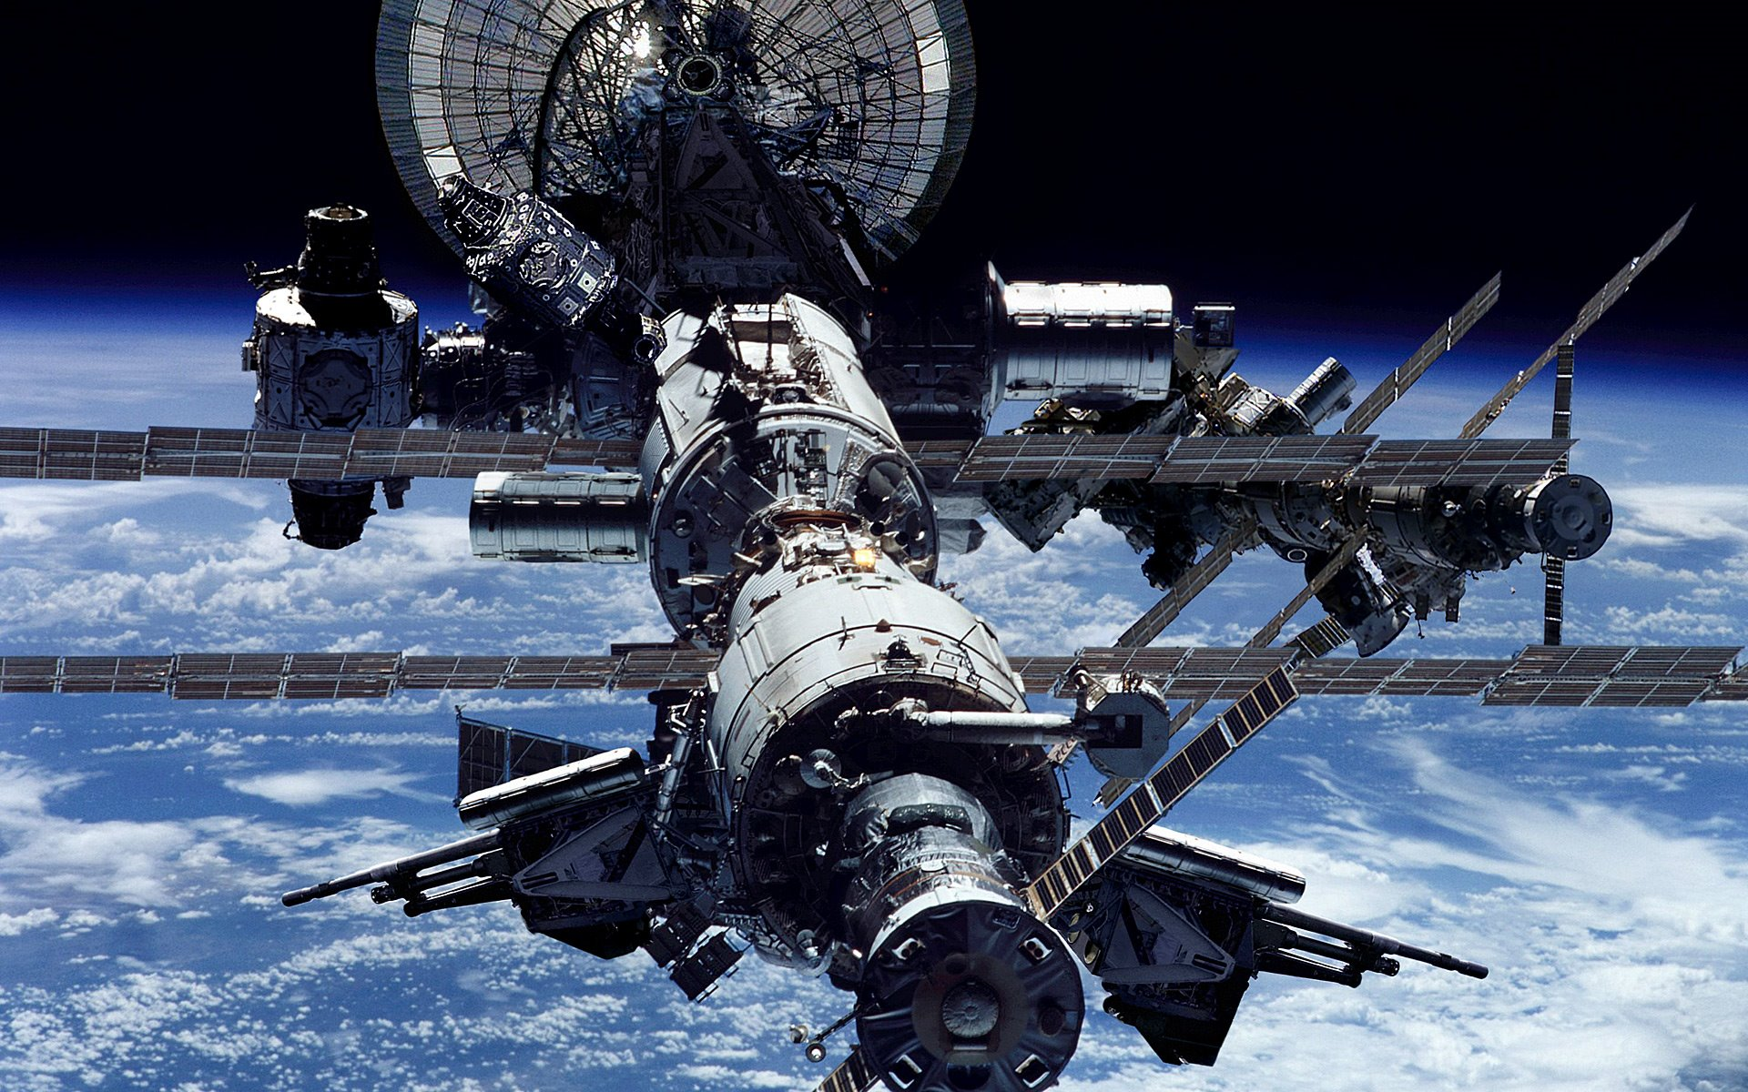
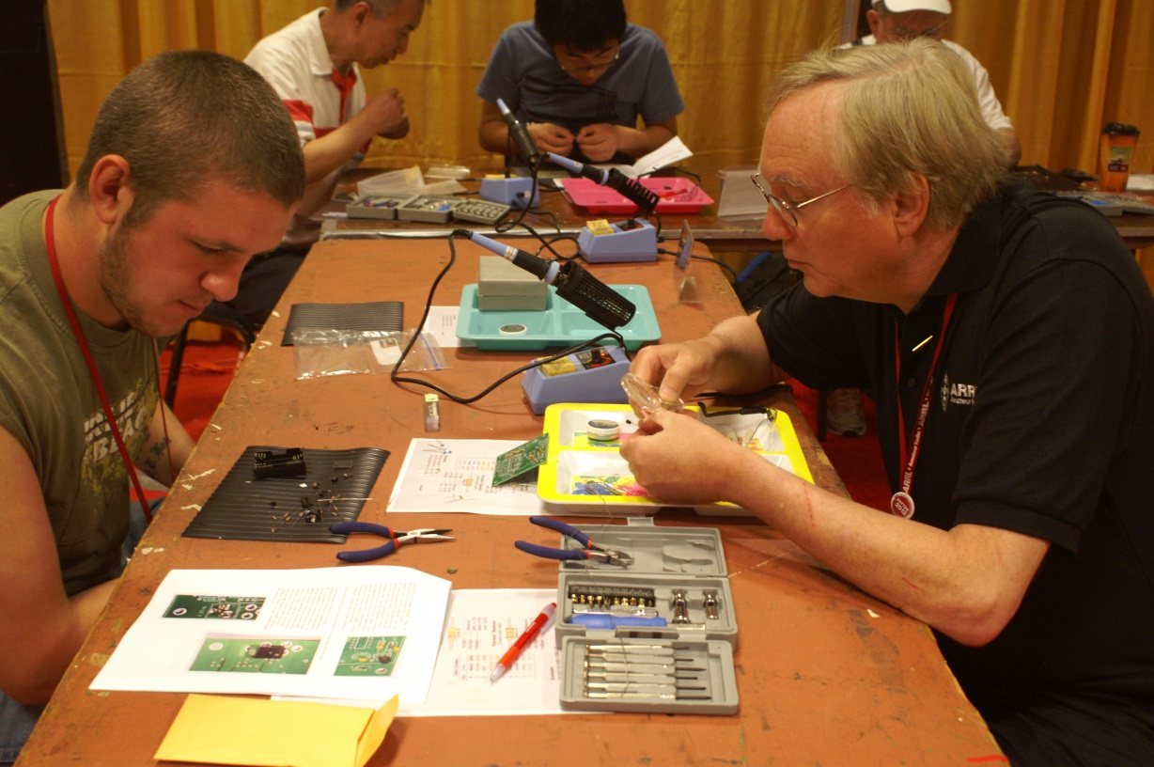
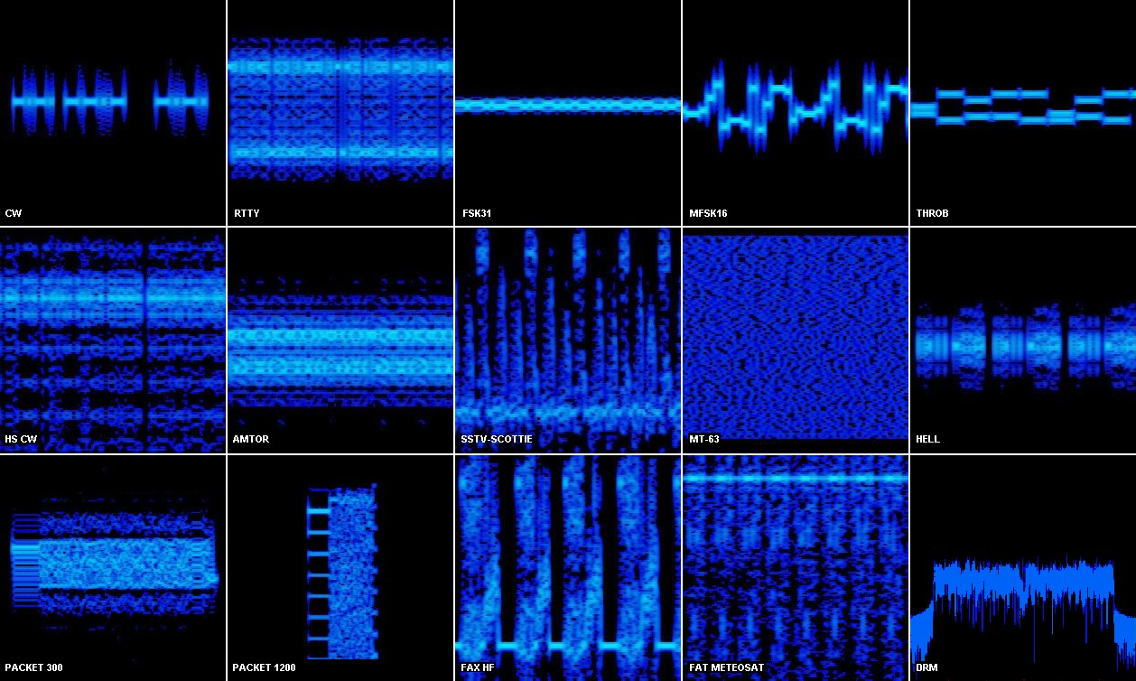
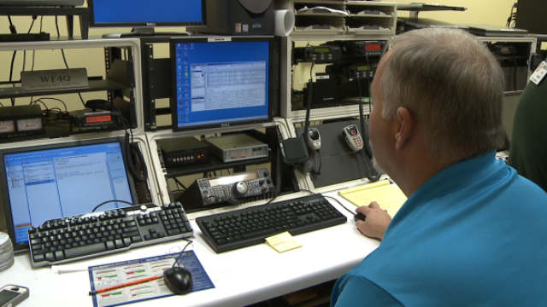
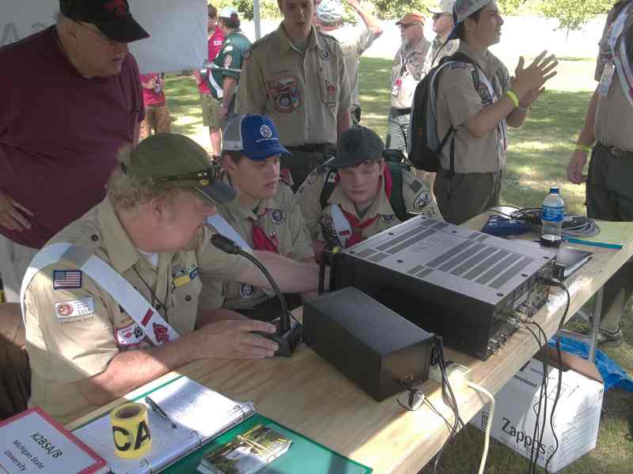
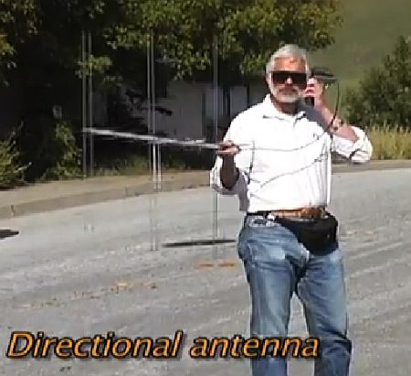
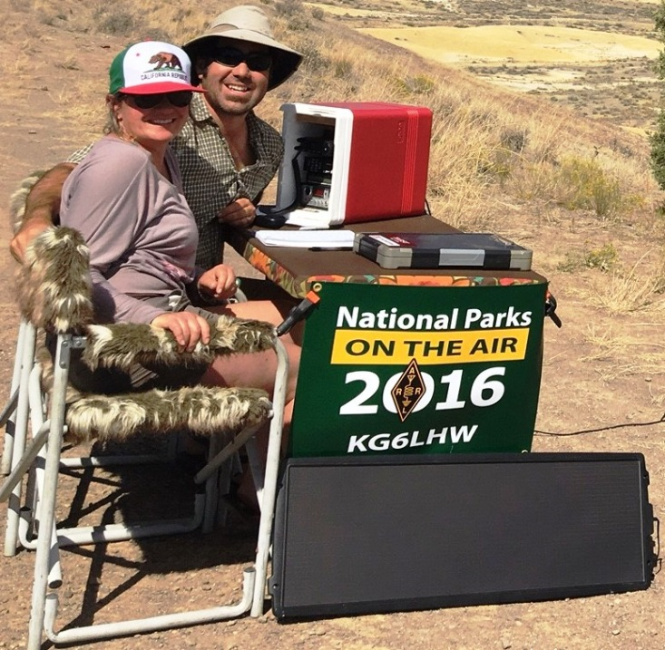
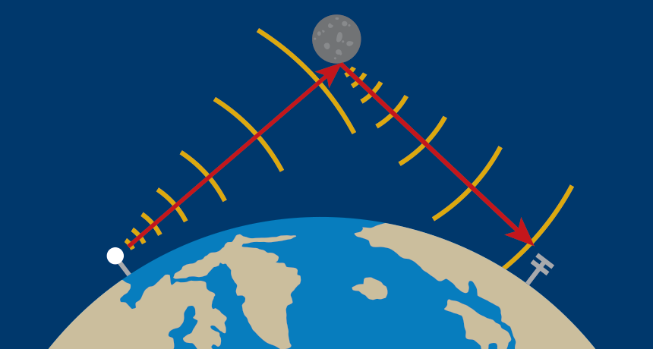
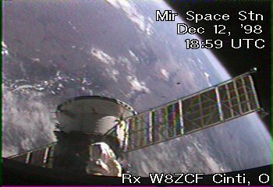
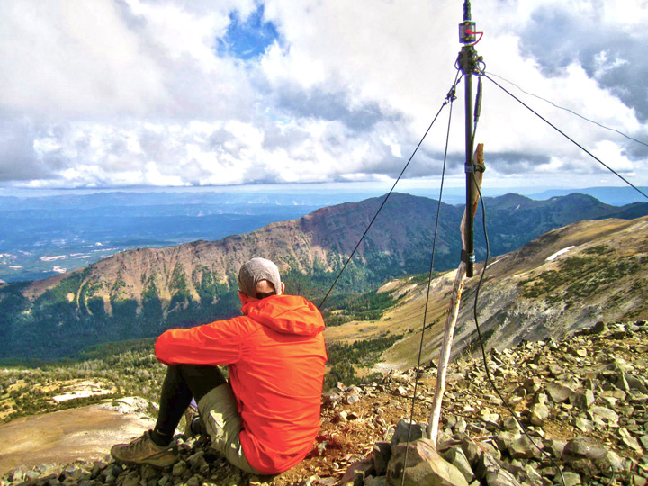
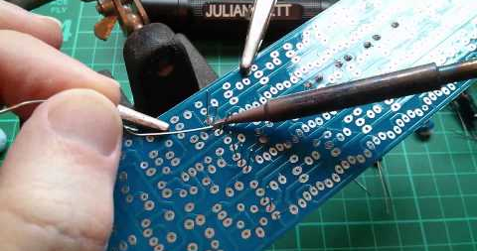
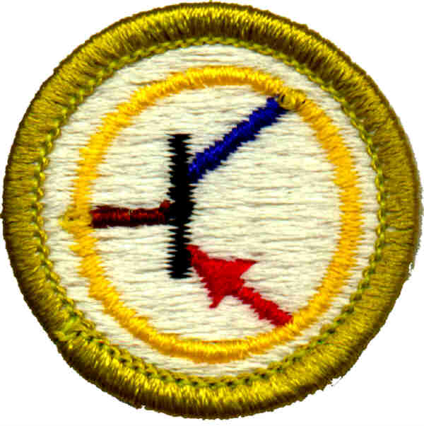
Req. 9.a.(1): Amateur Radio Fun!
Moonbounce
Earth-Moon-Earth
(EME)
Slow Scan
Television
Moon
Bicycle
Mobile
Amateur
Radio
Direction
Finding
(ARDF)
“Foxhunting”
SOTA
Digital
Basic Operating
1
2
3
4
5
6
7
8
9
10
11
12
13
Notes:
4 minutes for this slide
[13] There are many ways to have fun in ham radio. Of course, there’s the basic operating like we do here at K2BSA, contacting people all over the United States and the world!
[12] Foxhunting, another activity here at K2BSA, is known as a “radiosport,” because it requires radio skills, physical fitness, and other Scout skills such as map and compass.
[11] You could become interested in satellite communication and create your own Earth Station.
[10] K2BSA at this Jamboree will be making a contact with the International Space Station. (See Operations Guide for Jamboree ISS contact info)
[9] You could set up a bicycle with a full ham radio mobile station, antenna and all!
[8] Many hams are into digital communication, where software is combined with radio equipment to transmit all types of digital signals around the world. What you see here are various types of modulated signals that are created by the software that drives the transmitter.
[7] Instead of the traditional telegraph key or microphone, the ham operator uses a computer with a regular transmitter to modulate the signal.
[6] Some hams are big into the outdoors, combining their radio hobby with high adventure. Those involved in “National Parks On The Air” try to visit and operate from as many national parks as possible.
[5] And in “Summits On The Air”, hams will climb to the top of various mountain peaks and operate from the top! We have a SOTA site here at the Jamboree: At the summit of Garden Ground
[4] We can even operate “slow scan television,” sending video signals from ham radios. Here we see a slow scan ham radio signal from a space station.
[3] With something we call “Moonbounce” a signal with the right equipment and antennas can reflect off the moon, travel back to earth and be received by another ham a continent away!
[2] A lot of hams like to build their own equipment.
[1] Learning how to read schematics, identify electronic parts and use tools such as soldering irons can be a lot of fun! You can get deep into this by earning the Electronics Merit Badge!
SLIDE END

Slide 3
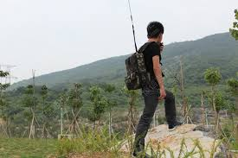
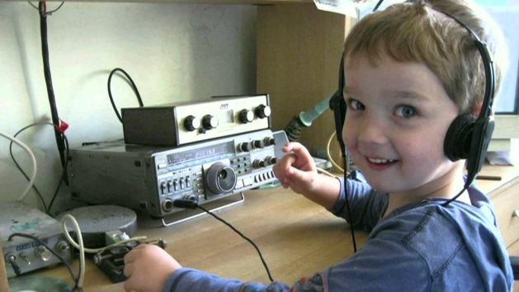
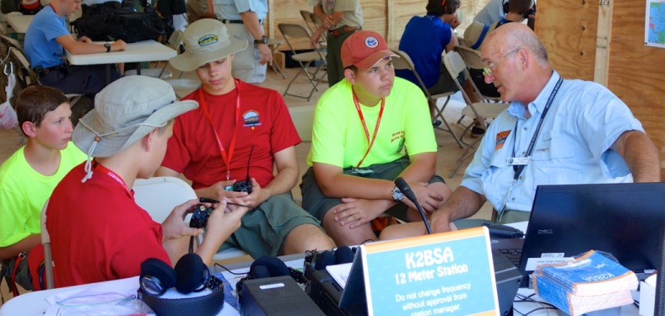
Req. 9.a.(2): Amateur Radio License Differences
Extra
3
General
2
Testing
Technician
1
Amateur Radio Licenses
1
2
3
4
5
Notes:
5 minutes for this slide
[5] There are three amateur radio licenses in the United States:
[4] The Technician Class license requires you to learn basic operating procedures, understand important radio regulations and learn some basic electronics.
Technician Class license holders are allowed to operate on several bands, with an emphasis on VHF and UHF.
[3] General Class license holders need to have an intermediate understanding of practices, regulations and electronics theory. While they can are allowed to use the same bands as Technicians, Generals also get on more of the shortwave bands and communicate all around the world.
[2] Extra Class license holders have passed an exam on advanced electronics theory and practices. The have privileges on all bands, and can administer license examinations.
[1] The FCC allows certified volunteers to administer amateur radio license exams. These volunteers are call “Volunteer Examiners.”
SLIDE END

Slide 4
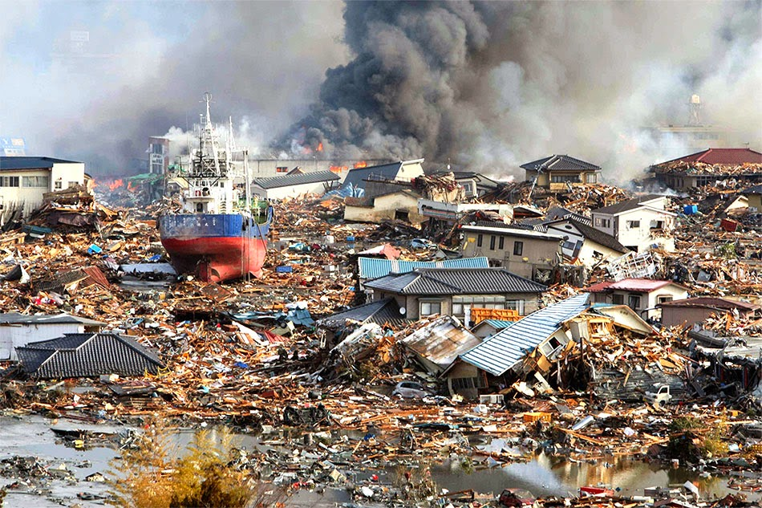
Req. 9.a.(4): Emergency Calls
“BREAK-BREAK”
Emergency
Calls
S
O
S
“MAYDAY!”
“EMERGENCY!”
1
2
3
4
5
6
Notes:
2 minutes for this slide
[6] We all live in areas where there are different types of risk for major disaster events.
The East coast has its hurricanes.
The West coast has its earthquakes and tsunamis
The middle of the country has its tornadoes
As a ham radio operator, you need to be ready to send an emergency message.
In fact, during catastrophic emergencies like the one we just showed, anyone can use any kind of radio when it’s a life or death situation.
If you are a ham, or even if you aren’t and have access to communications equipment, you would turn on the gear and first listen for what we call “traffic” (people already talking).
[5] Then you would speak clearly into the microphone and say “Break-Break.” This tells people you likely have an immediate need to make a contact.
[4] The common word used on the radio for “I HAVE AN EMERGENCY” is “MAYDAY”
[3] If you forget the word Mayday, you could just say “Emergency!”
[2] Ask: What do you think this is?
That’s right. It is the symbols we use when writing Morse Code.
Ask: What do you think it’s saying?
[1] Good guess! That’s right, it means S-O-S, which is the Morse Code version of the word Mayday.
SLIDE END

Slide 5
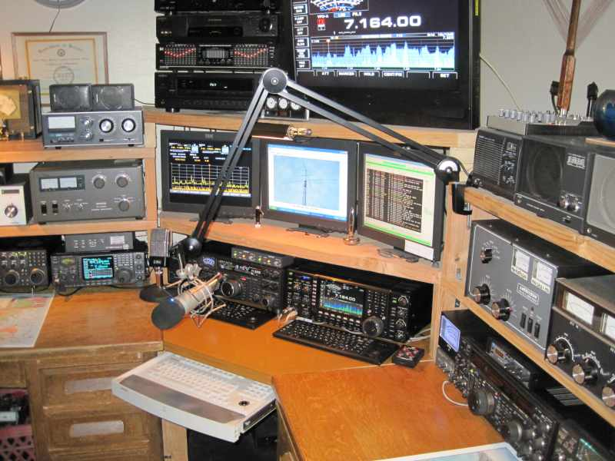
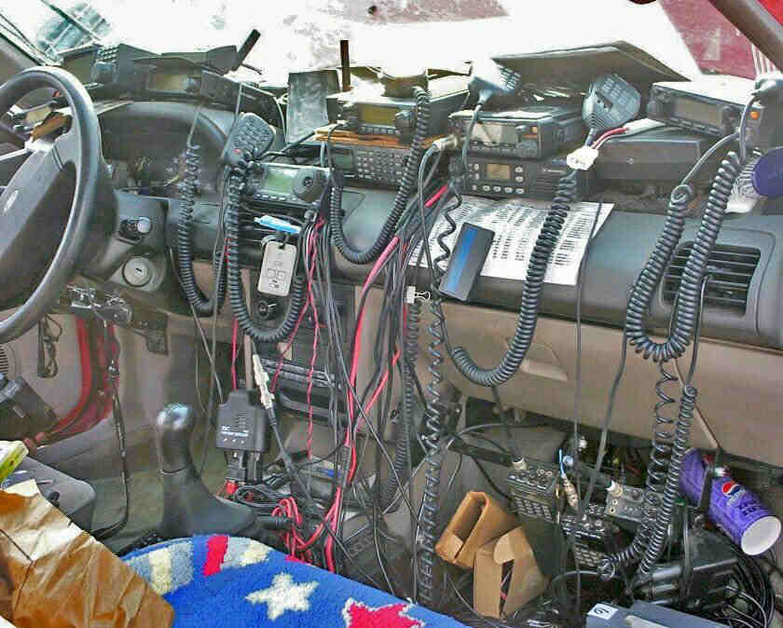
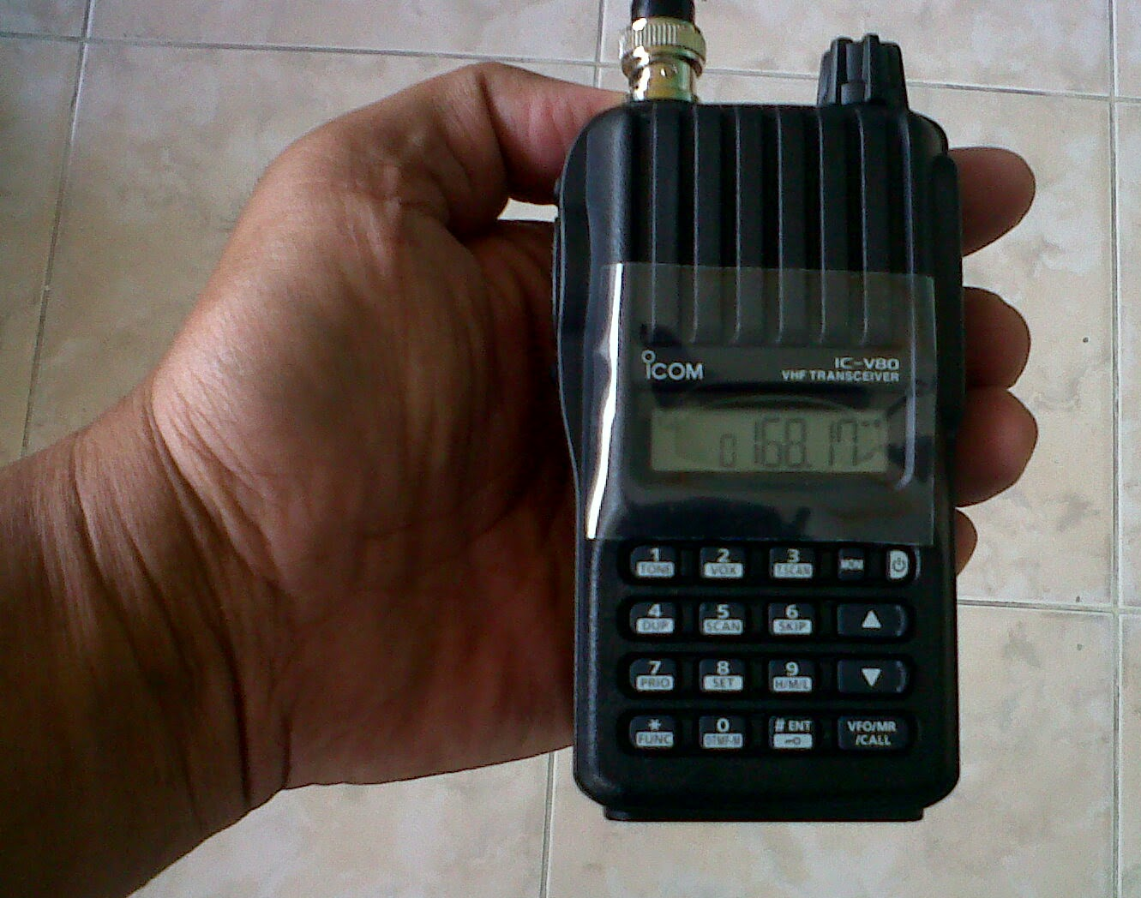
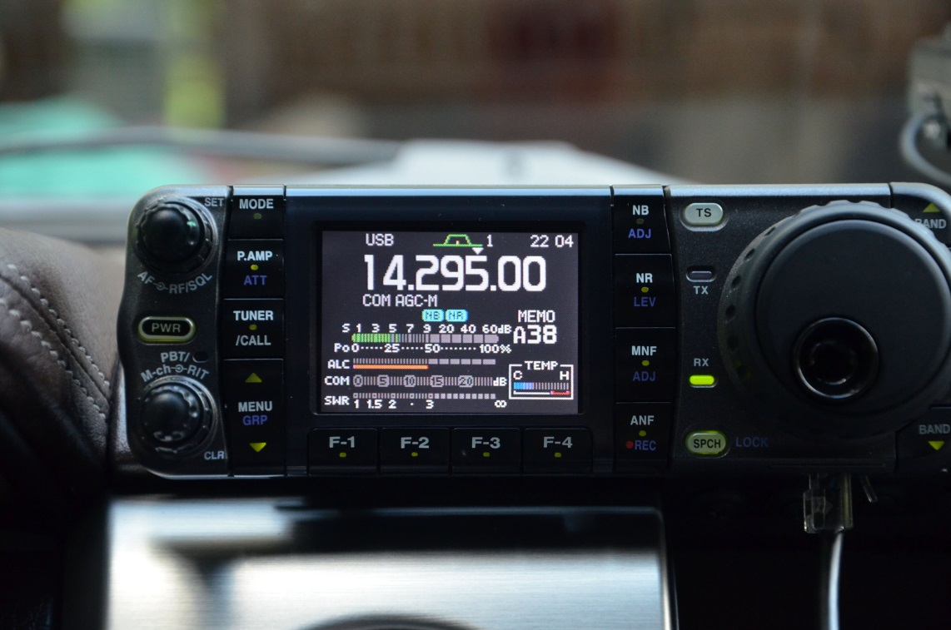
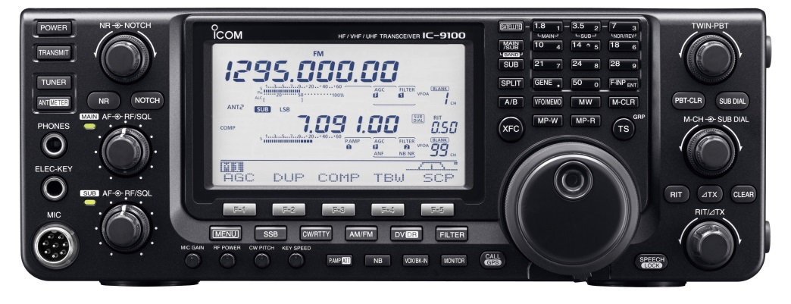
Req. 9.a.(5): Types of Equipment
TYPES OF
HAM RADIO
EQUIPMENT
Base Station Transceiver
MobileTransceiver
H-T
Ham Shack (Base Station)
1
2
3
4
5
6
Notes:
2 minutes for this slide
[6] Let’s cover some of the names for equipment that is used by ham radio operators.
[5] First, many of us use a Base Station Transceiver. This is usually located in a place we call our Ham Shack, where all our heavier gear is located.
[4] Some ham shacks can be very complicated!
[3] Many hams use their mobile radios more than anything else! Mobile radios in automobiles can communicate locally, especially through repeaters, but they also can be the kind of radio that will communicate internationally!
[2] Of course, some hams might get a little carried away with their mobile stations!
[1] And, most all hams have at least one handheld radio. You might call them a “walkie-talkie” but we call them “H-Ts” for short. This is an abbreviation for “Handy-Talkie”, a term that usually isn’t used much anymore by hams (but we still use the abbreviation!) Most all of the ham radio operators at K2BSA carry their H-Ts with them (just in case)!
SLIDE END

Slide 6
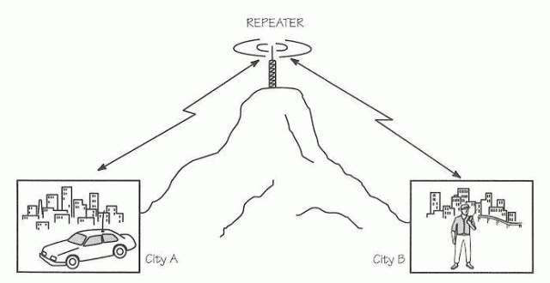
Req. 9.a.(5): Repeaters
Repeaters
1
Notes:
2 minutes for this slide
[1] We mentioned “repeaters” a couple minutes ago.
An H-T usually doesn’t have enough power for its signals to go a long distance, because things get in the way of the signal.
VHF and UHF radio signals can be easily blocked by an object such as a tall hill, ham operators frequently will install a repeater on top of the hill.
Repeaters will receive the signal from a low power H-T and simultaneously transmit the received signal out to distances much farther than the little H-T could accomplish all by itself. Others who may not have received the signal straight from the H-T WILL receive the retransmitted signal from the repeater!
Repeaters can be connected to the Internet via systems such as Echolink or the Internet Radio Linking Project. <briefly explain>
There are even links created between the repeater and the Internet that allow you to use you lower-power H-T to speak to someone someplace else in the world!
We have three different repeaters here at the Summit! If you have an H-T like the one I have, you can use it with the repeater to contact other hams just about anywhere at the Jamboree!
SLIDE END

