Slide 1
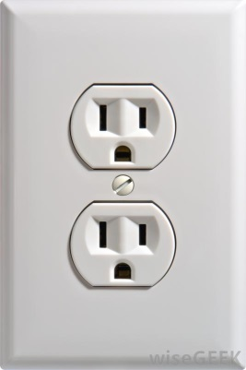
Req. 6: Electrical Safety
1000mA
Can electrocute 20 adults
120 volts AC
Safety!
15,000 mA
Heart convulsions usually fatal
50mA
15-20 mA
Painful shock – inability to let go
0-5 mA
Safe values
0-1 mA
No sensation
1
9
2
3
4
5
6
7
8
10
Notes:
2 minutes for this slide
[10] We need to discuss a topic very important to all ham radio operators: Safety! In radio, safety requires a lot of understanding. We won’t have enough time to really get into this here, but let’s cover the most important things to think about:
[9] The part of our body that is most affected by electricity is our heart.
[8] If we come in contact with the same 120 volts AC you find in your house the electricity will find a direct path to ground.
[7] If it’s a really good ground like a puddle of water, there will be a really strong path for electricity, and that path might travel right through your heart!
[6] Without going into technical detail, let’s say that only 1/1000 of an amp (1 milliamp) flows through your body when you contact 120 volts. You probably won’t feel it.
[5] Up to 5 milliamps of current flow at 120 volts is considered safe.
[4] If you touch 120 volts and 15-20 milliamps flow through your body, it will be a very painful shock; you may not be able to let go because your muscles will be contracted.
[3] At 50 milliamps, your heart will convulse and you will usually die from electrocution.
[2] 1000 milliamps (1 amp) can electrocute 20 adults at the same time!
[1] Hopefully, you’ll have respect for a simple home electrical outlet that can deliver 15,000 milliamps or more!
SLIDE END

Slide 2
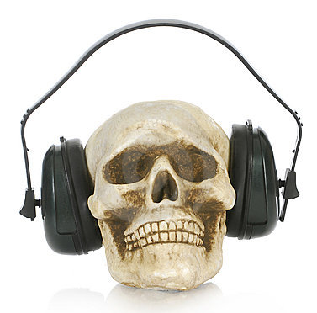
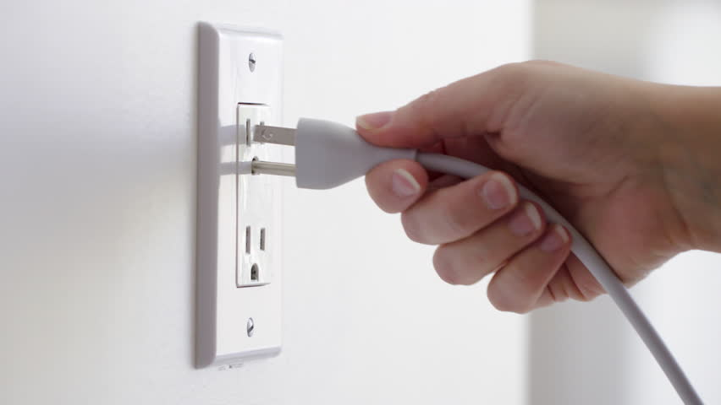
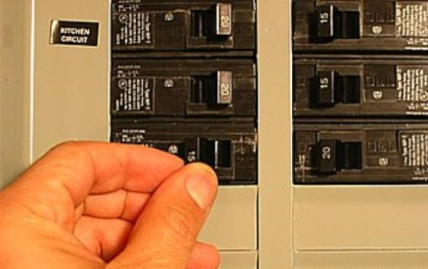
Req. 6: Electrical Safety Rules
Safety
Rules!
1
2
3
4
5
6
7
8
9
Notes:
2 minutes for this slide
[9] There are some basic common sense rules when working around electricity, whether it has to do with radio or not. (The title of this section is “Safety Rules!” You could consider it as saying “safety does rule!”)
[8] Whenever you’re working on radio equipment, unplug the equipment first. Leave the “hot” service work to someone who knows good safety practices for doing that work! Unless you know the special precautions necessary when working on energized equipment, don’t do it! Equipment should be turned-off and unplugged when you work on it.
[7] Sometimes it may be necessary to turn the power off at the circuit breaker box. Don’t hesitate to do that, making sure it’s OK with other family members. And never let anyone else turn the power off or on for you. You need to always confirm with your eyes the status of an electric circuit!
[6] Just like you aren’t very effective doing homework when you’re tired, you are not safe working with electricity when you’re tired. Don’t do it!
[5] Never wear headphones when repairing equipment. They could create a ground path for electricity to travel right through your head!
[4] Here we show a guy using both hands while working on something involving electricity.
[3] If the surfaces provide a path to ground, the shortest path will be through his chest and heart – not a good thing.
[2] If instead, he puts one hand in his pocket, the shortest path to ground will be down the side of his body, through his leg and then to ground. This can be a very bad shock; it might even knock him out, but it may not kill him. Having electricity go through your chest creates a likely scenario for death.
[1] Be careful with electricity; death is permanent.
SLIDE END

Slide 3
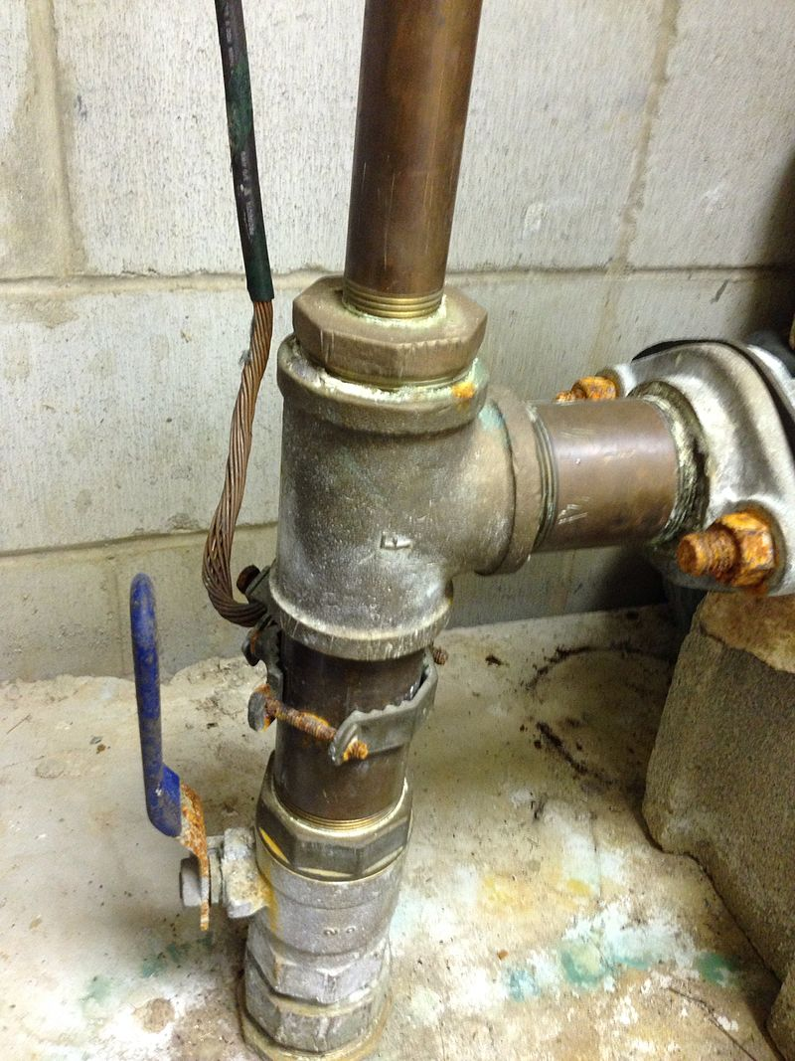
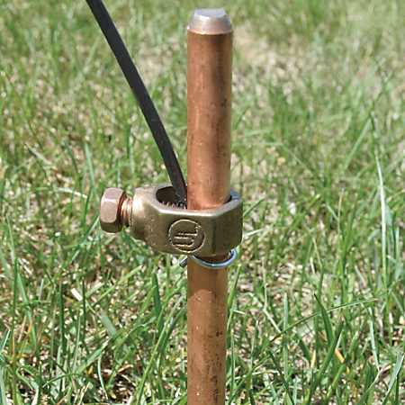
Req. 6: Electrical Grounding Safety
120/
Ham
Shack
240v
Grounding
Earth
Grounds
Earth
Ground
Earth
Ground
1
2
3
4
5
6
7
8
9
10
11
12
13
Notes:
3 minutes for this slide
[13] One of the most important safety features of your home ham shack is how the station is properly grounded. Being “grounded” may have meant only one thing to you up to this point. Now it means something a lot better and safer!
[12] Let’s look at how grounding occurs in your home.
[11] There is a heavy duty wire connected between a transformer and your home. This wire carries 120/240 volts.
[10] It also carries a ground wire that is connected to Earth ground near the pole or the underground transformer.
[9] After it attaches to your home, a main power line is routed through the walls to a circuit breaker box.
[8] The box distributes both 240 and 120 volts throughout the home.
[7] Regardless of the circuit voltage, each includes a ground wire that attaches to the circuit breaker box, then routes outside the box to a ground rod. It is the same Earth ground that the power pole or underground transformer is attached to.
[6] When you look closely at an electrical outlet, each socket has an individual ground receptacle that is attached to the overall electrical system ground. When you plug in electrical equipment that have three-prong plugs, they become connected to Earth ground if everything is wired correctly and the connections are properly made.
[5] If you have your own radio shack in the house, your radios will likely have power supplies that use three-prong plugs, so they will be attached to the electrical system’s Earth ground. But that’s not enough!
[4] Every ham shack should have an additional Earth ground system. A separate wire is run from your operating table down to ground rods you have pounded into the ground from 6 to 8 feet. Most radio shacks need more than one of these ground rods.
[3] The attachment at the ground rod looks like this. Grounding will be different depending on the kind of soil, so you really have to know (loam & clay: GOOD; sand and rock: NOT GOOD)
[2] Some ham shacks have separate ground wires attached to home cold-water pipes like this one. The idea is that cold water pipes eventually run through the Earth ground. Hot water piping may be isolated at the water heater from Earth ground, so they should never be used for this purpose. Natural gas lines should also not be used for grounding.
[1] As homes are using more and more plastic plumbing, we recommend the hams use separate ground rods unless they know for sure that materials use for piping will in fact be Earth grounded.
SLIDE END

Slide 4
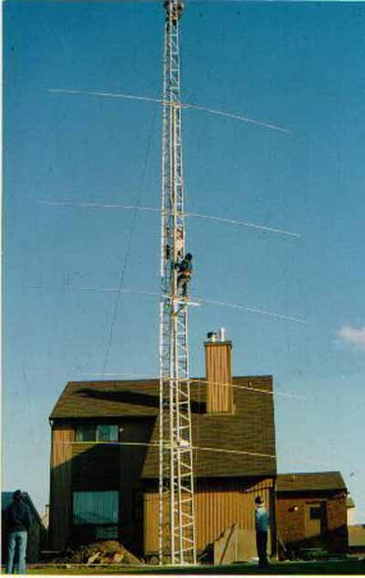
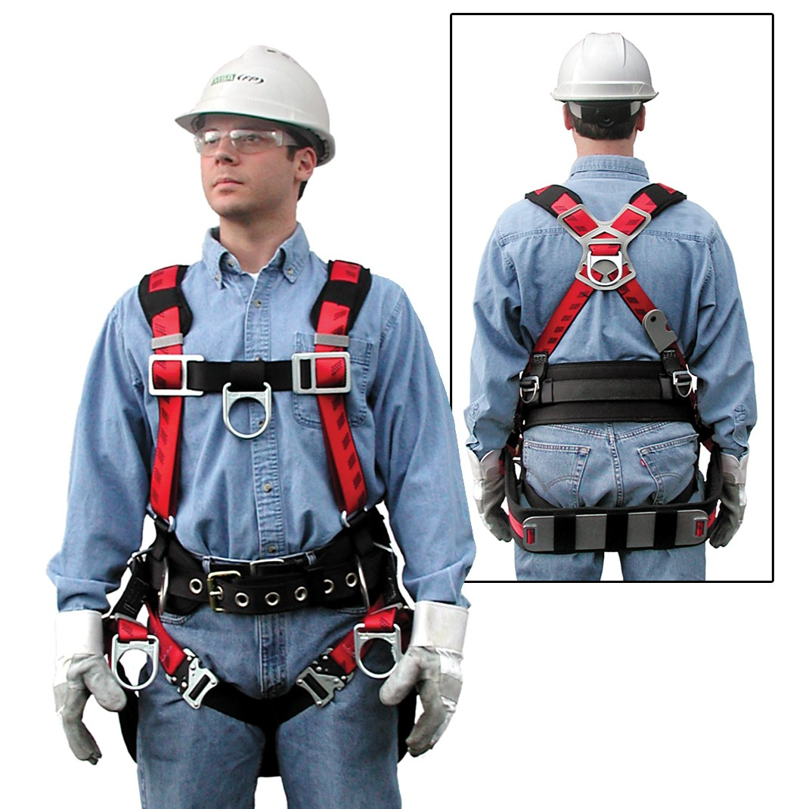
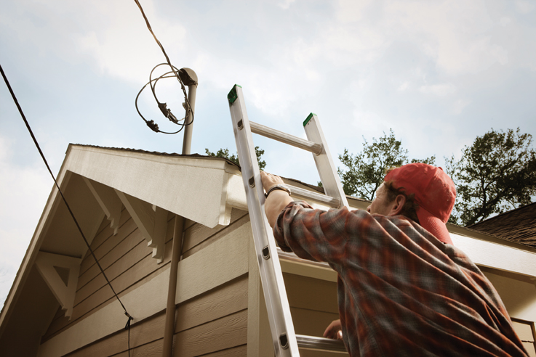
Req. 6: Electrical Safety Rules
1
2
Notes:
1 minute for this slide
[2] Too many deaths have occurred over the years from people not wearing proper protective equipment when climbing towers!
[1] Another situation that occurs is when accessing the roof of your home to set up the antenna. You must steer clear of power lines and never have your antenna near such a line!
SLIDE END

Slide 5
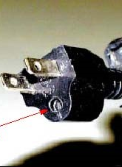
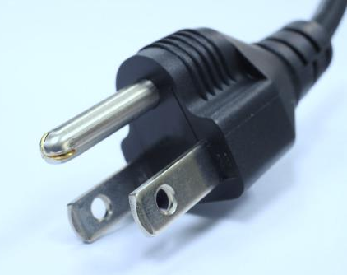
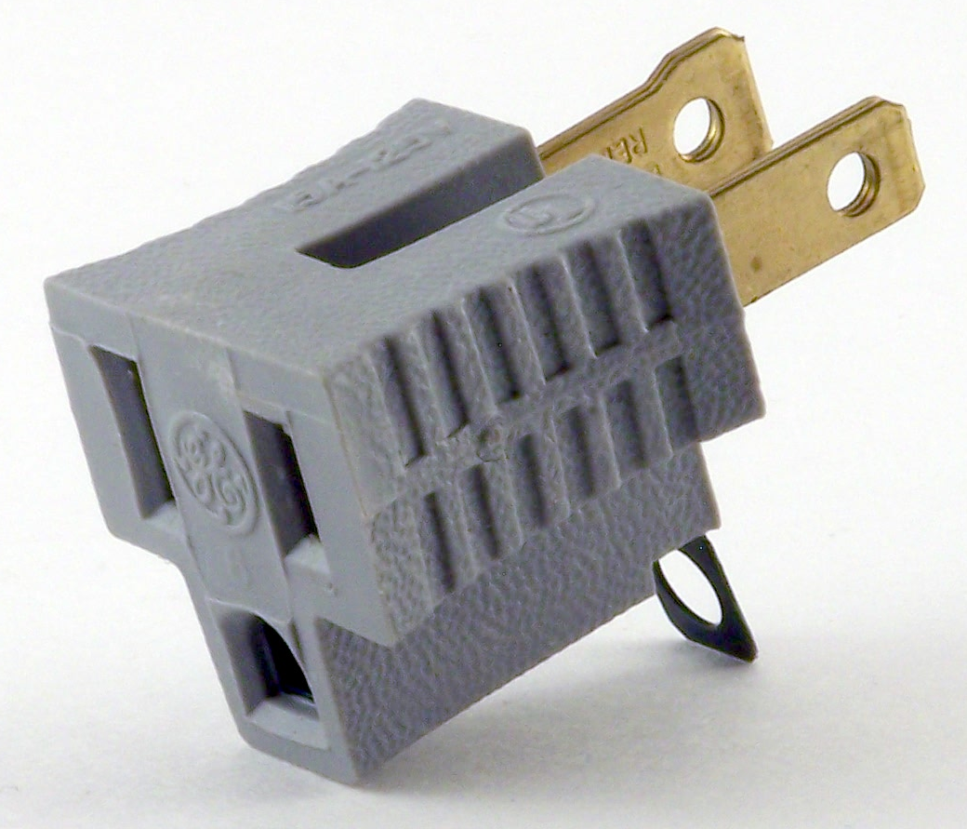
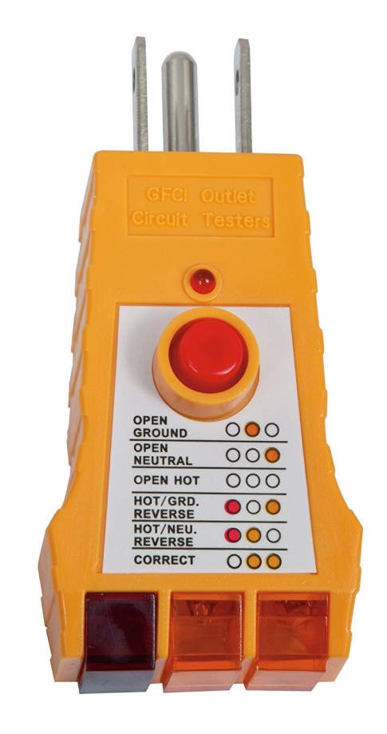
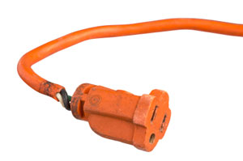
Req. 6: Safety in the Radio Shack
Safety in the
Radio Shack
1
2
3
4
5
6
7
8
9
Notes:
3 minutes for this slide
[9] Here’s some other important safety factors:
[8] A three-prong plug like this is included on most ham radio equipment that plugs into an outlet. The prongs need to be in good shape. The single round prong will connect the radio equipment to the house ground that we’ve already talked about.
[7] Never use a plug that has the ground prong cut off or somehow removed. If equipment came with a three-prong power cord, it was designed to have all three prongs in place. If they are not, you could be exposing yourself to the risk of a serious shock or electrocution!
[6] Sometimes people will use these adaptors to keep from cutting the ground pin, but this can be very hazardous, too! (no ground, etc.)
[5] Another one we see too often is a power cord with insulation that has broken away. This cord should be either repaired or discarded. Repair does not include just using electrical tape. This area is a weakened area, and if the internal insulation hasn’t yet broken away, it will soon. Repair would include replacement of the molded socket in such a manner that the wire has a strain relief and no exposed internal wires (and no tape!)
[4] One comment about Ground Fault Interrupter (GFI) outlets. These are being used more and more in newer home wiring, and they can be installed in older homes, too. They are also a good idea for ham radio shacks.
GFIs will break the circuit much quicker than the circuit breaker in your panel. You could easily die from a shock before the panel breaker would trip, but a GFI trips very rapidly with very little current flow to ground. To do this they have an electronic monitoring circuit that should be tested, and that’s why there is a test button and a reset button.
Some areas now require AFCIs (Arc-Fault-Circuit-Interrupting) breakers. These are located at the breaker panel, and are designed to protect against electrical fires (as opposed to GFIs).
[3] Just press the black butto to test. It will trip the GFI if everything is working as it should.
[2] Once you’ve finished testing it, press the red button to activate the outlet. If you don’t press the red button, the outlet will remain “dead” until you do.
[1] Here’s a handy device you can use to test all the three-prong outlets in your ham shack and your house. This will tell you if your outlets are wired properly and in what shape the mechanical connectors are inside the outlet. The red button on the tester also serves the same purpose as the “test button” on a GFI.
SLIDE END

Slide 6
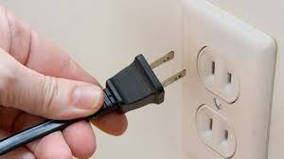
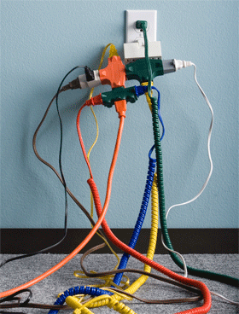
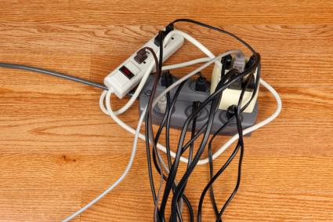
Req. 6: Electrical Cord Safety
1
Notes:
1 minute for this slide
Here’s a few more things to think about.
You never want something like this on the left or in the lower right. Not only might you be overloading the capability of one outlet, you might also be exposing yourself to electrical shock with some of these loose connections. A fire could occur here as well.
The picture on the top right shows a two-prong plug being inserted into a two prong outlet. The outlet is ungrounded; the device to which the plug is attached is probably safe without the ground, but the outlet here is the problem. You would not have a proper ground on any device with a three-prong plug!
All radio ham shacks must be using grounded outlets, preferably with Ground Fault Circuit Interrupters!
SLIDE END

Slide 7
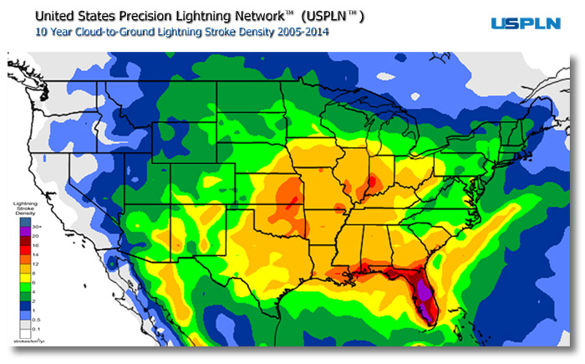
Req. 6: Safety Lightning Protection
Lightning
Protection
Lightning
Stroke
Density
30+
20
16
14
12
8
6
4
2
1
0.5
0.1
1
2
Notes:
2 minutes for this slide
[2] Now we’ll change the topic to lightning, the scourge of many ham radio operators.
[1] Here is a map of the continental United States that shows the density of lightning strokes from 2005 to 2014.
How many of you live within areas that show on the upper end of the scale (orange, red, dark red, purple)?
(Instructor shows his QTH and comments on his own situation.)
SLIDE END

Slide 8
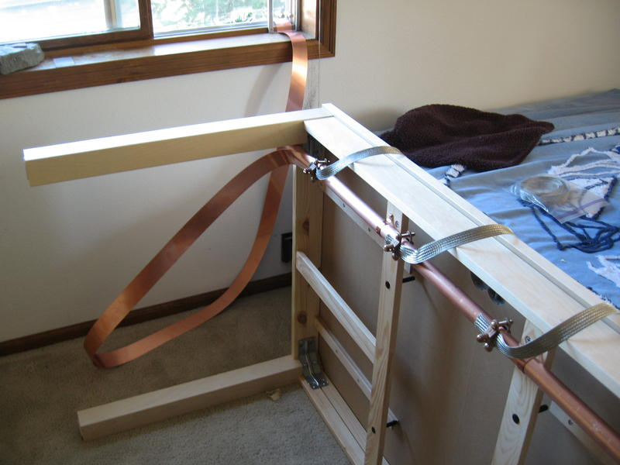
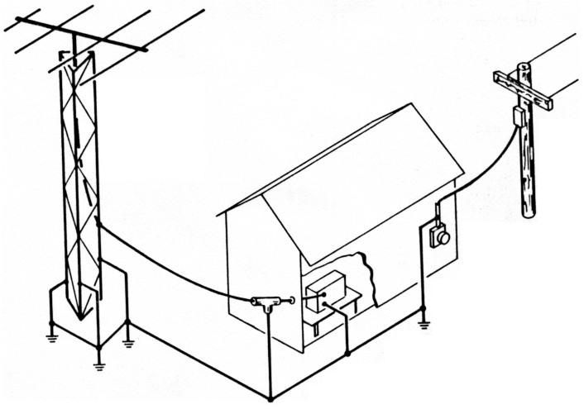
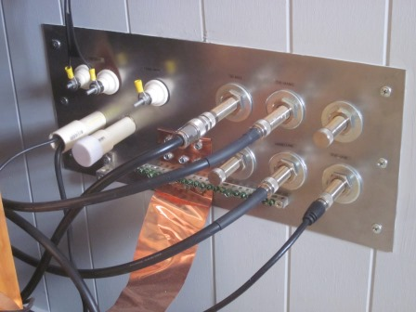
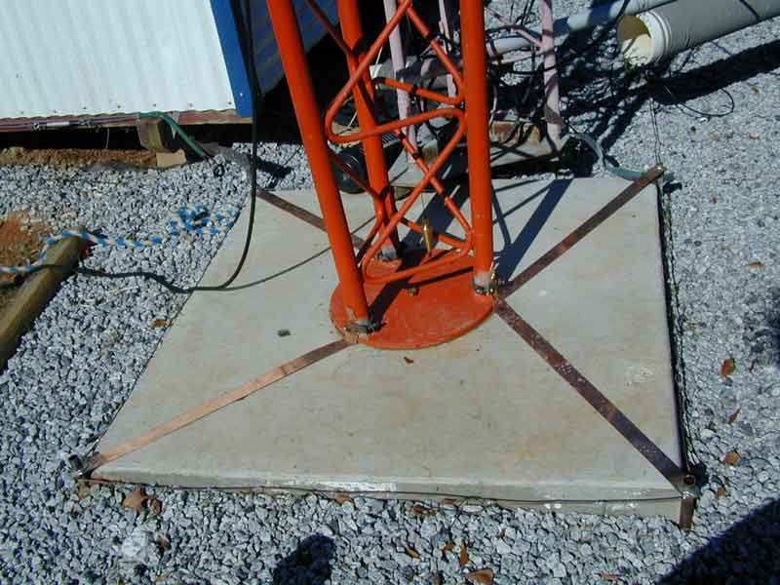
Req. 6: Safety Lightning Protection
1
9
2
3
4
5
6
7
8
Notes:
3 minutes for this slide
[9] Let’s take a look at a typical ham radio system.
[8] The heart of our system is the radio.
[7] A critical part of our system is the antenna. Our antenna could be a wire, or an expensive tower setup like this one. Some hams will set up their metal rain gutters to serve as an antenna, or maybe even their aluminum flag pole! For this discussion, we’ll use the tower.
[6] Even the power line coming to the house is part of our station system. You’ll see why in a minute.
[5] ASK: Anybody know what this might be?
Ham radio operators usually have lightning arrestors in their antenna feed lines to theoretically keep a lightning strike from their radios. I say “theoretically” because if we think we can totally control the nature of a lightning strike, that’s giving ourselves too much credit. Lightning arrestors are a good precautionary step with no guarantees. That said, we should have them in our system.
[4] The most important element for safety is our grounding system. This includes not only how we ground our equipment/antennas, but also the geology of the ground itself (damp/dry/hard/soft, etc). We don’t have time to get into this in depth, but the design of our ground system is critical not only for safety, but in many cases for how effective our system is in sending and receiving signals!
[3] You can see here that this ham operator put a lot of work into making a good ground at the base of his antenna.
[2] He also did a lot of engineering to properly feed the antenna lines into the house, another very important part of the ground system!
[1] Even more, he set up his radio shack bench with grounding measures.
VISUALS CONTINUE ON NEXT SLIDE

Slide 9
Req. 6: Safety Lightning Protection
1
2
3
4
5
6
Notes:
3 minutes for this slide
[6] Let’s watch what happens (at least theoretically) when lightning strikes our ham radio system.
[5] One of the common ways this can happen is when lightning strikes the electrical power lines. Energy from the strike can travel down the line, looking for a ground. It can instantly travel to the nearest ground which in this case could be the grounded entry point into our house.
[4] Another high risk entry point is through our antenna.
[3] The best case scenario is for the energy to travel down the metal tower and into the ground system around the antenna base. Some energy may try to go down the antenna feed line, but if our lightning arrester does the job, it will bypass to ground. (As we said before, there is no guarantee of this!)
[2] Now let’s look at what happens if there isn’t a good system ground. If we didn’t have adequate grounding around the antenna base and either didn’t have a good lightning arrester (or the one we had didn’t work), the energy would travel to the nearest ground which likely would be down to (and through) the radio and into the radio station’s ground rod or the building’s ground system. Your radio FRIES in this case, and if you’re near it and touching it, YOU might fry too!
[1] Since there is no good ground at the base of the antenna, the lightning finds the closes path to ground through the radio.
SLIDE END

Slide 10
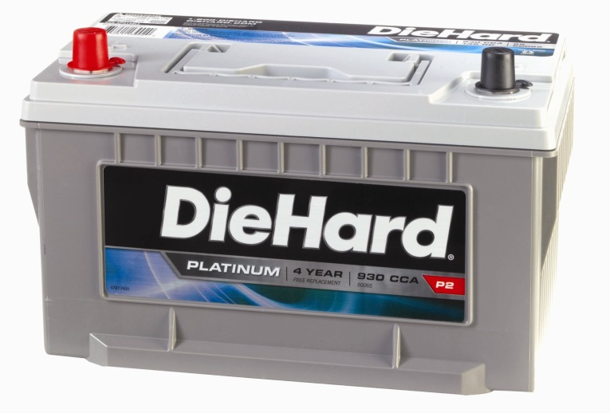
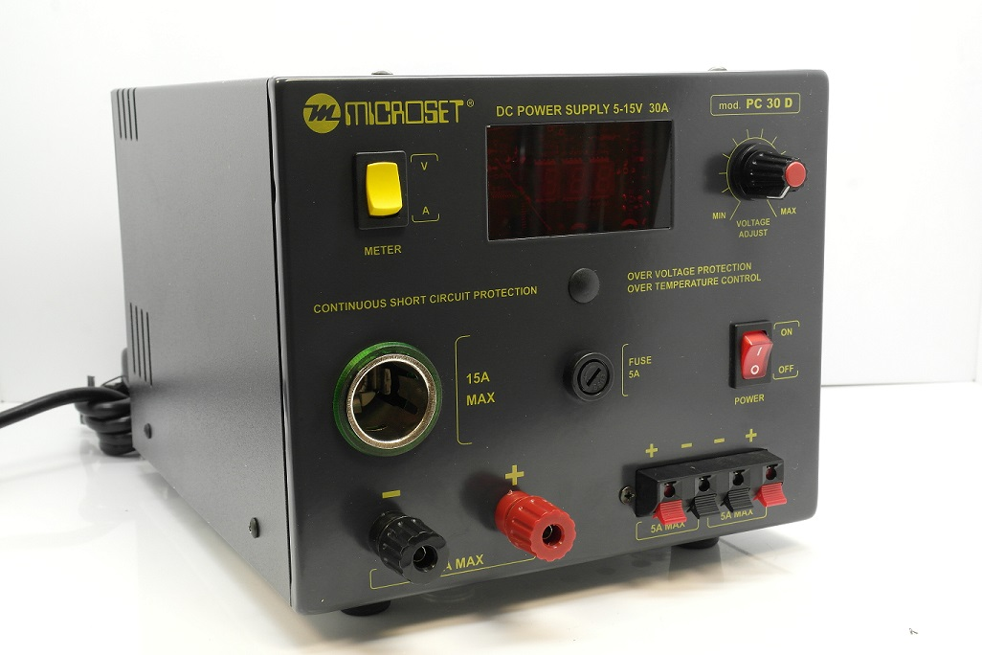
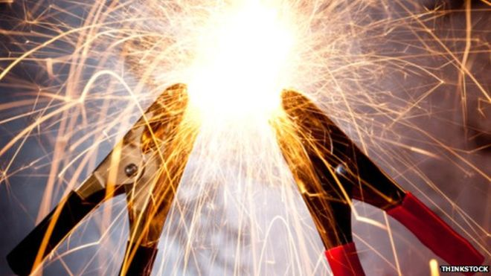
Req. 6: Direct Current Safety
Direct Current Safety
1
2
3
4
Notes:
2 minutes for this slide
[4] If anyone thinks that power from a direct current (DC) power supply is safe, just look at what happens when you short out a car battery!
[3] Remember our chart earlier that showed how little alternating current (AC) was required to kill you. 12 volts direct current is much less voltage, and that is one factor, but look at this chart that shows the cranking amps in an automobile battery! In come cases, over a thousand amps!
[2] If you short the positive (red) terminals on this high current ham radio power supply with the negative (black) ground terminals, you’ll get the same result as that from a battery and can severely injure yourself and damage the supply beyond repair, let alone the expense associated with buying a new power supply!
[1] Carefully observe the polarity of these terminals. It’s pretty universal that “red” means “positive” and “black” means “negative.” If you ever encounter a supply that isn’t set up with these colors, have second thoughts on whether you should use it!
SLIDE END

Slide 11
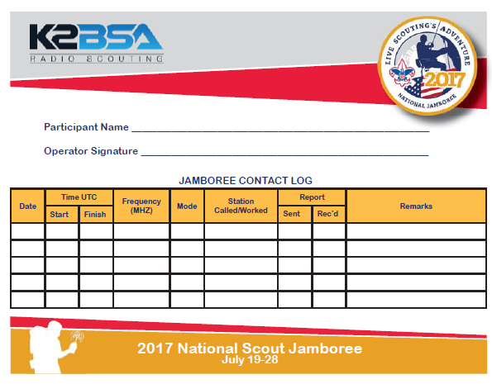
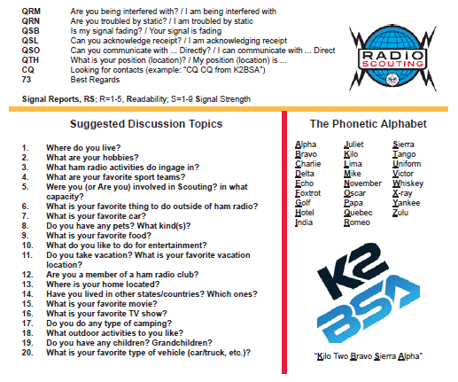
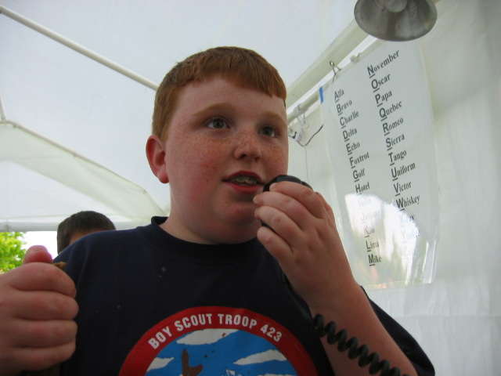
Req. 9.a.(6): 10-Minute Real or Simulated Contact PREPARATION _
Use the K2BSA Operating Card
Listen and call another ham radio station
Talk with the other radio station operator
Relax and have fun
Give your name
Tell where you live
Describe your school
Talk about the Jamboree
Use Q-signals
Log your contact on card
Be prepared to talk about it when you return!
Joe Scout
Joe Scout
7/24/17
15:50
16:00
14.275
SSB
W1AW
59
57
ARRL Headquarters Station!
7/24/17
16:10
16:12
14.310
SSB
K2MHE
58
59
Albany, New York
Contact!
1
2
3
4
5
6
7
8
9
10
11
12
13
14
Notes:
3 minutes for this slide
[13] Now you’re about to head on over to the K2BSA operating station to get your time in making a contact. But first, let’s give you some pointers on how to have fun while you’re doing it!
[12 down through 1] <Instructor: use slide graphics as your talking points>
SLIDE END

Slide 12
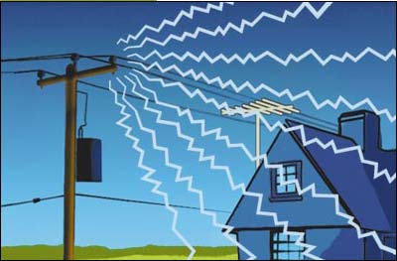
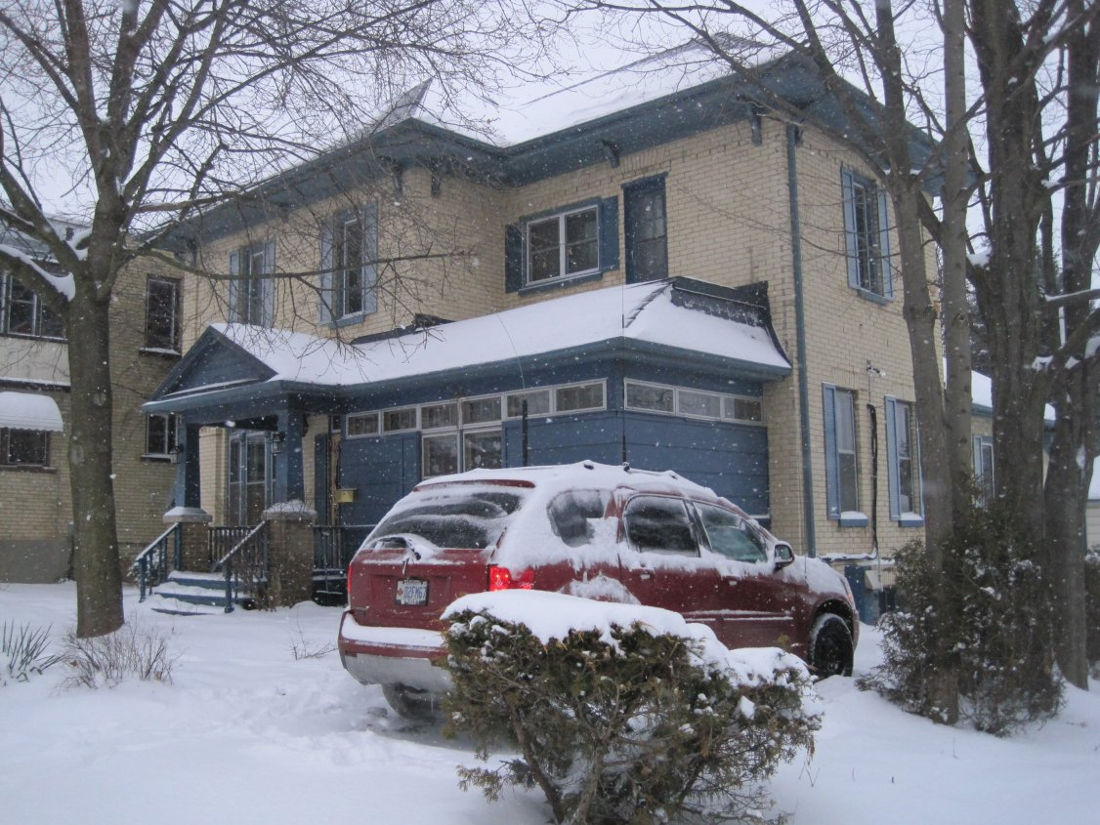
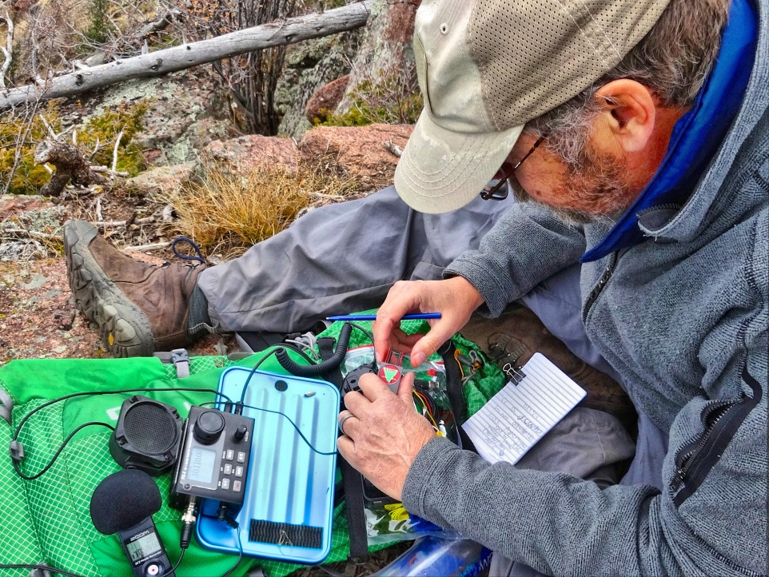
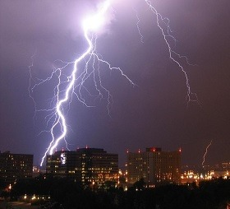
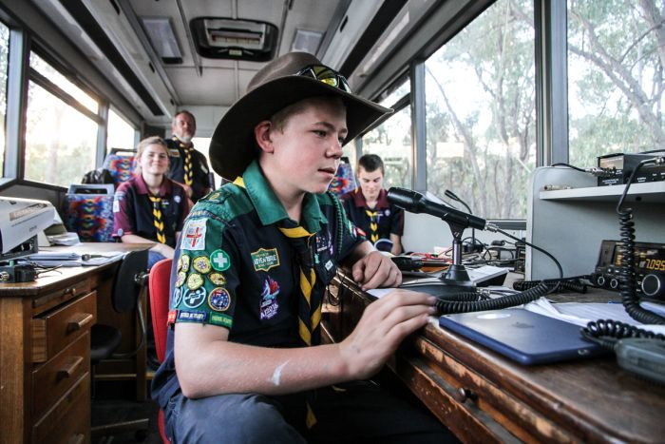
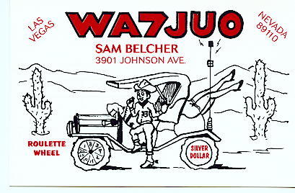
Req. 9.a.(3): Q-signals and Terms
Q-Signals
QRP
QTH
QRN
QRM
QSL
1
2
3
4
5
6
Notes:
4 minutes for this slide
[6] There is a lot of lingo and terms unique to ham radio.
One group of such unique ham radio “language” are Q-signals or Q-calls.
For instance, if a ham is detecting interference caused by some man-made source, whether it’s from another ham or from a powerline, it’s call QRM.
[5] There are lots of natural sources of radio interference and noise.
A lightning strike can be detected by hams many miles away.
When noise is generated by nature like this, hams call it “QRN”
[4] If you are communicating with another ham, and he tells you he is “operating QRP”, that means he is using a very low level of power. Most hams that operate portable like you see in this image are operating “QRP”
[3] If someone asks you where your “QTH” is, that means they want to know the location from which you are transmitting.
Most often, a ham’s QTH is their home, but when they operate mobile, wherever they are at the time of the transmission is their QTH
[2] “QSL” is the Q-signal for “I received your transmission OK.”
[1] It also is the name given to a special printed card that you send to another ham confirming that you had a contact with him.
SLIDE END

