Slide 1
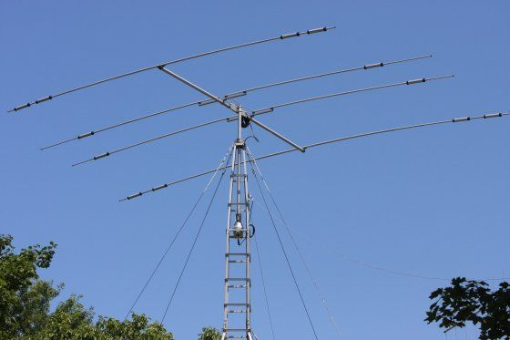
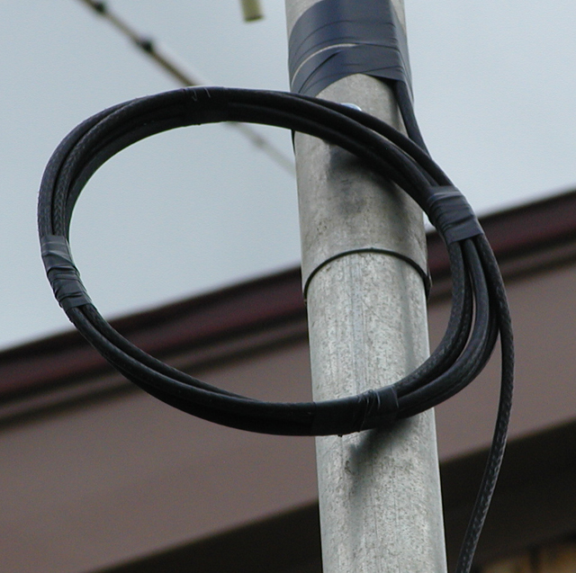
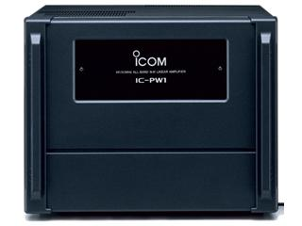
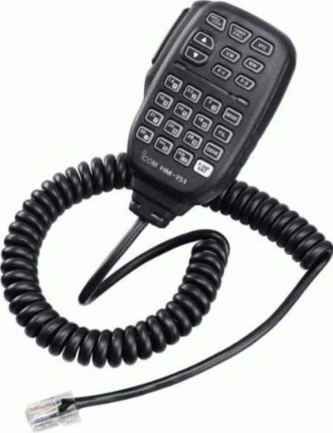
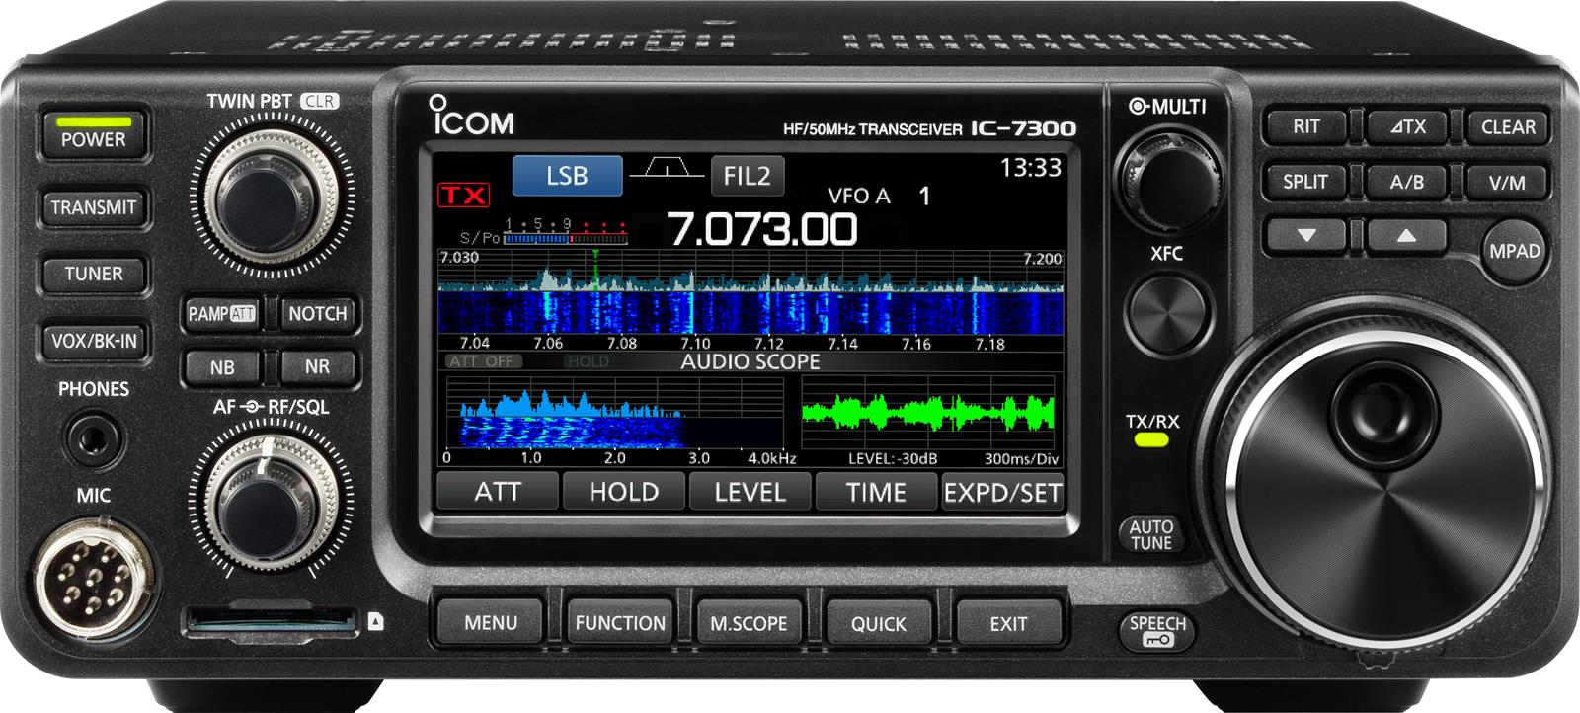
Req. 5.a.: Block Diagrams
Antenna
Block Diagrams
&
Schematics
Feedline
Antenna
Microphone
Transceiver
Amplifier
Feedline
Amplifier
Microphone
1
2
3
4
5
6
7
8
9
10
11
Notes:
3 minutes for this slide
[11] When you really get into radio, you may become interested in how they are put together and what makes them work. You will learn how to use block diagrams and schematics. We’ll start here by “building” a ham radio station using a block diagram:
[10] Usually when a radio operator starts thinking about the station, the transceiver is one of the first things that come to mind. You’ll see lots of them here at K2BSA.
[9] We’ll lay down this label (Transceiver) as part of our radio station block diagram.
[8] Most hams will use a microphone like this connected to the transceiver to convert their voice into radio waves.
[7] We’ll connect the microphone label to the transceiver on our block diagram
[6] Many hams want to add an amplifier to their radio station. Why might you think they would want an amplifier?
[5] For our station here, we’ll connect our transceiver to an amplifier label to end up with a stronger radio signal.
[4] All ham radio stations use some sort of antenna to radiate our signal
[3] Here is our block label for the antenna
[2] We connect the amplifier to the antenna with a special kind of wire called the feedline. The feedline carries the amplified radio signal to the antenna
[1] There you have it: A basic ham radio station in a block diagram. The block diagram gives you a high level picture of your ham radio station system. But as you become more interested in how things work, you might want to become familiar with schematics. Schematics are “maps” of all the electronic components inside a device.
Now let’s look at schematics…
SLIDE END

Slide 2
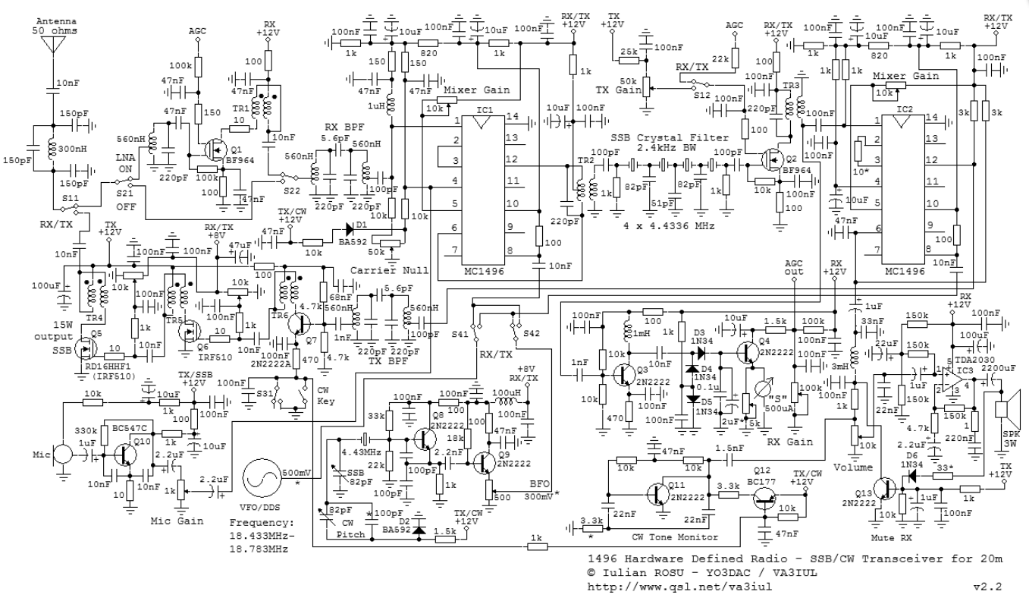
Req. 5.a.: Schematic Diagrams
Antenna
Feedline
Microphone
Transceiver
Amplifier
Transceiver
1
2
3
4
5
Notes:
2 minutes for this slide
[5] The schematic maps out all the components in our transceiver and how they are connected. This is very helpful when troubleshooting the equipment. You can’t really repair a complex device like a ham radio transceiver, or even a simple one for that matter, without knowing how to read and use a schematic.
If you want to learn more about schematics, the Electronics Merit Badge will help you get there!
[3] You can see if we just shrink the size of our schematic to make it part of our block diagram, it really doesn’t help us.
[2] The block diagram helps us at a high level, seeing the whole system in an easy-to-read manner.
[1] Before you become knowledgeable about electronics, components and schematics, a block diagram should help you understand how a radio system goes together.
SLIDE END

Slide 3
Req. 5.b.: Radio Station Diagram
Finish
Block
Diagram
1
Notes:
7 minutes for this slide
[1] Note to Instructor: They should have been building their block diagram throughout the prior slides. This time period is provided for them to finish the drawing.
SLIDE END

Slide 4
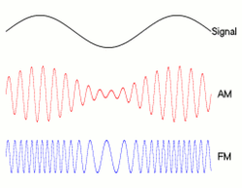
Req. 5.c.: How Information is Transmitted -AM & FM
Verbal
(audio) message being sent
AM (Amplitude Modulation)
FM (Frequency Modulation)
How
Information
is
Transmitted
1
2
3
4
5
Notes:
3 minutes for this slide
[5] Let’s look at how information is transmitted; how radio waves carry information.
[4] When we talk, the variation of our vocal cords creates audio sound waves. That’s how you can hear my voice right now. The wave on the screen represents an audio sound wave; it is what we want to transmit from our radio antenna.
[3] One way we can transmit our audio wave is to use Amplitude Modulation, or “AM”. If you look closely at this AM radio wave, you actually can see three waves. The higher frequency radio carrier wave that the transmitter sends out the antenna, and our original audio wave, duplicated along the top and bottom of the carrier. We say the amplitude (“vertical height”) of the carrier changes according to the audio signal it is carrying. When you listen to “AM radio,” your radio receiver is detecting this kind of wave.
[2] Now we see a totally different way to carry our voice: Frequency Modulation, or “FM.” Note how the three moving illustrations here compare. Different than AM, the FM signal keeps the same amplitude, but changes its frequency with each change in your voice signal. There are advantages and disadvantages to AM and FM that we don’t have time to talk about here. But at least you can easily see how they are very different!
[1] These are only a couple ways information can be sent over the airwaves. Let’s study some more!
SLIDE END

Slide 5
Req. 5.c.: How Information is Transmitted - SSB
AM (Amplitude Modulation)
SSB (Single
Sideband)
1
2
3
Notes:
2 minutes for this slide
[3] To look at our next mode of transmitting information, we’ll bring back up our Amplitude Modulation diagram.
[2] Our next mode is Single Sideband, or SSB. Notice you’re not seeing anything right now. That’s because no one is talking into the microphone. In the AM signal above, there is always a transmitted carrier, even if no one is talking. Once you start talking into an AM transmitter, the carrier is then modulated as shown.
[1] But in a Single Sideband transmission, nothing happens on the airwaves unless you talk. Here we’re showing an SSB signal that matches the words that are being spoken into the mic.
Instructor: You can cycle back to #2 and then click your remote’s advance button to replay.
Single Sideband is much more efficient with energy than is an AM signal because no energy is going out when there is no talking, even during the pauses between words or sentences!
SLIDE END

Slide 6
Req. 5.c.: CW
CW?
DIT
DIT
DIT
DAH
V
“CW”
CONTINUOUS WAVE
1
2
3
4
5
6
7
8
Notes:
3 minutes for this slide
[8] Let’s look at another way to send information in our transmitted signal.
[7] This image shows an actual scan of a different kind of radio carrier wave. It’s called “continuous wave” even though you see breaks in it like we show here. The name might be confusing to you:
[6] If the ham operator wanted to, he could transmit a solid continuous wave like this one. He breaks up the continuous wave for a reason, though. Can you guess what that reason might be?
[5] When one of these little pieces of continuous wave is detected by a radio receiver, it makes a short “dit” sound in the speaker or headset.
[4] If the operator strings three of these short bursts of continuous wave, it will create three “dit sounds”.
[3] A slightly longer burst results in what the operator calls a “dash” or “dah.” What we see here is that the operator sent continuous wave bursts of “dit-dit-dit-dah.” What information do you think the operator is sending?
[2] The operator is sending the Morse Code for the letter “V.”
[1] We ham operators refer to the sending of Morse Code as “CW.” What does CW mean?
CW was the first form of messaging on the airwaves. In a sense, it was also the first form of digital communications!
SLIDE END

Slide 7
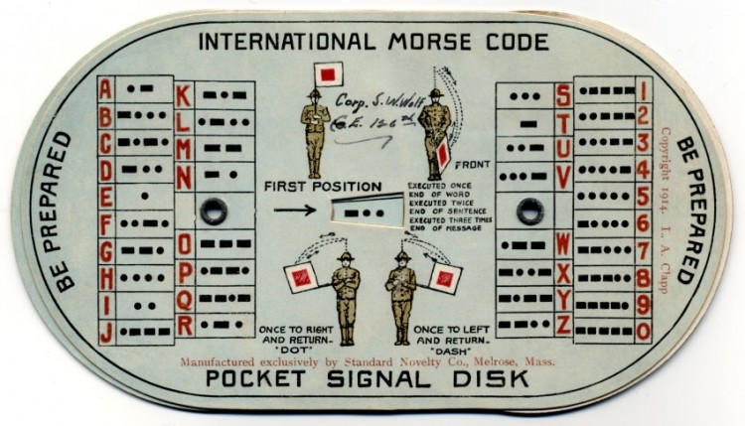
Req. 5.c.: CW
1
2
Notes:
1 minute for this slide
[2] This was a typical Morse Code and Semaphore aid for Scouts in the 1940s and 1950s.
[1] We won’t say much about Semaphore (communicating with flags), but either Morse Code or Semaphore was once a requirement for Scouting rank. Morse Code goes way back to the 1800s!
Find the letter “V” and you’ll see those three “dits” and one “dah” that we just talked about….
SLIDE END

Slide 8
Req. 5.c.: CW
B
S
A
1
2
3
Notes:
1 minute for this slide
[3] Let’s look at one more…
[2] Take a look at this string of CW dits and dahs. What might the operator be sending here?
[1] Here you go!
SLIDE END

Slide 9
Req. 5.c.: Digital Signals
Digital!
1
2
3
Notes:
2 minutes for this slide
[3] Now let’s compare a couple of radio wave signals, and get your idea on what might be going on…
[2] First we have a typical continuous wave. There is no modulation; that is, there are no dits and dahs being sent with this continuous wave. If you could somehow hear it, it would sound like a continuous tone on your radio.
[1] Compare your continuous wave with this one.
ASK: What might this type of wave be? For what purpose would this kind of wave be transmitted?
SLIDE END

Slide 10
Req. 5.c.: Digital Signals
58μs
100μs
= 116
1
1
1
0
1
0
0
1
2
3
4
5
6
7
8
Notes:
2 minutes for this slide
[8] Let’s take a closer look at this digital radio wave…
[7] The wave consists of two different elements, a short burst and a longer burst.
[6] In this particular type of digital signal (and there are many different types), the first “high part” of short burst takes only 58 millionths of second to happen.
[5] The first high part in this longer burst takes 100 millionths of a second to happen. Not quite twice as long at the short one, but long enough to be different! The computer (and its software) that is connected to a radio receiver that detects this signal can identify the two separate lengths of these bursts.
[4] The first short burst is associated with the number “1”.
[3] The second longer burst is associated with the number “0”.
[2] The whole string of bursts then reads “1 – 1 – 1 - 0 – 1 – 0 – 0.”
[1] This is the Base 2 number for “116”, which could be code for some command or information understood by the receiving radio and/or computer software.
SLIDE END

Slide 11
Req. 5.c.: Digital Signals
Let’s Transmit
Digital!
A
B
MESSAGE DIRECTION
1
2
3
4
5
Notes:
2 minutes for this slide
[5] To help understand how all this works, let’s take a look at one example of digital communications in action…
[4] Here is a very simple digital communications system connected with wire or possibly fiber optics. In this example, we are sending some sort of digital information from A to B. We use a computer to create our information message and an encoder to change the digital data to some form of signal to be sent over the wire or cable. The digital signal is picked by a decoder at B which sends the decoded message to the computer at B where the operator can somehow read or use the data.
[3] Now let’s replace the encoder and decoder with radios that are set up to do such a thing.
[2] Of course, radios don’t communicate by wire; instead they transmit and receive radio waves over the air. Antennas are used to transmit the signal, then receive it.
[1] Now the same signal that was shared through wires or cables is now sent from one antenna to the other. We no longer are relying on the infrastructure of wires or cables. This is a very big deal. Where most communications systems rely somehow on wires or cables, ham radio signals can be entirely “off the grid.” In a major disaster or emergency, this comes in very handy!
SLIDE END

Slide 12
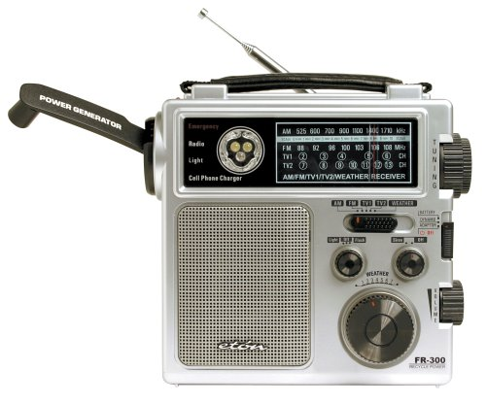
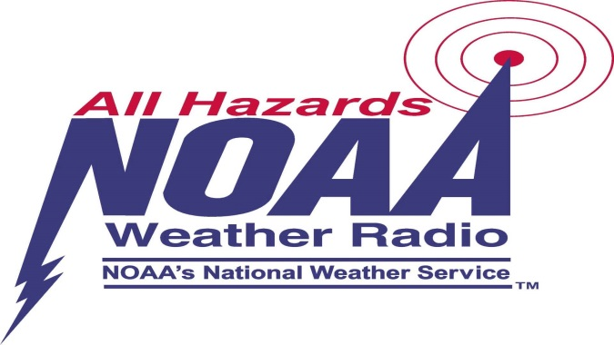
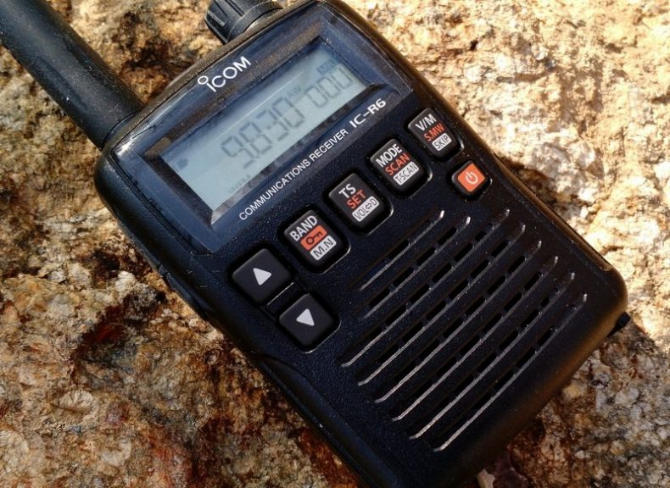
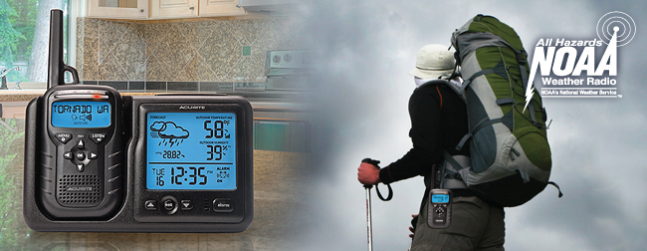
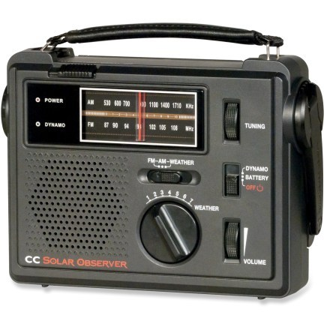
Req. 5.d.: NOAA Weather Radio (NWR)
1
2
Notes:
2 minutes for this slide
[2] NOAA Weather Radio (NWR; also known as NOAA Weather Radio All Hazards) is a network of radio stations in the United States that broadcast continuous weather information directly from a nearby (<40 miles) weather forecast office.
NOAA Weather Radio broadcasts National Weather Service warnings, watches, forecasts, weather observations and other hazard information 24 hours a day.
It also broadcasts alerts of non-weather emergencies such as national security, natural, environmental and public safety (such as an AMBER Alert) through the U.S. Federal Communications Commission's (FCC) Emergency Alert System.
[1] There are many special radios designed for receiving NWR broadcasts. One of these radio receivers could be a great addition to your home emergency kit!
SLIDE END

Slide 13
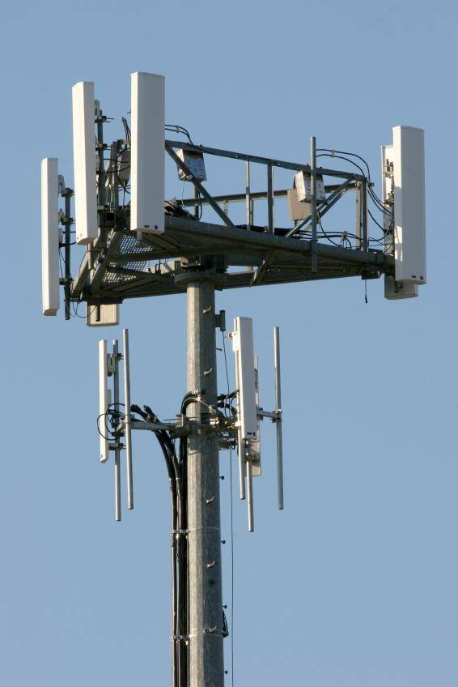
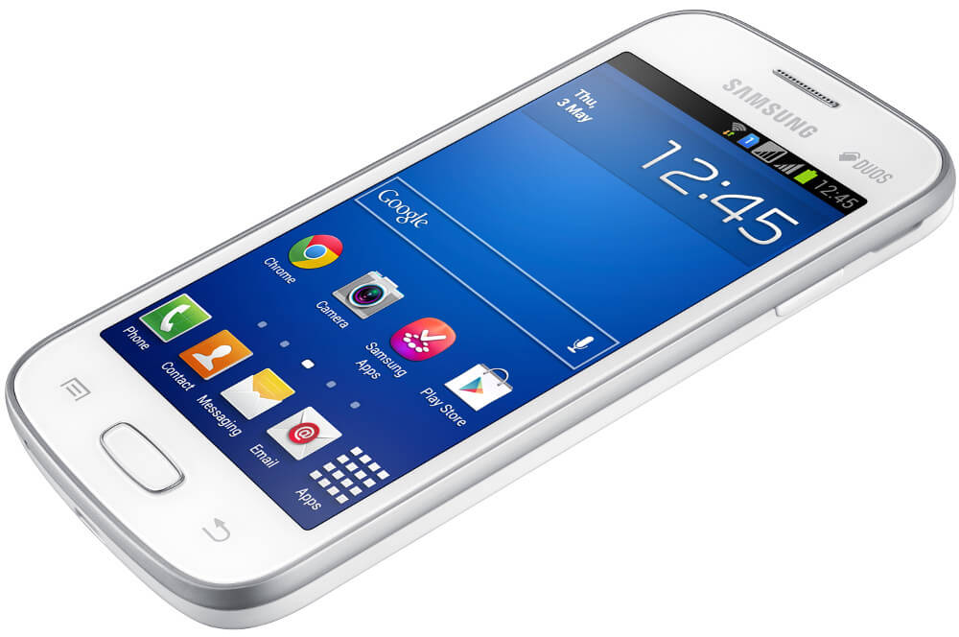
Req. 5.e.: Cell Phones
How
Cell Phone
Systems Work
Transceiver
Computer
Battery
Transmitting/Receiving Antenna
Microphone
Speaker
1
2
3
4
5
6
7
8
9
Notes:
3 minutes for this slide
[9] As we mentioned at the beginning of this course, most all of us use radio every day, even if we’re not a ham radio operator! We use cell phones!
[8] Ever see one of these someplace in your town? ASK: What is it?
Cellular telephone base station antennas like this one are located in more places than you would imagine! We take them for granted, but this is a very interesting technology! They send and receive communications signals 24 hours a day.
[7] A mobile phone or wireless device is a low-power two way radio operating at a maximum of 2 watts (peak).
[6] Much of the phone is a battery, strong enough to make several calls, send lots of test messages, search the Internet and take photos with the camera!
[5] The phone has an audio circuit that includes a microphone and a small speaker. Some have earpiece connections; others use Bluetooth to send an audio signal to a wireless earpiece. Bluetooth is another form of digital radio!
[4] Of course, the phone has a computer with lots of memory. A cell phone has more computing power than the computer used when we sent a man to the moon!
[3] The phone has a transceiver section, one that transmits and receives signals.
[2] Finally, no radio system will work without an antenna. Yes, even cell phones have built-in antennas!
[1] Such mobile phones have become more important for all the things they do besides making a call!
SLIDE END

Slide 14
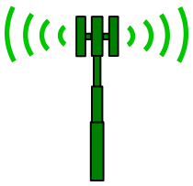
Req. 5.e.: Cell Phones
1
2
3
4
6
7
8
9
5
Notes:
3 minutes for this slide
[9] Let’s look at the basics of a cellular telephone system in a make-believe town (somewhere.)
[8] First, we’ve got those base station antennas. Wireless companies locate them in the best possible places, considering population, obstructions to signals and available property. We’re just showing four base station antennas here, but there are usually enough in any size town to cover most all areas.
[7] Now we’re showing the “cells” that are covered by the base station antennas. The cell is as big as the range of the base station antenna. Here we’re showing they all reach out the same distance, but in reality, the distances can vary quite a bit. If we want a bigger cell, we can at least increase the power of a base station transmitter. For this discussion, we’ll show them to have the same range.
[6] The base station antennas are all wired directly to the cell carrier’s network, which ties all base stations together around the country.
[5] The cell carrier’s network is also tied to other carrier’s networks and to standard telephone systems.
[4] When your phone is turned-on, even when you are not using it, it tries to link up with the nearest base station antennas. How well it’s doing this is usually shown with some indication on your phone.
In this case, the phone is linked very well to two base station antennas because of your location.
[3] When you call a friend up here, he is also close enough to a base station tower to have a very connection. He probably won’t experience a “drop” because he has a strong signal.
[2] But when you call a different friend down here, his location is on the edge of the cell, with no other base station near by. His call may “drop” because of this.
[1] And when you try calling another friend down here, his cell phone will not pick up a signal because he is out of range of the cell. His phone will probably indicate “no signal” or “out of range” or something like that.
SLIDE END

Slide 15
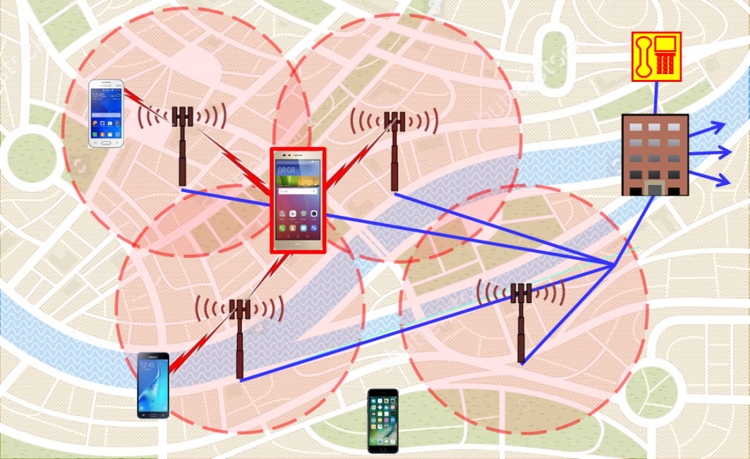
Req. 5.e.: Cell Phone System Limitations in Disasters
90+% load during normal times… What will happen with a bigger-than-normal load?
Still requires land- line telephone system
Requires functioning electrical power system
Limitations in Disasters
1
2
3
4
Notes:
2 minutes for this slide
[4] We could talk a lot about the differences between using mobile phones and ham radio during disasters, but let’s look at some big differences.
[3] Cell systems during normal use are handling large numbers of regular calls, usually at about a 90% load. We’ve learned that cell systems quickly are overloaded when a disaster occurs: If twice as many people tried to use a mobile phone, the system would be loaded at 180% -- It won’t work! The only real load with ham radio is the ability of trained hams to operate under emergency protocol.
[2] Cell systems do have a wireless component as we’ve already discussed, but we’ve also mentioned that the land line telephone system has to be functioning in order for cell phones to work. Ham radio does not have such a requirement.
[1] Cell systems also require electrical power. Ham radio does as well, but can easily be functional with batteries or portable generators. Cell systems do not have the same capabilities!
SLIDE END

