Slide 1
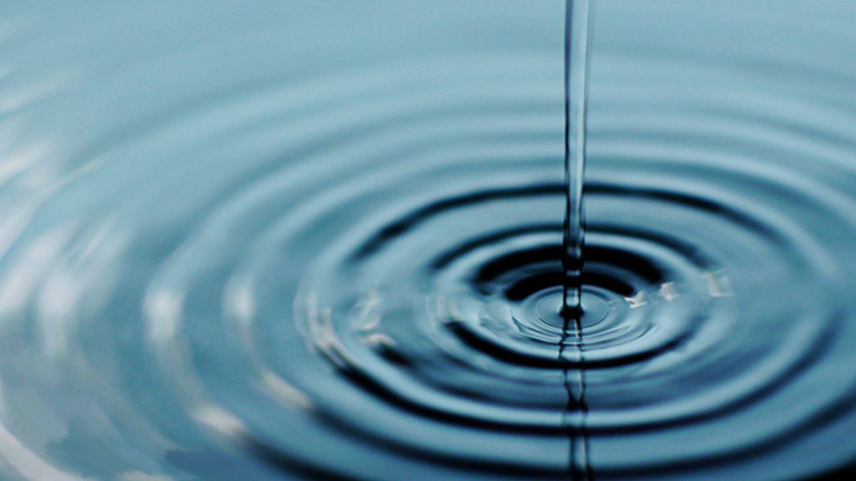
Req. 4.: How Radio Waves Carry Information
How Radio Waves
Carry Information
ANTENNA
1
2
3
4
Notes:
2 minutes for this slide
[4] Radio is about a lot of things, “radio waves” being an extremely important part. There are all sorts of radio waves.
[3] We often compare radio waves with the ripples in water caused by a thrown rock.
[2] Instead of throwing a rock, radio waves are somehow thrown by some sort of antenna.
[1] Waves of many different types will start at the antenna and travel in many directions for long distances, sometimes around the world.
We’re pretty sure they don’t look like the waves shown here, but at least you get the idea.
And these waves are all around us, right here where we’re sitting. Your mobile phones are receiving (and sending) radio waves all the time. The radio waves from our K2BSA antennas are much stronger up high at the point where the radio waves “shoot” off the antenna.
SLIDE END

Slide 2
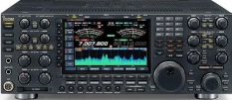
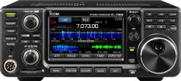
Req. 4.: How Radio Waves Carry Information
United States
Europe
Our Wireless
System
Receiving
Antenna
Transmitting
Antenna
Voice
Into
Microphone
Radio
Transmitter
Radio
Receiver
Loud
Speaker
1
2
3
4
5
6
7
8
9
10
Notes:
5 minutes for this slide
[10] Radio is wireless; the Internet is NOT wireless; cable TV is NOT wireless;
Radio is “OFF THE GRID.” That’s what makes radio cool! If electrical power, cell phone and telephone service goes out, you can still get through with radio! (using batteries, generators, solar, etc.)
[9] Radio uses transmitters to generate energy waves and a radio receivers to detect them and make them useful
[8] There can be tens, hundreds or thousands of miles between a transmitter and receiver, across the city, county, country or WORLD (or SPACE!)
[7] Transmitters must be connected to an antenna to send out the waves
[6] Receivers must also have some sort of antenna to collect the waves
[5] These energy waves are generated when some sort of signal (like a voice into a microphone) is presented to a radio transmitter
[4] The transmitter converts the voice (in this example) to radio wave energy and sends this energy up to the antenna
[3] The antenna throws-off the waves in directions and distances based on how the system is designed
[2] The transmitted energy waves are collected by any receiving antenna designed to detect them, and sends the radio wave energy down to the receiver.
[1] The radio receiver processes the energy waves and converts them into audio that you can hear either through a speaker or headphones
Many radio receivers can be directly connected to a computer where the signal is digitized.
SLIDE END

