Slide 1
Req. 2.a.: Introduction to How Radio Waves Travel
186,000 miles per second!
How
Radio Waves
Travel
1
2
3
4
5
Notes:
2 minutes for this slide
[5] Some people think the whole idea of “radio waves” is magic!
[4] Even though we can’t really “see” radio waves, we often show them as a series of ripple lines like this.
[3] Radio waves actually move.
[2] They move at the speed of light!
Ask: How fast is “the speed of light”?
[1] <186,000 mi/second> or <approx. 300,000,000 meters/second>
SLIDE END

Slide 2
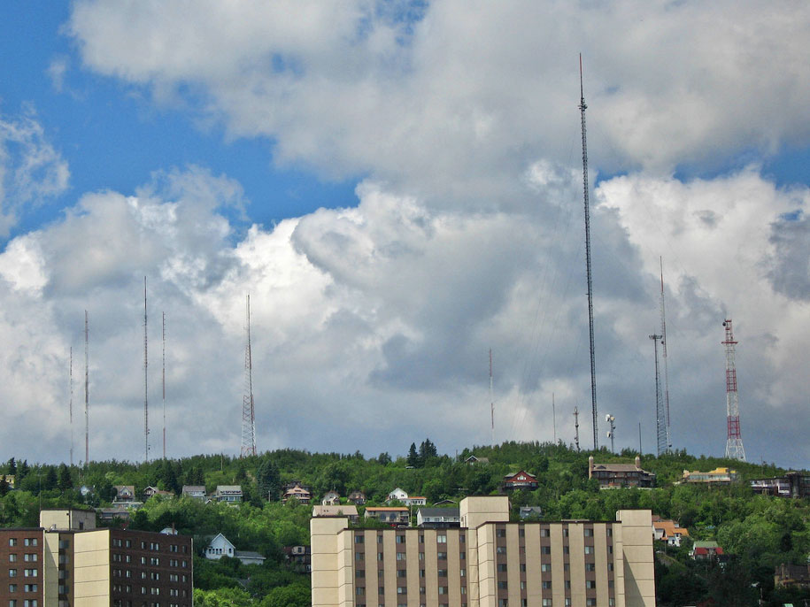
Req. 2.a.: Introduction to How Radio Waves Travel
EARTH
1
2
3
Notes:
2 minutes for this slide Start 02:00
[3] The simplest for of radio wave travel is called “line of sight.” You’ll learn later that radio waves called “Very High Frequency” (and higher) depend pretty much on line of sight.
As shown here, someone transmitting radio waves from their location to yours is simply a matter of sending the signal straight across.
[2] This works well unless there is something in the way of the line-of-sight signal, such as a small mountain.
[1] That’s why you’ll often see antennas on hilltops so that their line-of-sight signal will travel farther!
SLIDE END 04:00

Slide 3
Req. 2.a.: How Radio Waves Travel
EARTH
1
Notes:
1 minute for this slide
[1] Even if there are no mountains in the way of you line-of-sight signal the curve of the earth will eventually make it impossible for the signal to reach someone far enough around the curve! Line-of-sight signals can “bend” a little, but not for long distances.
That’s where other forms of wireless radio come into play.
SLIDE END

Slide 4
Req. 2.a.: How Radio Waves Travel
IONOSPHERE
2ND HOP
CHICAGO
DENVER
SKIP ZONE
SAN
FRANCISCO
GROUND
WAVES
2ND SKIP ZONE
SKIP
DISTANCE
2ND HOP
SKIP DISTANCE
NEW YORK CITY
EARTH
1
Notes:
8 minutes for this slide
[1] Consider four cities lying along the curvature of the earth, San Francisco, Denver, Chicago and New York City. We’ve already talked about line-of-sight radio waves, and we know they pretty much can’t follow the curve of the earth.
Even some transmitters designed to send radio waves around the earth will throw off some ground waves that won’t go very far.
This is where the Ionosphere comes in. The Ionosphere is an interesting invisible cloud of charged particles that surrounds the earth. This is one of the most interesting parts of radio because it has many effects on radio waves.
If I’m in San Francisco, my transmitter and antenna will throw off radio waves at an angle up into the sky.
When my signal enters the Ionosphere, the radio waves bend back down toward the earth as if they were being reflected off a mirror. While the Ionosphere isn’t exactly a mirror, it has a similar effect. My radio waves come back down to earth at approximately the same angle they entered the Ionosphere, and can be detected by someone listening on my frequency near where the waves get close to the ground.
We call this reflection off the Ionosphere “skip” and the total up and down distance is called “skip distance”
What about the people in Denver? People listening on my frequency cannot hear my signal because it has “skipped” over them!
We call this area where a signal skips over the “skip zone.”
After the first skip of my signal, it will reflect off the earth and head back out towards the Ionosphere. It will then reflect again off the Ionosphere, heading back down to earth. Here we show that it hits somewhere near New York City, where someone may be listening in.
We call this the “2nd hop” (or 2nd skip) of my signal. My signal has gone all the way from San Francisco to New York City; not possible with line-of-site or ground waves.
And with a second hop, there is a second skip zone. In the case no one in Chicago will hear my signal because it’s travelling too high for their antennas to detect!
The total of both hops is called the “2nd hop skip distance”
There are two other interesting things that can happen with skip:
Let’s say I position my antenna in such a way as to lower the angle my radio waves travel to the ionosphere.
They will reflect back down at that lower angle, making them go much farther like I’m showing here. Now my first skip hop got my signal all the way to Chicago, while on the first try, it didn’t quite go as far.
And on the 2nd hop, this signal travels over New York City to someplace in the Atlantic Ocean (maybe a tropical island?).
Finally, I might position my antenna so that radio waves angle up too sharply.
They will deflect a bit, but they’ll end up going right through the ionosphere into space; no one will hear them (except an alien or possibly an astronaut!
SLIDE END

Slide 5
Req. 2.a.: How Radio Waves Travel
EARTH
1
2
3
Notes:
1 minute for this slide
[3] Now let’s look at what really is amazing…
[2] This skip effect can take a radio wave signal all the way around the other side of earth!
[1] What’s really crazy, signals can sometimes skip their way completely around the earth, and I’m able to hear my own signal!
If the instructor has time: At 186,000 miles per second, how long does it take my signal to make one run around the earth? (25,000/186,000 = .134 seconds; a little more than a tenth of a second.
In our illustration here, it would take about .065 seconds to travel half way around the world!.
SLIDE END

Slide 6
Req. 2.a.: How Radio Waves Travel
IONOSPHERE
2ND HOP
CHICAGO
DENVER
SKIP ZONE
SAN
FRANCISCO
2ND SKIP ZONE
SKIP
DISTANCE
2ND HOP
SKIP DISTANCE
NEW YORK CITY
Finish Drawing!
EARTH
1
Notes:
6 minutes for this slide
Keep this slide showing, allowing them to use it as a template to make their required diagram.
SLIDE END

Slide 7
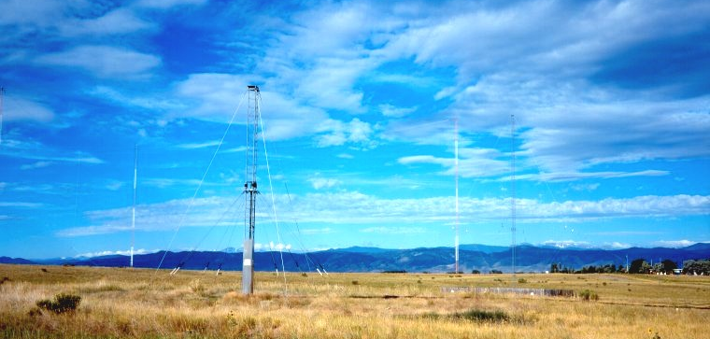
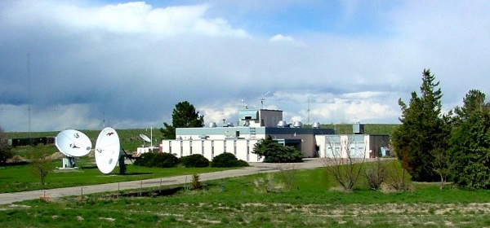
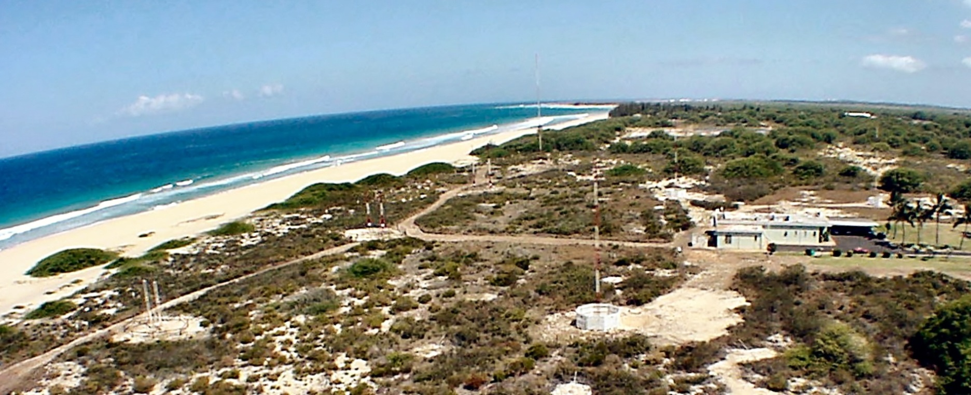
Req. 2.b.: WWV and WWVH
WWV
WWVH
1
2
3
4
Notes:
3 minutes for this slide
[4] What exactly is “WWV?”
[3] WWV is the call sign of the United States National Institute of Standards and Technology's (NIST) radio station near Fort Collins, Colorado.
[2] WWV uses high performance antennas to continuously transmit its signal, and can be heard all over the world!
They transmit simultaneously on several frequencies. Their frequencies and time signals are controlled by atomic clocks located in Boulder, Colorado.
[1] NIST also operates the very similar radio station WWVH in Kauai, Hawaii, using the same frequencies.
WWV and WWVH make recorded announcements; since they share frequencies, WWV uses a male voice to distinguish itself from WWVH, which uses a female voice.
They also make other recorded announcements of general interest, e.g., the GPS satellite constellation status and severe oceanic weather warnings.
SLIDE END

Slide 8
Req. 2.b.: WWV and WWVH
<Click for WWV audio>
1
Notes:
1 minute for this slide
[1] Instructor: In presentation mode, simply click on speaker icon.
It is helpful to have external speakers for this audio
SLIDE END

Slide 9
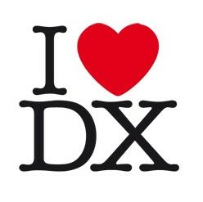
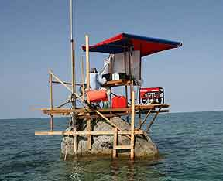
Req. 2.c.: DX
DXpedition
= “DISTANCE”
1
2
3
Notes:
2 minutes for this slide
[3] Ask: Can you guess what the abbreviation “DX” means?
[2] DX is shorthand for "distance."
There’s no exact amount of distance defined for DX, but we say DX communication is over great distances using the ionosphere to refract the transmitted radio signal.
DXing is the pursuit of distant stations with the goal of earning various awards.
[1] A DXpedition is a trip to operate in a rare DXCC entity, such as one to Scarborough Reef in the South China Sea.
SLIDE END

Slide 10
Req. 2.d. ITU/FCC
International
Telecommunication Union
Federal
Communications Commission
ITU?
FCC?
International
Treaty
United States
Radio Law
1
2
3
Notes:
3 minutes for this slide
[3] Because radio has no boundaries (radio waves don’t stop at borders), the countries of the free world get together and make formal agreements on how radio should be used.
It is up to each country to create their own laws which ensure they abide by the international agreements.
An formal international group has been created to coordinate the agreements between countries.
[2] This international group is called the International Telecommunications Union (or “ITU”). The ITU coordinates the agreements in the form of treaties between countries and has headquarters in Geneva, Switzerland.
[1] The agency in the U.S. government which creates and enforces law to help us fulfill the international treaties is called the Federal Communications Commission (FCC).
Nearly all who transmit radio signals for any purpose are required to be registered and licensed by the FCC.
The FCC is the agency that assigns those call signs we talked about earlier in Requirement 1c.
REQUIREMENT 2 END

