Slide 1
Radio
Merit
Badge
1
Notes:
Cover Slide w/3 minutes instructor intro
[1] Instructors:
> Introduce self
Name, call, years licensed
Ham radio interests
> Describe how this course will work
Classroom instruction
Station visit/operations
Wrap-up classroom instruction
> Hand out and describe how notes forms are to be used

Slide 2
Req. 1.: What is Radio?
S
A
B
1
2
3
4
5
6
7
Notes:
2 minutes for this slide
[7] Ask: Have you ever looked closely at the Radio Merit Badge itself?
There are strange little markings around the top of the merit badge, above the “lightning bolts”
[6] The first little group is a dash followed by three dots.
[5] In Morse Code, that’s the letter “B”
[4] The second group is three dots
[3] The letter “S”
[2] Can you guess what the third is?
[1] A dot and a dash for the letter “A”
“BSA”
Morse Code was the first kind of message sent by man using radio waves.
REQUIREMENT 1 END

Slide 3
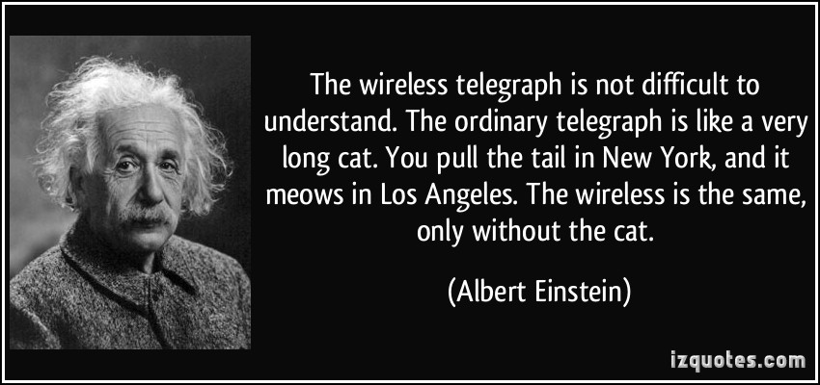
Req. 1.: What is Radio?
Radio?
What is
Radio?
Communication system, using electromagnetic waves
Wireless
“Off The Grid”
1
2
3
4
5
6
Notes:
2 minutes for this slide
[6] What exactly is “radio?”
[5] A technical way of describing radio is that it’s a system to communicate, using electromagnetic waves. But that’s kind of a GEEK response!
[4] Many refer to radio as “Wireless”, which it is…
[3] How many have used one of these? Is it a “radio?” It is wireless, that’s for sure. But in order for it to communicate, it needs the rest of the system, including computers and telephone wires to interconnect the cell phone towers. But there is definitely a part of it that is “radio.” And most of you use it every day!
[2] Some will say ham radio is “off the grid”, meaning that with only a generator, a radio and an antenna, we don’t need cell towers, power or telephone lines to communicate.
[1] Albert Einstein had a great quote. Will someone volunteer to read it for us?
SLIDE END

Slide 4
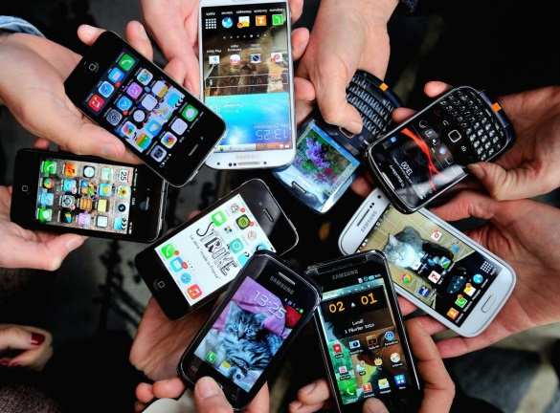
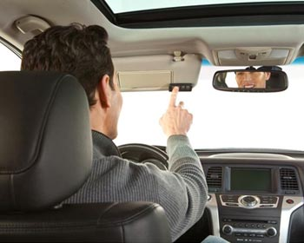
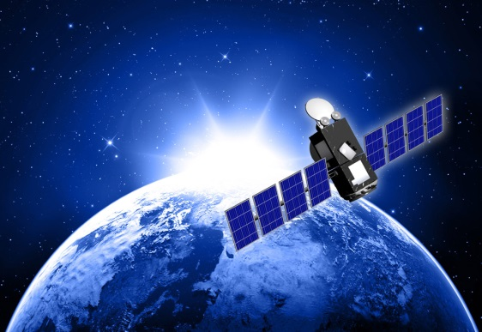
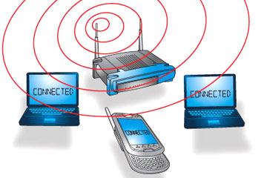
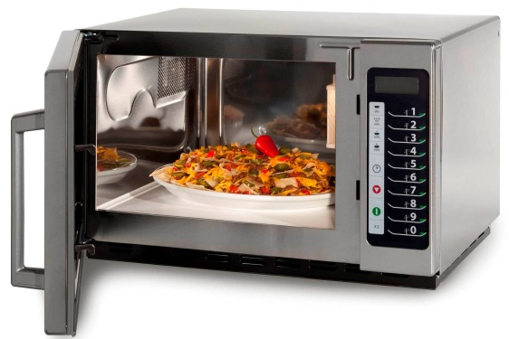
Req. 1.: What is Radio?
Lot’s of things
we use every day
could be considered
forms of radio…
1
2
3
4
5
6
7
Notes:
2 minutes for this slide
[7] Today we get our entertainment, news and other information over the Internet
[6] The Internet usually makes it to our devices through radio using WiFi
[5] In addition to WiFi, we get information via satellite, another radio method that is very strong.
But radio isn’t just entertainment and information.
[4] We use radio when we operate our mobile phones.
[3] We use radio when we open the garage door remotely.
[2] We use radio when we heat something in the microwave oven.
[1] We even use radio when the EZPass in our car communicates with the gate to charge us the toll and let us through.
SLIDE END

Slide 5
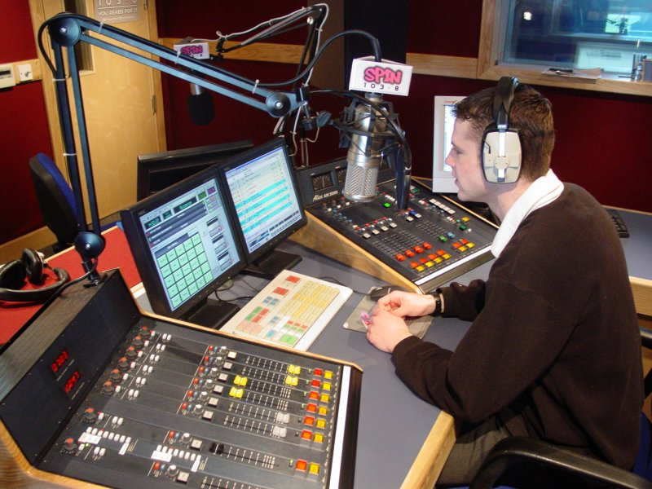
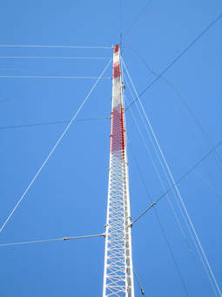
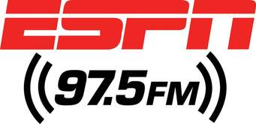
Req. 1.a.: Broadcast Radio
1
2
Notes:
One minute for this slide
[2] Broadcast radio used to be a major entertainment source before the Internet. Today there are still many good music radio stations, but there are a huge number of talk radio stations such as ESPN.
Usually, a broadcast radio station has one or more studios like this one, with large “boards” (the equipment with all the buttons and knobs) and of course, computers.
[1] Broadcast stations also use large antenna towers like this one, to make sure their signal can reach as many of their intended audience as possible. When there is a hill or small mountain nearby a populated area, you’ll see one or more of these!
SLIDE END

Slide 6
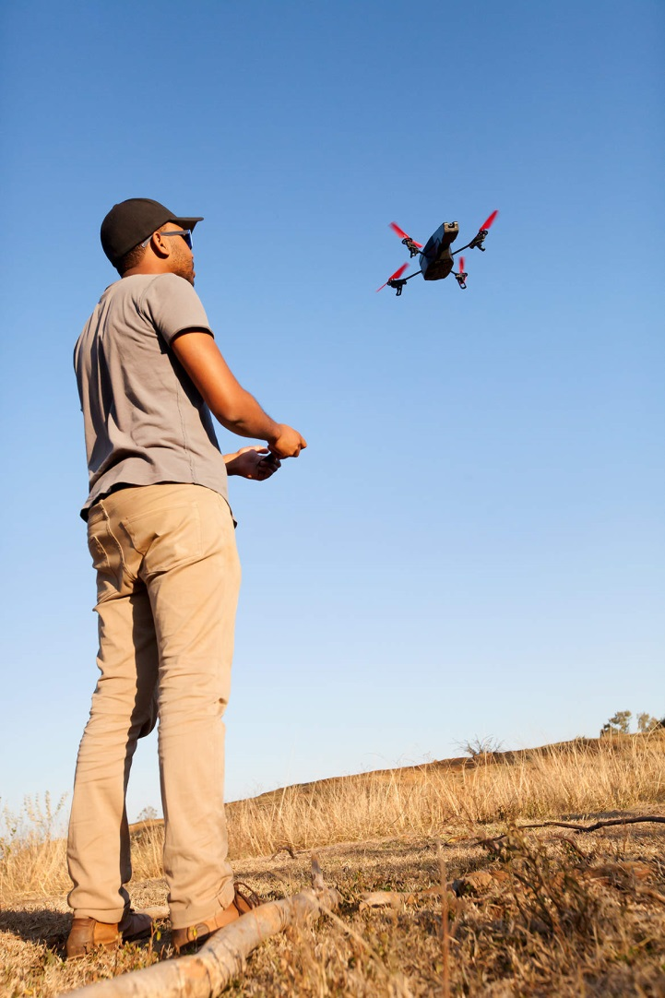
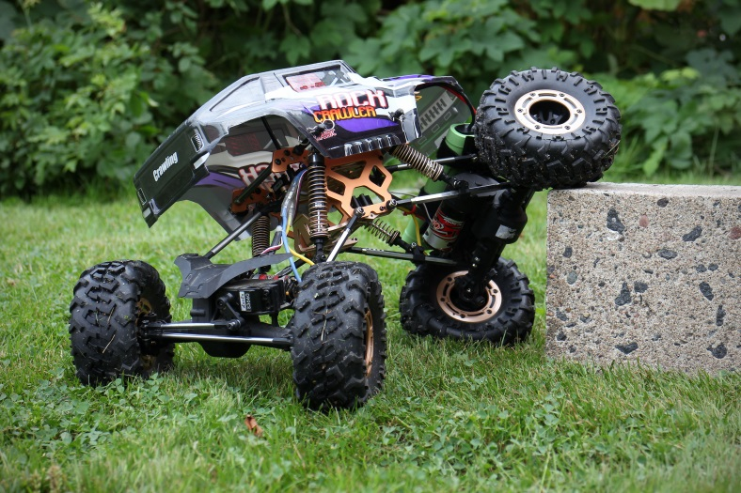
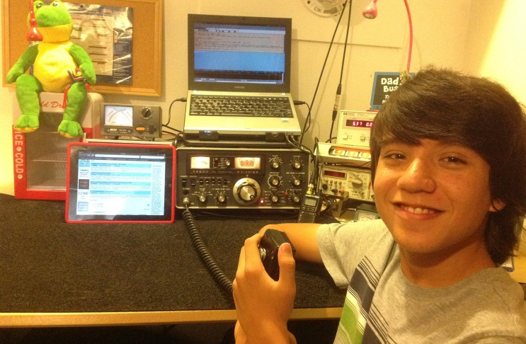
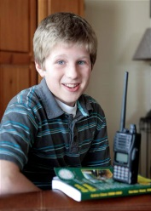
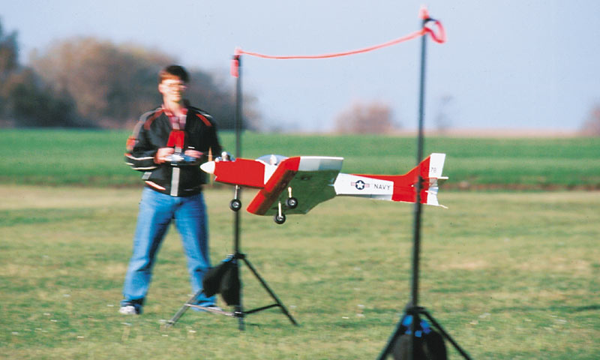
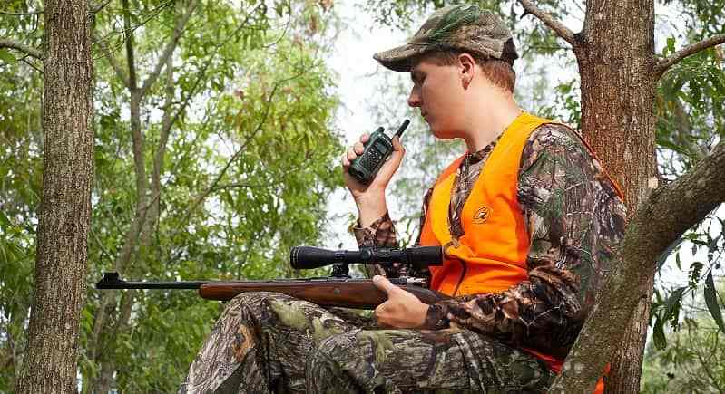
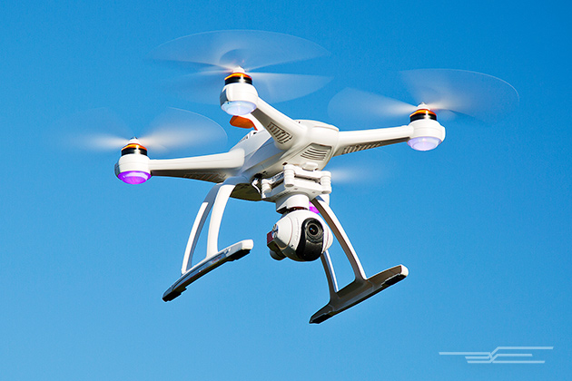
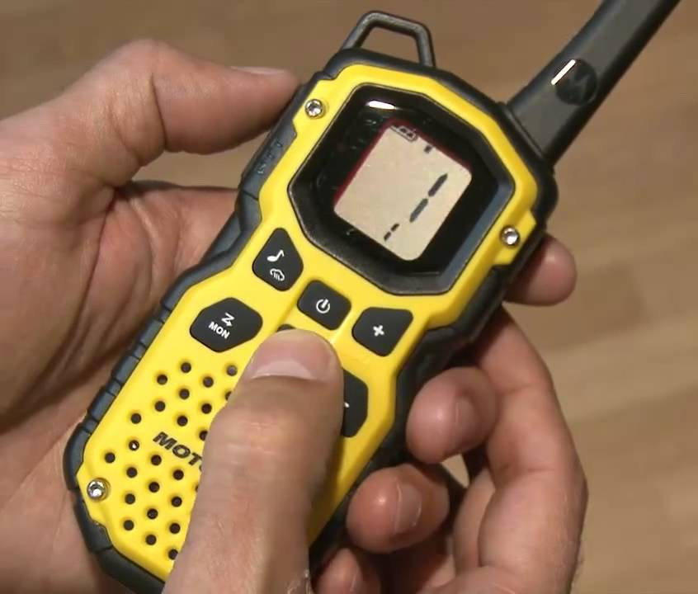
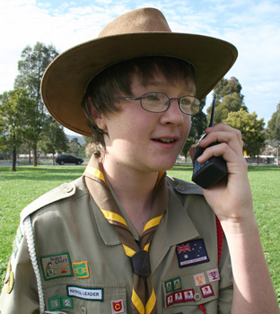
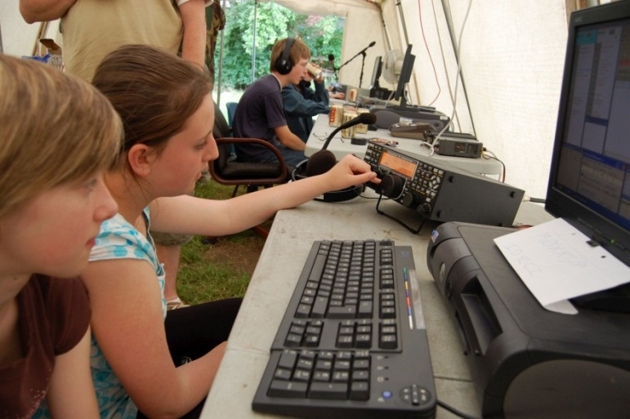
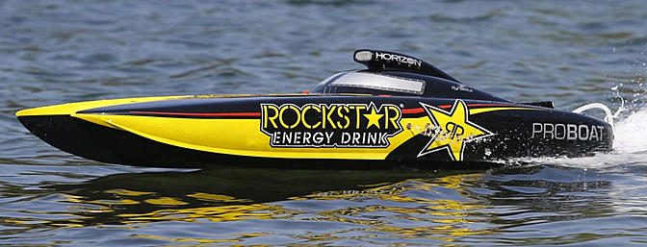
Req. 1.a.: Hobby Radio
2
1
3
4
5
Notes:
2 minutes for this slide
[5] Radio as a hobby is very popular.
Probably the single biggest group of hobby radio people is with ham radio operators
There is no minimum age; every one of you in this class could get an amateur radio license.
[4] Another type of hobby radio is Radio Control of cars, boats and airplanes.
[3] These days, drones are becoming a very popular radio controlled device
[2] Citizens Band radio is used by many truckers.
[1] Many like to use Family Radio Service (FRS) radios when they need to communicate wirelessly such as during hunting.
SLIDE END

Slide 7
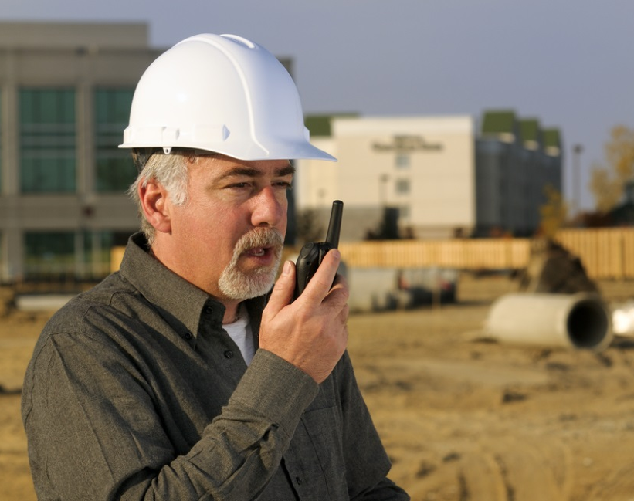
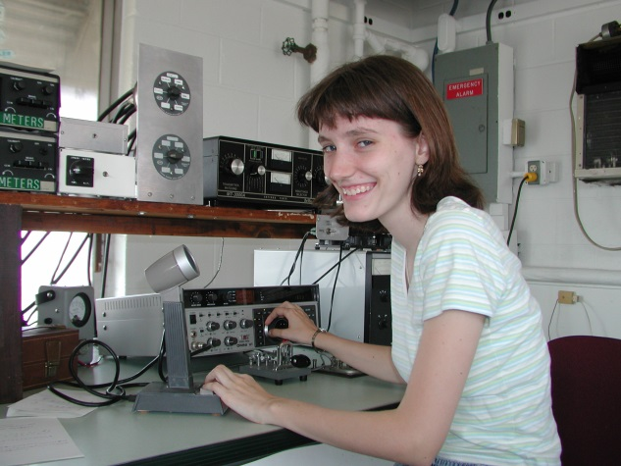
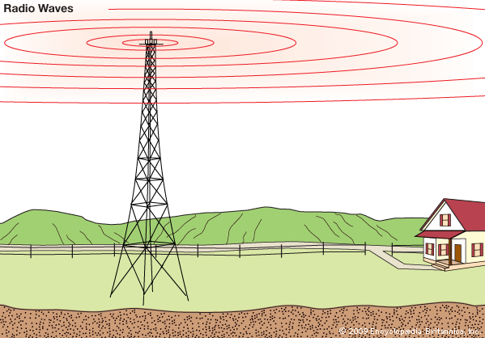
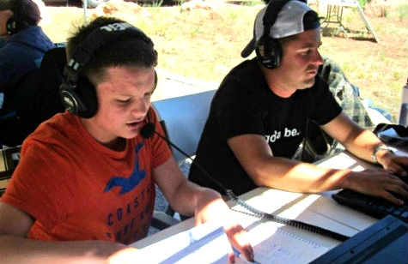
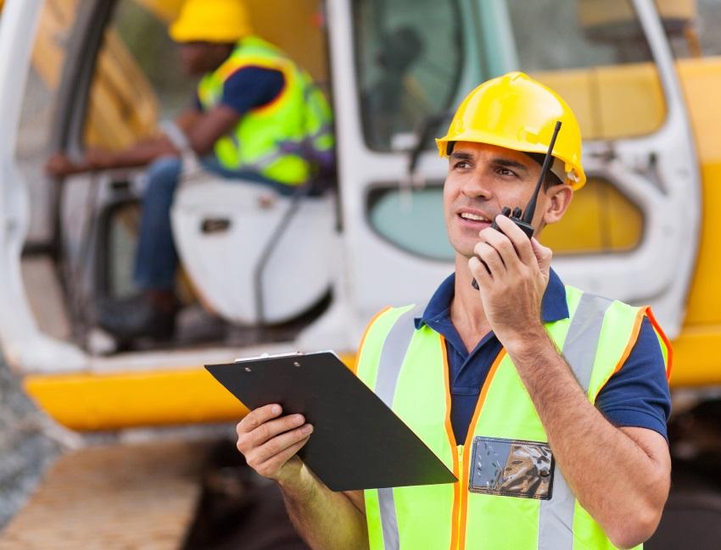
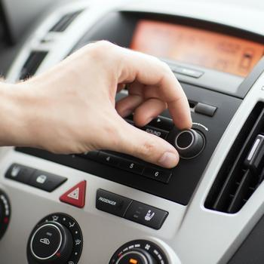
Req. 1.b.: Broadcasting vs. Two-Way Radio
1
2
3
Notes:
1 minute for this slide Start 13:00
[3] Broadcasting is one-way communication.
Usually you can spot a broadcasting antenna; it’s very tall and such antennas are usually located near large population areas.
Everyone can listen-in on their radio to the programming.
Broadcasting is usually operated as a business, where advertisers pay to have their products/services advertised over the air waves.
Two-Way Communication is just that; it’s NOT one-way broadcasting; there are always two (or more) involved
[2] Businesses use two-way communication to be more efficient.
[1] Ham radio operators use two-way communication in emergencies, when experimenting with equipment and antennas, and mostly for fun!
SLIDE END 14:00

Slide 8
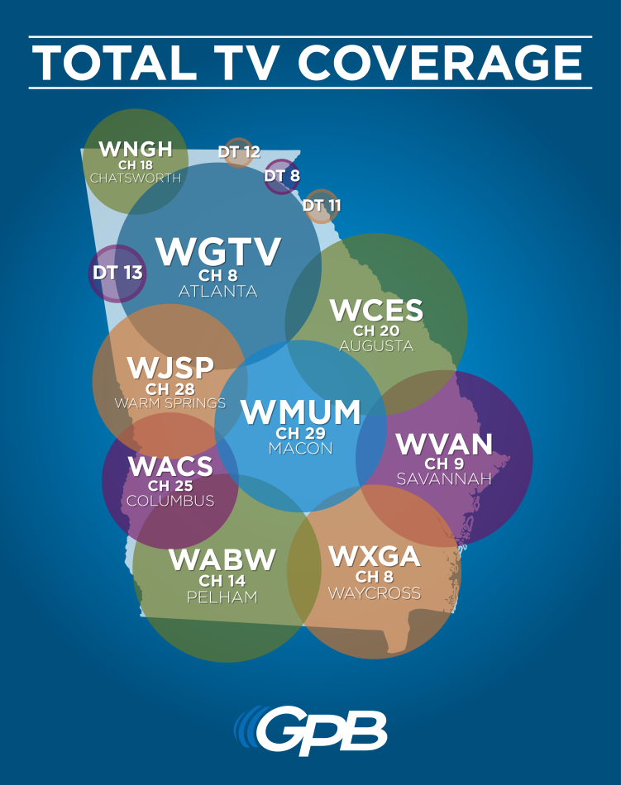
Req. 1.c.: Call Signs
Call Signs
1
2
3
Notes:
2 minutes for this slide
[3] Call signs are a unique identification for a licensed radio station.
[2] Broadcast radio station call signs are three or four letters such as the FM station above and the television broadcasting stations on the right.
Cable television does not use call signs because their signal does not travel over the airwaves
[1] U.S. Amateur radio station call signs are letters and a number such as the one shown above
SLIDE END

Slide 9
Req. 1.c.: Call Signs
K2GW
K2GW
K2GW
AA - AL
K
KA - KZ
N
NA - NZ
W
WA - WZ
AD4UM
0 - 9
AD4UM
AD4UM
N7QR
N7QR
N7QR
WB8AXP
WB8AXP
WB8AXP
1
2
3
Notes:
2 minutes for this slide
[3] Every licensed ham radio operator is assigned a unique call sign.
[2] All U.S. ham radio operators have call signs beginning with AA-AL, K, N or W
[1] Each U.S. ham radio operator also has a single number in their call letters, 0-9
SLIDE END

Slide 10
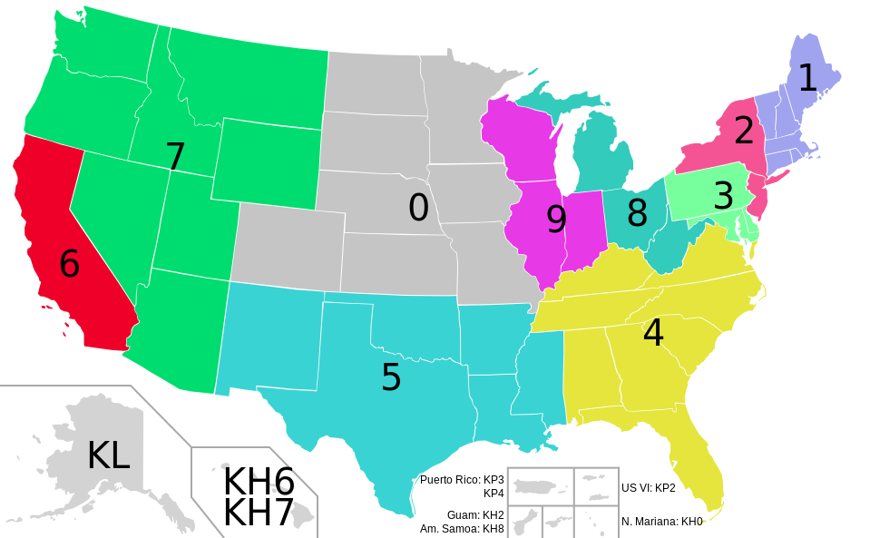
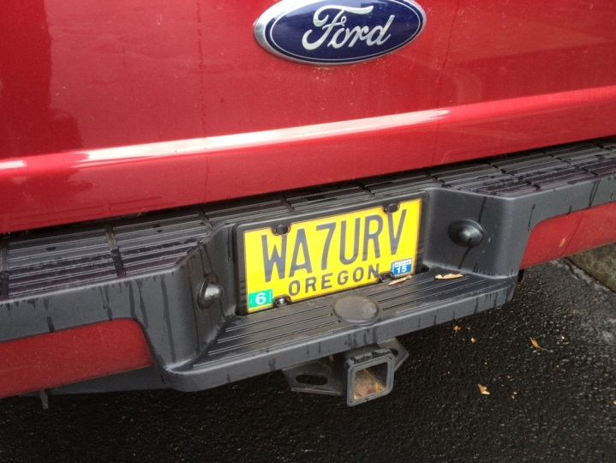
Req. 1.c.: Call Signs
Create Your Own Imaginary Call Sign!
1
2
3
Notes:
2 minutes for this slide
[3] The number in our call shows the call sign district where our first license was granted.
(If you move to another district, you keep the same number. You can’t be sure anymore that a person with a certain district number actually lives in that district…) If each one of you passed the requirements for your ham radio license where you lived right now, what would the number be in your call?
[2] It is very common for ham radio operators to have a custom license plate made for their vehicle, like this one.
[1] <Create Your Imaginary Call Sign>
Pick K, N, or W, a number, and add your initials
SLIDE END

Slide 11
Req. 1.c.: Call Signs
Global Call Signs
5R8UI
PW8S
1
2
3
4
Notes:
1 minute for this slide
[4] There are 308 entities in the world with unique first letters or combinations of letters and numbers in radio call signs called “prefixes”. (Many countries have multiple entities, such as the U.S. with Guam, Puerto Rico, etc.)
[3] If I’m operating in my radio station and come across the call letters “5R8UI”, I know that other ham is licensed in Madagascar.
[2] If I contact someone with call letters “PW8S,” I know they are licensed in Brazil.
[1] As a ham radio operator, my heart starts beating hard when I make a contact with a another ham from one of these faraway places!
SLIDE END

Slide 12
Req. 1.d.: Phonetic Alphabet
C
E
A
lfa
H
otel
O
scar
V
ictor
Phonetic
Alphabet
B
D
G
B
ravo
I
P
W
ndia
apa
hiskey
C
T
J
V
harlie
uliet
Q
uebec
X
-ray
P
Z
D
elta
K
ilo
R
omeo
Y
ankee
E
cho
L
ima
S
ierra
Z
ulu
Phil
Bill
F
oxtrot
M
T
ike
ango
G
olf
N
ovember
U
niform
1
2
3
4
Notes:
3 minutes for this slide
[4] Many letters sound similar over the radio.
Weak radio signals and noise might make it difficult to hear voices.
[3] The letters B, C, D, E, G, P, T, V or Z might sound the same.
[2] A guy who gives his name “Phil” during a radio transmission is often mistaken for the name “Bill”
An operator for whom English is not a native language may pronounce letters differently, too.
[1] Radio operators use a standardized phonetic alphabet to improve understanding and avoid communication errors.
Now each of you speak the call you made a couple minutes ago, using the phonetic alphabet words instead of just saying the letters.
<Instructor give his own example>
SLIDE END

