Slide 2
What is Radio Scouting?
Jim Wilson, K5ND and Bill Stearns, NE4RD

Slide 3
What is Radio Scouting?
Jamboree on the Air
Radio Merit Badge
Amateur Radio Operator Rating Strip
Morse Code Interpreter Strip
National Scout Jamboree Operation
More…

Slide 4
Radio Scouting Path
Introduction
Jamboree on the Air
Rank Advancement
Radio Merit Badge
Special Recognition
Morse Code Interpreter Strip
Amateur Radio Operator Rating Strip
Special Awards
ARRL Service to Scouting Award

Slide 5
What is Jamboree on the Air?
World-Wide Annual Event – Third Weekend in October – Started 1957
Largest Scouting Event in the World
1 million Scouts
22,000+ Radio Amateurs
17,000+ Stations
150+ Countries

Slide 6
What are the Benefits?
Scouts engage in conversations with other Scouts across the country and around the world.
They get a glimpse of other cultures and regional differences.
Scouts get exposed to the technology, fun and magic of amateur radio.
Natural starting point for Radio Merit Badge.

Slide 7
Scouts Having Fun in Conversations Across the Country and Around the World

Slide 8
USA JOTA Results
 | 2010 | 2011 | 2012 | 2013 | 2014 | 2015
Stations | 31 | 68 | 204 | 271 | 205 | 208
Growth |  | 119% | 200% | 33% | -24% | +1%
Participants | 454 | 3,185 | 18,537 | 13,866 | 13,326 | 12,255
Growth |  | 602% | 482% | - 25% | -4% | -8%

Slide 9
How do I organize a JOTA event?
Work with your local Scout Council, District, or Unit.
See JOTA Talking points at http://k2bsa.net/talking-points/
Line up with an existing Scouting event that happens on JOTA weekend — October 14-16, 2016
Go where the Scouts are as one more supporting activity for their event — camporee, etc.

Slide 10
What Resources are Available?
The go-to website is http://scouting.org/jota.aspx
Leader guidelines, operator guidelines, planning and calendars, program ideas, success stories, activity books, participation certificates, graphics.
Supporting website is http://k2bsa.net

Slide 11
Get on the Air during JOTA
Demonstrate Hospitality
Hand out QSO’s and Conversations
Invite Scouts to our Hobby

Slide 12
Radio Scouting Path
Introduction
Jamboree on the Air
Rank Advancement
Radio Merit Badge
Special Recognition
Morse Code Interpreter Strip
Amateur Radio Operator Rating Strip
Special Awards
ARRL Service to Scouting Award

Slide 13
What is Radio Merit Badge?
Introduced as Wireless Merit Badge 1918
Introduction to Radio
Broadcast, SWL, and Ham Radio Options – Soon to Add ARDF Option
Can be completed in a day-long workshop
Jamboree used a four-hour time frame

Slide 14
Strong Interest & Growth

Slide 15
Radio Scouting Path
Introduction
Jamboree on the Air
Rank Advancement
Radio Merit Badge
Special Recognition
Morse Code Interpreter Strip
Amateur Radio Operator Rating Strip
Special Awards
ARRL Service to Scouting Award

Slide 16
Amateur Radio Operator Rating Strip
Builds on Senior Scout Radioman Strip from 1940’s
All licensed youth and adult members can wear it
Natural follow-on to Radio Merit Badge with Technician license training and uniform patch rewar

Slide 17
Morse Code Interpreter Strip
5 wpm send and receive, requirements online at http://k2bsa.net/morse-code/
Initially sold at 1,200/year in first two years, now at 345 sold in past 12 months.

Slide 18
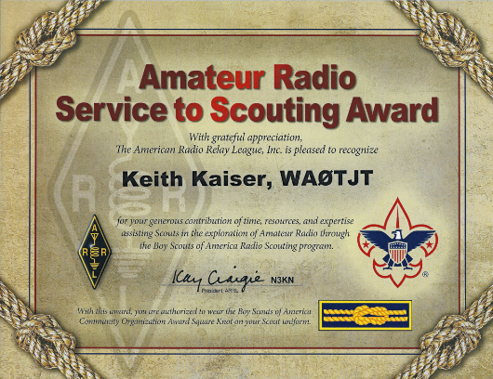
Amateur Radio Service to Scouting Award

Slide 19
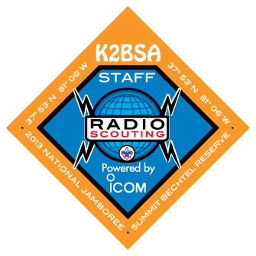
National Scout Jamboree
K2BSA Operation, July 2013
Demonstration Station — 2,600 Scouts
Radio Merit Badge — 339 Scouts
ARDF-Foxhunting — 100+
ISS Contact, 10 Scouts
Four High-Altitude Balloon Launches
Permanent Repeater Installation (3)

Slide 20
2017 Jamboree Sponsors
Icom America – transceivers, repeaters and support throughout the year with station loans to Scout Councils and promotion.
DX Engineering – verticals and beam antennas, coaxial cables, band-pass filters, multiplexers.
MFJ – headphones, rotator, dipoles.
Thanks for such great support

Slide 21
What does it mean to me?

Slide 23
For More Info
K2BSA Website http://k2bsa.net
K2BSA Facebook Page http://facebook.com/K2BSA.Scouting
K2BSA Twitter http://twitter.com/K2BSA_Scouting
JOTA Pages http://scouting.org/jota
World JOTA-JOTI http://jotajoti.info

Slide 24
Q & A
Radio Scouting

