Slide 2
What is Radio Scouting?
And what does it mean to me?

Slide 3
Jim Wilson, K5ND World JOTA-JOTI Team
Chairman, USA Radio Scouting Committee
President, K2BSA Amateur Radio Assn.

Slide 4
What is Radio Scouting?
Jamboree on the Air
Radio Merit Badge
Amateur Radio Operator Rating Strip
Morse Code Interpreter Strip
National Scout Jamboree Operation

Slide 5
Radio Scouting Path
Introduction
Jamboree on the Air
Rank Advancement
Radio Merit Badge
Special Recognition
Morse Code Interpreter Strip
Amateur Radio Operator Rating Strip

Slide 6
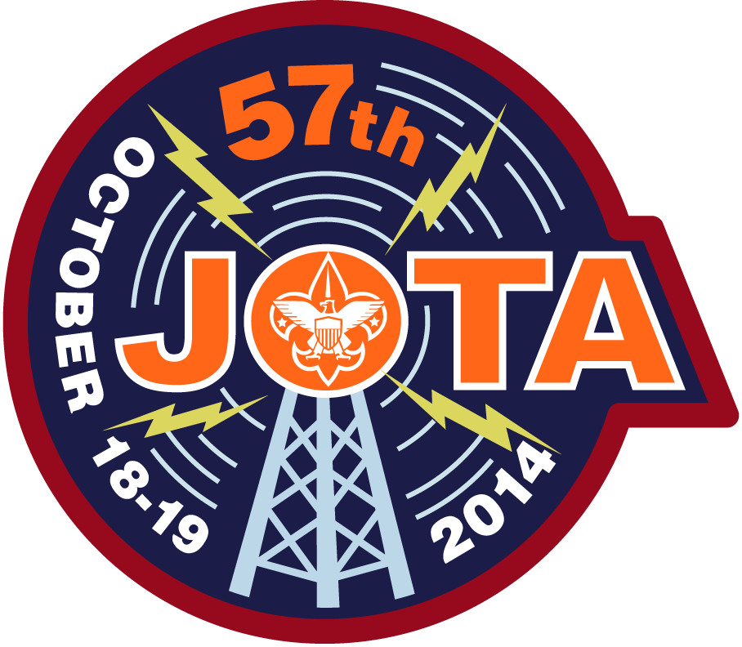
What is Jamboree on the Air?
World-Wide Annual Event --- Third Weekend in October --- Started 1958
Largest Scouting Event in the World
750,000+ Scouts
29,000+ Radio Amateurs
12,000+ Stations
150+ Countries

Slide 7
What are the Benefits?
Scouts engage in conversations with other Scouts across the country and around the world.
They get a glimpse of other cultures and regional differences.
Scouts get exposed to the technology, fun and magic of amateur radio.
Natural starting point for Radio Merit Badge.

Slide 8
Scouts Having Fun in Conversations Across the Country and Around the World

Slide 9
USA JOTA Results
 | 2010 | 2011 | 2012 | 2013
Stations | 31 | 68 | 204 | 271
Growth |  | 119% | 200% | 33%
Scouts | 454 | 3,185 | 18,537 | 13,866
Growth |  | 602% | 482% | - 25%

Slide 10
How do I organize a JOTA event?
Work with your local Scout Council, District, or Unit.
See JOTA Talking points at http://www.k2bsa.net/talking-points/
Line up with an existing Scouting event that happens on JOTA weekend --- October 17-19, 2014
Go where the Scouts are as one more supporting activity for their event --- camporee, etc.

Slide 11
What Resources are Available?
The go-to website ishttp://www.scouting.org/jota.aspx
Leader guidelines, operator guidelines, planning and calendars, program ideas, success stories, activity books, participation certificates, graphics.
Supporting website is http://www.k2bsa.net

Slide 12
Get on the Air during JOTA
Demonstrate Hospitality
Hand out QSO’s and Conversations
Invite Scouts to our Hobby

Slide 13
Radio Scouting Path
Introduction
Jamboree on the Air
Rank Advancement
Radio Merit Badge
Special Recognition
Morse Code Interpreter Strip
Amateur Radio Operator Rating Strip

Slide 14
What is Radio Merit Badge?
Introduction to Radio
Broadcast, SWL, and Ham Radio Options
Can be completed in a day-long workshop
Jamboree used a four-hour time frame

Slide 15
Strong Interest & Growth

Slide 16
Radio Scouting Path
Introduction
Jamboree on the Air
Rank Advancement
Radio Merit Badge
Special Recognition
Morse Code Interpreter Strip
Amateur Radio Operator Rating Strip

Slide 17
Amateur Radio Operator Rating Strip
Builds on Senior Scout Radioman Strip from 1940’s
All licensed youth and adult members can wear it
Natural follow-on to Radio Merit Badge with Technician license training and uniform patch reward
Highly Popular --- 6,800+ sold in first year

Slide 18
Morse Code Interpreter Strip
5 wpm send and receive, requirements online at http://www.k2bsa.net/morse-code/
Already the second largest selling interpreter strip at 1,200 in the past year

Slide 19
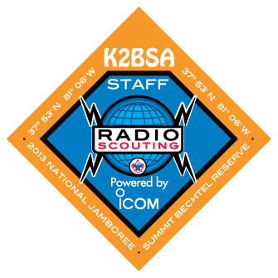
National Scout Jamboree
K2BSA Operation, July 2013
Demonstration Station --- 2,600 Scouts
Radio Merit Badge --- 339 Scouts
ARDF-Foxhunting --- 100+
ISS Contact, 10 Scouts
High-Altitude Balloon Launches
Permanent Repeater Installation (3)

Slide 20
Jamboree Sponsors
Icom America --- transceivers, repeaters and so much more --- on site and great support
SteppIR --- verticals and beam antennas
Array Solutions --- band pass filters
GigaParts --- headphones/microphones
Thanks for such great support

Slide 21
World JOTA-JOTI
New World JOTA-JOTI Team in 2014
HQ Move to Kuala Lumpur from Geneva
Registration System and Supporting Website

Slide 22
What does it mean to me?

Slide 24
10 Complete Stations for loan to Councils, entering third year of the program
Promotion of Radio Scouting year round
Official Jamboree Transceiver/Repeater Sponsor
Installed 3 repeaters at The Summit in WV

Slide 25
For More Info
K2BSA Website http://www.k2bsa.net
K2BSA Facebook Page http://www.facebook.com/K2BSA.Scouting
K2BSA Twitter http://twitter.com/K2BSA_Scouting
JOTA Pages http://www.scouting.org/jota
Jim Wilson, K5ND jim.wilson@k2bsa.net

Slide 26
Q & A
Radio Scouting

