Slide 1
Jamboree on the Air Radio Scouting
Jim Wilson, K5ND
HamCom 2016

Slide 2
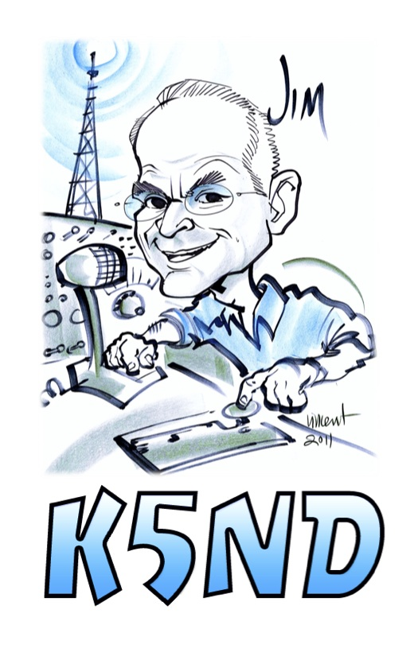
Chairman BSA National Radio Scouting Committee Member World Scouting JOTA-JOTI Team President K2BSA Amateur Radio Association

Slide 3
What is Radio Scouting?
Who is Involved?
What Have Been the Results?
How Can You Get Involved?

Slide 4
What is
Radio Scouting?

Slide 5
Boy Scouts of America Radio Scouting
1
2
Scouting Advancement – Radio Merit Badge
3
Licensing and Morse Code – Uniform Badges
Jamboree on the Air – Introduction for Scouts
4
Leader Recognition – ARRL Service to Scouting
Notes:
This is another option for an overview slide.

Slide 6
Who is Involved?

Slide 7
Scouts

Slide 8
Who Else?
World Organization of the Scout Movement
Started in 1957
Owns and Operates the World-Wide Event
Boy Scouts Primarily and Girl Scouts Invited
Boy Scouts of America
Responsible for National Operation
BSA International Department
Local Council International Representative

Slide 9
Supporters
ARRL
Promotes Event
Encourages Clubs and Members
Education, Youth, Public Relations
K2BSA Amateur Radio Association
Communication Program
Resource Clearing House
Jamboree Operation
Local Amateur Radio Clubs
World JOTA-JOTI Trusted Partners

Slide 10
Sponsors
Icom America
Jamboree on the Air Promotion
Local Council Loan Station Program
Now being updated from IC-7200 to IC-7300
Official Transceiver Supplier for the National Scout Jamboree (2013 and 2017)
Installed 3 Repeaters at the Summit
Provided Transceivers for 2015 NOAC and for 2016 Philmont Scout Ranch activation
Additional Jamboree Sponsorship Soon

Slide 11
What Have Been the Results?

Slide 12
World Scouting JOTA-JOTI

Slide 13
Active in Malaysia and around the World

Slide 14
World Scouting JOTA-JOTI 2015
Nearly 1 million Scouts and Guides
151 Active Countries
17,776 Stations
Registration System Operational but crashed on Saturday
Testing new registration now and it will be active in August/September 2016

Slide 15
USA JOTA 2015 Results
7,117 Scouts, down 8% from 2014
208 stations filed their reports
106 countries worked on the weekend
346 stations registered but only 60% filed an after action report
Increased contest interference from state QSO Parties: Iowa, Illinois, South Dakota, New York

Slide 16
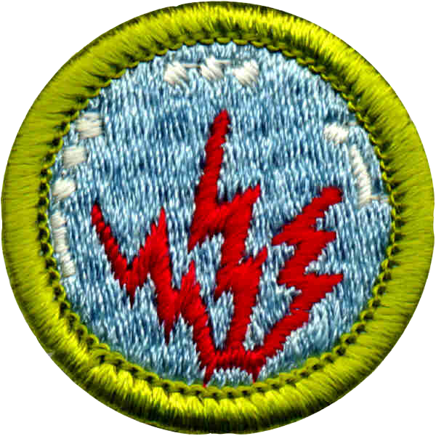
Radio Merit Badge

Slide 17
More Numbers and Actions
Amateur Radio Operator Rating Strip = 1,826
Morse Code Interpreter Strip = 319
ARRL Service to Scouting Award = 49 total
Radio Merit Badge Revision Underway

Slide 18
K2BSA ARA Actions / Results
Membership Growth = 165 members now, up from 8 in January 2015
New Materials and Support
Email List = ~ 1,800
2016 Dayton Hamvention® Booth
2017 Jamboree Staff Recruiting Complete

Slide 19
How Can You Get Involved?

Slide 20
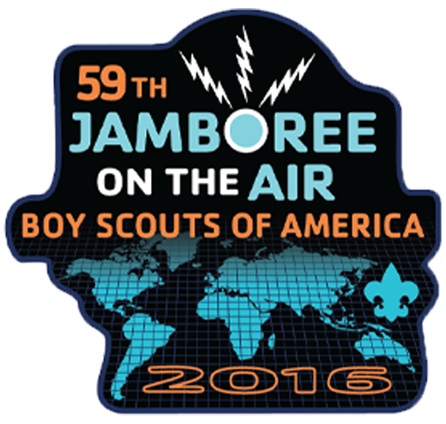
Jamboree on the Air
Get on the air
Work with Scout Units to set up a station
Work to align camporees with JOTA weekend
Keep Scout Frequencies Clear during the weekend
Encourage State QSO parties to adopt Contest Free Frequencies

Slide 21
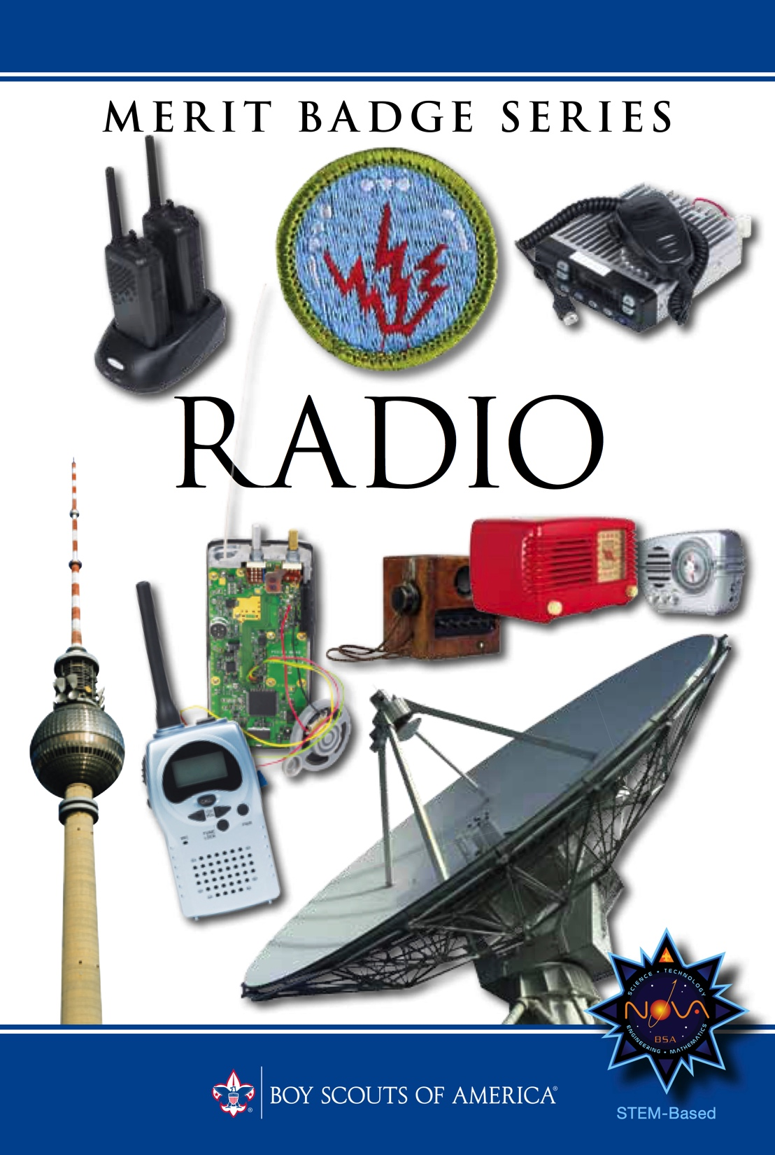
Other Opportunities
Radio Merit Badge Counselor
Start a Council Radio Scouting Committee
Actively Support Council S-T-E-M Initiatives
Work with local units (packs, troops, crews)

Slide 22
Apply Ham Radio to All Your Scouting Activities
Don Kunst, W3LNE has written on this topic
http://www.k2bsa.net/apply-ham-radio-to-all-scouting-activities/
Hiking, Camping, Communicating
He identifies 14 related merit badges
“Cell Phones Down, Radios Up”

Slide 23
Summary
Find Out What’s Already Happening Locally
Get Your Club Involved
Engage Your Local Scout Unit and Council
Get on the Air for JOTA
Join the K2BSA Amateur Radio Association

Slide 24
Further Information
www.K2BSA.net
www.JOTAJOTI.info
www.Scouting.org/JOTA
www.ARRL.org/jamboree-on-the-air-jota
www.ARRL.org/amateur-radio-and-scouting
Girl Scout Thinking Day on the Air at www.guides-on-the-air.co.uk
Jim.Wilson@k2bsa.net

Slide 25
Questions &
Answers
Discussion

